Slide 1
Welcome and
Happy New Year!

Slide 2
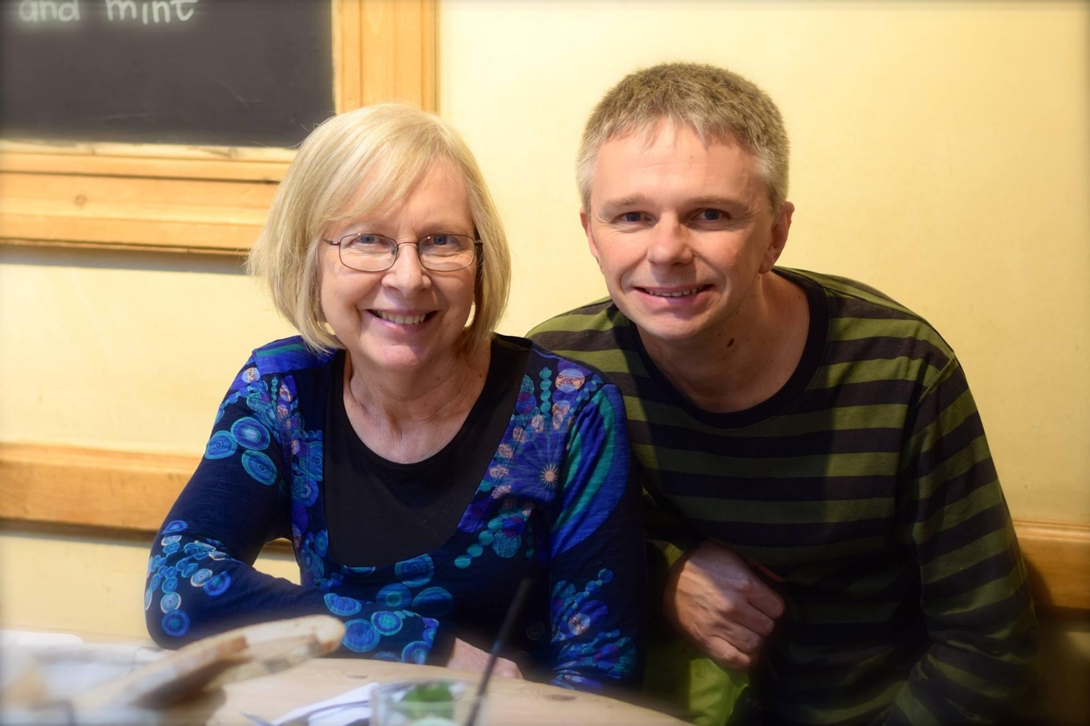

Slide 3
³ Praise be to the God and Father of our Lord Jesus Christ! In his great mercy he has given us new birth into a living hope through the resurrection of Jesus Christ from the dead, ⁴ and into an inheritance that can never perish, spoil or fade.

Slide 4
New Year Message 2024

Slide 5
Five words for us for 2024…
Welcoming
Encouraging
Being
Sharing
Growing

Slide 6
A Welcoming church…

Slide 7
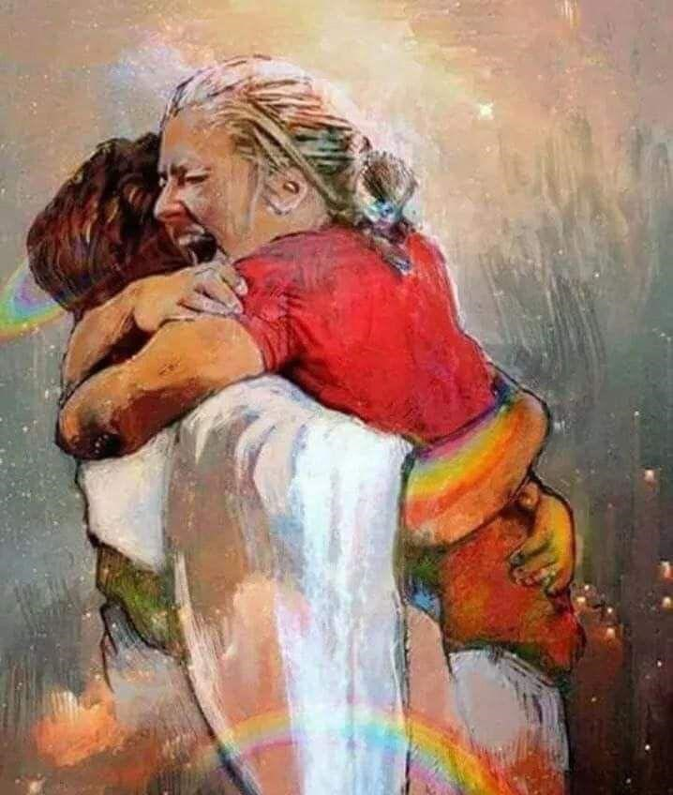
A Welcoming church…

Slide 8
An Encouraging church…

Slide 9
A Being church…

Slide 10
A Sharing church…

Slide 11
A Growing church…

Slide 12
John 13:34-35…
‘A new command I give you: love one another. As I have loved you, so you must love one another. By this everyone will know that you are my disciples, if you love one another.’

Slide 13
John 13:34-35…
‘A new command I give you: love one another. As I have loved you, so you must love one another. By this everyone will know that you are my disciples, if you love one another.’

Slide 14
Welcoming, Encouraging, Being
Sharing, Growing
‘A new command I give you: love one another. As I have loved you, so you must love one another. By this everyone will know that you are my disciples, if you love one another.’

