Slide 1
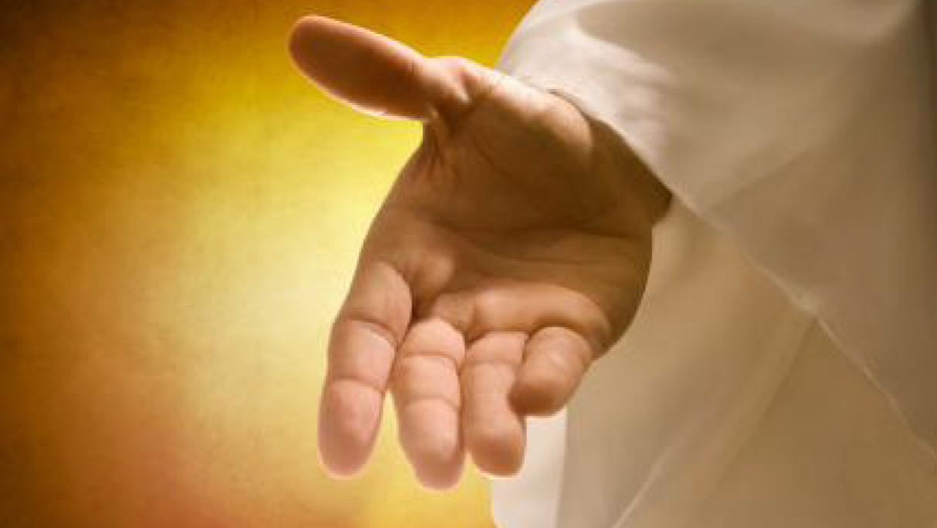
Notes:
Good morning church! Rested, refreshed, raring to go?! Perhaps not quite yet…dark, cold weeks of January aren’t easy are they?!
Hopefully had some chance to rest and pray…many have been doing that over this past week…
Perhaps chance to meditate on the five words I brought last week? Anyone remember?...
TAKE FEEDBACK…

Slide 2
Five words for us for 2024…
Welcoming
Encouraging
Being
Sharing
Growing
Notes:
Here they are… W, E, B, S, G…
Five words to describe us and five words for us to seek to be more like as we collectively live out God’s command to…

Slide 3
Welcoming, Encouraging, Being
Sharing, Growing
‘A new command I give you: love one another. As I have loved you, so you must love one another. By this everyone will know that you are my disciples, if you love one another.’
Notes:
Love one another…
To love one another as Christ has loved us…
To love one another in a way that serves as a witness, that points people towards Jesus…
That leaves people in no doubt that it’s Jesus whom we are following…

Slide 4
Partnering in God’s mission
Notes:
Ultimately, the mission of Jesus is a LOVE MISSION…
And the great news is, that God has chosen us to join with him in this mission…
That’s why I’ve chosen to call our series for this term, “Partnering in God’s mission”…
Having spent some time in the autumn term in Acts, Learning from the Life of the Early Church…
We will now be exploring some passages in the middle chapters of the book as the Good News of Jesus is taken out from Jerusalem and Judea to those of other tribes, nations and languages…
Today, however, we’re going to take one step back, back into Luke’s Gospel to focus on a key incident, near the start of Jesus’s ministry…
Which helps us to understand what God’s mission is all about…
Judith will come to read for us now… ON SCREEN… Bible open in front… Luke 4:14-30 (Raise your hand if like a Bible)…

Slide 5
Luke 4: 14-30
¹⁴ Jesus returned to Galilee in the power of the Spirit, and news about him spread through the whole countryside. ¹⁵ He was teaching in their synagogues, and everyone praised him.
¹⁶ He went to Nazareth, where he had been brought up, and on the Sabbath day he went into the synagogue, as was his custom. He stood up to read, ¹⁷ and the scroll of the prophet Isaiah was handed to him. Unrolling it, he found the place where it is written:

Slide 6
¹⁸ “The Spirit of the Lord is on me, because he has anointed me to proclaim good news to the poor. He has sent me to proclaim freedom for the prisoners and recovery of sight for the blind, to set the oppressed free, ¹⁹ to proclaim the year of the Lord’s favour.”

Slide 7
²⁰ Then he rolled up the scroll, gave it back to the attendant and sat down. The eyes of everyone in the synagogue were fastened on him. ²¹ He began by saying to them, “Today this scripture is fulfilled in your hearing.”
²² All spoke well of him and were amazed at the gracious words that came from his lips. “Isn’t this Joseph’s son?” they asked.

Slide 8
²³ Jesus said to them, “Surely you will quote this proverb to me: ‘Physician, heal yourself!’ And you will tell me, ‘Do here in your hometown what we have heard that you did in Capernaum.’”
²⁴ “Truly I tell you,” he continued, “no prophet is accepted in his hometown. ²⁵ I assure you that there were many widows in Israel in Elijah’s time, when the sky was shut for three and a half years and there was a severe famine throughout the land.

Slide 9
²⁶ Yet Elijah was not sent to any of them, but to a widow in Zarephath in the region of Sidon. ²⁷ And there were many in Israel with leprosy in the time of Elisha the prophet, yet not one of them was cleansed—only Naaman the Syrian.”
²⁸ All the people in the synagogue were furious when they heard this. ²⁹ They got up, drove him out of the town, and took him to the brow of the hill on which the town was built, in order to throw him off the cliff. ³⁰ But he walked right through the crowd and went on his way.

Slide 10
Partnering in God’s mission (Luke 4:14-30)
Notes:
Thank you Judith!
Well-known and oft-quoted passage…
Exciting, shocking…quite how shocking, perhaps difficult for us to appreciate given the distance between us in time and culture…
It’s a foundational passage for our understanding of mission…
But it’s not one I’m going to go through verse by verse in methodical study…
If you want to do that, then that’s great… I would only encourage it, but a commentary will do that better than me…
Instead, I’m going to pull out a few key ideas, which I hope the Holy Spirit will take and will use to stir our minds and excite our hearts…put some fire in our bellies and send us out into this year ahead, ready to partner with God in his mission…
(Truth be told, I had another talk written last night, binned most of it… not a talk really, more of an essay actually and not a very good one at that!… too much head, not enough heart…
Also want to apologise that there are no small group notes, ran out of time and needed to go to bed!…
Are some printed copies of these slides and my notes I will send them out by e mail…

Slide 11
What is God’s mission?
Notes:
So, if we’re going to partner in God’s mission, what is the mission?… what is it that we can get excited and inspired about?...

Slide 12
What is God’s mission?
A reflection of God’s heart and character
Notes:
A reflection of God’s heart and character… Latin word Missio = to send… God is a sending God, that’s why he sent himself, in the person of Jesus, a gift of love, born in the humblest of surroundings, growing up in the little regarded town of Nazareth, learning and plying his trade until his time came to explode onto the scene as he does here in this passage.

Slide 13
What is God’s mission?
A reflection of God’s heart and character
The starting point for the life and actions of the church
Notes:
Mission starts with God, it’s God’s idea, it’s at the root of all he is and it’s the starting point for who we are as church…
It’s the reason why we’re here, the essence which should underpin all of our actions…
It is NOT a bolt-on activity or an optional extra which makes up part of our overall schedule…
That’s why our time here together on Sunday is but one small part of the picture…
The things that we do the rest of the week are what really constitute our calling as church and our part in God’s mission…
God’s mission is Warm Welcome, God’s mission is Foodbank, God’s mission is Tadpoles, it’s inviting a newcomer for lunch, it’s encouraging sometime whose going through a tough time, it’s helping a neighbour with their shopping, it’s babysitting for a couple in need of a night out…
So, thank you, for partnering in God’s mission…

Slide 14
What is God’s mission?
2. Planned, prophesied, proclaimed, prayed
Notes:
2. God’s mission is Planned, prophesied, proclaimed, prayed…
Jesus’s Messianic self-declaration in the synagogue in Nazareth may have surprised his listeners, but it was no surprise to God!…
Planned, from the beginning of time, foretold by the prophets, here in Isaiah 61, it was now proclaimed by Jesus himself…a Jesus who taught and healed and who worked miracles, but also crucially a Jesus who prayed…
A Jesus who had spent 40 days of prayerful preparation in the wilderness before beginning his ministry, enduring all kinds of temptations and trials… a Jesus who took himself away from the crowds to lonely places to pray and to be with his Father, a Jesus who prayed for his disciples before going to the cross, who prayed for his persecutors as he hung there to die…
God’s mission is prayer….

Slide 15
What is God’s mission?
2. Planned, prophesied, proclaimed, prayed
Empowered by the Holy Spirit
Notes:
It’s prayer because God’s mission is empowered by the Holy Spirit
Notice the references to the HS in this text…
Jesus returned to Galilee in the power of the Spirit, verse 14…
The spirit of the Lord is on him and has anointed him, verse 18…
There is WORD, there is Scripture and there is SPIRIT and the two go hand in hand.
God’s mission is both Word and Spirit and we will need both Word and Spirit if we are to partner with him in the way that he has planned for us…

Slide 16
What is God’s mission?
3. The person of Jesus…his words, his actions – teaching, healings, miracles
Notes:
Word and Spirit, yes…
But above all God’s mission is found in the person of Jesus…
What he said, what he did…
His wise teaching and his utterly amazing miracles… water to wine, healing the ill and the afflicted, walking on water and, supremely rising from the dead…

Slide 17
¹⁸ “The Spirit of the Lord is on me, because he has anointed me to proclaim good news to the poor. He has sent me to proclaim freedom for the prisoners and recovery of sight for the blind, to set the oppressed free, ¹⁹ to proclaim the year of the Lord’s favour.”
Notes:
Let’s look again at those words from Isaiah 61 that Jesus reads there in the synagogue, words that he declares himself to fulfill
God’s mission is good news to the poor… the materially poor…and the poor in spirit…
Jesus’s doesn’t promise riches, rather his words and actions demonstrate that the poor have a special place in his heart…
God’s mission means freedom for the prisoners and the oppressed, the literal captives and those caught up in bondage to sin, to jealousy, to hatred, to lust…
On Thursday evening at the Revive event at MMCC we were encouraged to speak the name of Jesus over various people and situations in our society…
We live in a society help captive by consumerism, by drink, by drugs, by pornography and it is squeezing the life slowly out of us…
Jesus comes to bring FREEDOM, FREEDOM FROM THESE THINGS AND FREEDOM TO LIVE life to the full, as he intended…
Recovery of sight for the blind… again the physically blind, Bartimaeus a case in point, but also the spiritually blind… those who cannot see Jesus, whether through lack of opportunity or deliberate decision…Jesus comes as the true light, that we might see clearly… who he is and who God intends for us to be…
The year of the Lord’s favour… cancelling of debt, complete restoration… being made whole… sin forgiven…

Slide 18
What is God’s mission?
3. The person of Jesus…his words, his actions – teaching, healings, miracles
Proclaimed and demonstrated
Notes:
That’s God’s mission…it’s proclaimed and it’s demonstrated in the person of Jesus…
Will we join him? It’s the same mighty power who raised Jesus from the dead, who is alive and at work in us?...

Slide 19
What is God’s mission?
4. For ALL…
Notes:
At work in us…
But for ALL…especially perhaps for those we often tend to forget or ignore…
Yes, God’s mission is to us…we need him, just like anybody else…
But we need to look outside of ourselves…
Jesus doesn’t mince his words to his listeners in the synagogue in Nazareth that Sabbath… he tells them in plain terms that he has come just as much for the foreigner as for the Jew, in fact that when his own people will turn their back on him that God will take his blessing elsewhere…
So be warned…
Be warned God’s chosen people, be warned then… be warned today…

Slide 20
What is God’s mission?
4. For ALL…
For the world, those of all faiths and none, not simply “God’s chosen people”
Notes:
We must open our minds to the full scope and volume of God’s mission for all…
Looking outside of ourselves and those that are like us, and reaching out to those we find challenging, those perhaps we find difficult to love, those whose ways and beliefs seem alien and incomprehensible to us…
That’s partnering in God’s mission…God’s mission for ALL…

Slide 21
How are you feeling about all this?
Notes:
So, how are you feeling about all this?
Abivalent?
Bored?
Excited?
Or something else?
Because when we’re confronted by the reality of God’s mission in the person of Jesus, different reactions are possible…
We see that in the passage in verses 28 and 29…
One response is fury and outrage… the claims of Jesus are outrageous and his call on our lives is uncompromising… we too can drive him out of town…intending to throw him off the cliff of our lives…
Do we, if we’re honest, feel like this at times…hand on heart, I’d be lying if I said this was never me…
Maybe you’re feeling confused, like those mentioned in verse 22… you like what you hear from Jesus but you don’t really quite get who he is and what he really wants from you…
If that’s you, then thank you for your honesty… we’re here together in this… we all have much to learn and we’re here to learn together and to encourage one another in doing so…
Perhaps, however, you’re full of wonder and praise…you’re up for this, you’re hungry for more of Jesus, you’re to ready to partner with God and you’re raring to go?...
If so, then that’s brilliant… God has a plan for you, a place for you and a purpose for you…He wants you and he’s chosen you to partner with him in his mission…

Slide 22
Are we up for partnering in God’s mission?
An opportunity to respond…
Notes:
As I close, there’s an opportunity now for us to take a moment and to respond…to respond to God’s call to partner with him, in his mission at this start of 2024…
In a second, I’m going to ask you to close your eyes and we will play a song…God of justice…
The words of which echo much of what we’ve been thinking about this morning…
If you feel that you want to commit yourself, whether for the first time, or the thousandth and first time to responding to God’s Word and Spirit, to giving to God your heart and your head, to seeking his help and that of those around you in serving Jesus and partnering with God in his mission of love, of justice, of mercy, of forgiveness, of welcome, of encouragement, of being, or sharing, of growing…
If you want to respond, then as the song plays, either slowly stand where you are, or raise your hand in the air…
This is a moment for each of us, and us all to BE…
To be in the presence of God… to listen to the prompting of his Spirit and to respond, if we are willing
AND THEN as the song comes to a close I will pray…
So, let’s close our eyes, let’s listen, and let’s respond as prompted…

