Slide 1
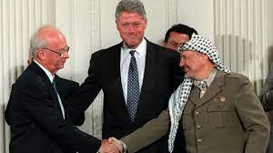
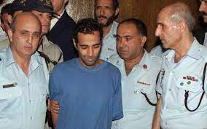
1995
Oslo Accords
Yigal Amir

Slide 2
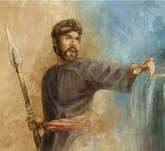
Violent zeal – Phinehas (Numbers 25)

Slide 3
The blinding light

Slide 4
The heavenly voice
“Saul, Saul, why are you persecuting me?”
Paul’s Temple and Body images

Slide 5
The ultimate failure of zeal
The Zealot v. the risen Christ
Paul: Faith in Christ must be the hallmark of Jesus’ followers

