Slide 1
Partnering in God’s Mission
Peter and Cornelius
- a surprising vision?
Acts 10:1-35
NMBC 18th February 2024

Slide 2
PARTNERING IN GOD’S MISSION
A SERIES OF SURPRISING ACTS
Acts 8: The Ethiopian and Philip
Acts 9: Saul/Paul and Ananias at Damascus
Acts 10: Peter and Cornelius
Acts 12: Herod and Peter
Acts 12/13: Saul and Barnabas

Slide 3
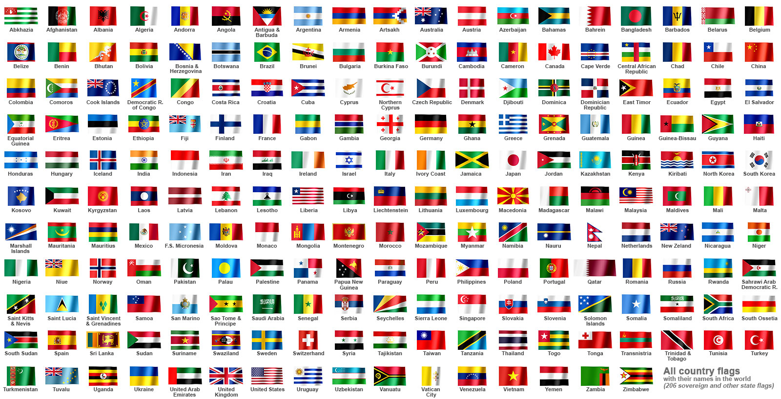
PARTNERING IN GOD’S MISSION
TO THE END OF THE EARTH
Acts 1:8 .. you will be my witnesses to the end of the earth
Jerusalem
Judea
Samaria
New Malden

Slide 4
SURPRISING PROBLEMS
.. GODLY SOLUTIONS
Acts 10:1-8
Cornelius’ vision
Acts 10:9-18
Peter’s vision
Acts 10:19-23
  Peter welcomes Cornelius’ men
Acts 10:24-35 + 44-48
  Cornelius and his friends and relations hear the gospel and are saved

Slide 5
PETER AND CORNELIUS
Job: Apostle
From: Galilee
Living in: Joppa
Upbringing: Jewish
Faith: Christian
Missing: ?
Job: Centurion
From: Italy? Roman
Living in: Caesarea
Upbringing: (Gentile)
Faith: devout .. God-fearing .. respected by Jews
Missing: ?

Slide 6
CORNELIUS’ VISION
Acts 10:3-4 Cornelius .. saw clearly in a vision an angel of God
And he stared at the angel in terror
Acts 10:5-8 “Now send men to Joppa and bring Peter”
Acts 11:14 Cornelius told Peter that the angel had said “Peter will declare a message by which you and your household will be saved”

Slide 7
PETER’S VISION
Acts 10:13 “Rise, Peter; kill and eat”
14 “Lord I have never eaten anything common or unclean”
20 “Rise and go with 3 men without hesitation for I have sent them”
15 “What God has made clean do not call common”
22 Cornelius a God-fearing man was directed by a holy angel to send for you and to hear what you have to say”

Slide 8
PETER OPENS THE DOOR TO GENTILES
Acts 10:19 The Spirit said to Peter “Go with them without hesitation .. because I have sent them”
22 Cornelius wants to hear what Peter has to say
28 “You yourselves know how unlawful it is for a Jew to associate with or to visit anyone of another nation
but God has shown me that I should not call any person common or unclean”

Slide 9
CORNELIUS AND HIS FRIENDS AND RELATIONS
HEAR THE GOSPEL AND ARE SAVED
Acts 10:33
“We are all here in the presence of God to hear all you have been commanded by the Lord”
43 everyone who believes in Jesus Christ receives forgiveness of sins through his name
44 the Holy Spirit fell on all who heard the word
48 .. baptised in the name of Jesus Christ

Slide 10
MORE AMAZING CHANGES
23 and some of the brothers from Joppa accompanied Peter
45 And the believers from among the circumcised who had come with Peter were amazed, because the gift of the Holy Spirit was poured out even on the Gentiles

Slide 11
ARE WE SURPRISED ENOUGH
TO BE PART OF GOD’S MISSION?
How can we be Jesus’ witnesses to the end of the earth?
    in New Malden
    to other communities and nations
Are there people we consider to be common or unclean?
Are we truly impartial and inter-national?

