Slide 1
Acts 12
Peter’s miraculous escape from prison

Slide 2
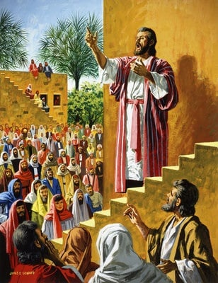

Slide 3
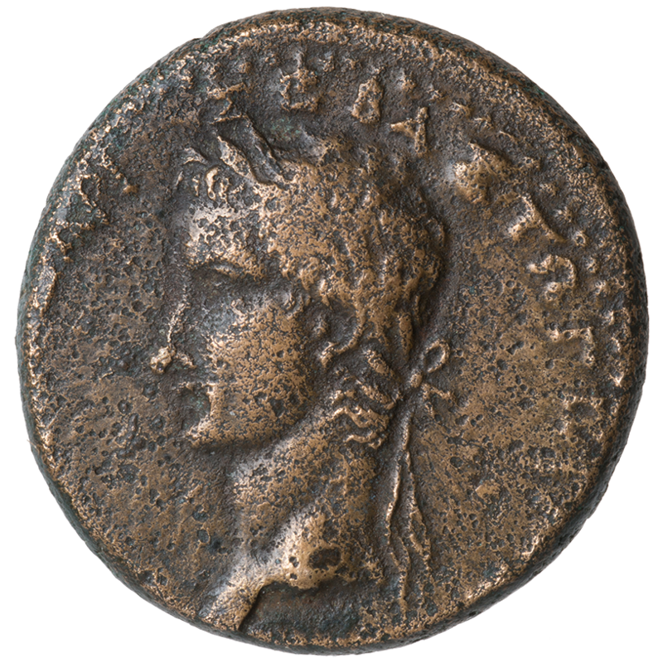

Slide 4
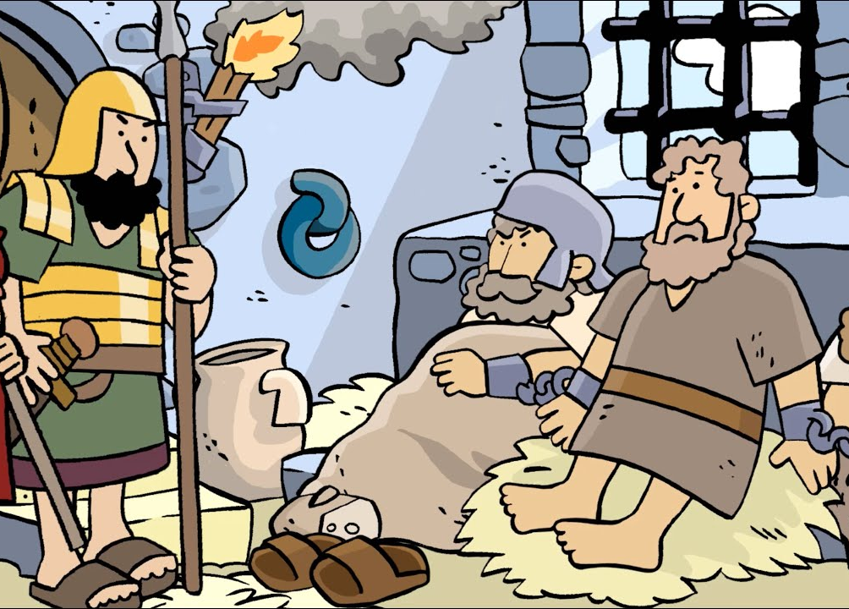

Slide 5
When these times of uncertainty come, we cannot let what we do not know cause us to forget what we do know.

Slide 8
King Herod -
V1: It was about this time that King Herod arrested some who belonged to the church intending to persecute them
V 21-23: Herod, wearing his royal robes, sat on his throne and delivered a public address to the people. They shouted, “This is the voice of a god, not of a man.” Immediately, because Herod did not give praise to God, an angel of the Lord struck him down, and he was eaten by worms and died.

Slide 9
What happened | Truth it shows
Herod- military power – Herod killed by angel | God is all powerful

Slide 10
2 BUTS!
Peter was kept in prison, BUT the church was earnestly praying to God for him. v 5
Herod … was eaten by worms and died. BUT the word of God continued to spread and flourish v 23-24

Slide 11
Church prayed...
Earnestly & persistently
Specific
Together in community
Slow to believe God’s answer!

Slide 12
How God answered
Peter’s peace in prison
Peter’s rescue
Growth of church

Slide 13
What happened | Truth it shows
Herod- military power – Herod killed by angel | God is all powerful
Peter in prison – BUT church prayed | God listens and intervenes

Slide 14
James is put to death…..
While Peter is rescued

Slide 15
What happened | Truth it shows
Herod- military power – Herod killed by angel | God is all powerful
Peter in prison – BUT church prayed | God listens and intervenes
James killed but Peter rescued | God is sovereign

Slide 16
And when it feels all hope has faded
The heavy questions hit so hard
And though my soul may feel forsaken
You still reign and You're still God
Though I can't see what's before me
I know that I can trust Your heart
And this one truth will be my story
Your still reign and You're still God

