Slide 1
God’s mission…
through the local church
Acts 12:25-13:12

Slide 2
Acton
Amberley
Ashford
Ashurst
Bagshot
Barking
Barlow
Barnsley
Barrow
Bellingham
Belmont
Berwick
Bishopston
Bisley
Blackheath
Charlestown
Charlton
Cheriton
Derwent
Dunkirk
Eccles
Eden
Elmbridge
Farnham
Fifield
Gravesend
Hartley
Itchen
Joppa
Kensington

Slide 3
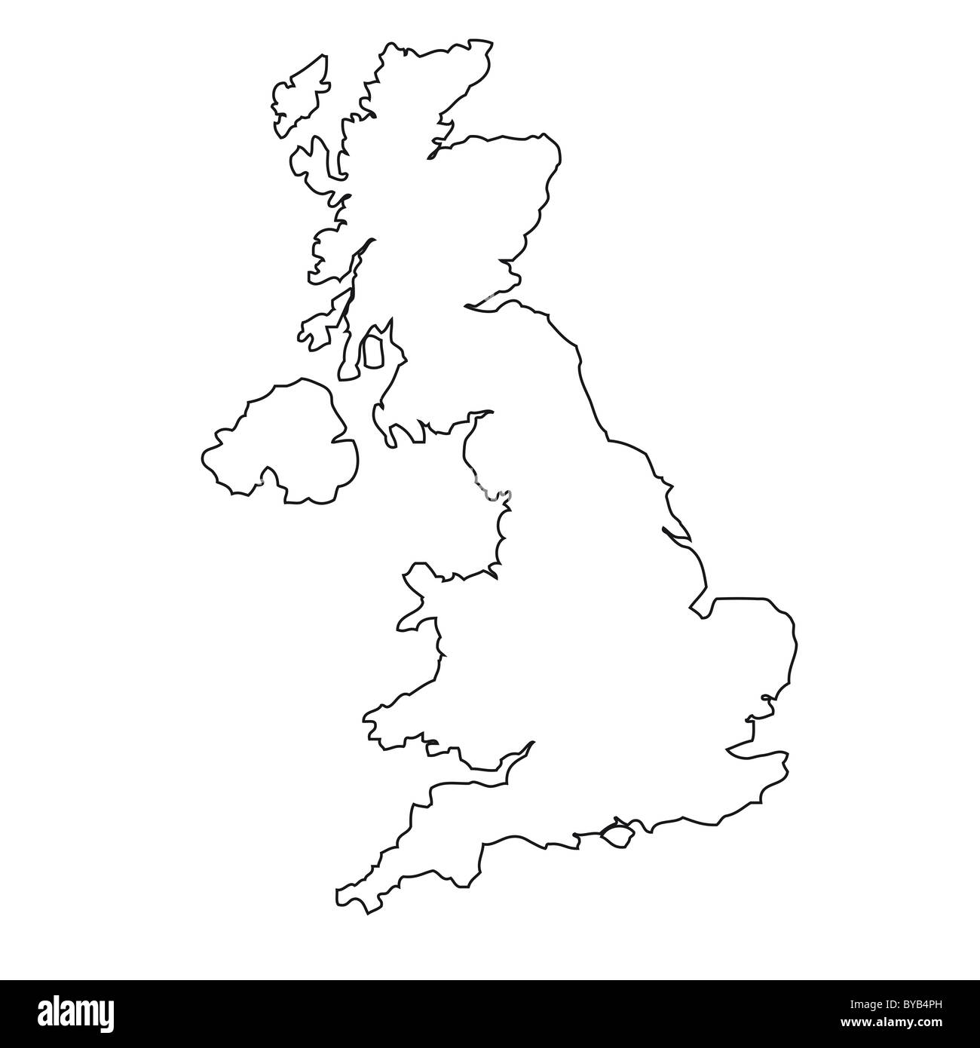
Acton
Acton
Acton
Acton
Acton
Acton
Acton

Slide 4
Med area
MACEDONIA
Rome
Philippi
ITALY
Thessalonica
GALATIA
Corinth
Ephesus
Antioch
Colosse
Antioch
Crete
Cyprus
Mediterranean Sea
Jerusalem
Alexandria

Slide 5
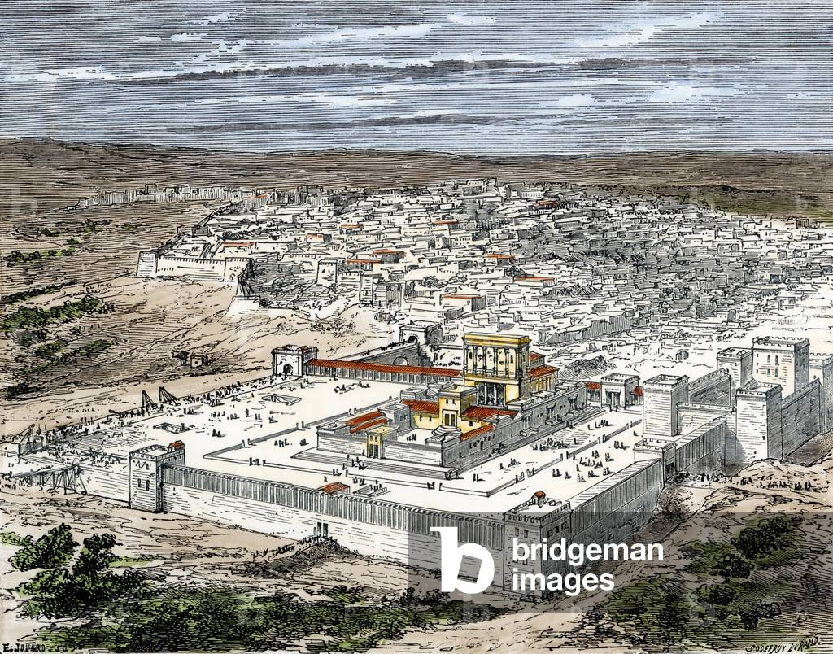

Slide 6
FAMINE
IN JERUSALEM!

Slide 7
The believers in Antioch
wanted to help… Acts 11:29
Each of them decided how much
of their own money they could give.
Then they gave the money
to Barnabas & Saul.
Barnabas & Saul took this gift to
the leaders of the believers in Jerusalem.

Slide 8
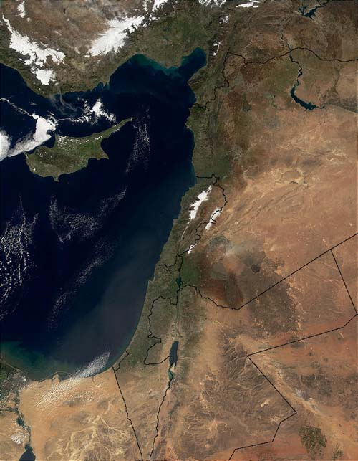
Jerusalem to Antioch
Turkey
•
Antioch
Cyprus
Syria
Mediterranean
Lebanon
Iraq
Israel
West
Bank
Jordan
Gaza
•
Saudi Arabia
Egypt
Jerusalem

Slide 9
Med area
MACEDONIA
Rome
Philippi
ITALY
Thessalonica
GALATIA
Corinth
Ephesus
Antioch
Colosse
Antioch
Crete
Cyprus
Mediterranean Sea
Jerusalem
Alexandria

Slide 10
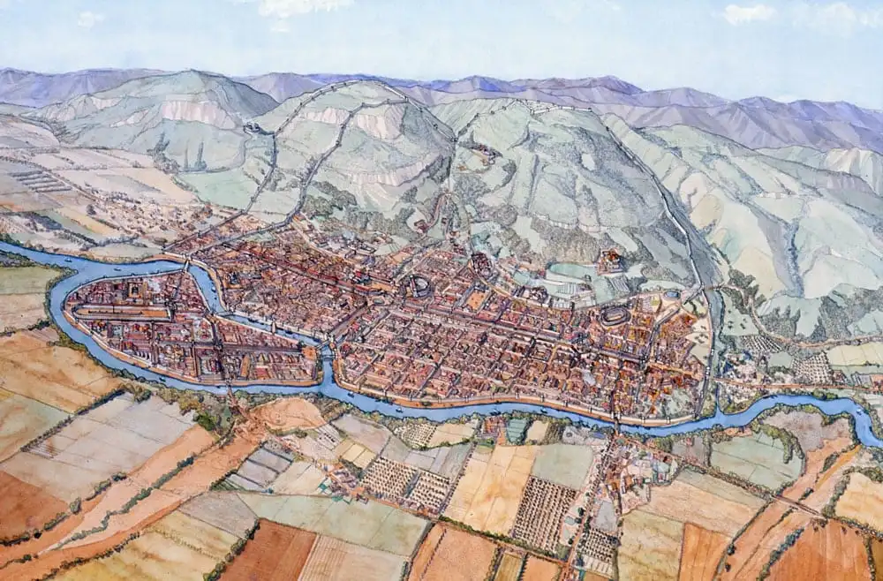

Slide 11
Jerusalem to Antioch
Turkey
•
Antioch
Cyprus
Syria
Mediterranean
Lebanon
Iraq
Israel
West
Bank
Jordan
Gaza
•
Saudi Arabia
Egypt
Jerusalem

Slide 12
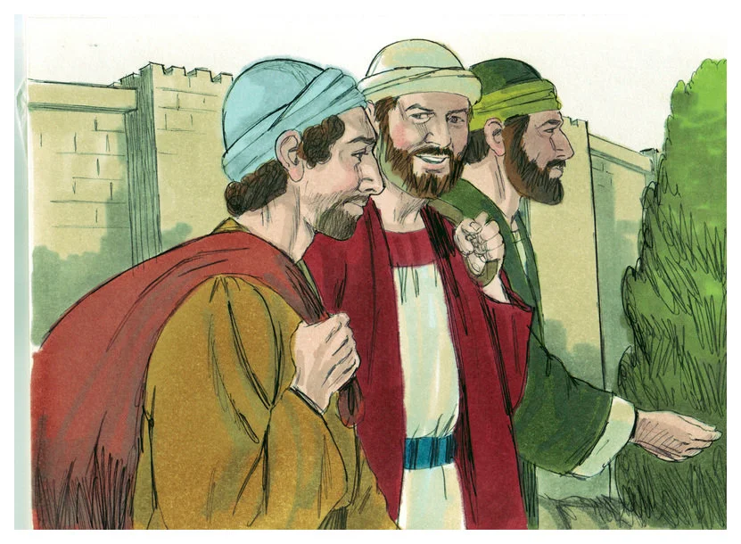
Acts 13:1
When Barnabas and Saul
had finished their mission,
they returned from Jerusalem,
taking with them John,
also called Mark.

Slide 13
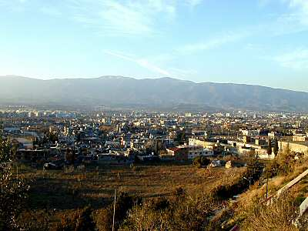
Antioch view

Slide 14
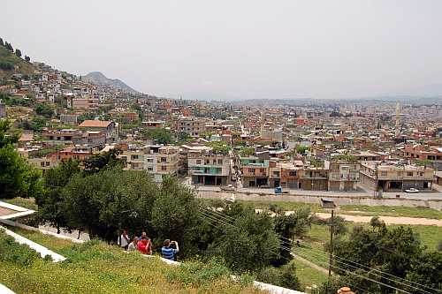
Antioch view
Getting back to
God’s agenda
for his people

Slide 15
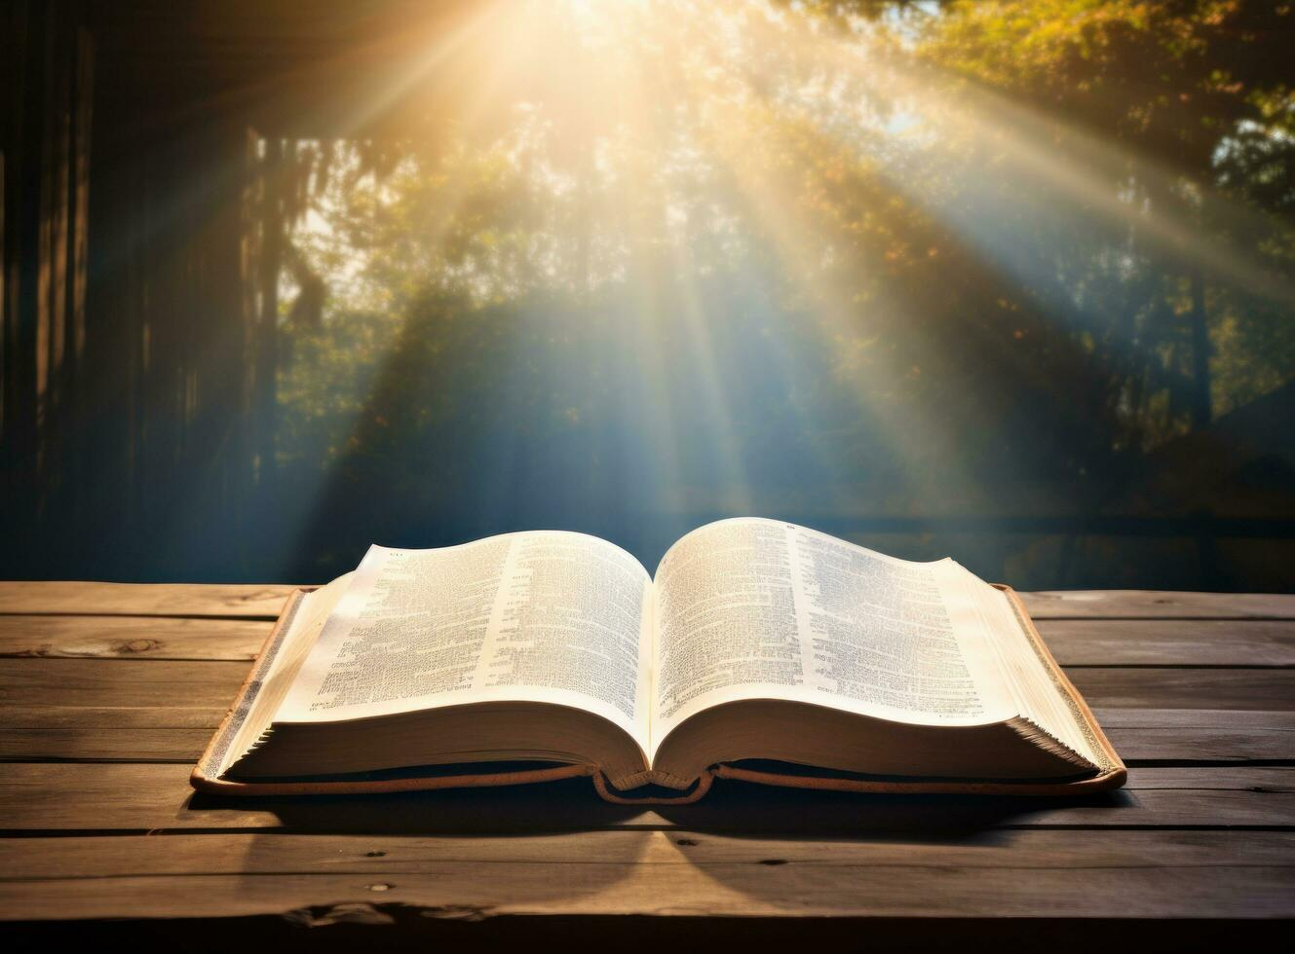
5 texts giving God’s agenda

Slide 16
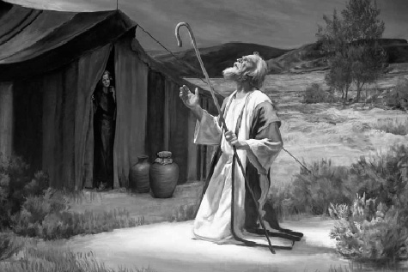
Genesis 12:1-3
1
The Lord said to Abram,
“Leave your country … & your father's home,
& go to a land that I will show you.
I will give you many descendants,
and they will become a great nation.
I will bless you … so that you will be a blessing.”

Slide 17
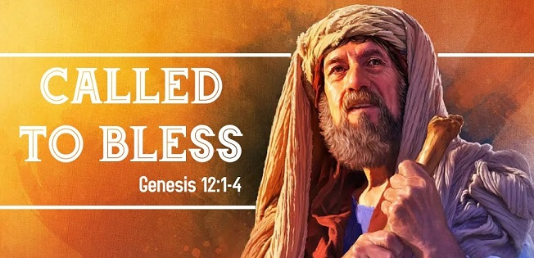
Genesis 12:1-3
I will bless those who bless you,
But I will curse those who curse you.
And through you
I will bless all the nations.”

Slide 18
2
Psalm 22:27-31
All nations will remember the LORD.
From every part of the world
they will turn to him;
all races will worship him.
The Lord … rules the nations.

Slide 19
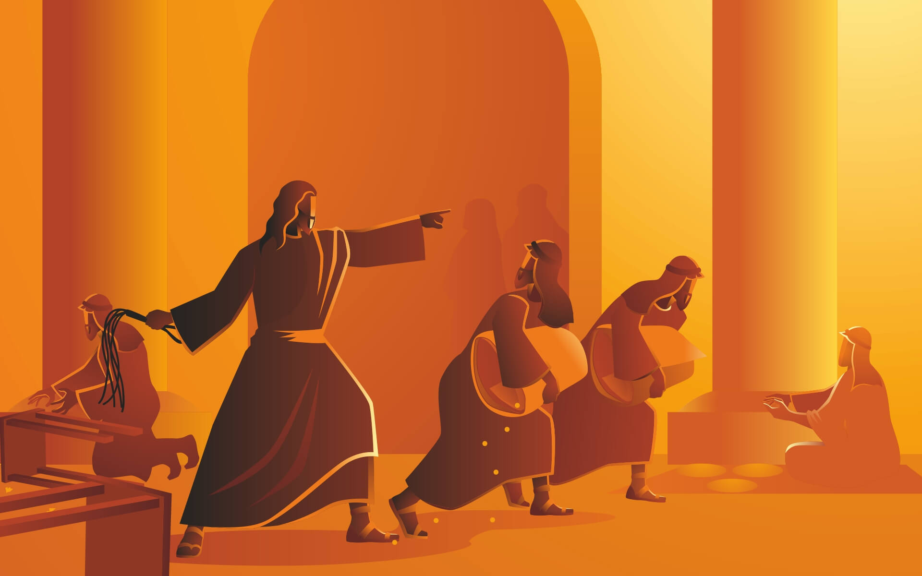
3
Mark 11:17
Is it not written:
“My house will be called a
house of prayer
for all nations?”

Slide 20
4
Acts 1:8
‘You will receive power
when the Holy Spirit has come upon you,
and you shall be my witnesses
both in Jerusalem,
and in all Judea and Samaria,
& in every part of the world.’

Slide 21
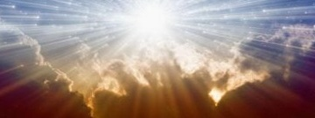
5
Revelation 7:9-10
‘I looked, and there before me was
a great multitude which no one could count, from
every nation, & all tribes & peoples & tongues…
And they cry out with a loud voice saying,
“Salvation to our God who sits on the throne,
and to the Lamb.”

Slide 22
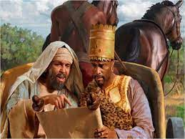
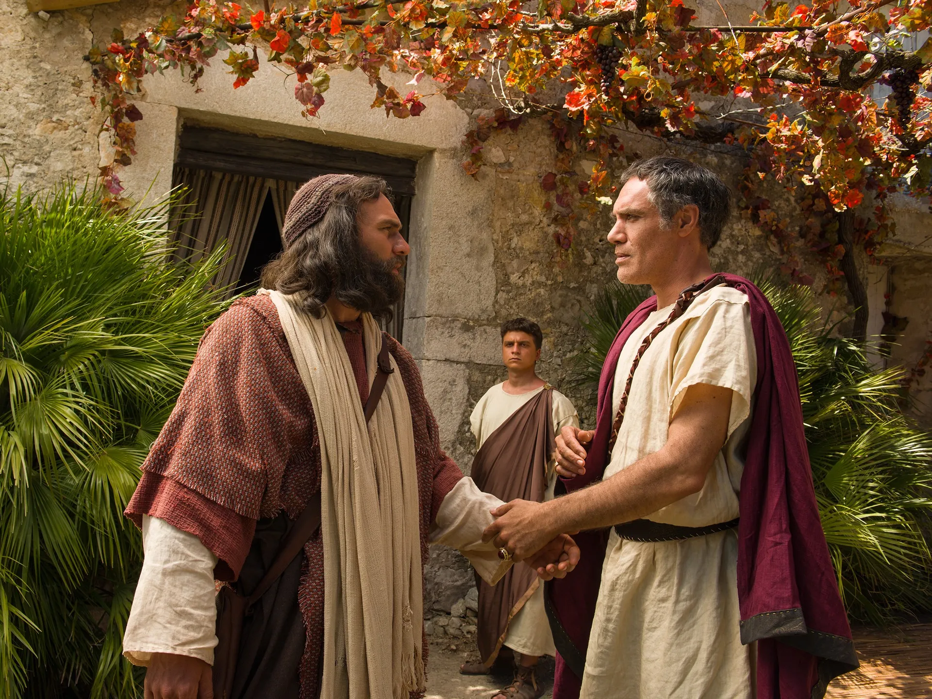
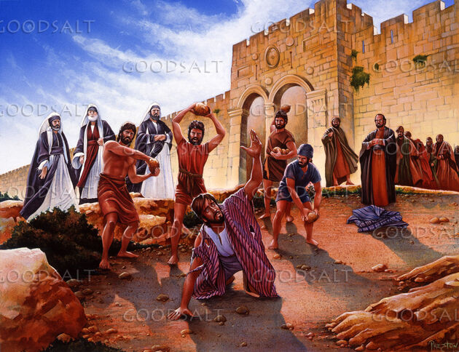
Peter
&
the
Roman
officer
Philip
&
the
Ethiopian
Saul approved of their killing Stephen
a great persecution
broke out against the church in Jerusalem,
and all except the apostles were
scattered throughout Judea & Samaria.

Slide 23
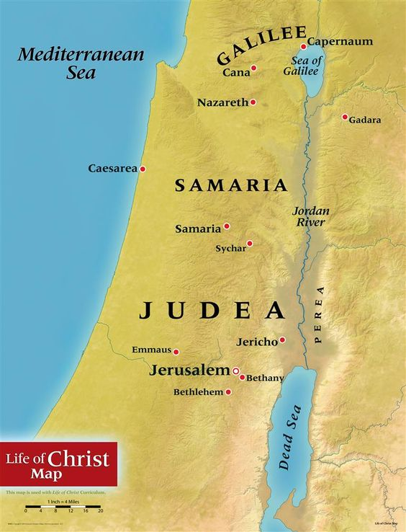

Slide 24
Jerusalem to Antioch
Turkey
•
Antioch
Cyprus
Syria
Mediterranean
Lebanon
Iraq
Israel
West
Bank
Jordan
Gaza
•
Saudi Arabia
Egypt
Jerusalem

Slide 25
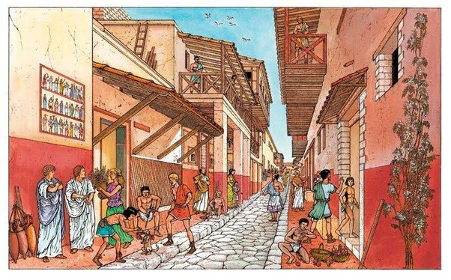
Acts 13:1
Acts 13:1
In the church at Antioch
there were prophets & teachers:
Barnabas, Simeon called Niger,
Lucius of Cyrene, Manaen
(who had been brought up with Herod the tetrarch)
& Saul.

Slide 26
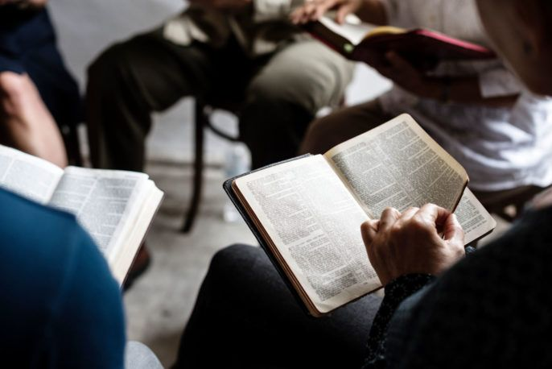
Acts 13:2
Acts 13:2
While they were
worshipping the Lord & fasting,
the Holy Spirit said,
“Set apart for me Barnabas & Saul
for the work
to which I have called them.”

Slide 27
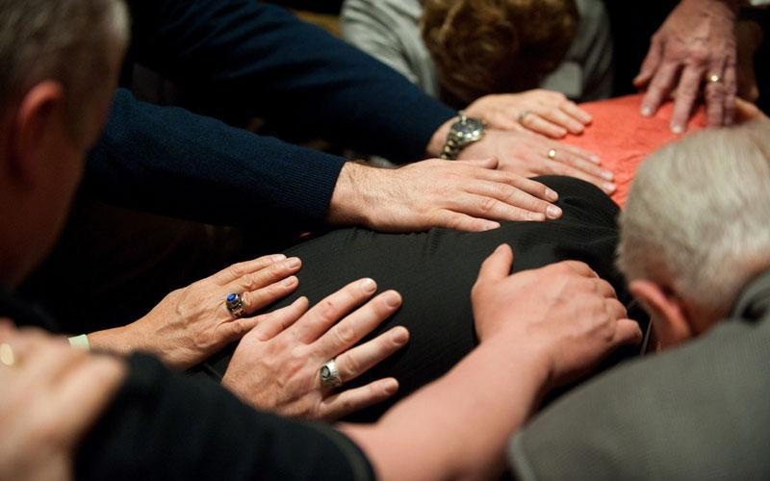
Acts 13.3
Acts 13:3
So after
they had fasted & prayed,
they placed their hands
on them
& sent them off.

Slide 28
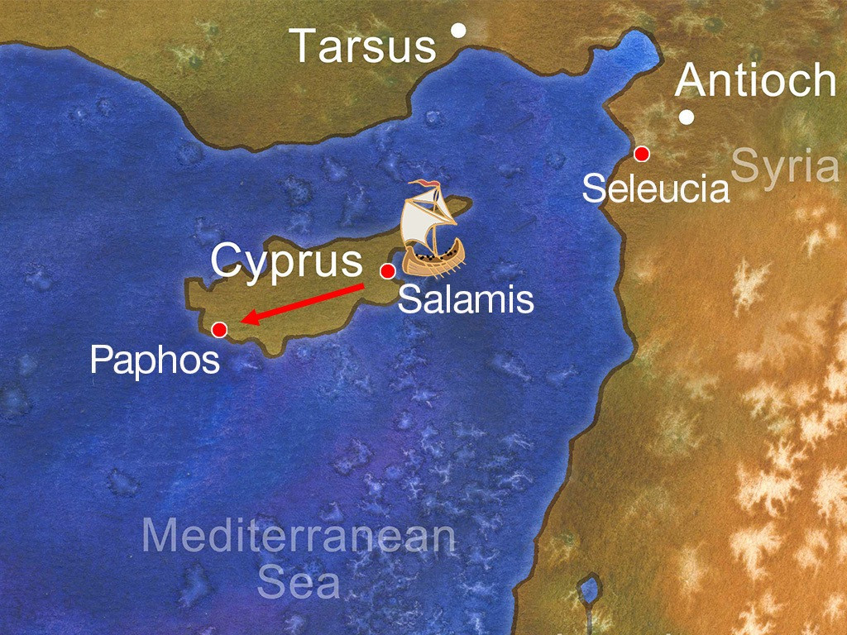

Slide 29
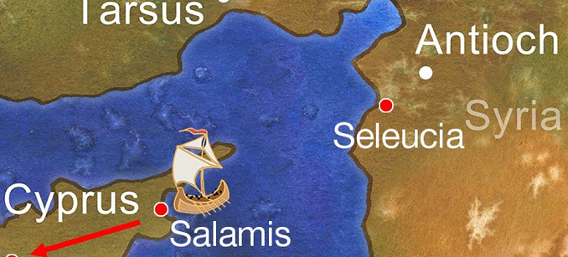
4 The two of them, sent on their way by the Holy Spirit,
went down to Seleucia
and sailed from there to Cyprus.
5 When they arrived at Salamis,
they proclaimed the word of God
in the Jewish synagogues.
John was with them as their helper.

Slide 30
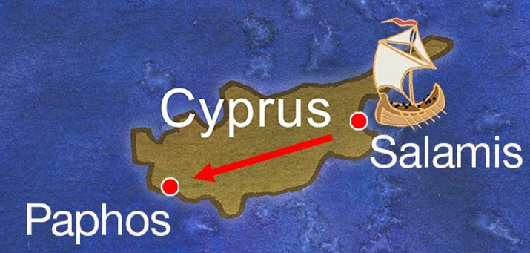
6 They travelled through the whole island
until they came to Paphos.
There they met a Jewish sorcerer
and false prophet named Bar-Jesus,
7 who was an attendant of the proconsul, Sergius Paulus.
The proconsul, an intelligent man,
sent for Barnabas and Saul
because he wanted to hear the word of God.

Slide 31
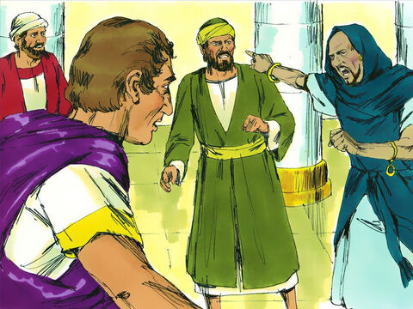
8 But Elymas the sorcerer
(for that is what his name means)
opposed them & tried to turn
the proconsul from the faith.
9 Then Saul, who was also called Paul,
filled with the Holy Spirit,
looked straight at Elymas and said,
10 “You are a child of the devil
and an enemy of everything that is right!
You are full of all kinds of deceit and trickery.
Will you never stop perverting the right ways of the Lord?
11 Now the hand of the Lord is against you.
You are going to be blind for a time,
not even able to see the light of the sun.”

Slide 32
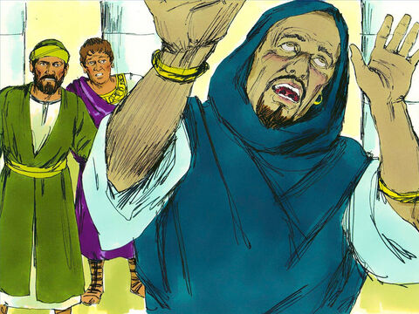
Immediately mist and darkness
came over him,
and he groped about,
seeking someone to lead him by the hand.
12 When the proconsul saw what had happened,
he believed,
for he was amazed at
the teaching about the Lord.

Slide 33
Mission definition 1
MISSION grew out of the
prayerfulness
of the local church
& worship
& self-denial

Slide 34
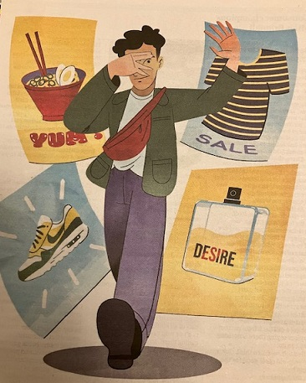
How to successfully
take on the
‘no-spend’ challenge

Slide 35
Mission definition 1
MISSION grew out of the
of the local church
prayerfulness
& worship
& self-denial
& generosity
& unselfishness

Slide 36
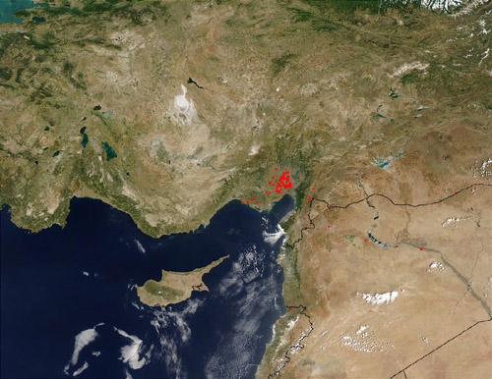
Antioch to Derbe
GALATIA
Antioch
•
Iconium
•
Lystra
•
•
Derbe
Perga
•
Antioch
•
CYPRUS
Salamis
•
SYRIA
Paphos

Slide 37
Derbe to Antioch
GALATIA
Antioch
•
Iconium
•
Lystra
•
•
Derbe
Perga
•
Antioch
•
CYPRUS
Salamis
•
SYRIA
Paphos

Slide 38
Acts 14:26
Acts 14:26
They sailed back to Antioch,
where they had been committed to the grace of God
for the work
they had now completed.

Slide 39
Acts 14:27
Acts 14:27
On arriving there,
they gathered the church together
& reported
all that God had done through them
& how he had opened
the door of faith to the Gentiles…

Slide 40
1
What do we expect to happen
when the church meets?
While they were
worshipping the Lord & fasting,
the Holy Spirit said,
Set apart for me Barnabas & Saul
for the work
to which I have called them.

Slide 41
Do we genuinely desire
the direction of the
Spirit of God?
1
13.2
The Holy Spirit said,
‘Set apart for me
Barnabas & Saul…’
13.4
The two of them,
sent on their way
by the Holy Spirit

Slide 42
1 Thessalonians 4:1 Brothers and sisters, we instructed you
how to live in order to please God… Now we ask you and urge you in the Lord Jesus to do this more and more.

Slide 43
Are we equipped
for making known the
Word of the Lord?
1
They proclaimed
the Word of God…
Sergius Paulus wanted to hear the Word of God.
He believed because
he was amazed at the teaching about the Lord

Slide 44
1
Does the
‘Mission’ of God
to the nations
thrill us, engage us,
put us to prayer…
& to work?
Ruth Sharman in Claygate

Slide 45
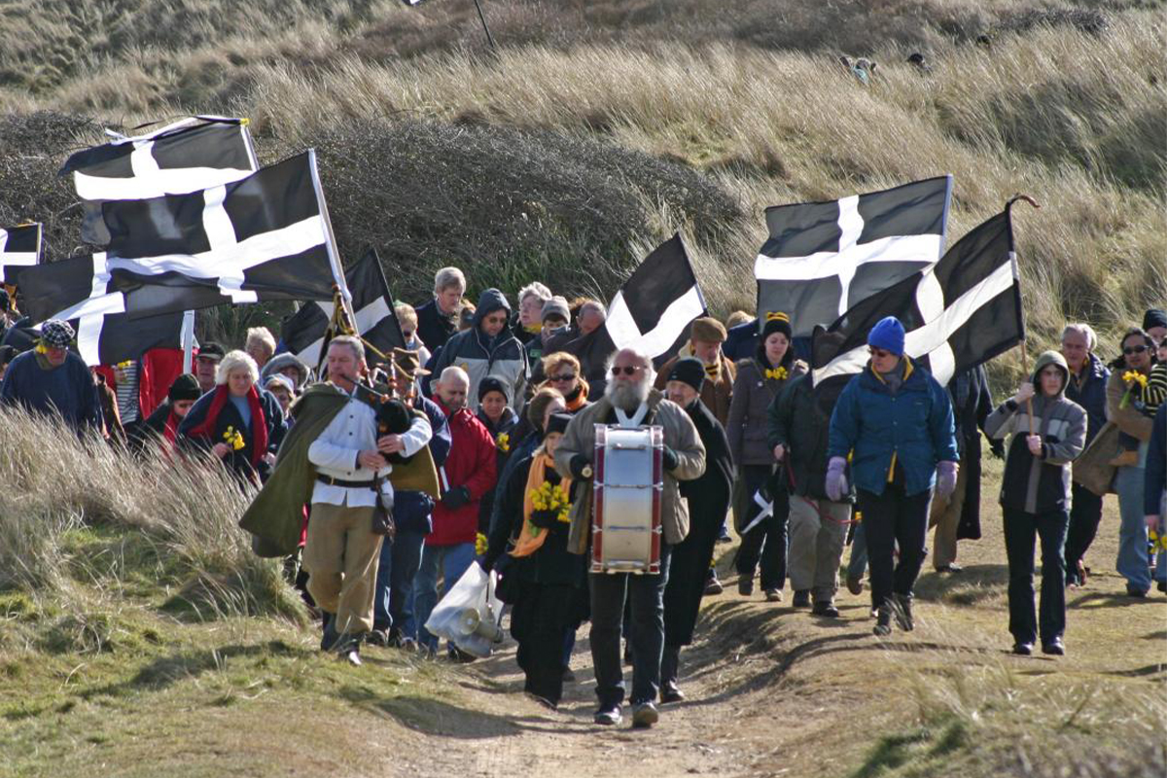

Slide 46
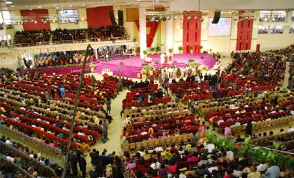

Slide 47
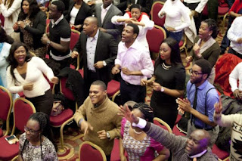

Slide 48
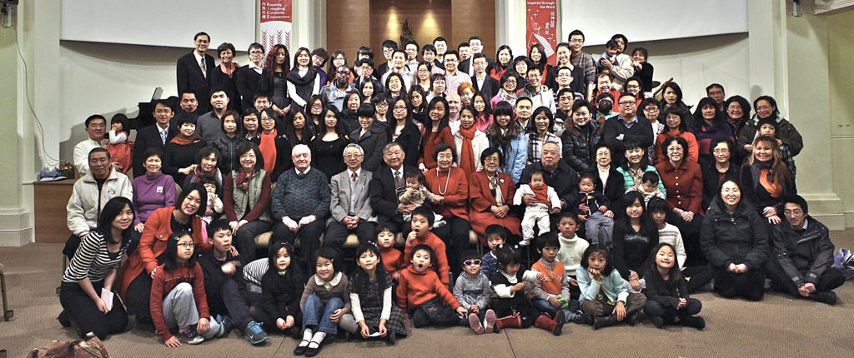

Slide 49
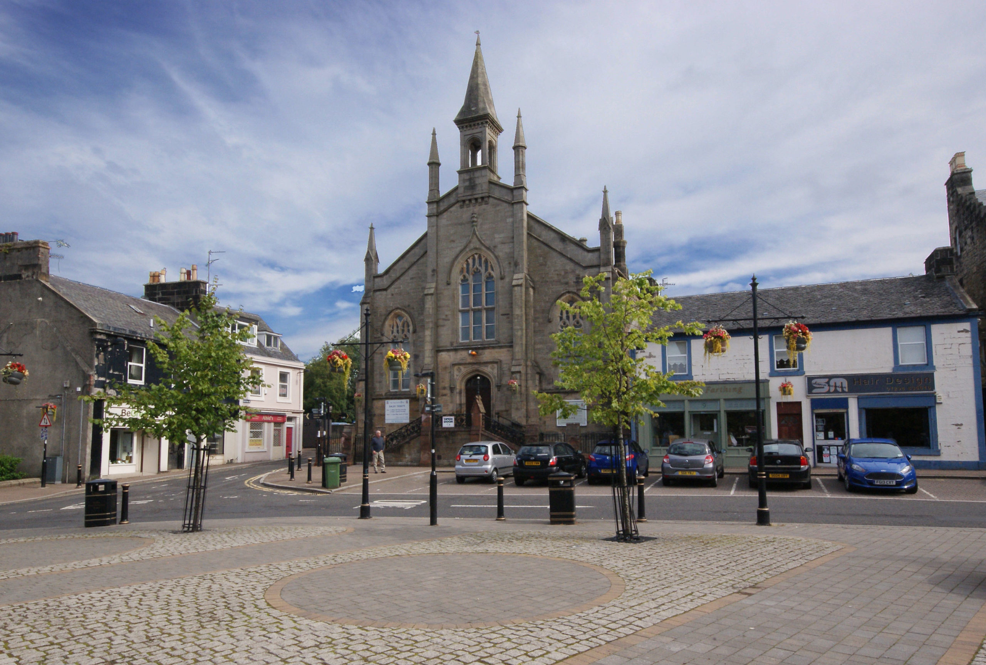
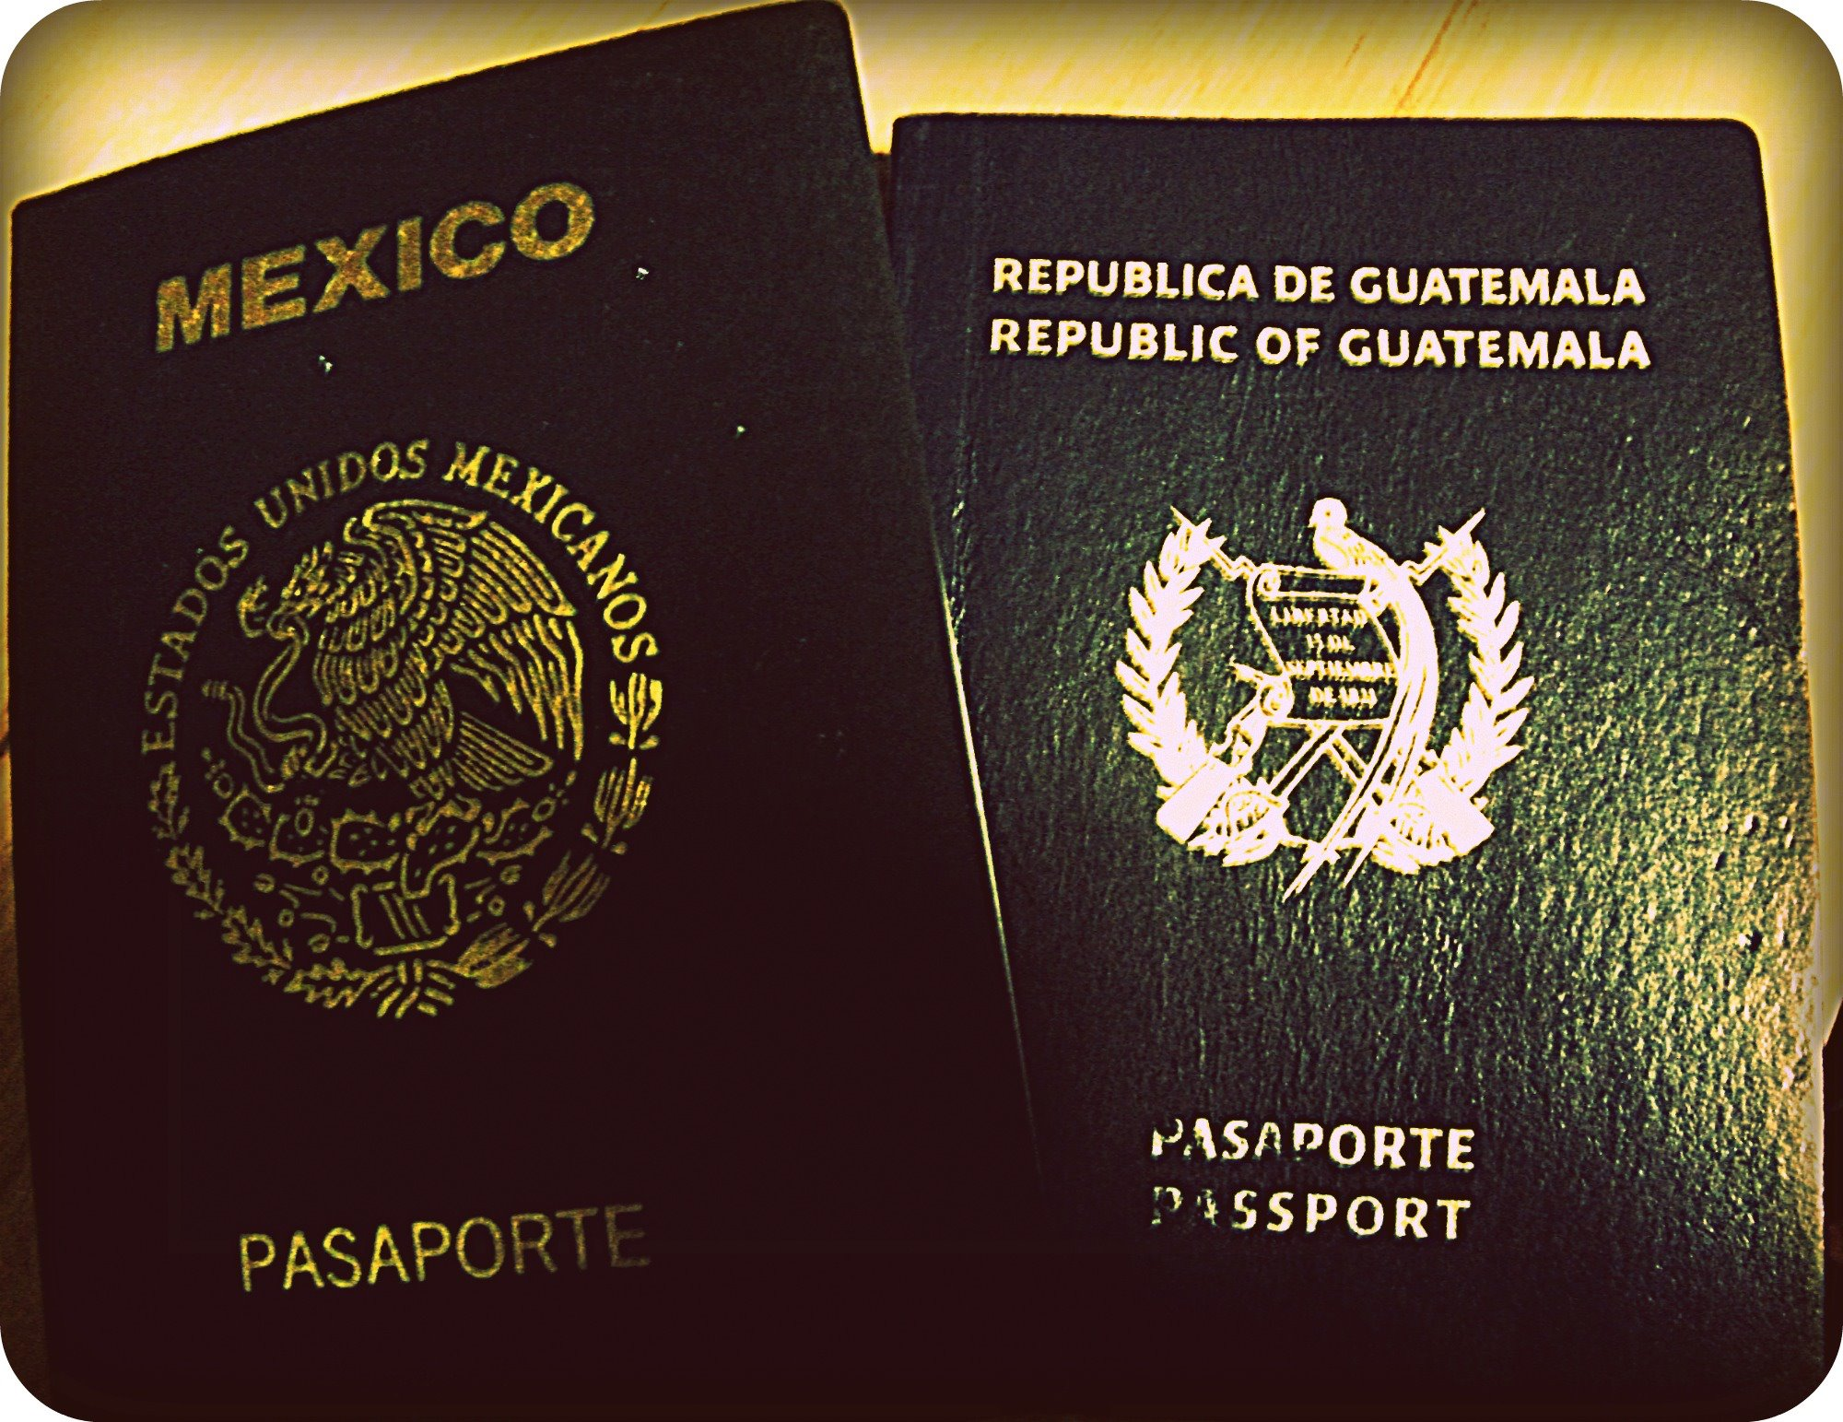

Slide 50
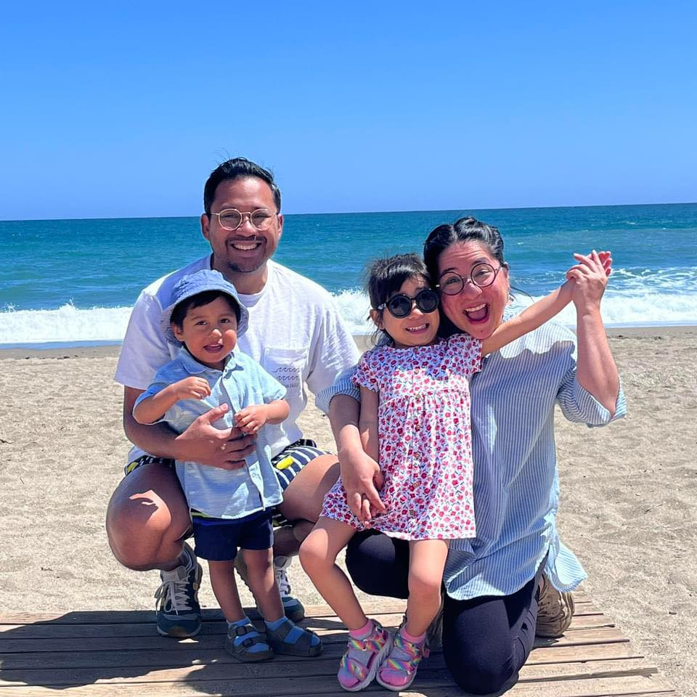

Slide 52
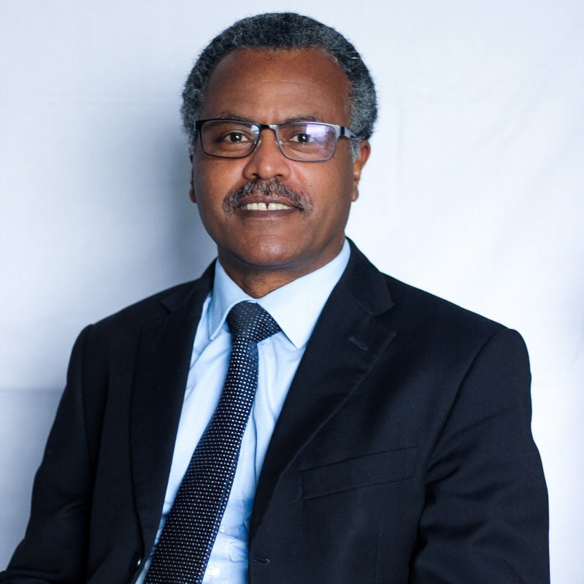

Slide 53
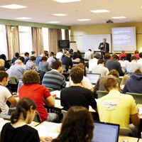
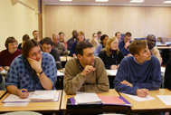
LST Kings College

Slide 54
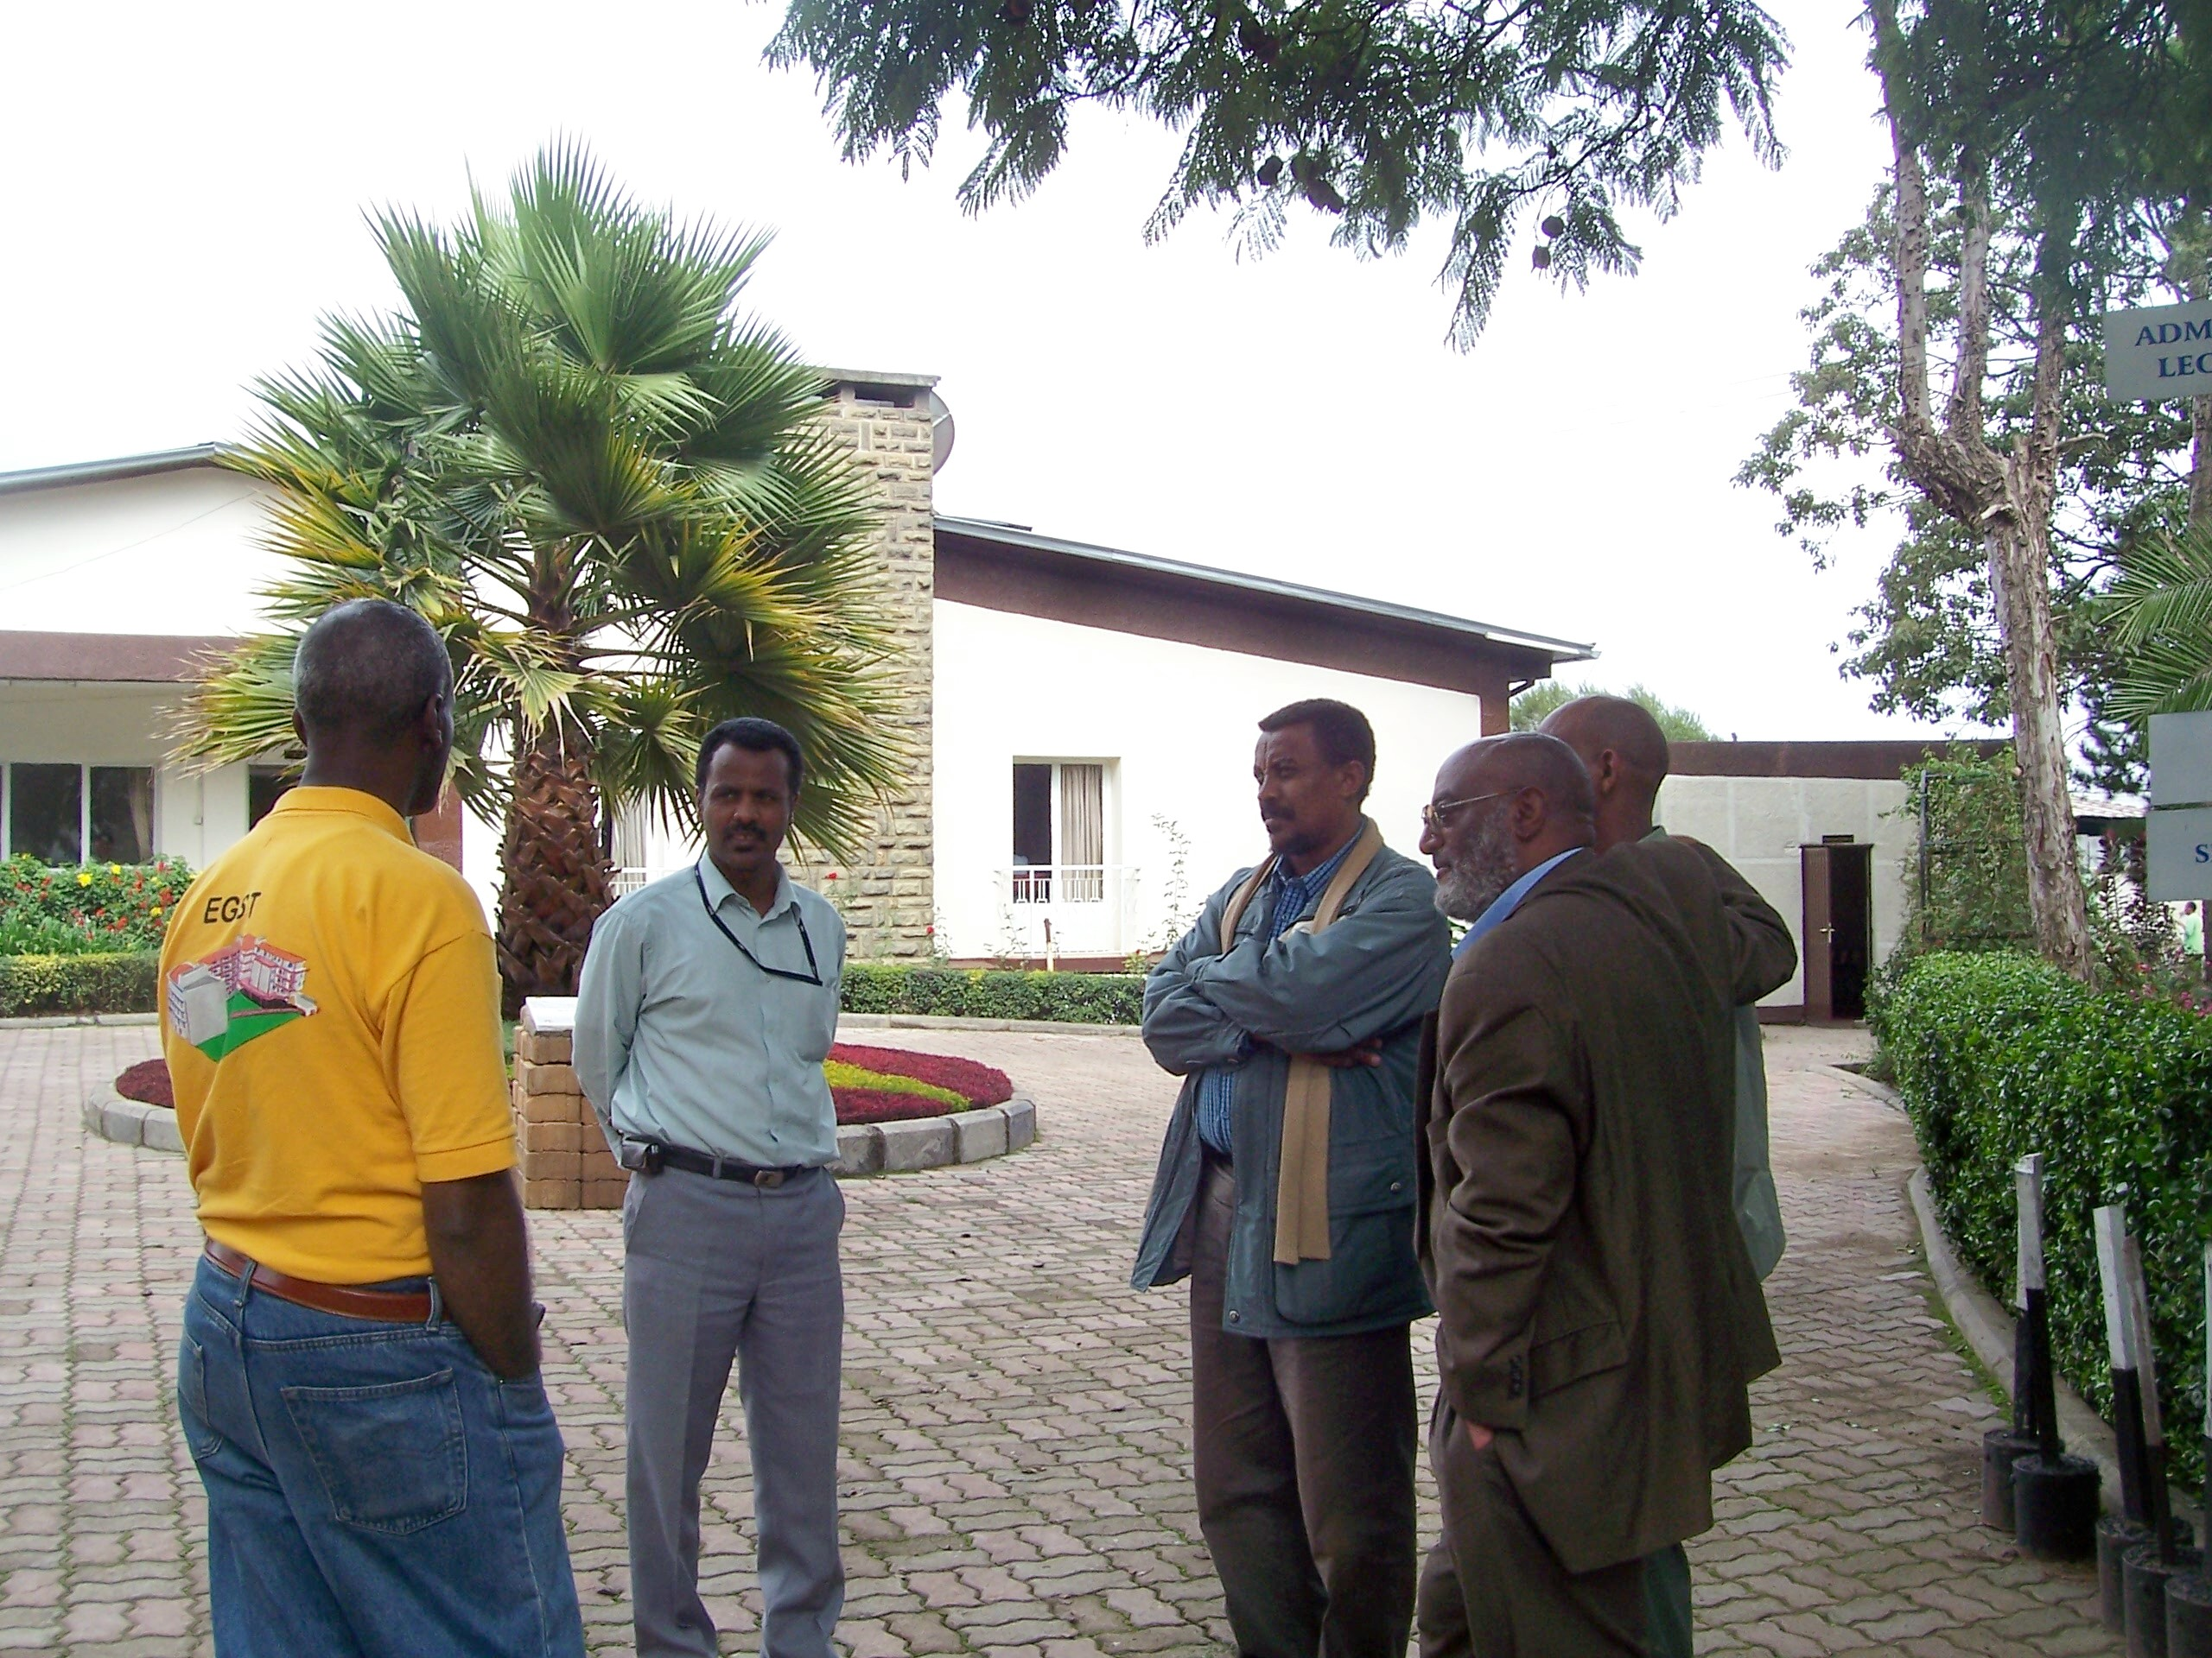
EGST
Desta
Heliso
Ethiopian Graduate School of Theology

Slide 55
Resilient & flourishing societies
5 strategic pillars
Ethical > corruption
Political > ethnocentrism
Religious > extremism
Economic > poverty
Academic > mindset, culture & values

Slide 56
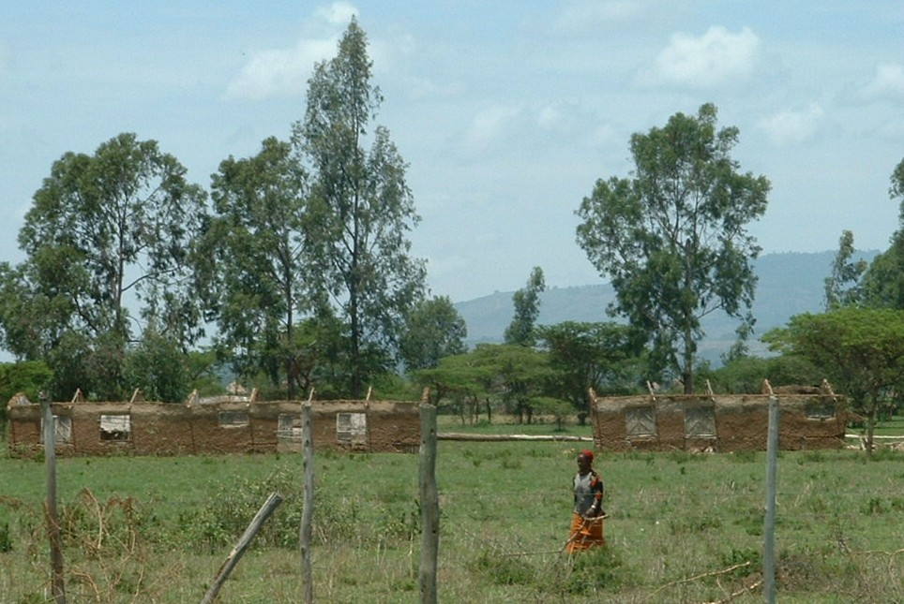
Old school

Slide 57
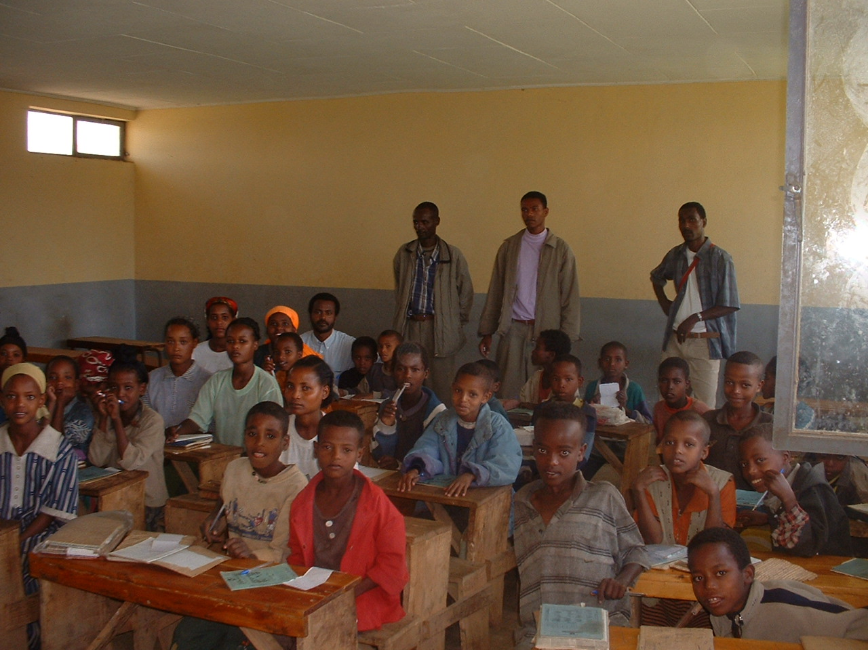
Class 1 Shemo

Slide 58
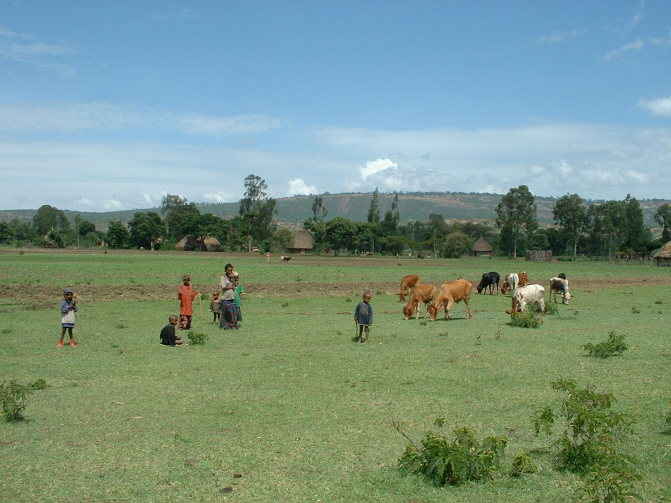

Slide 59
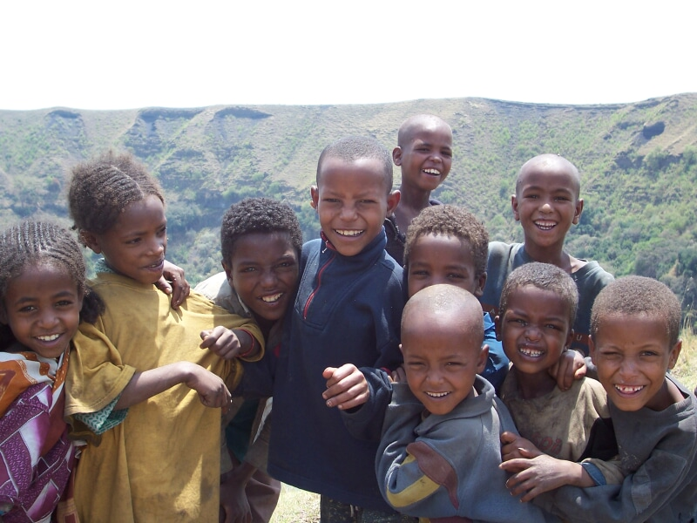

Slide 61
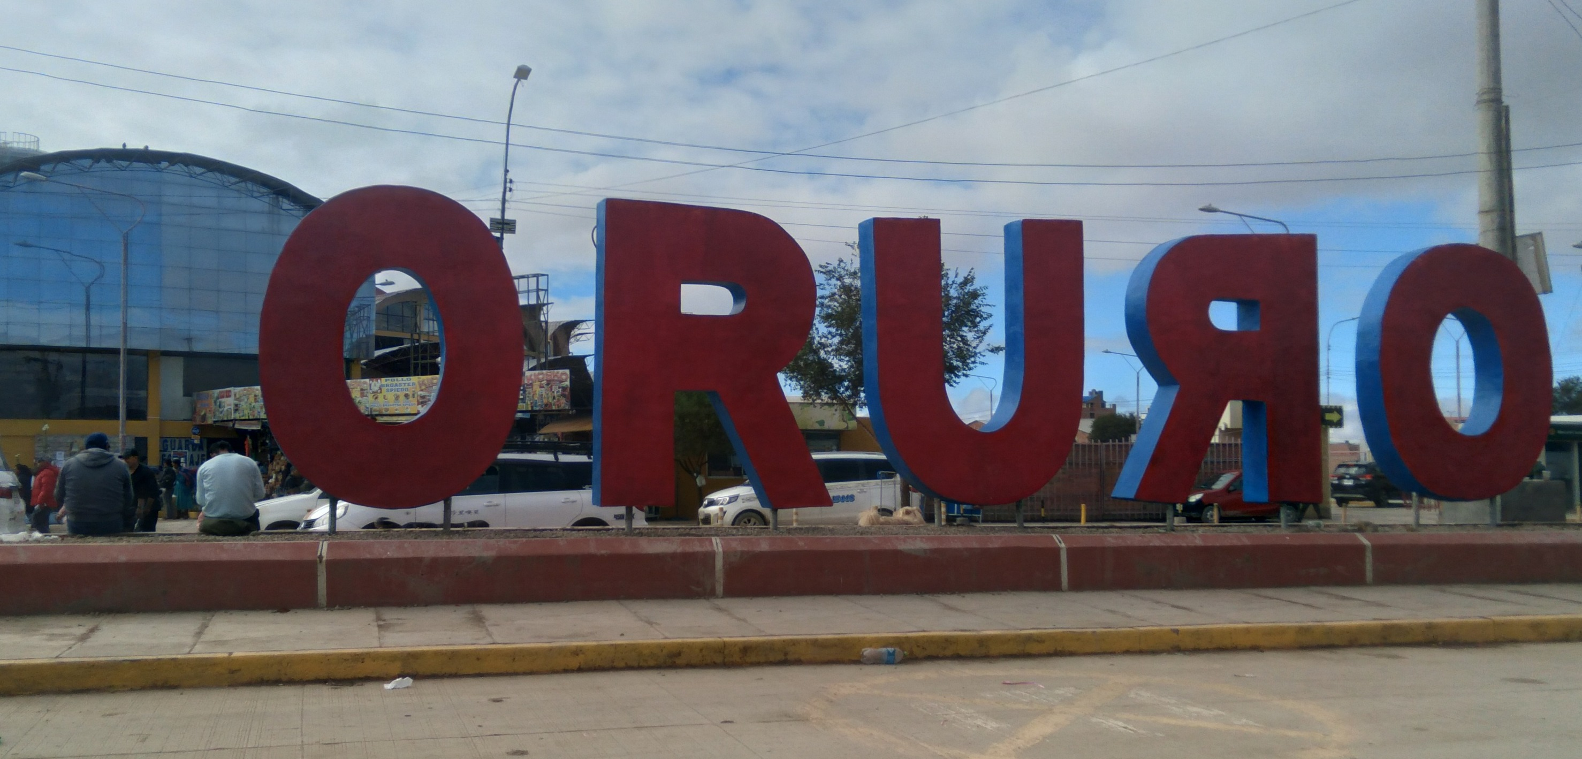

Slide 62
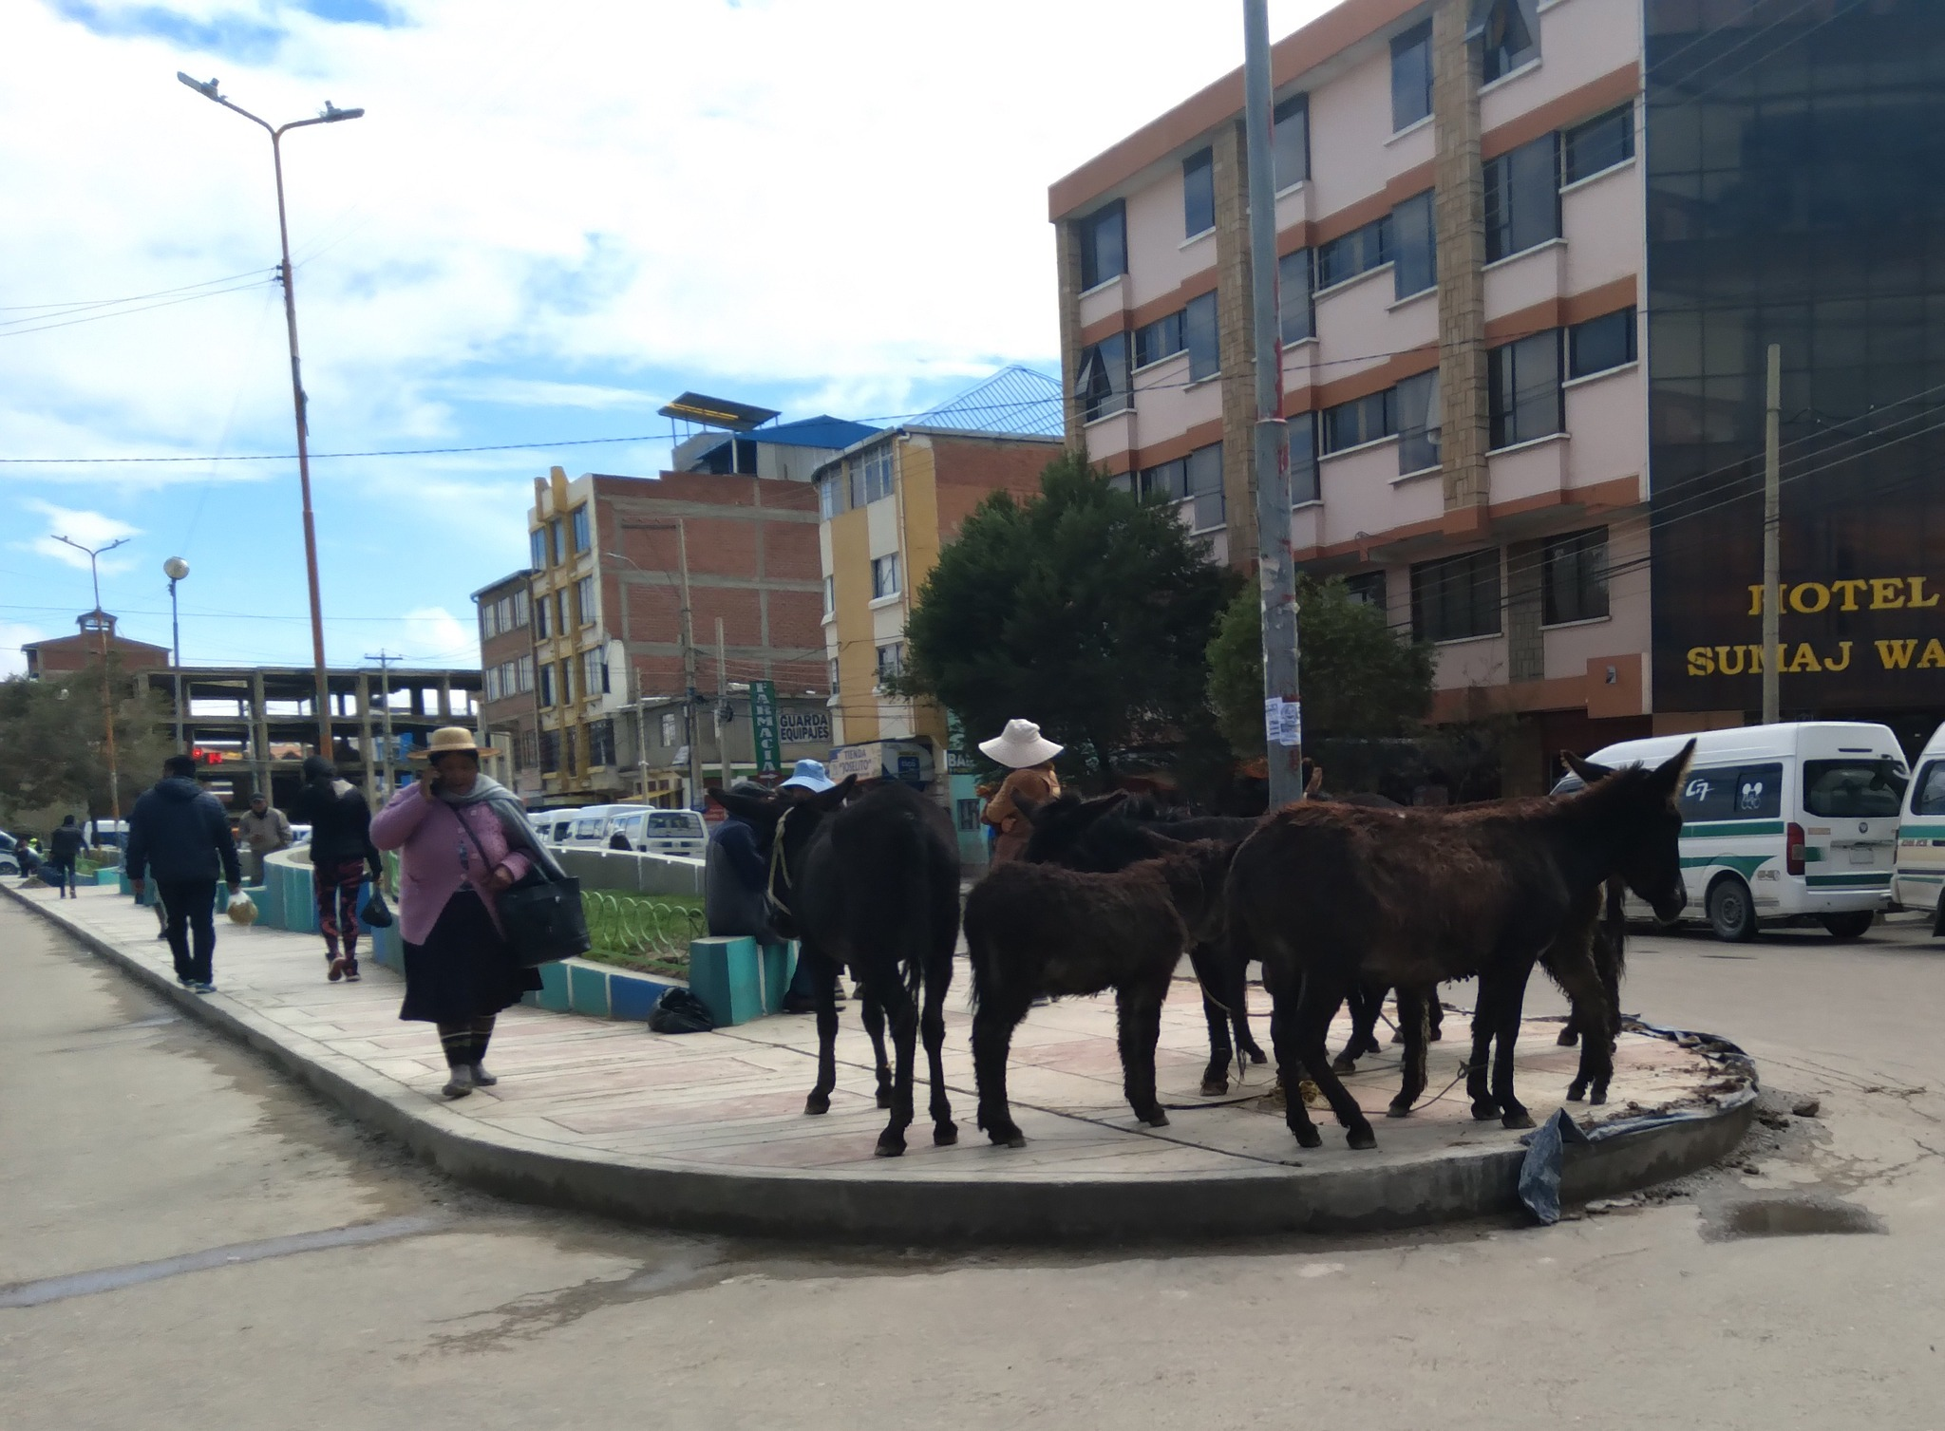

Slide 63
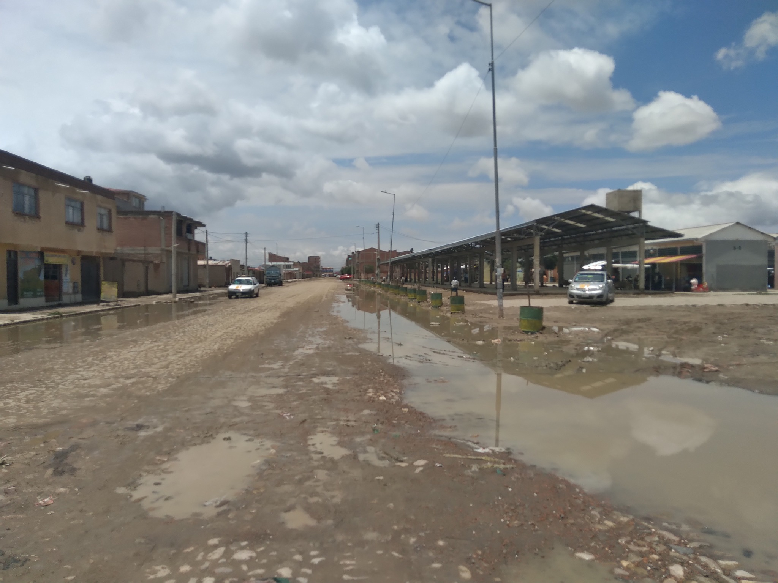

Slide 64
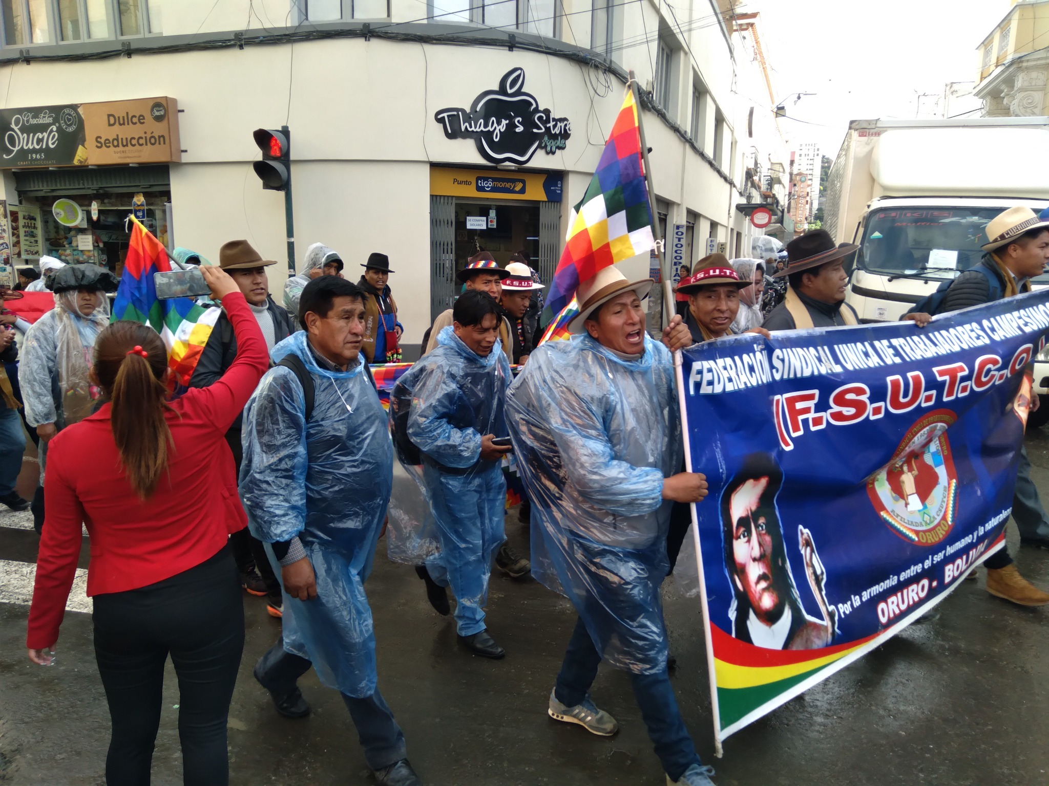

Slide 65
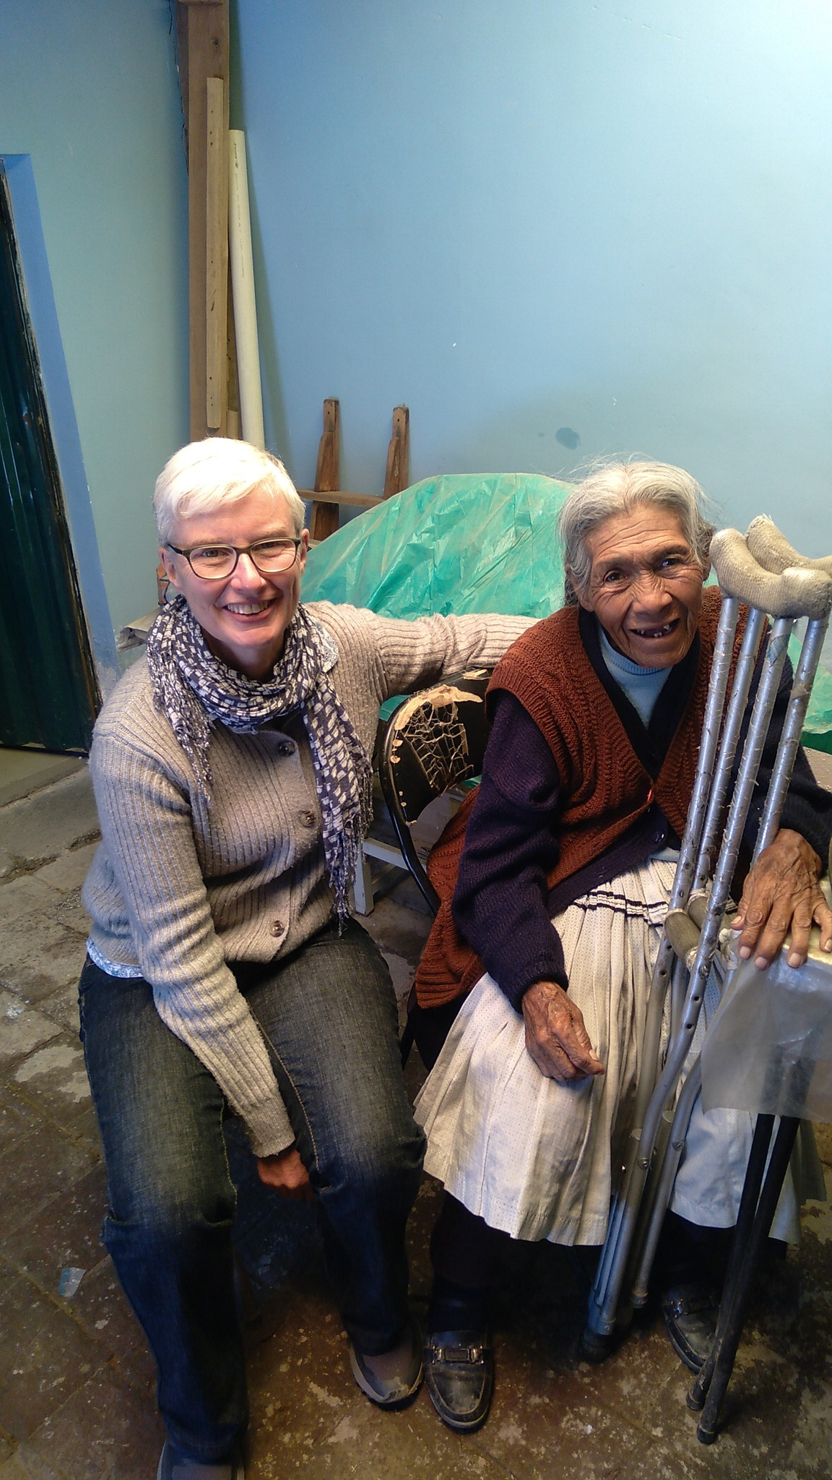
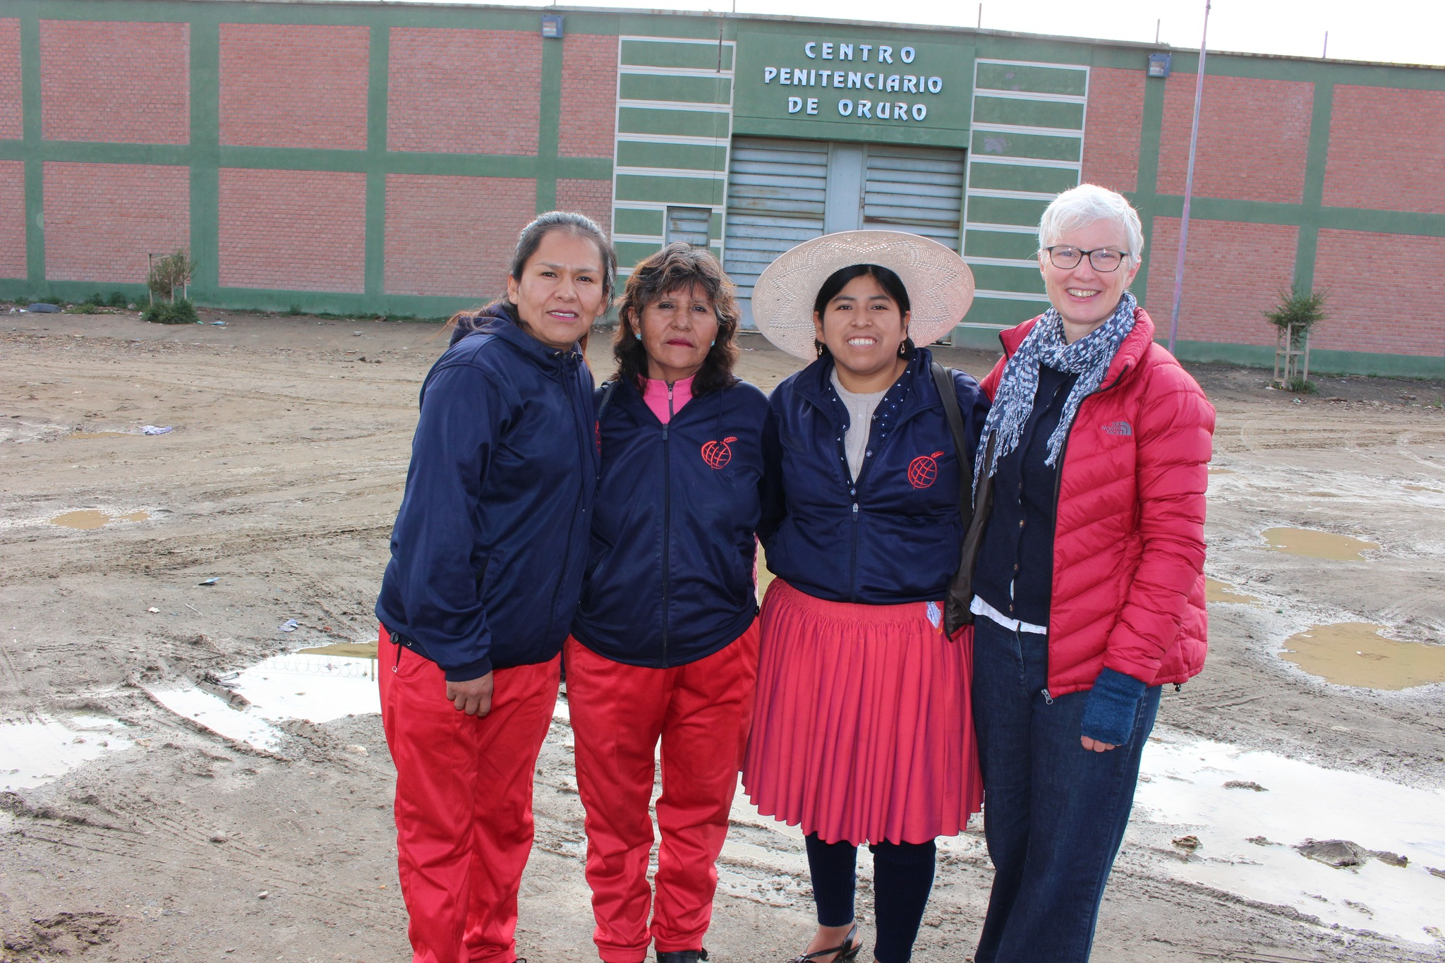

Slide 66
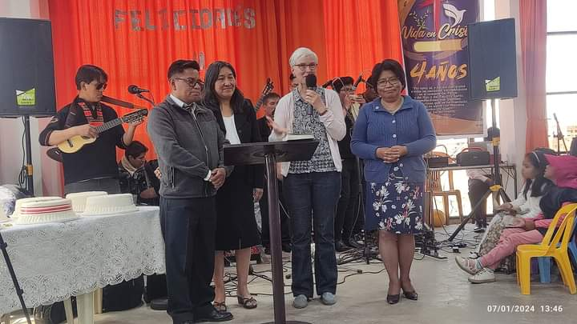

Slide 67
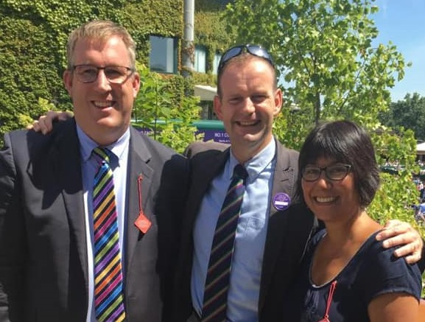

Slide 68
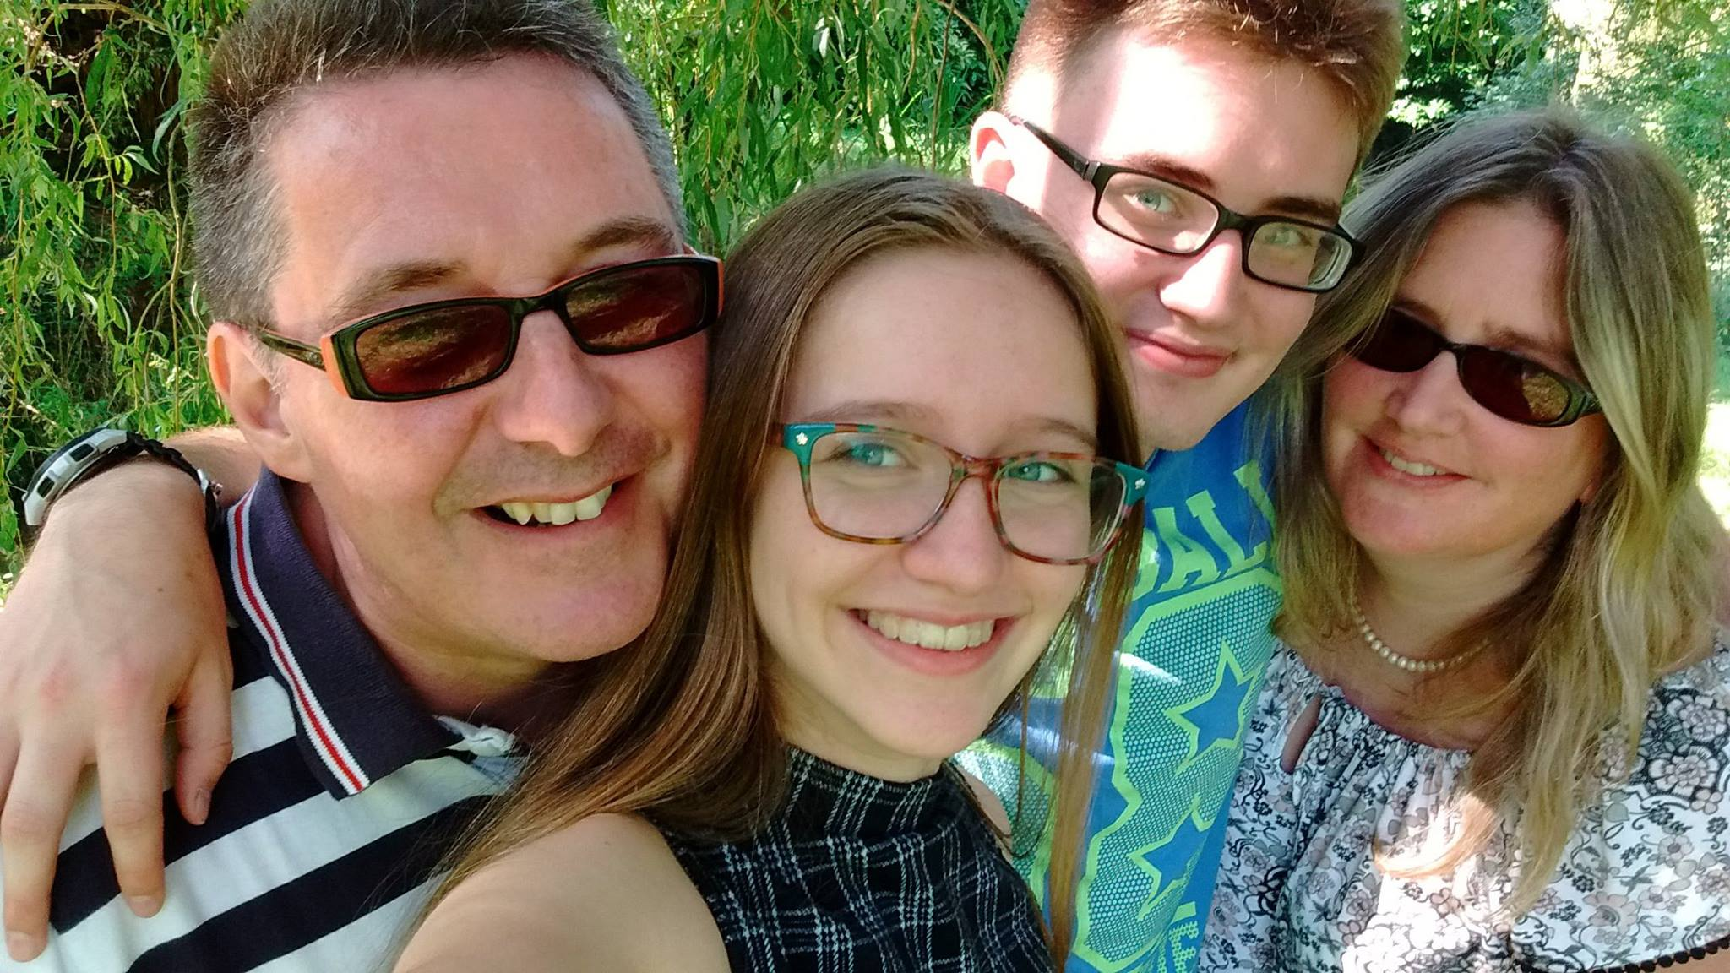
1
Terry & Christine Miller
Cordoba, Spain

Slide 69
Sun Malden Manor Community Church
Mon Terry & Christine Miller Cordoba, Spain
Tue Dnipro Hope Mission
Warm Welcome Café
Wed Operation Restoration
Roger & Isha Hulford Youth with a Mission
Thu Foodbank
Kingston Churches Action on Homelessness
Fri Analice Miná Collyer Youth for Christ
Eara Ko with Students
Sat Insight Kingston Tim Neale
Oxygen John Trend Adam Kelly

Slide 71
Sun Malden Manor Community Church
Mon Terry & Christine Miller Cordoba, Spain
Tue Dnipro Hope Mission
Warm Welcome Café
Wed Operation Restoration
Roger & Isha Hulford Youth with a Mission
Thu Foodbank
Kingston Churches Action on Homelessness
Fri Analice Miná Collyer Youth for Christ
Eara Ko with Students
Sat Insight Kingston Tim Neale
Oxygen John Trend Adam Kelly

Slide 72
‘Thank you Lord for waking us up this morning.’
‘Lord, we know that you’ll be coming through this line today.’
‘So Lord, help us to treat you well’

Slide 74
‘I’m here because…’
‘you prayed’
‘you gave’
‘you came…’

Slide 75
‘Facing a task unfinished,
that drives us to our knees…’

Slide 76
Jesus said
“Any of you who want to be my follower
must stop thinking about yourself & what you want.
You must be willing to carry the cross
that is given to you for following me.”
Mark 8:24-35

