Slide 1
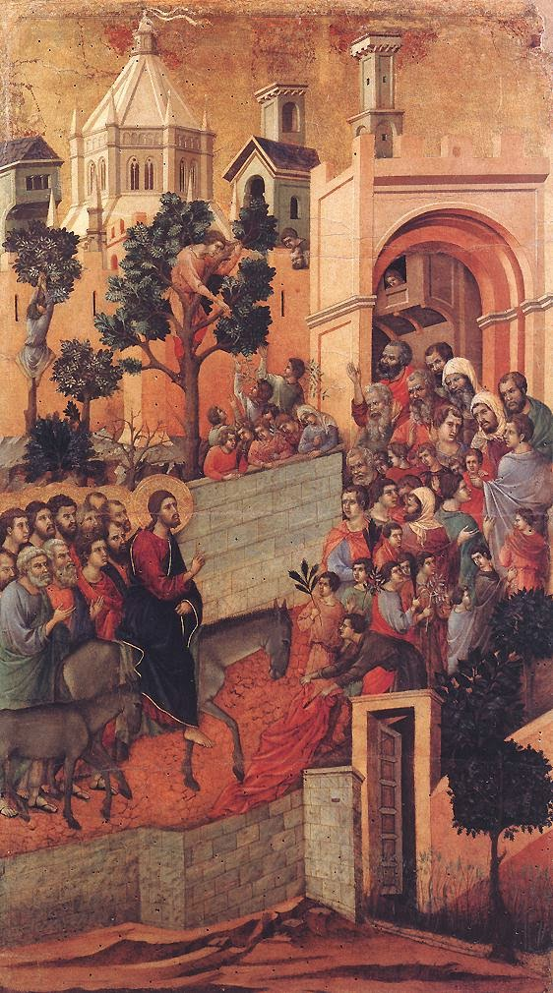
PALM SUNDAY
The Road to Easter
Matthew 21:1-17

Slide 2
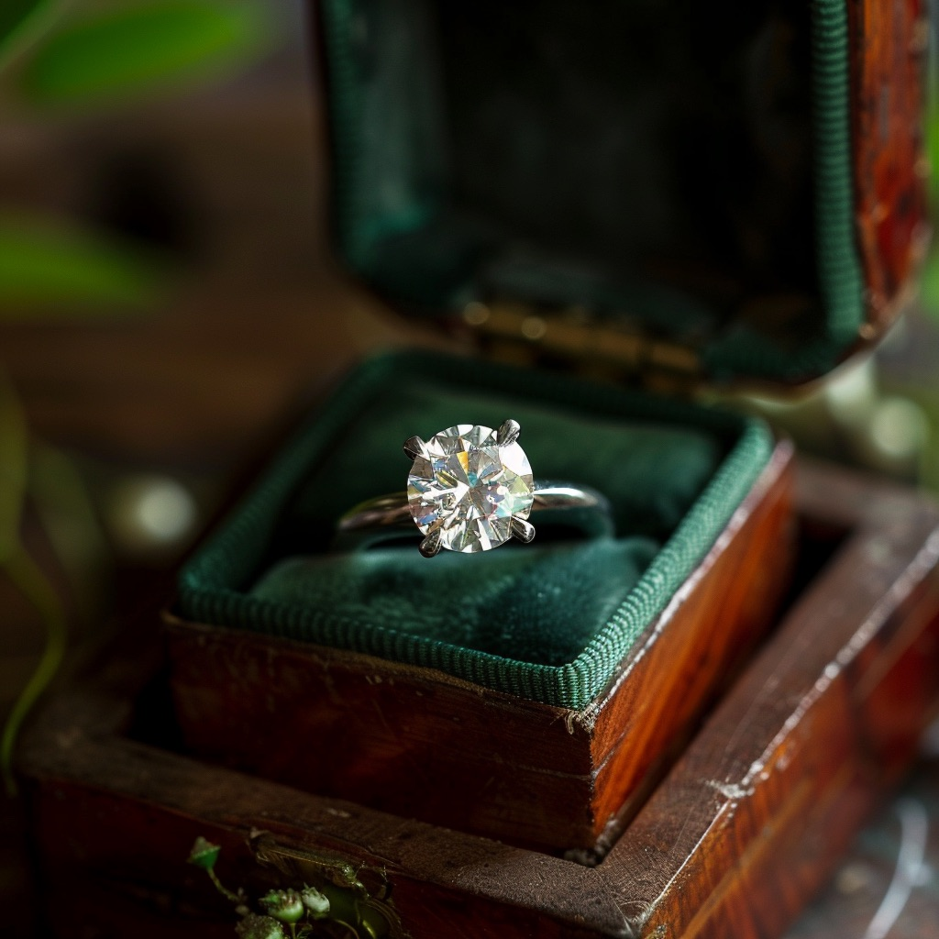

Slide 3
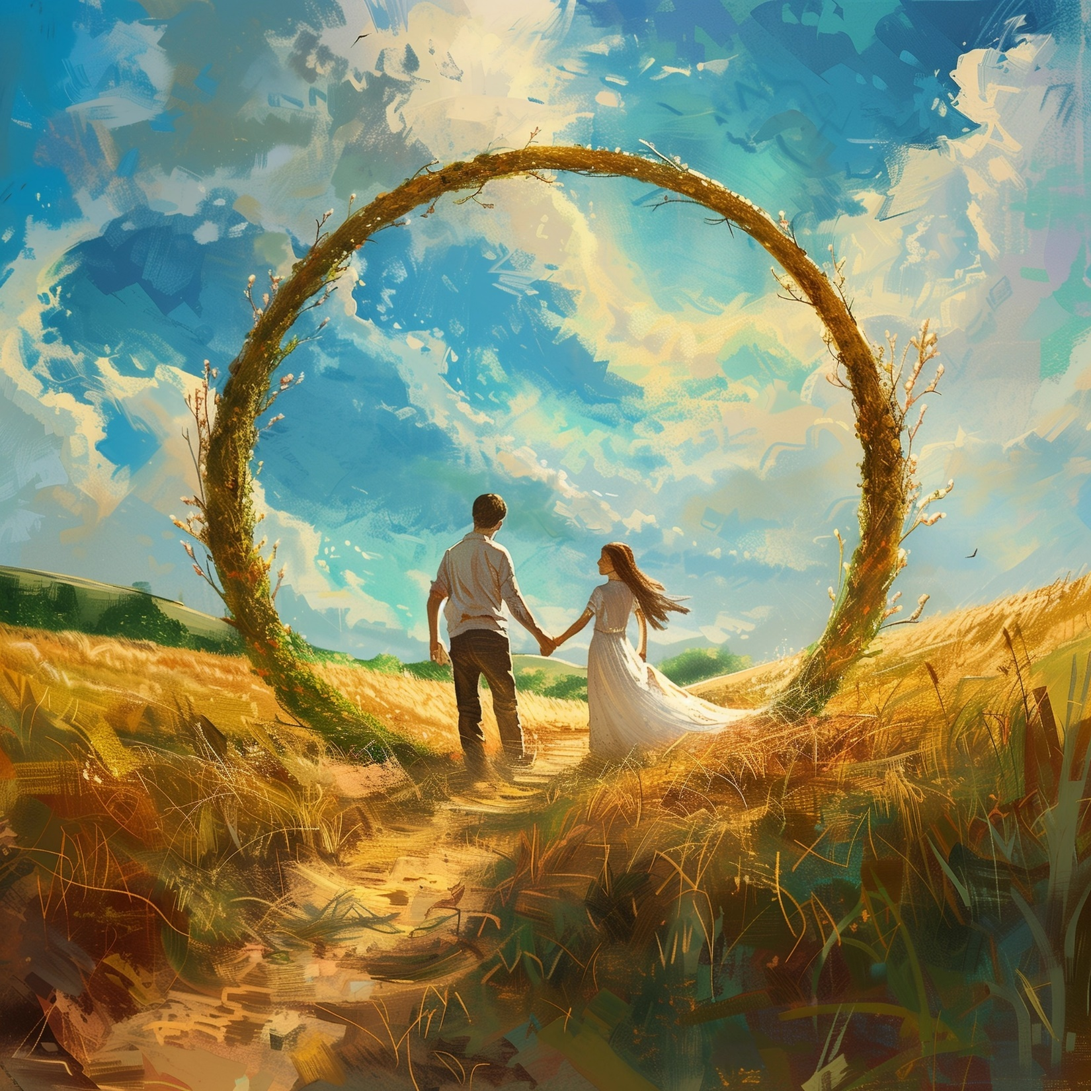

Slide 4
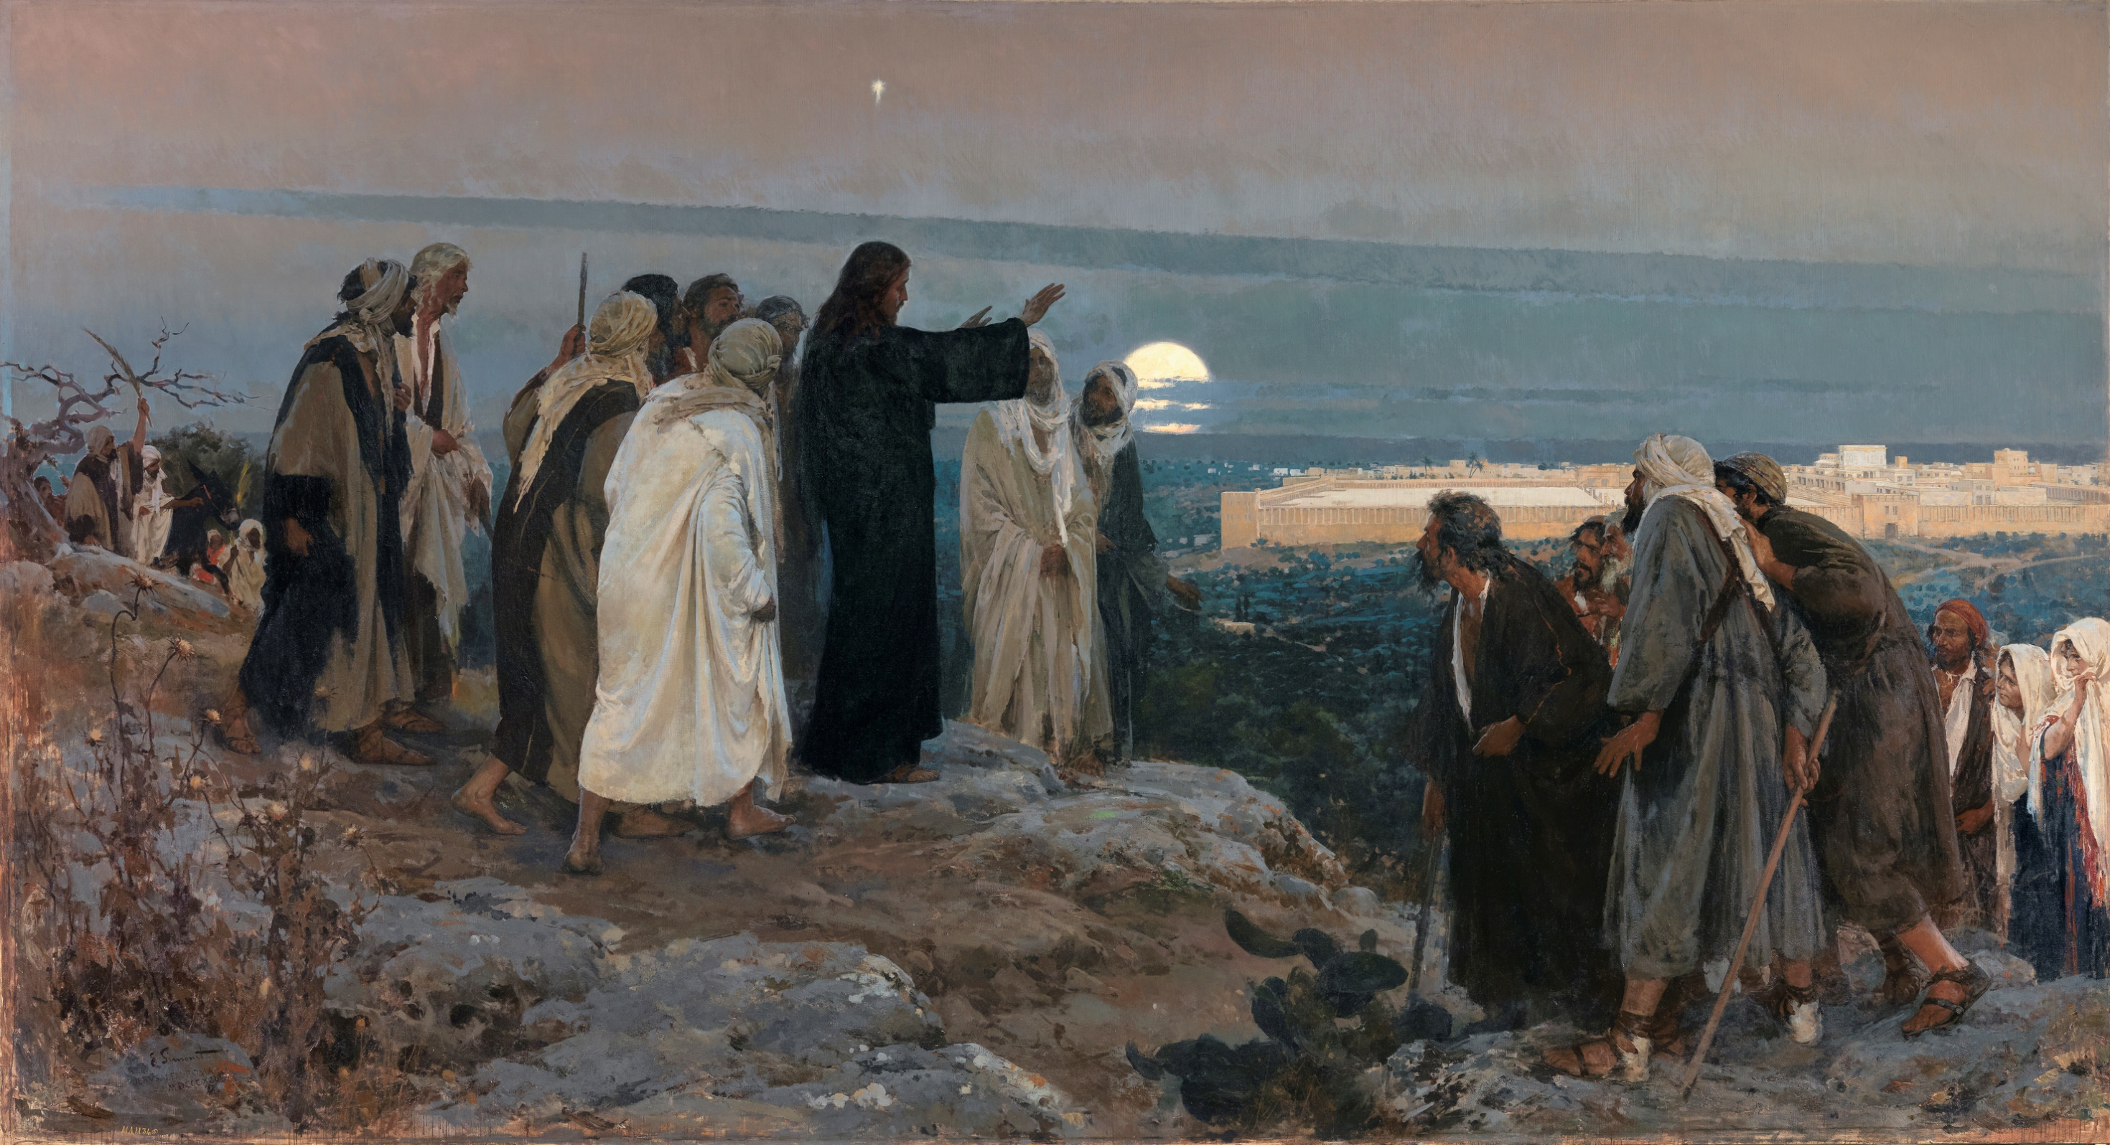

Slide 5
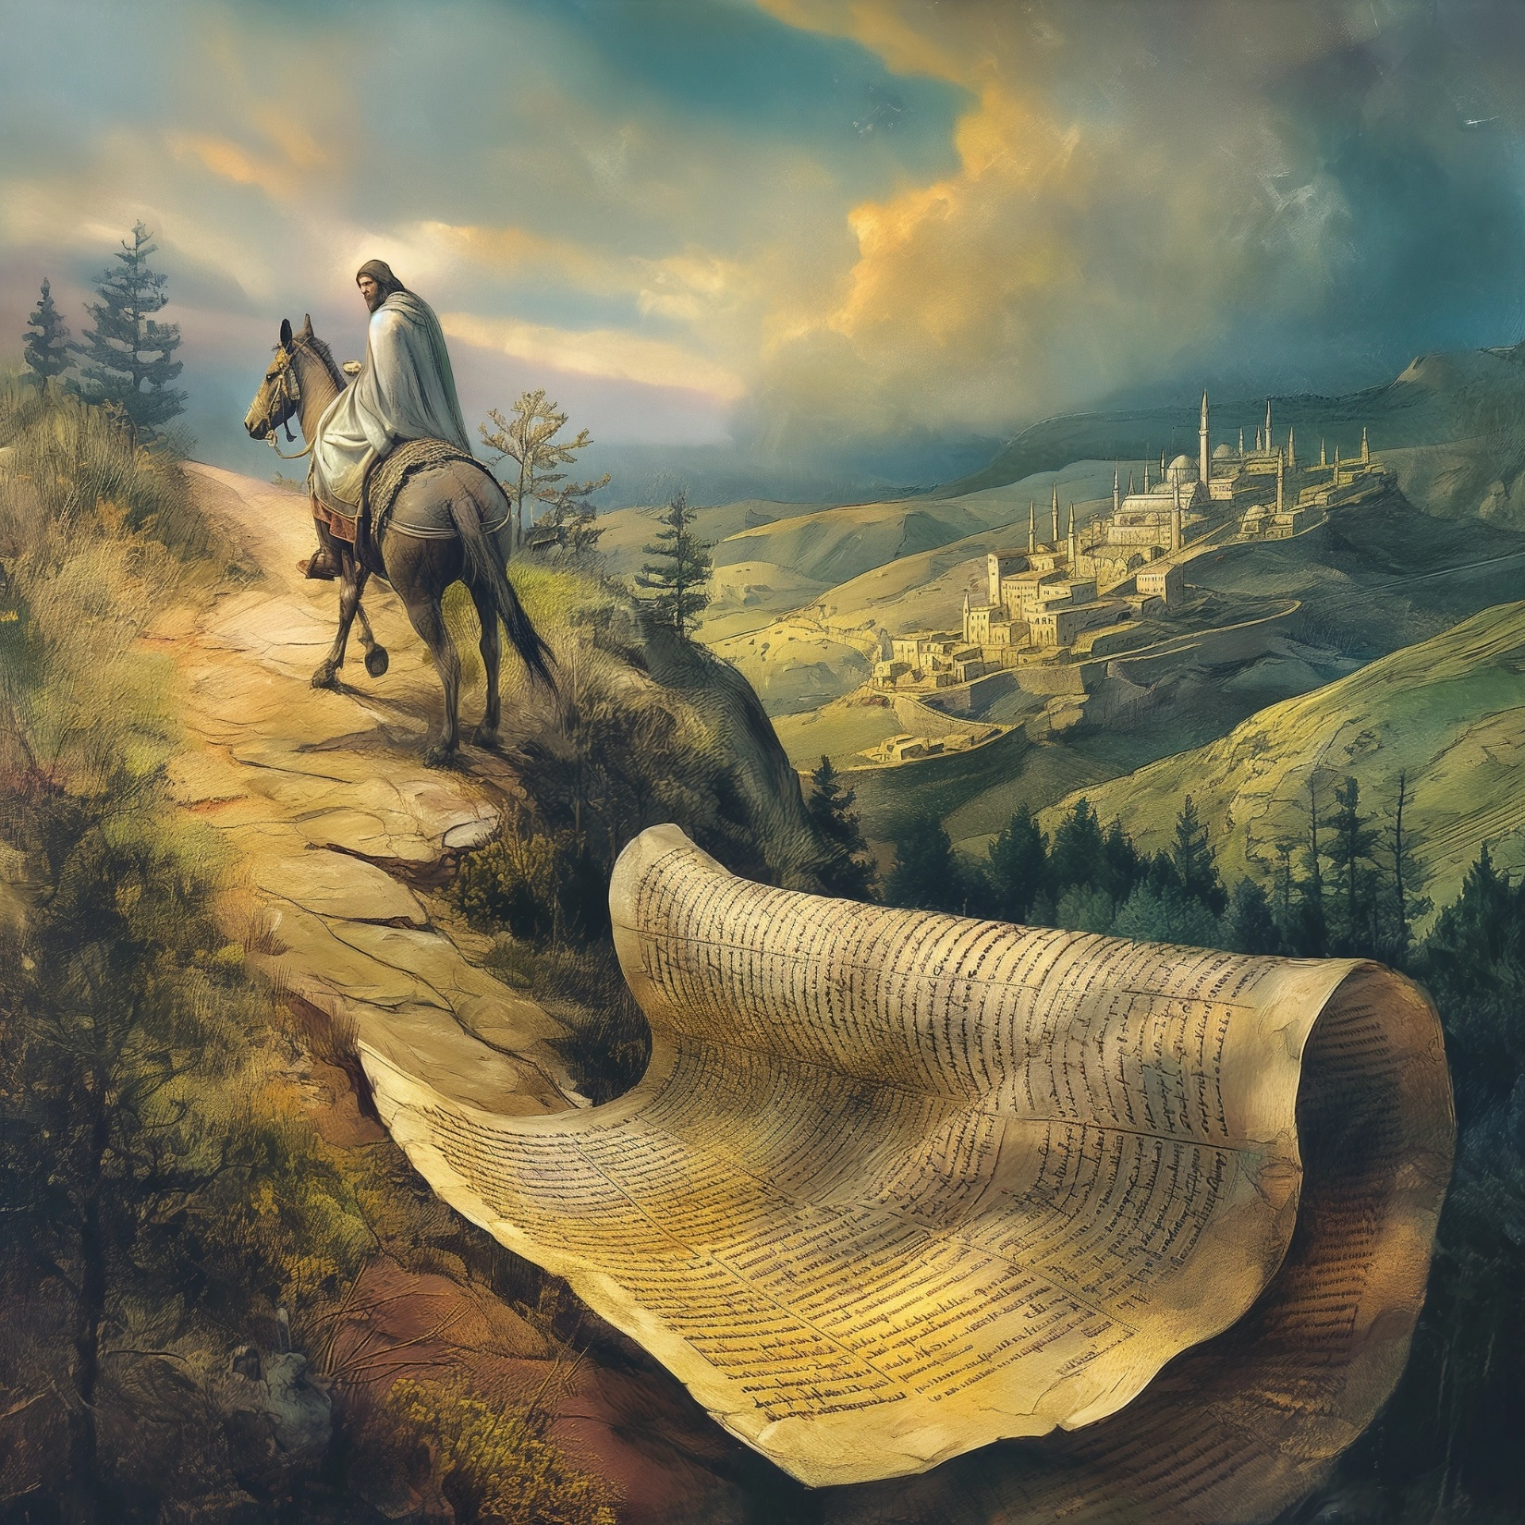

Slide 6
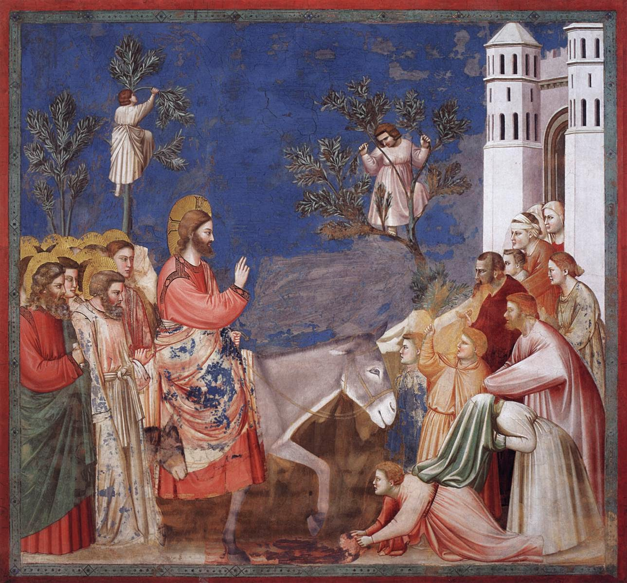

Slide 7
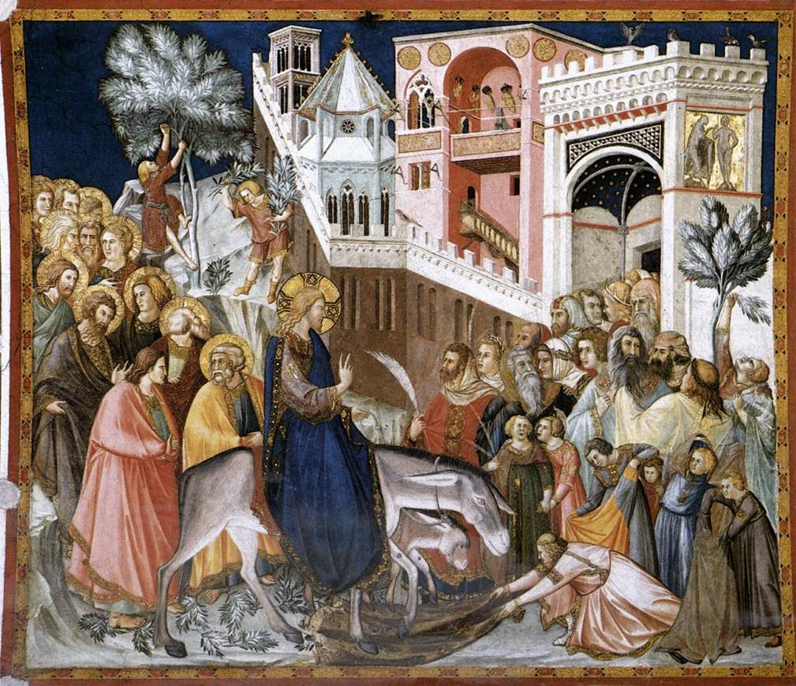
“Rejoice greatly, O daughter of Zion! Shout aloud, O daughter of Jerusalem! Behold, your king is coming to you; righteous and having salvation is he, humble and mounted on a donkey, on a colt, the foal of a donkey.”
Zechariah 9:9

Slide 8
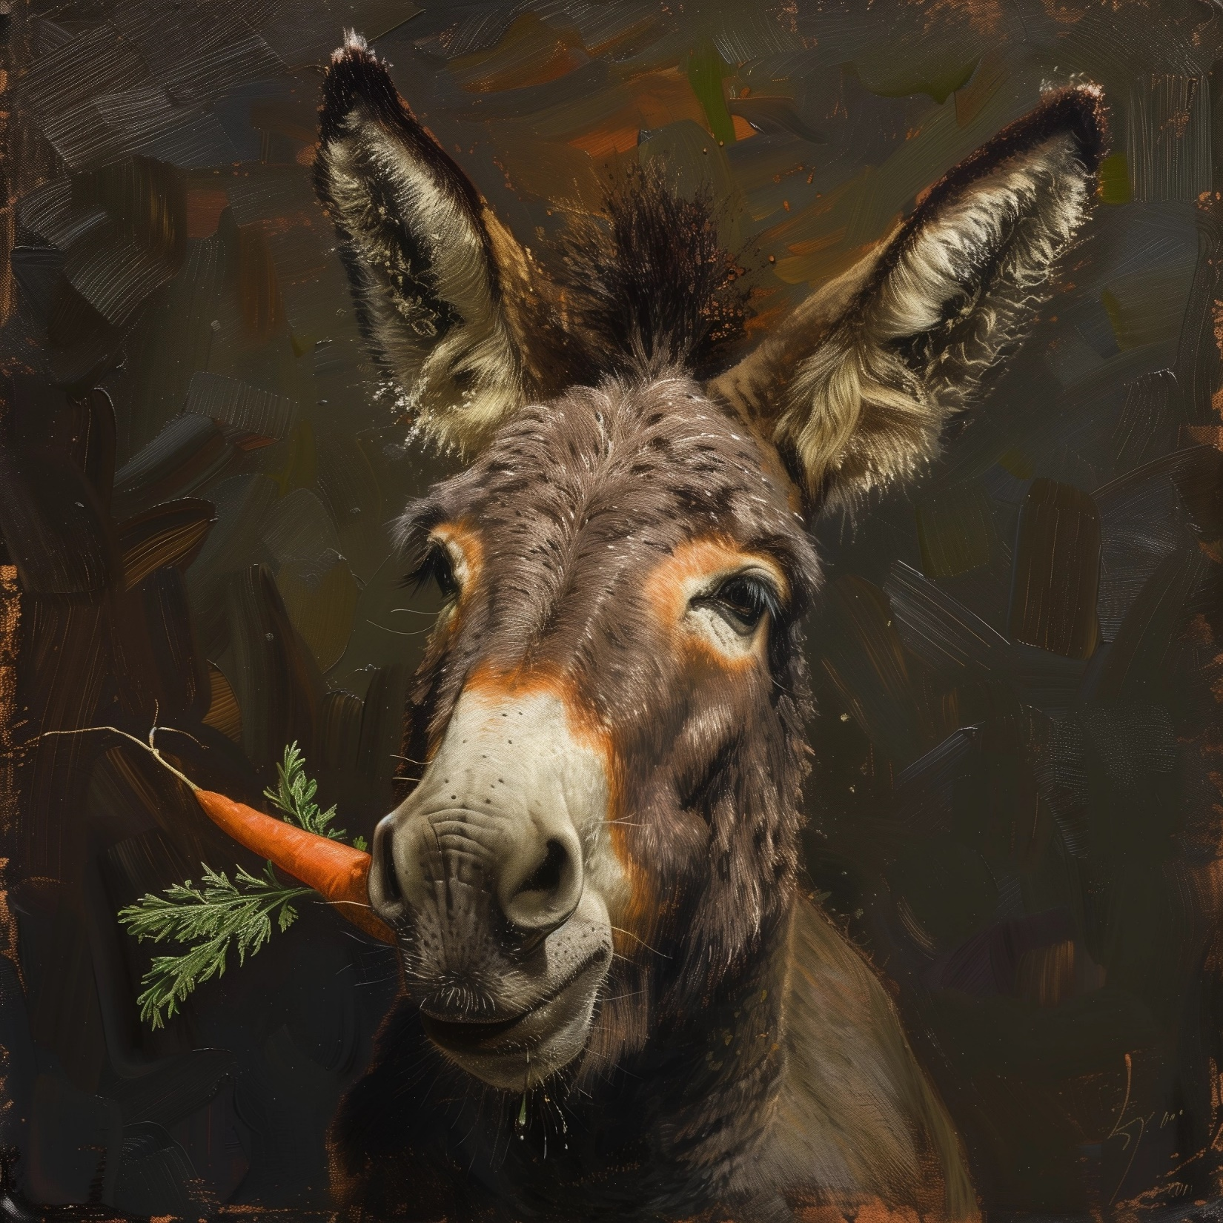

Slide 9
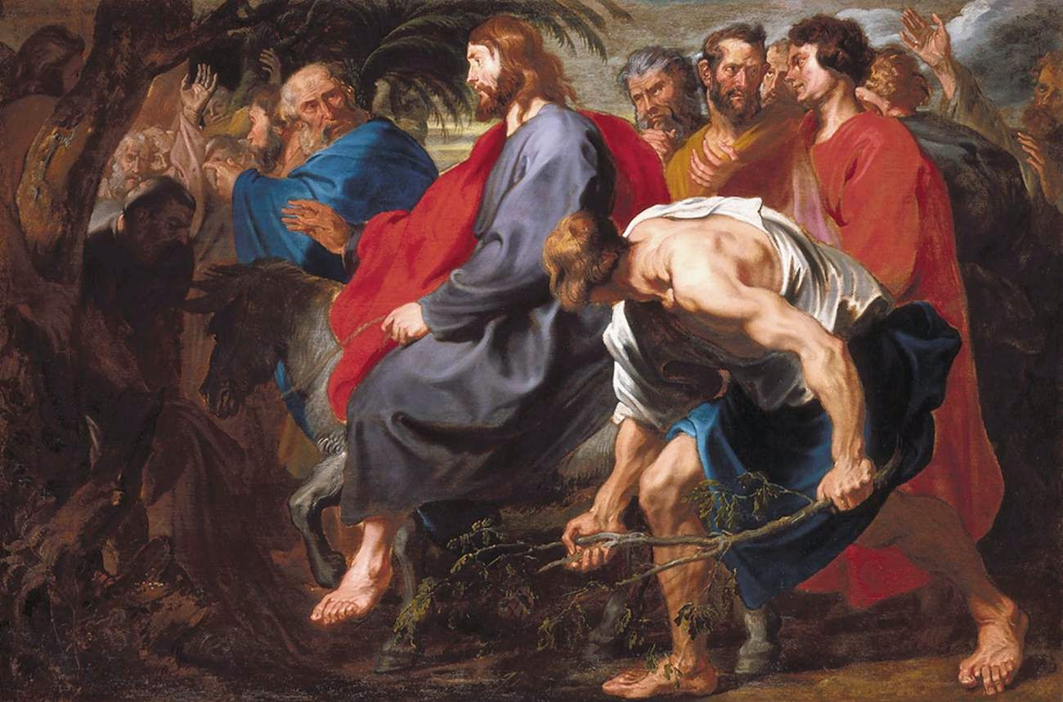
“most of the crowd spread their cloaks on the road”

Slide 10
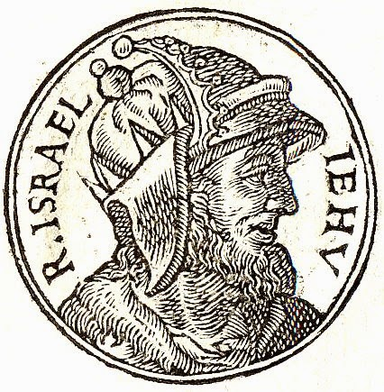

Slide 11
“And the young man poured the oil on his head, saying to him, ‘Thus says the Lord, the God of Israel, I anoint you king over the people of the Lord, over Israel. And you shall strike down the house of Ahab your master, so that I may avenge on Jezebel the blood of my servants the prophets, and the blood of all the servants of the Lord. For the whole house of Ahab shall perish, and I will cut off from Ahab every male, bond or free, in Israel... And the dogs shall eat Jezebel in the territory of Jezreel, and none shall bury her.”
(2 Kings 9:6-10)

Slide 12
“When Jehu came out to the servants of his master, they said to him, ‘Is all well? Why did this mad fellow come to you?’ And he said to them, ‘You know the fellow and his talk.’ And they said, ‘That is not true; tell us now.’ And he said, ‘Thus and so he spoke to me, saying, ‘Thus says the Lord, I anoint you king over Israel.’’ Then in haste every man of them took his garment and put it under him on the bare steps, and they blew the trumpet and proclaimed, ‘Jehu is king.’”
2 Kings 9:11-13

Slide 13
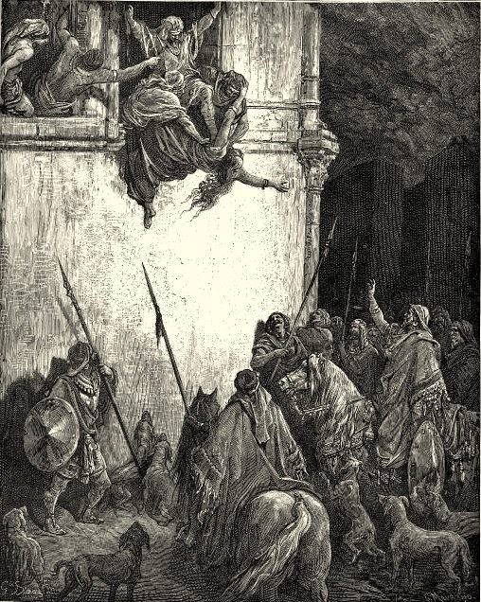

Slide 14
“Hosanna to the Son of David!
Blessed is he who comes in the name of the Lord!
Hosanna in the highest!”
Matthew 21:9

Slide 15
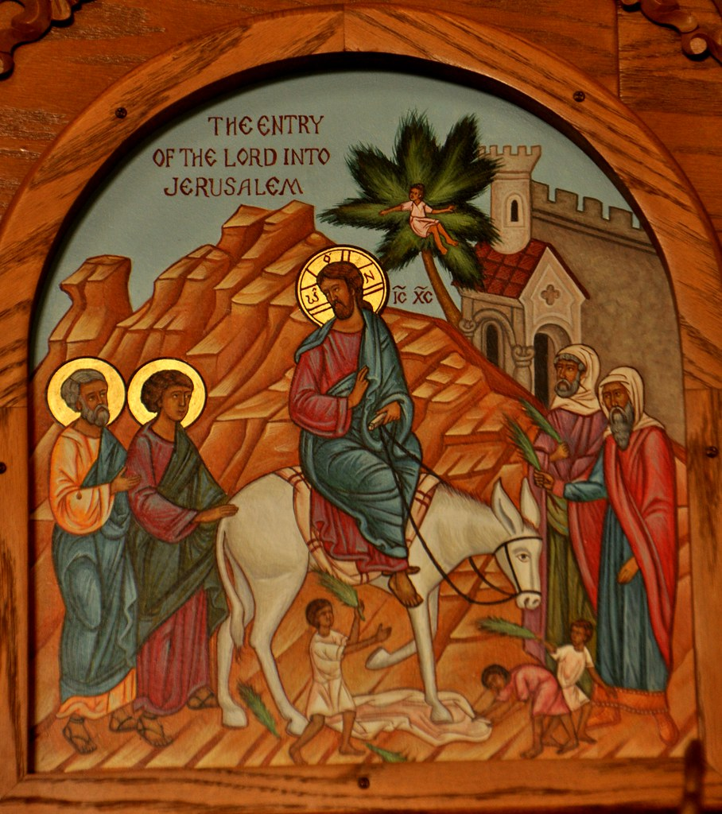

Slide 16
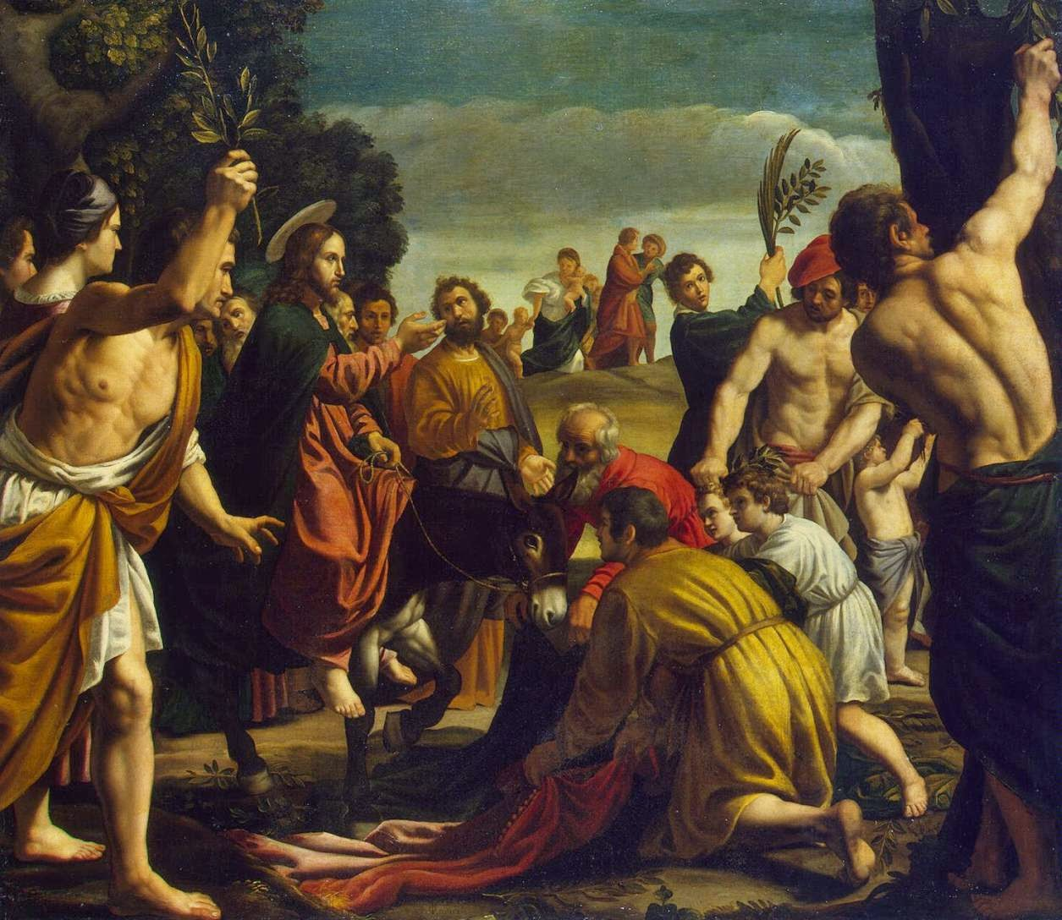

Slide 17
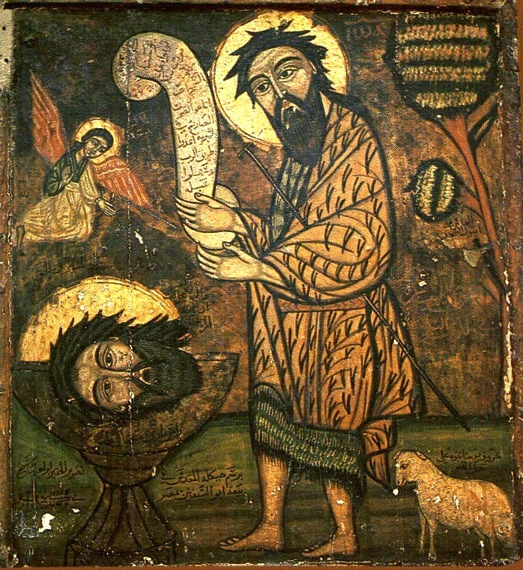

Slide 18
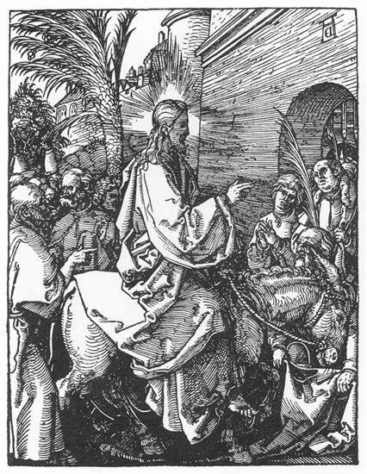

Slide 19
“…a royal priesthood, a holy nation, a people for his own possession, that you may proclaim the excellencies of him who called you out of darkness into his marvellous light.”
(1 Peter: 2:9)

Slide 20
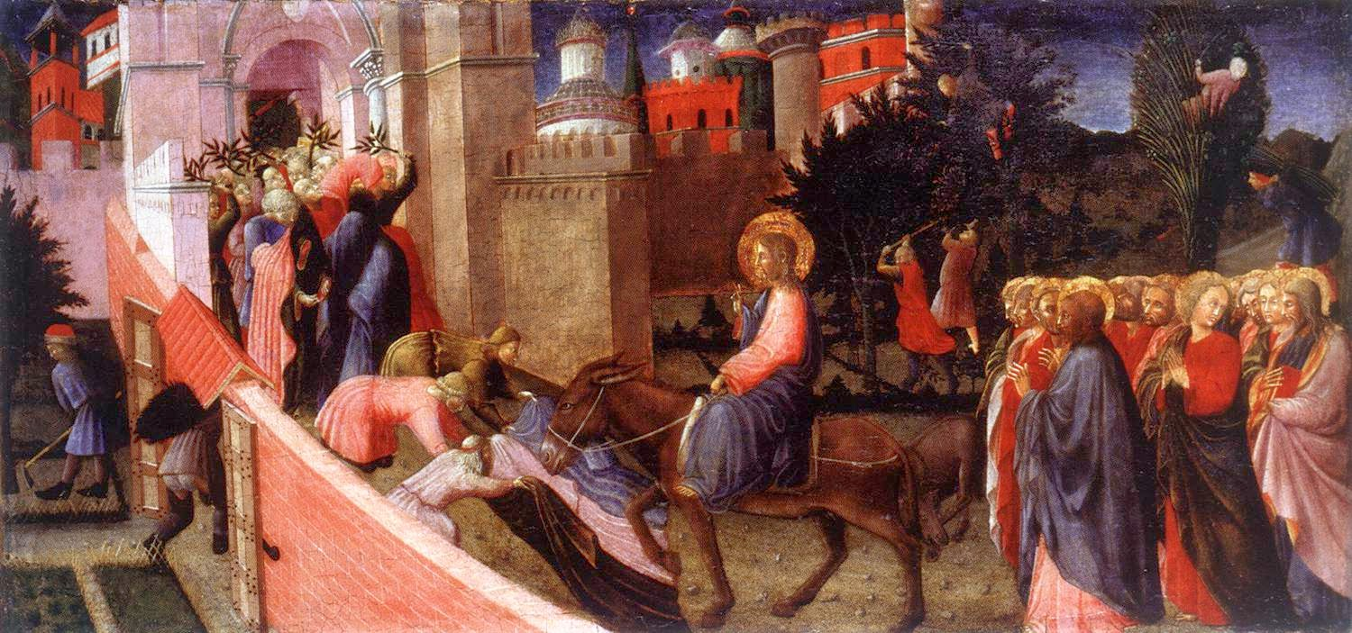
“Their wildest dreams had simply not been wild enough.”

Slide 21
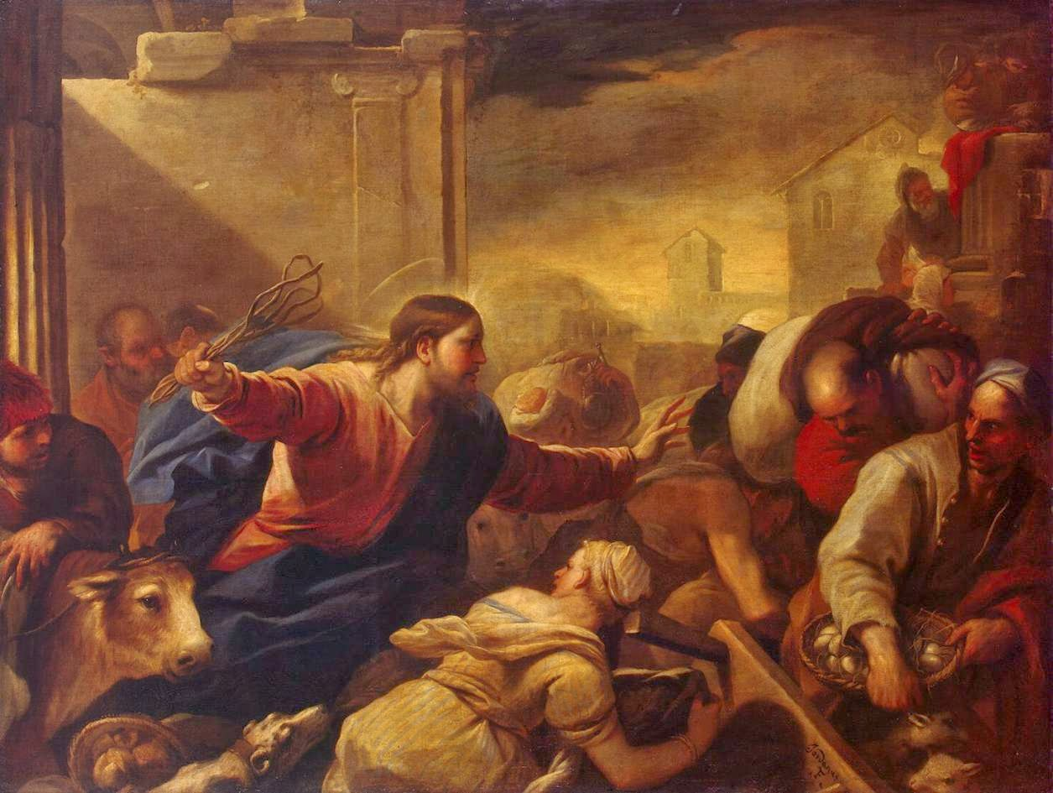
“It is written, ‘My house shall be called a house of prayer,’ but you make it a den of robbers.”
Matthew 21:13

Slide 22
“And the foreigners who join themselves to the Lord, to minister to him, to love the name of the Lord, and to be his servants, everyone who keeps the Sabbath and does not profane it, and holds fast my covenant— these I will bring to my holy mountain, and make them joyful in my house of prayer; their burnt offerings and their sacrifices will be accepted on my altar; for my house shall be called a house of prayer for all peoples.”
(Isaiah 56-6-7)

Slide 23
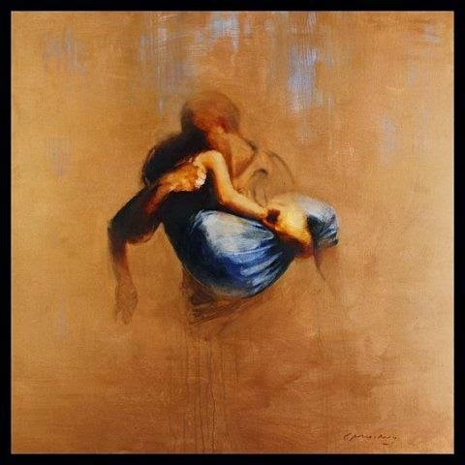

Slide 24
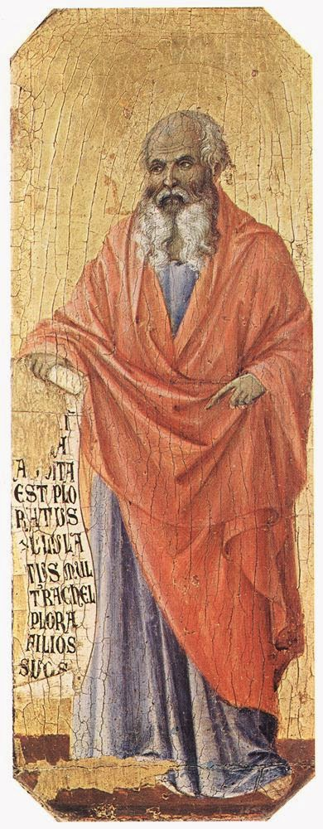
“For if you truly amend your ways and your deeds, if you truly execute justice one with another, if you do not oppress the sojourner, the fatherless, or the widow, or shed innocent blood in this place, and if you do not go after other gods to your own harm, then I will let you dwell in this place, in the land that I gave of old to your fathers for ever. Behold, you trust in deceptive words to no avail. Will you steal, murder, commit adultery, swear falsely, make offerings to Baal, and go after other gods that you have not known, and then come and stand before me in this house, which is called by my name, and say, ‘We are delivered!’ - only to go on doing all these abominations? Has this house, which is called by my name, become a den of robbers in your eyes? Behold, I myself have seen it, declares the Lord.”
(Jeremiah 7:5-11)

Slide 26
“When the sun rose, the reflection was nearly blinding. On a clear day the brilliance of the temple was visible from a considerable distance outside Jerusalem. And this brilliance was not due to gold alone; the upper parts of the temple were pure white, probably marble. Once a year the priests applied whitewash to this upper section.”

Slide 27
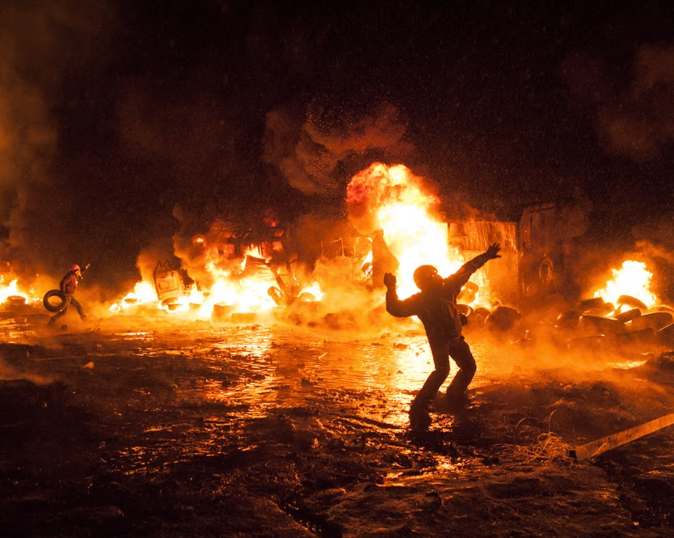

Slide 28
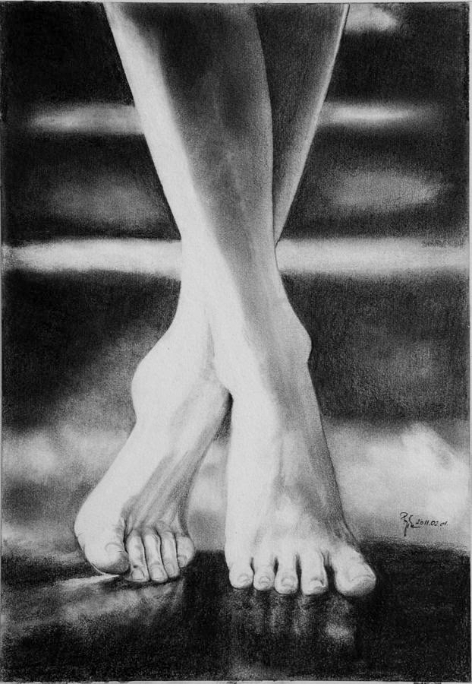
“…the blind and the lame came to him in the temple, and he healed them”
(Matt 21:14).

Slide 29
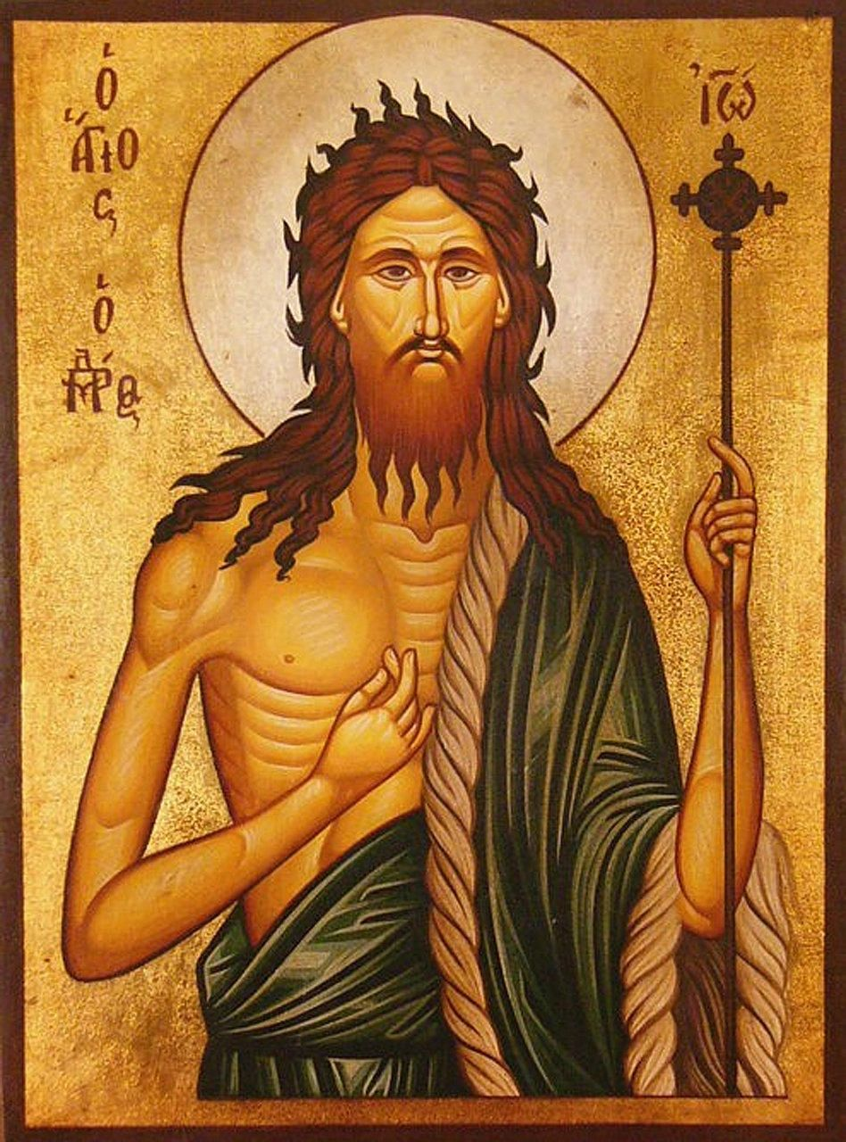
“Are you the one who is to come, or shall we look for another?”
(Matthew 11:3)

Slide 30
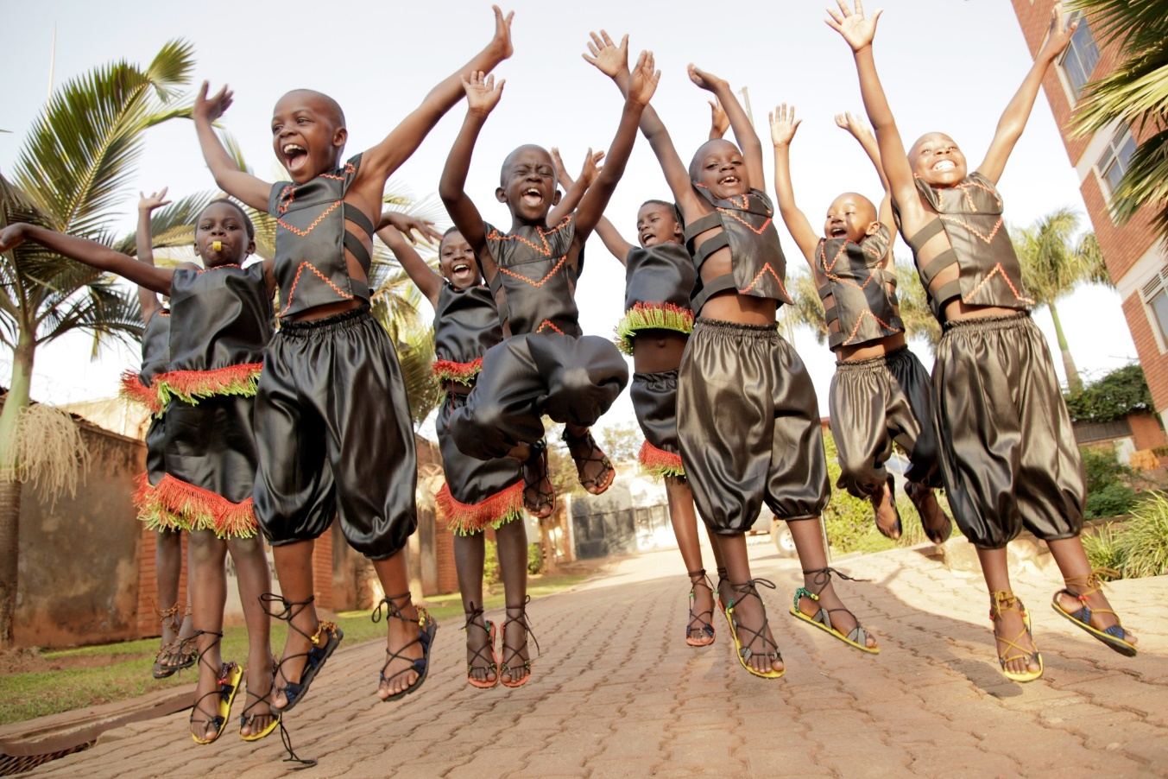
“Go and tell John what you hear and see: the blind receive their sight and the lame walk, lepers are cleansed and the deaf hear, and the dead are raised up, and the poor have good news preached to them. And blessed is the one who is not offended by me.”
(Matthew 11:4-7)

Slide 31
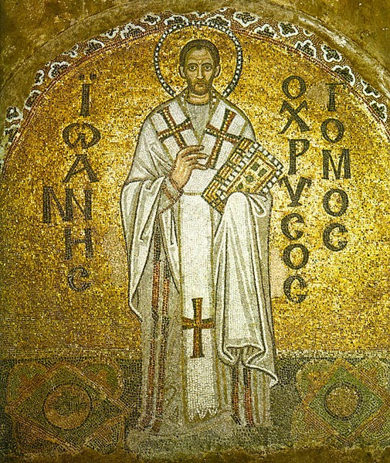
“For the cross destroyed the enmity of God towards man, brought about the reconciliation, made the earth Heaven, associated men with angels, pulled down the citadel of death, unstrung the force of the devil, extinguished the power of sin, delivered the world from error, brought back the truth, expelled the Demons, destroyed temples, overturned altars, suppressed the sacrificial offering, implanted virtue, founded the Churches. The cross is the will of the Father, the glory of the Son, the rejoicing of the Spirit, the boast of Paul…

Slide 32
“The cross is that which is brighter than the sun, more brilliant than the sunbeam: for when the sun is darkened then the cross shines brightly: and the sun is darkened not because it is extinguished, but because it is overpowered by the brilliancy of the cross. The cross has broken our bond, it has made the prison of death ineffectual, it is the demonstration of the love of God…

Slide 33
“The cross opened Paradise, it brought in the robber, it conducted into the kingdom of Heaven the race of man which was about to perish, and was not worthy even of earth. So great are the benefits which have sprung and do spring from the cross.”

Slide 34
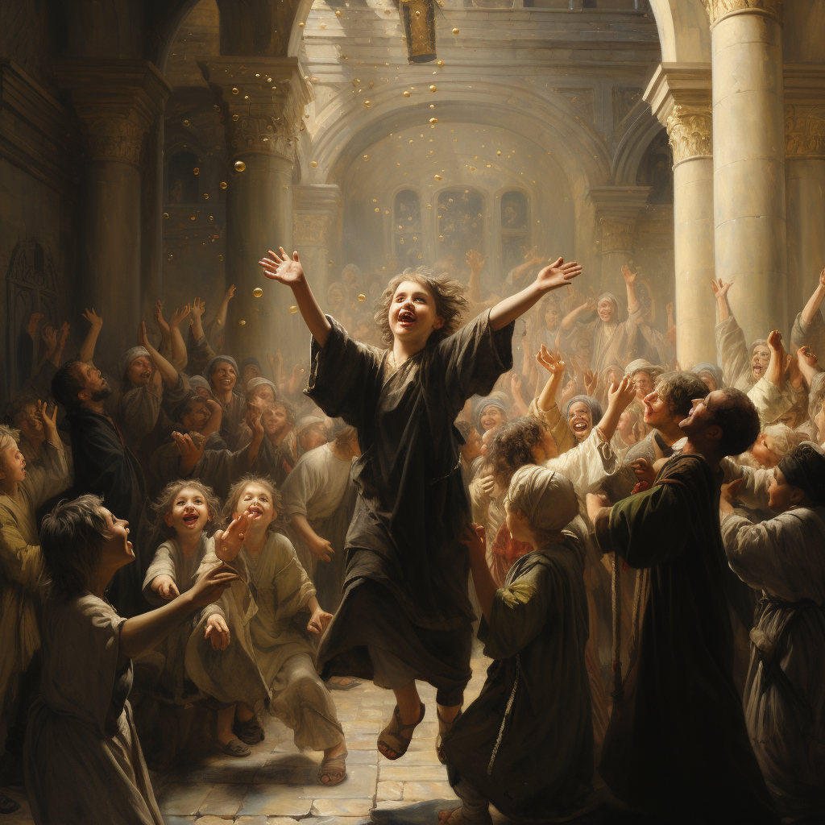
“Hosanna to the Son of David!”

Slide 35
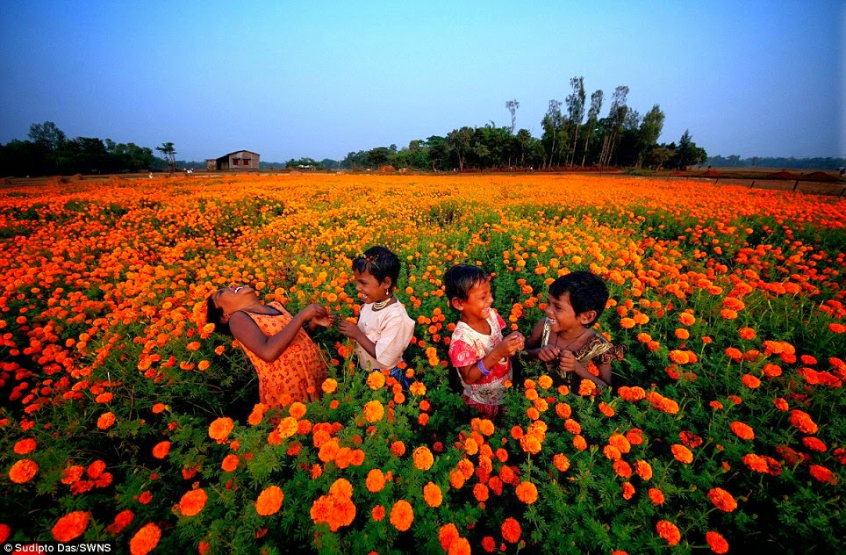
“Out of the mouth of infants and nursing babies you have prepared praise”

Slide 36
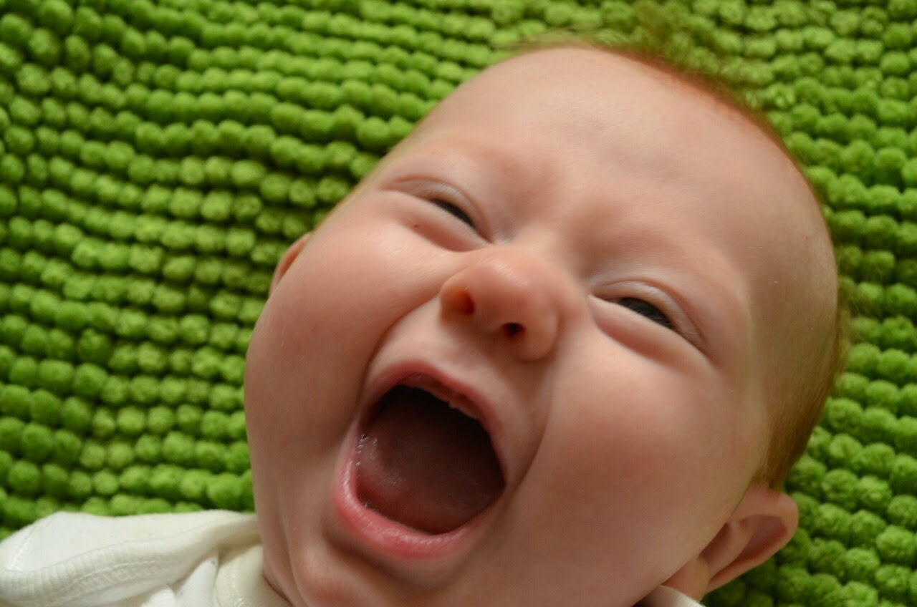

Slide 37
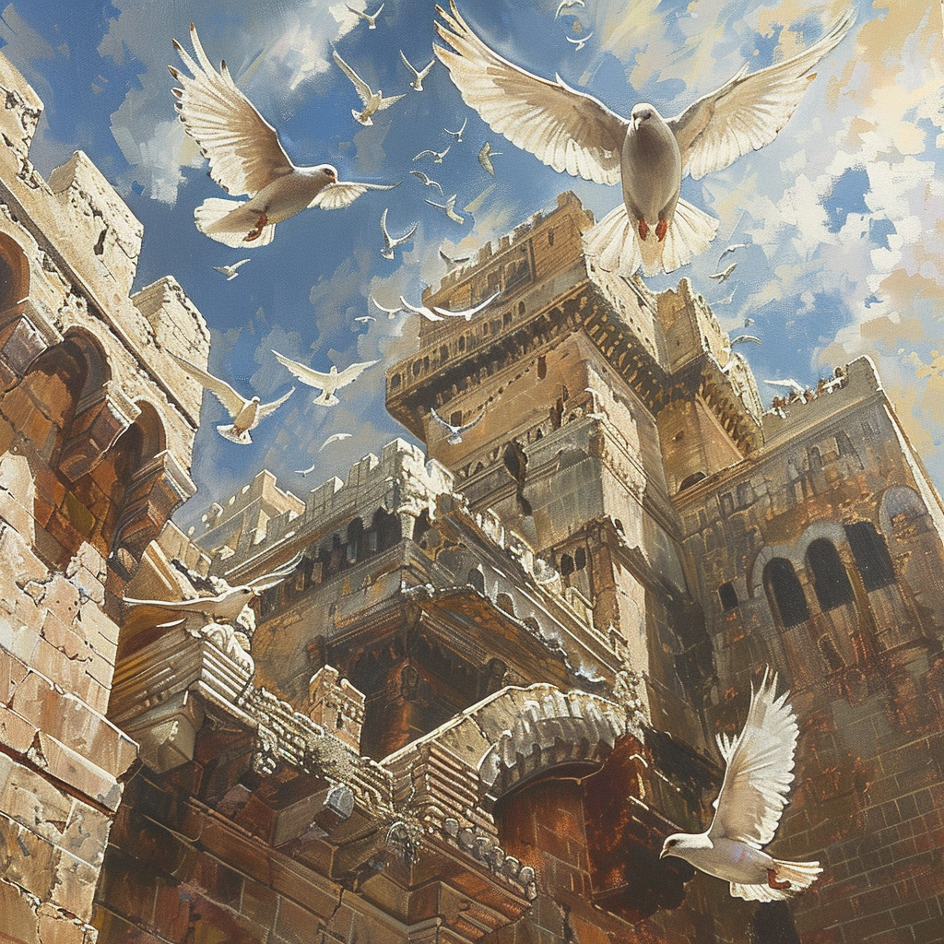

Slide 38
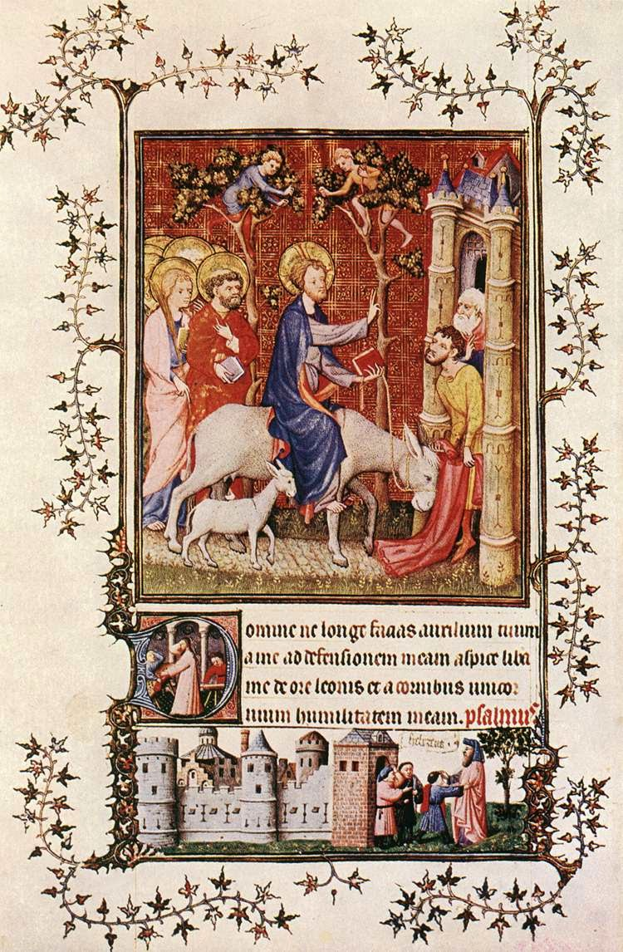

Slide 39
“If anyone would come after me, let him deny himself and take up his cross and follow me. For whoever would save his life will lose it, but whoever loses his life for my sake will find it.”
(Matthew 16:24-25)

Slide 40
“…washed their robes and made them white in the blood of the Lamb.”
(Revelation 7:14, ESV)

Slide 41
“After this I looked, and behold, a great multitude that no one could number, from every nation, from all tribes and peoples and languages, standing before the throne and before the Lamb, clothed in white robes, with palm branches in their hands, and crying out with a loud voice, ‘Salvation belongs to our God who sits on the throne, and to the Lamb!’

Slide 42
And all the angels were standing round the throne and round the elders and the four living creatures, and they fell on their faces before the throne and worshipped God, saying, ‘Amen! Blessing and glory and wisdom and thanksgiving and honour and power and might be to our God for ever and ever! Amen’”
(Revelation 7:9-12)

Slide 43
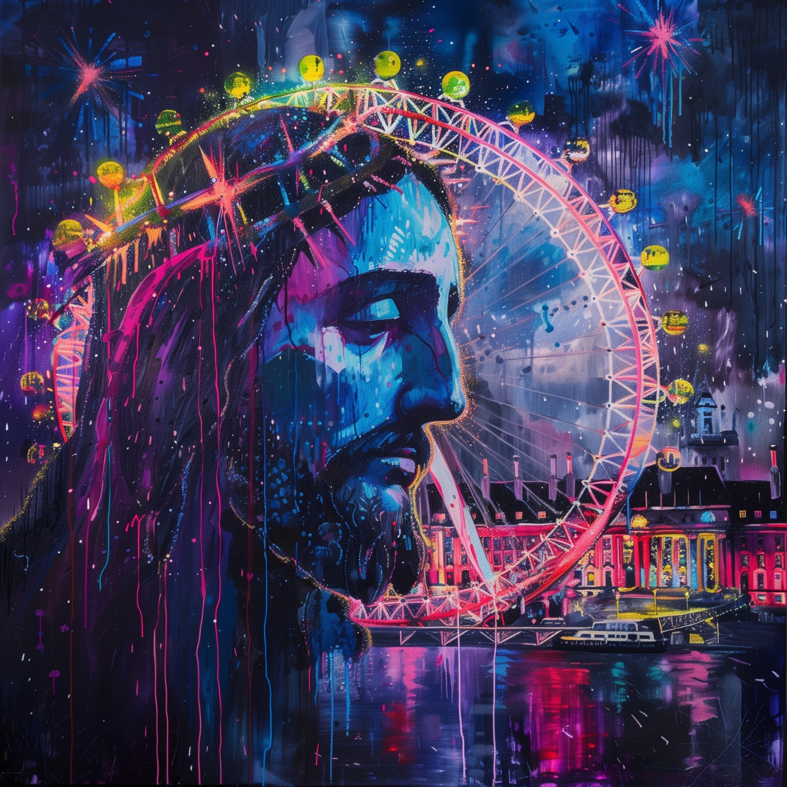

Slide 44
