Slide 1
The Spiritual Battle
1
‘Loving God – our heart’s first defence’
Deuteronomy 6:1-9

Slide 2
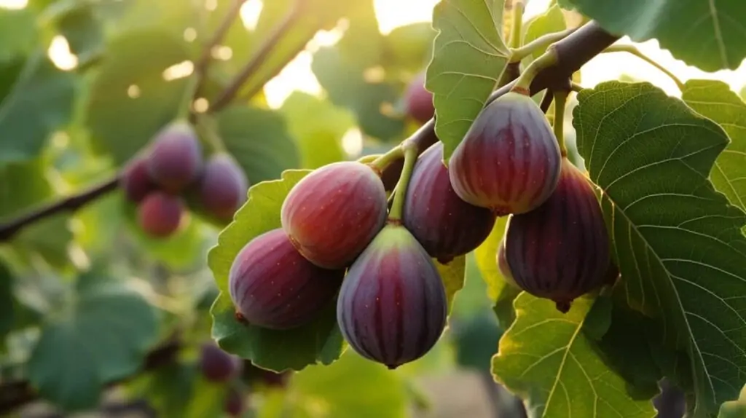

Slide 3
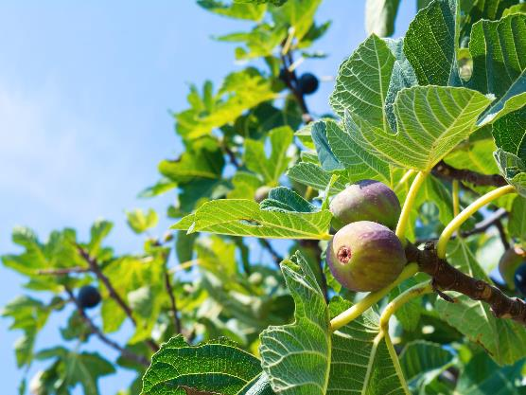
Jeremiah 8:13
“I wanted to gather my people,
as a farmer gathers a harvest;
but they are like a vine with no grapes,
like a fig tree with no figs;
even the leaves have withered.”

Slide 4
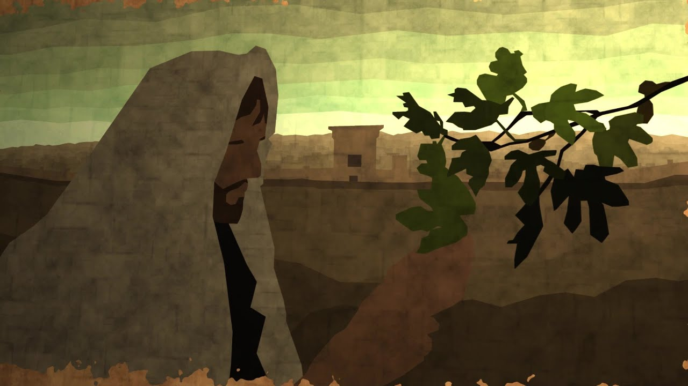
Jesus saw a fig tree… & he went to see if there were any figs But there were none, because it wasn't the season for figs.
So Jesus said to the tree,
“Never again will anyone eat fruit from this tree!”

Slide 5
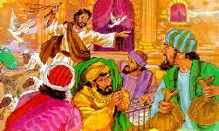
Jesus judges Jesus driving out
Jesus entered the temple & began driving out those who were buying & selling there.
Notes:
1

Slide 6
Jesus saw a fig tree… & he went to see if there were any figs But there were none, because it wasn't the season for figs.
So Jesus said to the tree,
“Never again will anyone eat fruit from this tree!”

Slide 8
…but Jesus did not sin.
Letter to the Hebrews 4:25

Slide 9
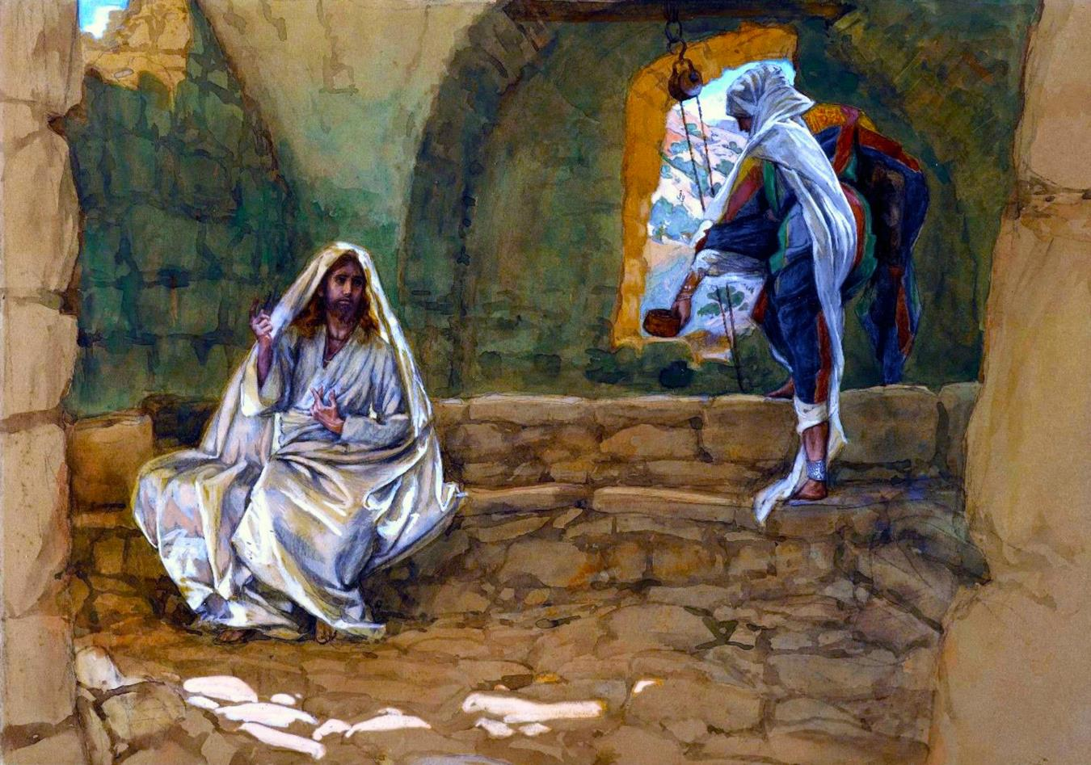
John 4:6
Jesus was tired
from the long walk
so he sat down by the well.
It was about midday.

Slide 10
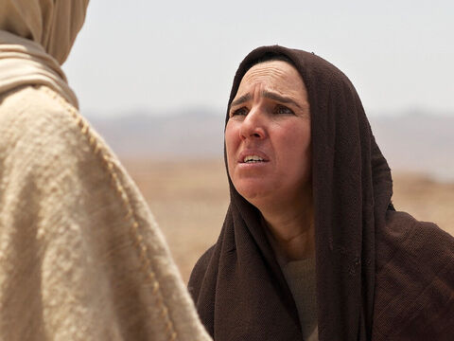
John 11:34-36
“Where have you buried him?”
“Come and see, Lord.”
Jesus wept
When the Lord saw her weeping
He was deeply moved in spirit & troubled

Slide 11
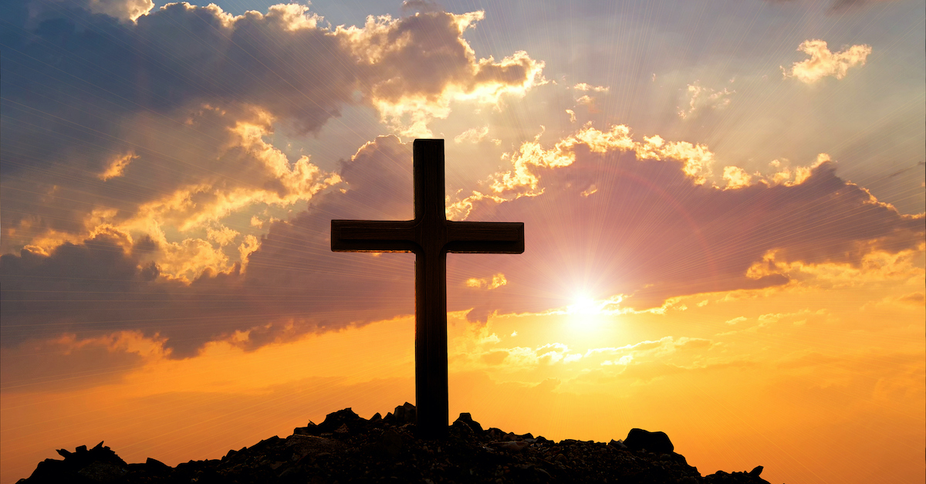
John 19:28
He knew that he had now finished his work.
To make the Scriptures come true,
Jesus said, “I am thirsty!”

Slide 12
We do not have a high priest
who is unable to feel sympathy
for our weaknesses
, a Saviour.. a Lord
…we have one who has been
tempted in every way,
just as we are
…but he did not sin.
Letter to the Hebrews 4:25

Slide 13
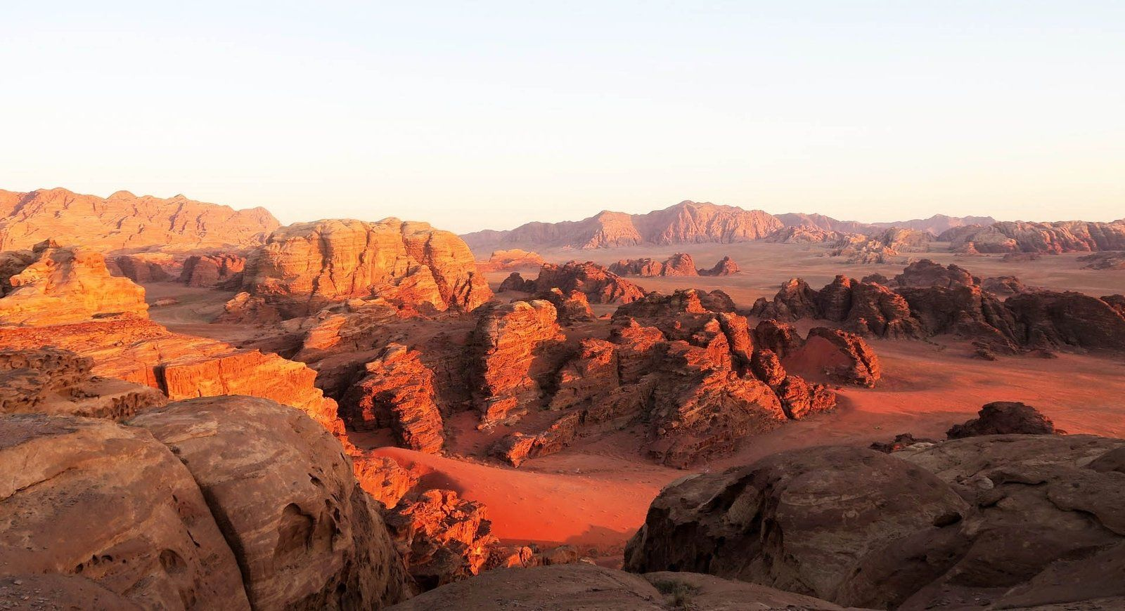
sand heat rocky
flat bare wind baked
burning sands furnace
dangerous barren rocky
‘tempted by the Devil…
He ate nothing during those days
& at the end of them
He was hungry’
He was hungry

Slide 14
…but he did not sin.

Slide 15
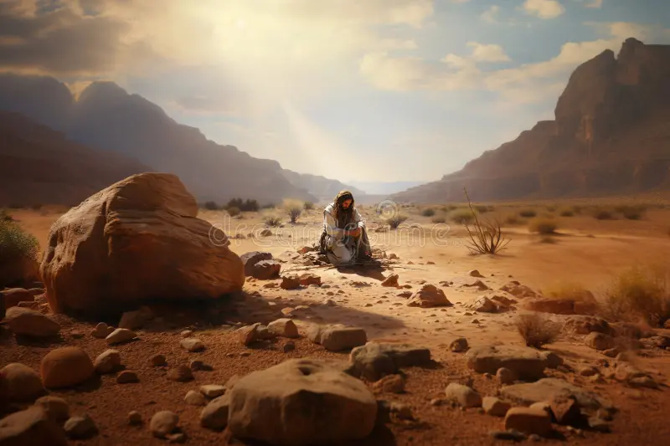
The tempter came to him and said,
‘If you are the Son of God, tell these stones to become bread.’
Jesus answered,
‘It is written: “Man shall not live by bread alone…”

Slide 16
The devil took him to a very high mountain
‘All this I will give you if you will bow down & worship me.’
Jesus said to him, ‘Away from me, Satan!
For it is written: “Worship the Lord your God, & serve him only.”’

Slide 17
The devil took him to the holy city …
‘If you are the Son of God, ‘throw yourself down’.
For it is written: “He will command his angels concerning you…”
Jesus answered him,
‘It is also written: “Do not put the Lord your God to the test.”’

Slide 18
Luke 4
Jesus answered
"It is written:
'Man does not live on bread alone.'
Deuteronomy 8:3
"It is written:
'Worship the Lord your God & serve him only.'
Deuteronomy 6:13
"It says:
'Do not put the Lord your God to the test.'
Deuteronomy 6:16

Slide 19
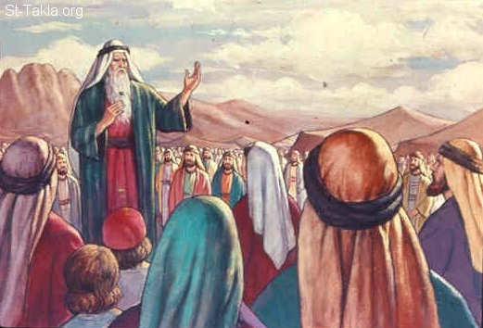

Slide 20
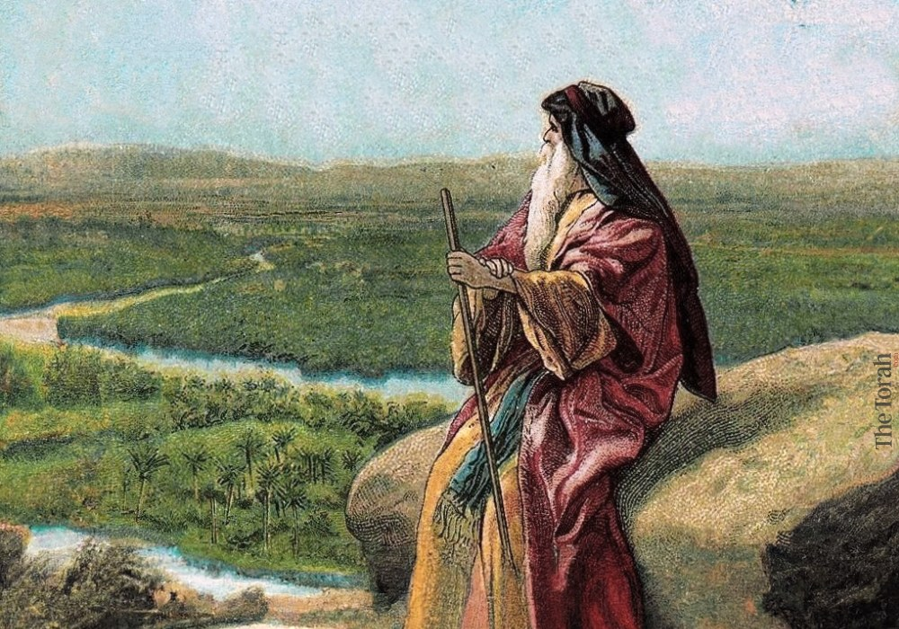

Slide 22
10 Zapovesti
Deuteronomy 4-10
‘These are the words Moses spoke to all Israel in the desert east of the Jordan’

Slide 23
10 Zapovesti
God’s 10 commands
1
One God; no equals, no rivals
2
No worship of any representation of any other power
3
God’s character & reputation must be honoured
4
One different day each week to be focused on the Lord
5
Parents to be loved, protected, & helped by their children
6
Life is sacred – no one should damage a life given by God
7
The sexual relationship is for the commitment of marriage only
8
No stealing; others’ possessions must be respected
9
No lying; truth is essential in all relationships
10
No envy of others’ possessions

Slide 24
4:37
Because he loved your ancestors … he brought you out of captivity…
by his presence & his great strength
7:9
The Lord your God is the faithful God,
keeping his covenant of love to a thousand generations
7:13
He will love you, and bless you, and increase your numbers.
10:18
He defends the cause of the orphan and the widow,
and loves the foreigner living among you…
And you are to love those who are foreigners,
for you yourselves were foreigners in Egypt.

Slide 25
We assume that a book like Deuteronomy
is a book of law
But look at it again!
It’s a book with
the love of God as it’s theme -
the love which protected &
strengthened Jesus
the love that will hold us
in his holiness

Slide 26
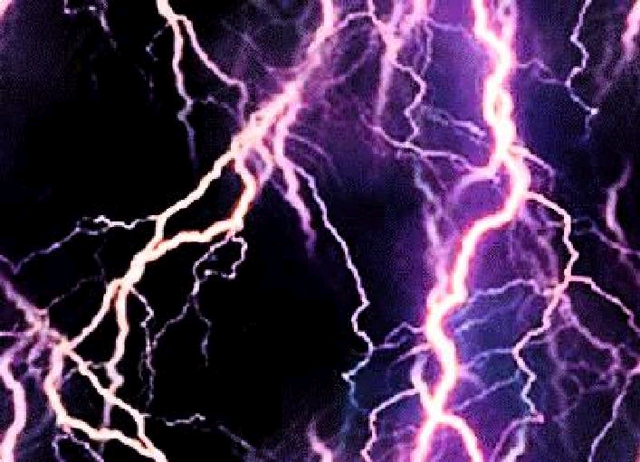
Mountain – licem u lice
Deuteronomy 5:4
“I am
the LORD your God
who brought you out of Egypt,
out of the land of slavery”
10
commandments

Slide 27
Mountain – licem u lice
Deuteronomy 5:4
Deuteronomy 7:8
It was because
the Lord loved you
that he redeemed you
from the land of slavery
10
commandments

Slide 28
Mountain – licem u lice
Deuteronomy 5:4
“I am
the LORD your God
who brought you out of Egypt,
out of the land of slavery”
grace & love
before law
- always

Slide 29
Blank
Deuteronomy 7
7:6 You are a people holy to the LORD your God…
The LORD your God has chosen you
out of all the peoples…
to be his people, his treasured possession
We must be special!
7:7 The LORD your God did not set his affection on you
& choose you because you were more numerous
than other peoples…
you were the fewest!
But it was because the LORD loved you…

Slide 30
Blank
Deuteronomy 8
8:17 You may say to yourself,
“My power & the strength of my hands
have produced this wealth for me.”
Aren’t we clever!
8:18 But remember the LORD your God,
for it is He who gives you the ability
to produce wealth,
& so confirms his covenant….

Slide 31
Blank
Deuteronomy 9
1 You are now about to dispossess nations
greater & stronger than you….
Aren’t we good?
4 …Do not say to yourself,
“The LORD has brought me here to take possession
of this land because of my righteousness.”
No, it is on account of the wickedness of these nations
5 It is not because of your righteousness
or your integrity…

Slide 32
Deuteronomy 6:4-9
Love the Lord your God
with all your heart
and with all your soul
and with all your strength.
These commandments…
are to be on your hearts.
Impress them on your children.
Talk about them when you sit at home…

Slide 33
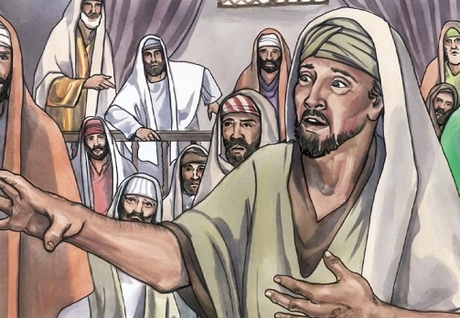
‘Of all the commandments,
which is the most important?’
Love the Lord your God with all your heart
& with all your soul & with all your strength.

Slide 34
God’s love for us…
It was because
THE LORD LOVED YOU
that he redeemed you…
Our response of love for him…
LOVE THE LORD YOUR GOD
with all your heart
and with all your soul
and with all your strength.

Slide 35
Outline of 1-3 & 4-11
And now…
Deuteronomy 10:12-13
What does the LORD your God ask of you?
to fear the LORD your God
to walk in obedience to Him
to love Him
to serve Him with all your life
to observe the LORD’s commands
…for your own good
1-4 & 4-11

Slide 36
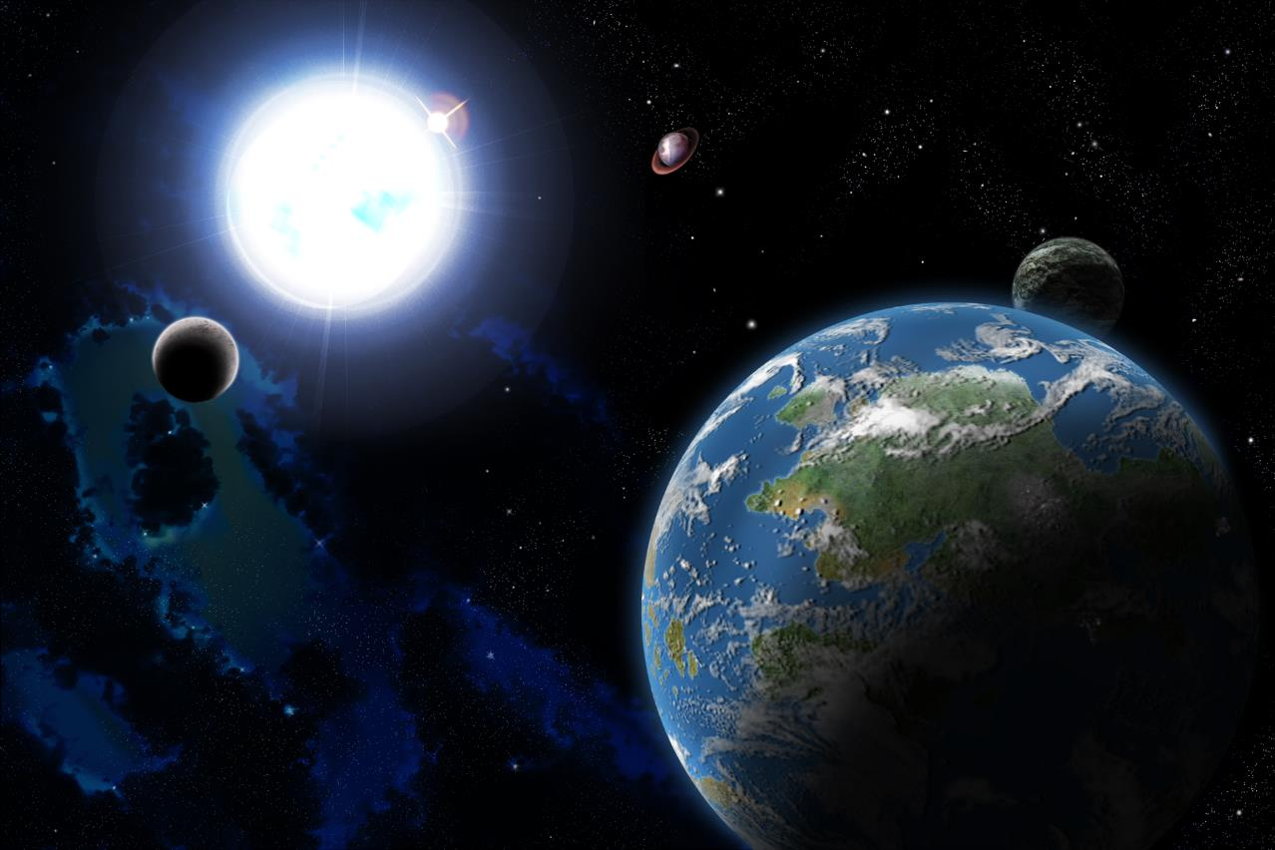
To the LORD your God
belongs
the highest heavens…
…the earth &
everything in it

Slide 37
Our ‘love’ response… to the ‘love’ of God
14 To the LORD your God belongs the highest heavens,
the earth & everything in it
17 For the Lord your God
is God of gods & Lord of lords, the great God, mighty & awesome…
15 Yet the LORD set his affection
on your forefathers & loved
them & he chose you
18 (Yet) He defends the cause of
the fatherless & the widow
& loves the foreigner
16 Therefore
circumcise your hearts…
19 Therefore,
love the foreigner…
heart
mission

Slide 38
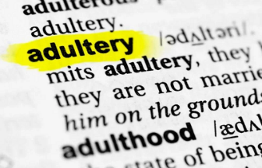
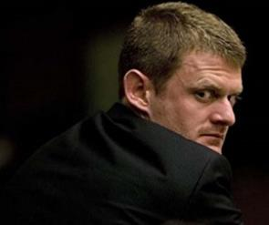
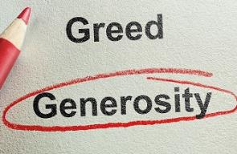

Slide 39
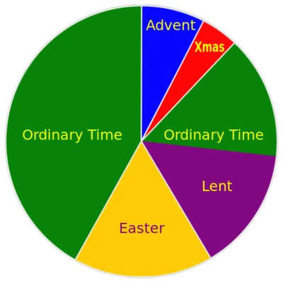
The Church Year

Slide 40
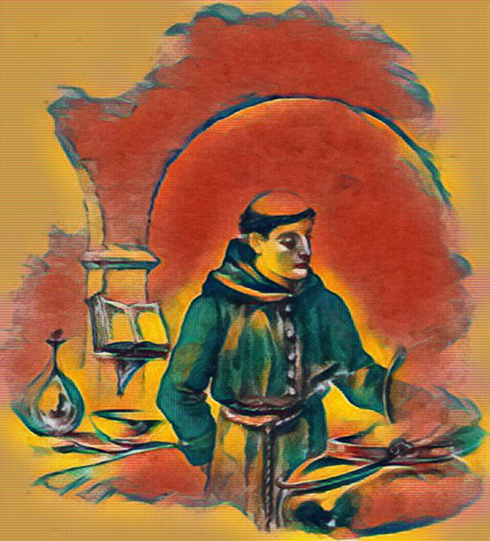
Brother Lawrence
1614-1691
“The practice
of the
presence
of God”

Slide 41
‘Brother Lawrence told me he had always been governed by love…
He resolved to make the love of God
the end of all his actions.
He was pleased when he could take up a straw from the ground
for the love of God,
seeking Him only, & nothing else,
not even His gifts.’

Slide 42
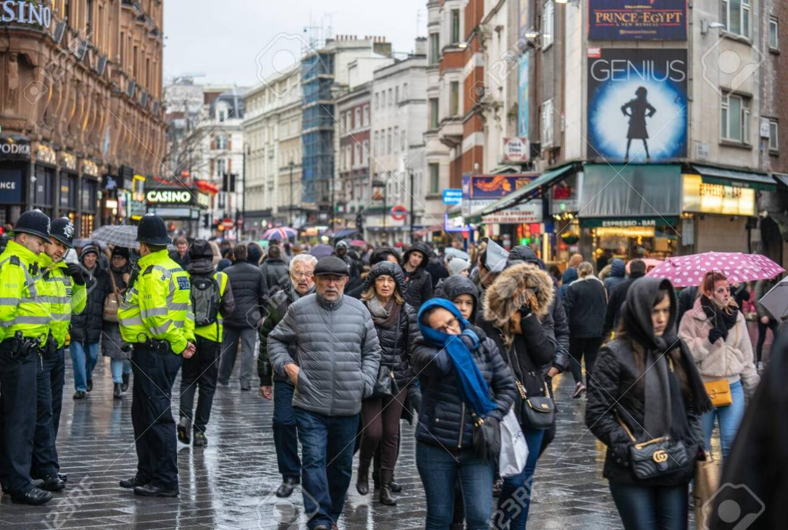
‘The practice of the presence of God’

Slide 43
‘The practice of the presence of God’

Slide 44
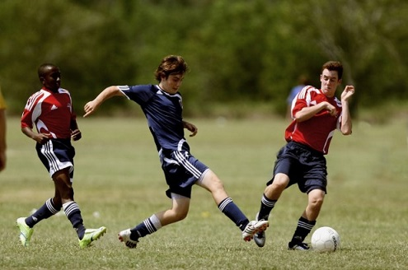
‘The practice of the presence of God’

Slide 45
‘The practice of the presence of God’

Slide 46
1 John 1:5-2:2
God is light,
and there is no darkness at all in him.

Slide 47
1 John 4:10
This is what love is:
it is not that we have loved God,
but that he loved us and
sent his Son to be the means
by which our sins are forgiven.

Slide 48
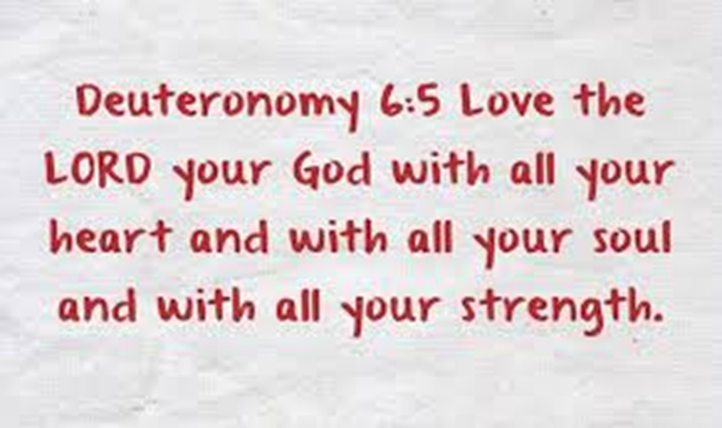
The Spiritual Battle
‘Loving God – our heart’s first defence’

