Slide 1
Get Sin Out Of Your Life

Slide 2
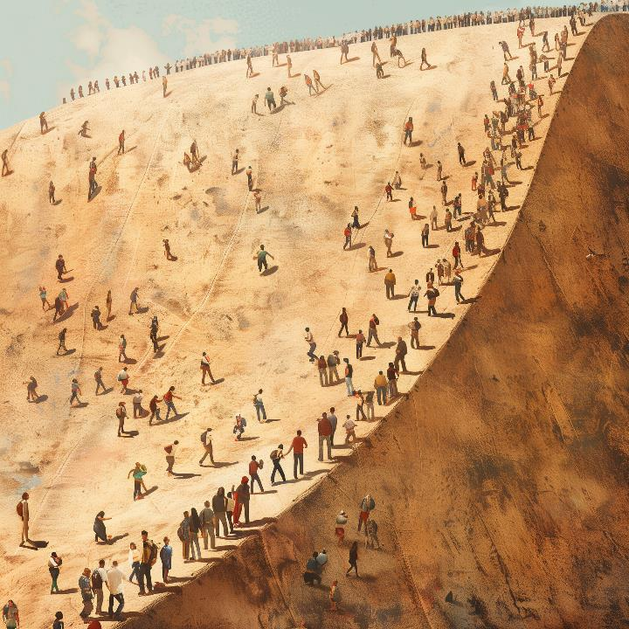

Slide 3
“…took place as examples for us, that we might not desire evil as they did.”
(1 Corinthians 10:6, ESV)

Slide 4
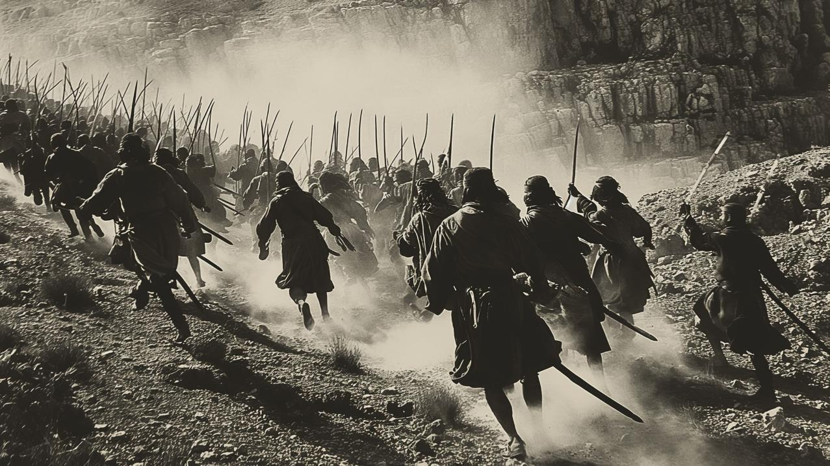

Slide 5
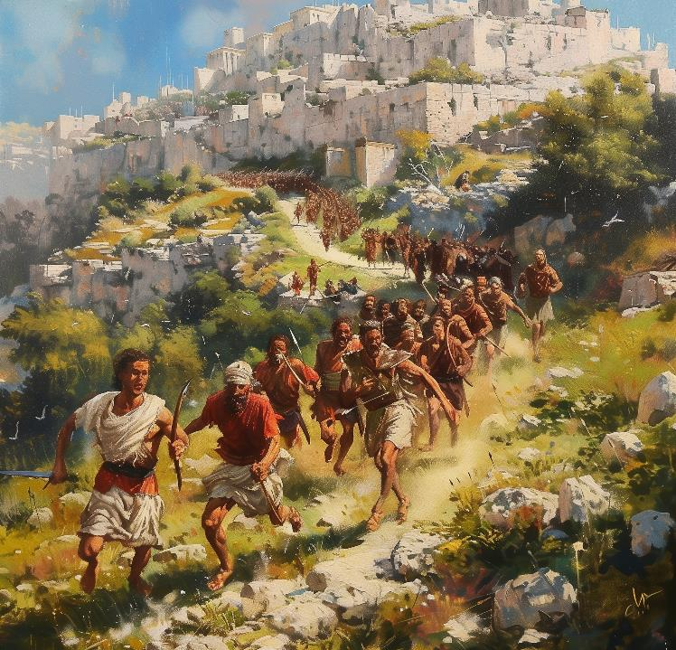
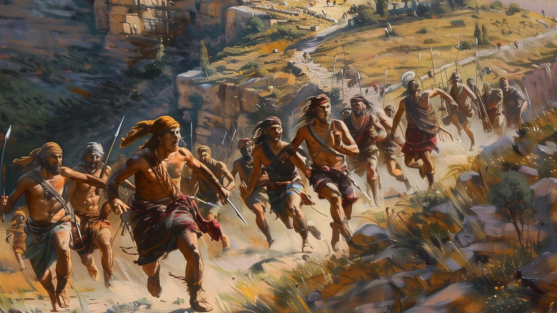

Slide 6
“…the hearts of the people melted and became as water.”
(Joshua 7:5, ESV)

Slide 7
“…the Canaanites and all the inhabitants of the land will hear of it and will surround us and cut off our name from the earth.”
(Joshua 7:9, ESV)

Slide 8
“Get up!”
(Joshua 7:10, ESV)

Slide 9
“…the city and all that is within it shall be devoted to the Lord for destruction.”
(Joshua 6:17, ESV)

Slide 10
“Israel has sinned; they have transgressed my covenant that I commanded them; they have taken some of the devoted things; they have stolen and lied and put them among their own belongings.”
(Joshua 7:11, ESV)

Slide 11
“I will be with you no more, unless you destroy the devoted things from among you.”
(Joshua 7:12, ESV)

Slide 12
“My son, give glory to the Lord God of Israel and give praise to him. And tell me now what you have done; do not hide it from me.”
(Joshua 7:19, ESV)

Slide 13
“Truly I have sinned against the Lord God of Israel, and this is what I did: when I saw among the spoil a beautiful cloak from Shinar, and 200 shekels of silver, and a bar of gold weighing 50 shekels, then I coveted them and took them. And see, they are hidden in the earth inside my tent, with the silver underneath.”
(Joshua 7:20-21, ESV)

Slide 14
And Joshua and all Israel with him took Achan the son of Zerah, and the silver and the cloak and the bar of gold, and his sons and daughters and his oxen and donkeys and sheep and his tent and all that he had. And they brought them up to the Valley of Achor.
(Joshua 7:24, ESV)

Slide 15
“Why did you bring trouble on us? The Lord brings trouble on you today.”
(Joshua 7:25, ESV)

Slide 16
“And all Israel stoned him with stones. They burned them with fire and stoned them with stones. And they raised over him a great heap of stones that remains to this day. Then the Lord turned from his burning anger.”
(Joshua 7:25-26, ESV)

Slide 17
“So Joshua burned Ai and made it forever a heap of ruins, as it is to this day. And he hanged the king the king of Ai on a tree until evening.”
(Joshua 8:28-29, ESV)

Slide 18
1. Get sin out of your life!

Slide 19
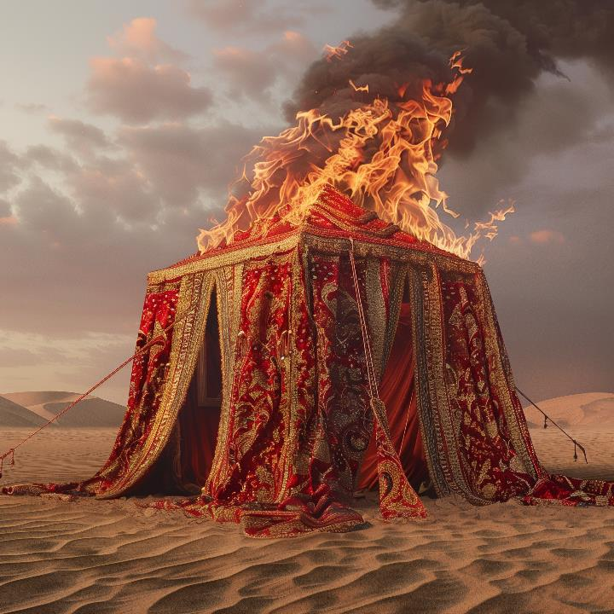

Slide 20
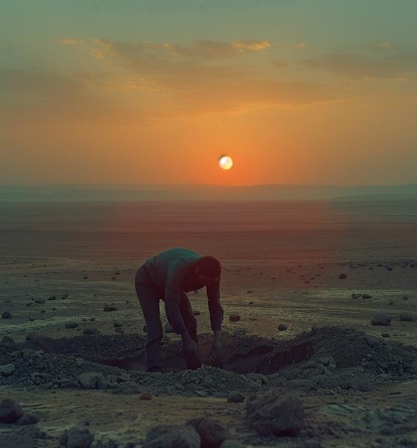
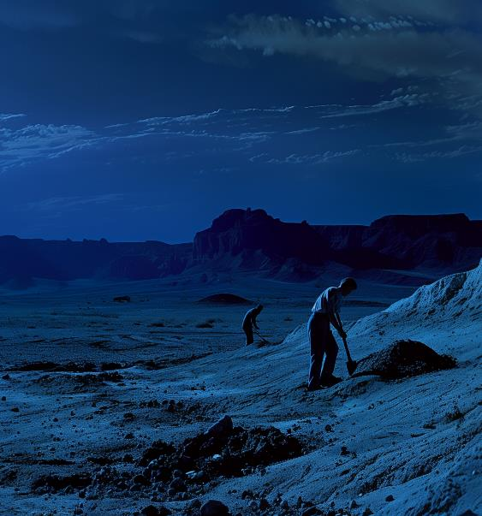

Slide 21
“Get up!”
(Joshua 7:10, ESV)

Slide 22
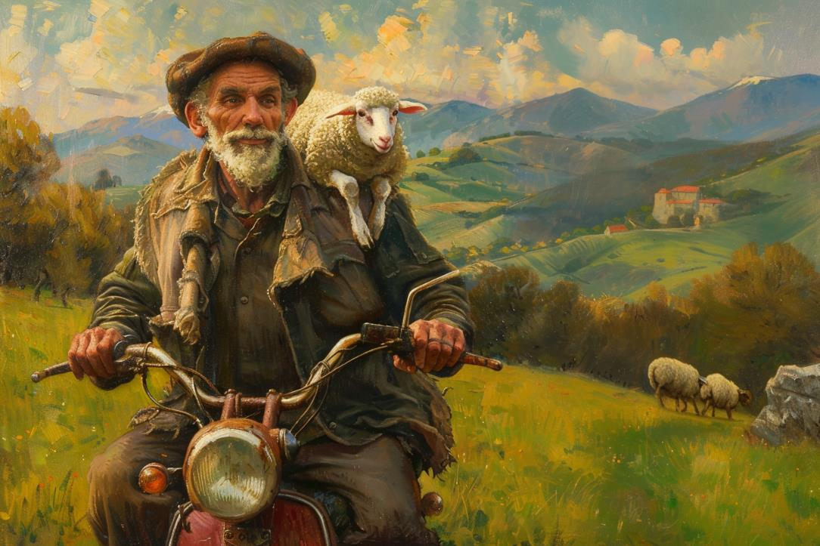

Slide 23
2. When we sin, other people get hurt.

Slide 24
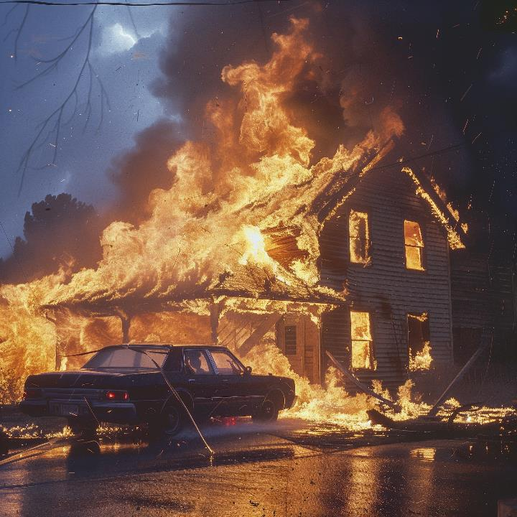

Slide 25
“If your right eye causes you to sin, tear it out and throw it away. For it is better that you lose one of your members than that your whole body be thrown into hell. “
(Matthew 5:29, ESV)

Slide 26
3. Sin makes us stupid.

Slide 27
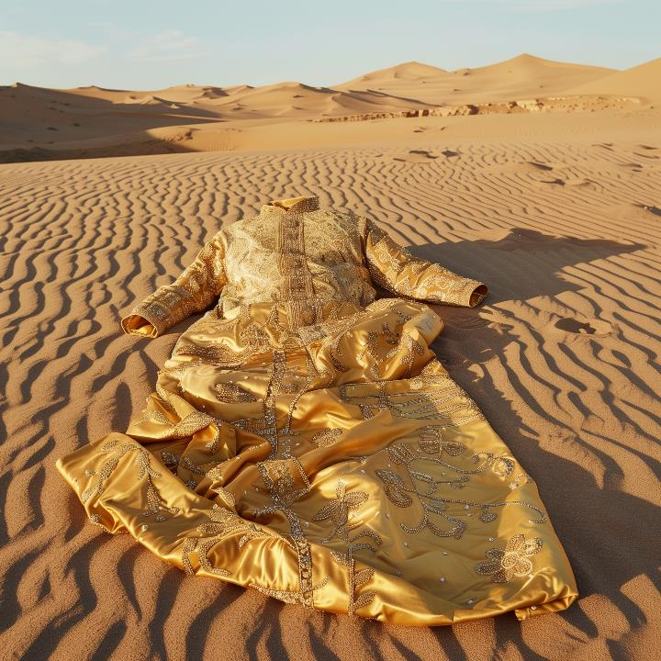

Slide 28
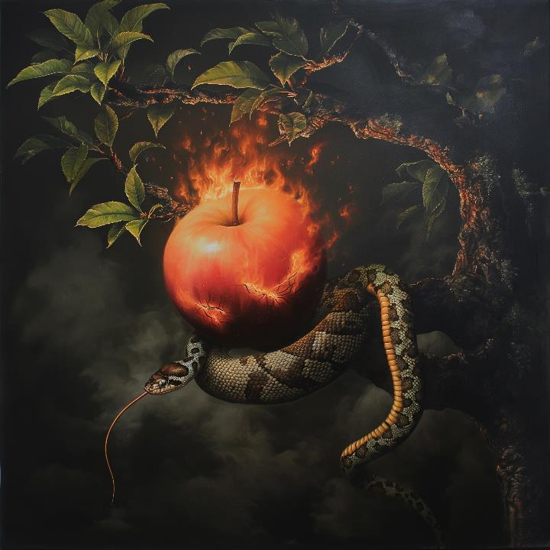

Slide 29
“Do not love the world or the things in the world. If anyone loves the world, the love of the Father is not in him. For all that is in the world - the desires of the flesh and the desires of the eyes and pride in possessions - is not from the Father but is from the world. And the world is passing away along with its desires, but whoever does the will of God abides for ever.”
(1 John 2:15-17, ESV)

Slide 30
“So when the woman saw that the tree was good for food, and that it was a delight to the eyes, and that the tree was to be desired to make one wise, she took of the tree and ate, and she also gave some to her husband who was with her, and he ate.”
(Genesis 3:6, ESV)

Slide 31
4. We need renewed minds.

Slide 32
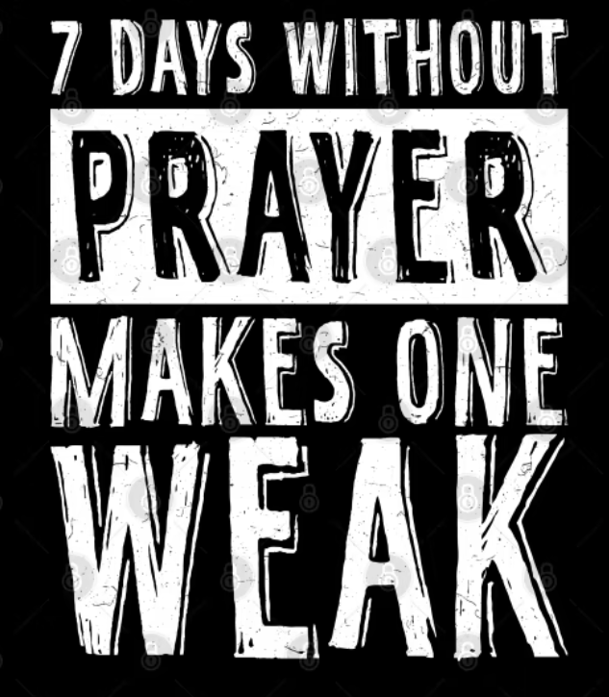

Slide 33
“Regretful remorse at the dishonour one has done to the God one is learning to love and wanting to serve.”
JI Packer, A Passion for Holiness, p.124

Slide 34
“For thus says the One who is high and lifted up,
who inhabits eternity, whose name is Holy:
‘I dwell in the high and holy place,
and also with him who is of a contrite and lowly spirit,
to revive the spirit of the lowly,
and to revive the heart of the contrite.’”
(Isaiah 57:15, ESV)

Slide 35
“…if you live according to the flesh you will die, but if by the Spirit you put to death the deeds of the body, you will live.”
(Romans 8:13, ESV)

Slide 36
“A man may easier see without eyes, speak without a tongue, than truly mortify one sin without the Spirit.”
(John Owen, Of The Mortification of Sin In Believers)

Slide 37
“Pain and grief, moans and groans, will certainly be involved, for your sin does not want to die, nor will it enjoy the killing process… You will feel you are saying goodbye to something that is so much part of you that without it you cannot live.”
(JI Packer, A Passion for Holiness, p.175)

Slide 38
“…put off your old self, which belongs to your former manner of life and is corrupt through deceitful desires, and to be renewed in the spirit of your minds, and to put on the new self, created after the likeness of God in true righteousness and holiness.”
(Ephesians 4:22-24, ESV)

Slide 39
“God loves you just the way you are, but he refuses to leave you that way. He wants you to be just like Jesus.”
(Max Lucado, Just Like Jesus)

Slide 41
“Therefore, having put away falsehood, let each one of you speak the truth with his neighbour, for we are members one of another.”
(Ephesians 4:25, ESV)

Slide 42
“Let no corrupting talk come out of your mouths, but only such as is good for building up, as fits the occasion, that it may give grace to those who hear. And do not grieve the Holy Spirit of God, by whom you were sealed for the day of redemption. Let all bitterness and wrath and anger and clamour and slander be put away from you, along with all malice. Be kind to one another, tender-hearted, forgiving one another, as God in Christ forgave you.”
(Ephesians 4:28-32, ESV)

Slide 43
5. Disobedience leads to defeat.

Slide 44
“Just as one traitor can put a whole army at risk, so the sin of an individual can place a whole community under the discipline of God.”
Spiritual Formation Bible

Slide 45
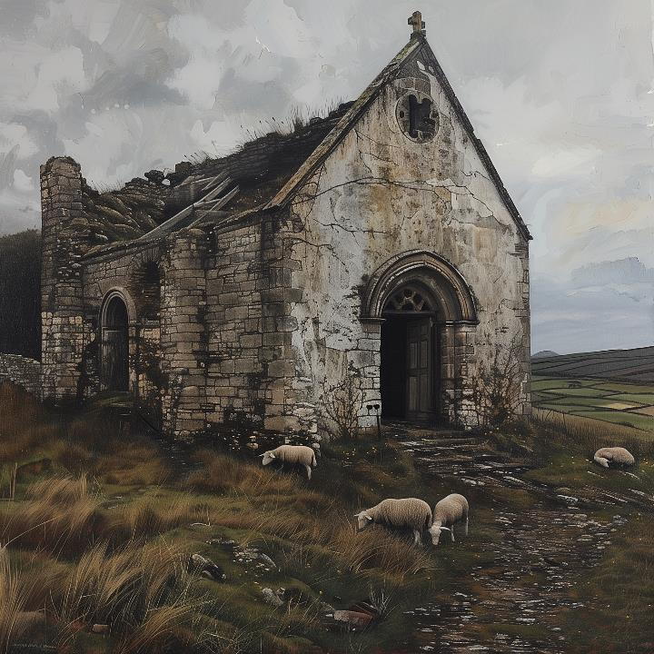

Slide 46
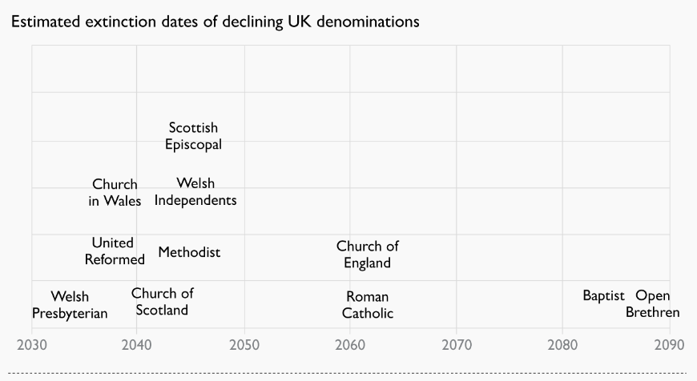

Slide 47
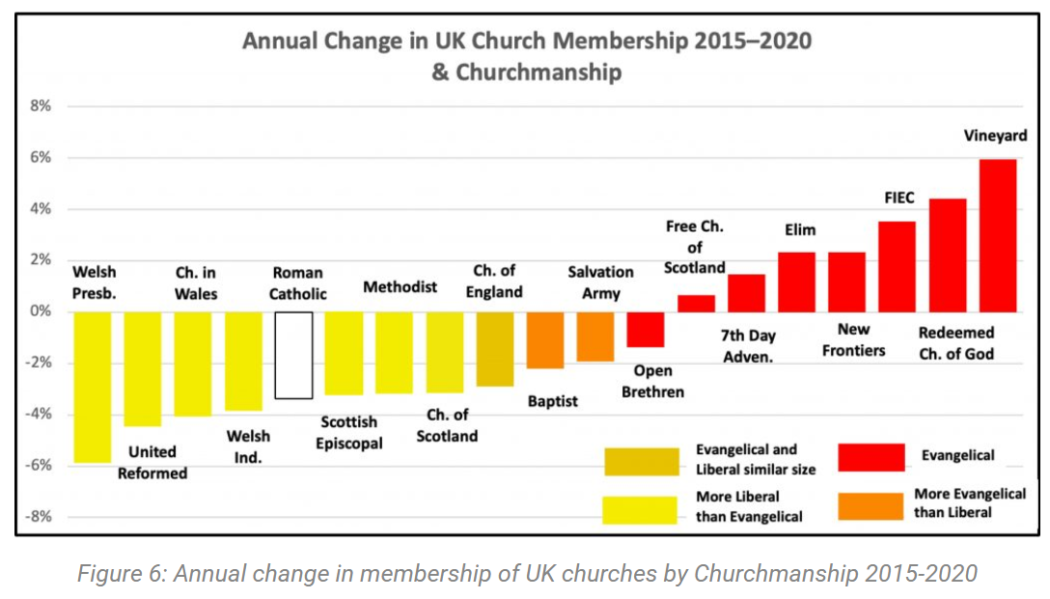

Slide 48
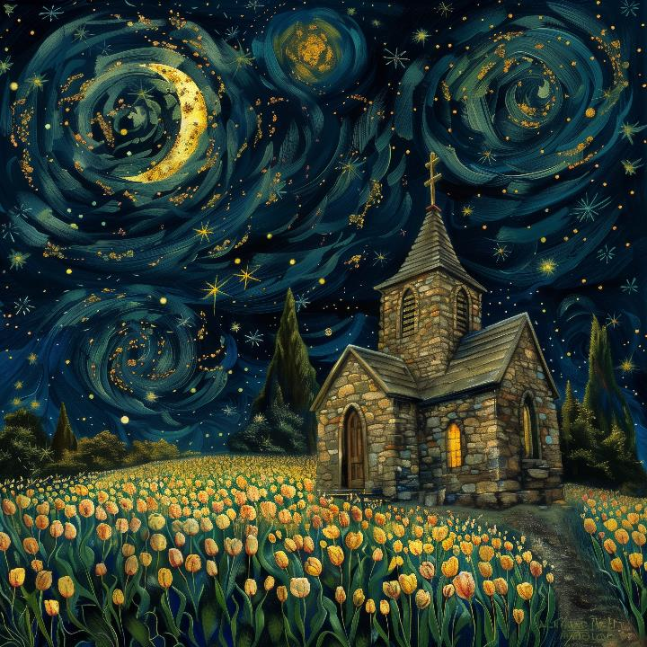

Slide 49
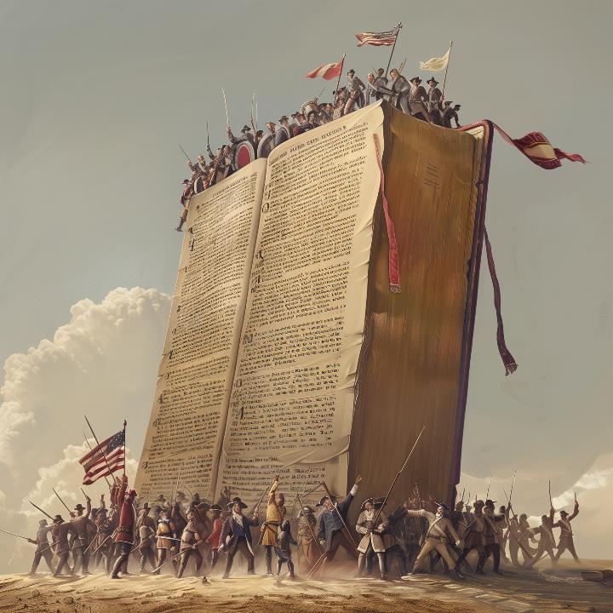

Slide 51
6.God’s wrath is real.

Slide 52
“Just as the weeds are gathered and burned with fire, so will it be at the close of the age. The Son of Man will send his angels, and they will gather out of his kingdom all causes of sin and all law-breakers, and throw them into the fiery furnace. In that place there will be weeping and gnashing of teeth.”
(Matthew 13:40-42, ESV)

Slide 53
“…turned to God from idols to serve the living and true God, and to wait for his Son from heaven, whom he raised from the dead, Jesus who delivers us from the wrath to come.”
(1 Thessalonians 1:9-10, ESV)

Slide 54
A God without wrath brought man without sin into a kingdom without judgment through the ministrations of a Christ without a cross.”
(H Richard Niebuhr, The Kingdom of God in America, 1938)

Slide 55
7. Jesus saves

Slide 56
“If we confess our sins, he is faithful and just to forgive us our sins and to cleanse us from all unrighteousness.”
(1 John 1:9, ESV)

Slide 57
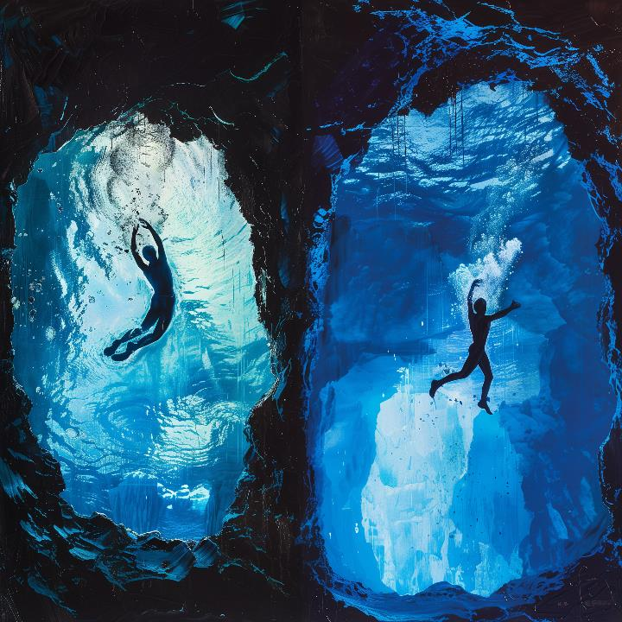

Slide 58
“…I will give her vineyards and make the Valley of Achor a door of hope.”
(Hosea 2:15, ESV)

Slide 60
“My little children, I am writing these things to you so that you may not sin. But if anyone does sin, we have an advocate with the Father, Jesus Christ the righteous. He is the propitiation for our sins, and not for ours only but also for the sins of the whole world. And by this we know that we have come to know him, if we keep his commandments.”
(1 John 2:1-3, ESV)

