Slide 7
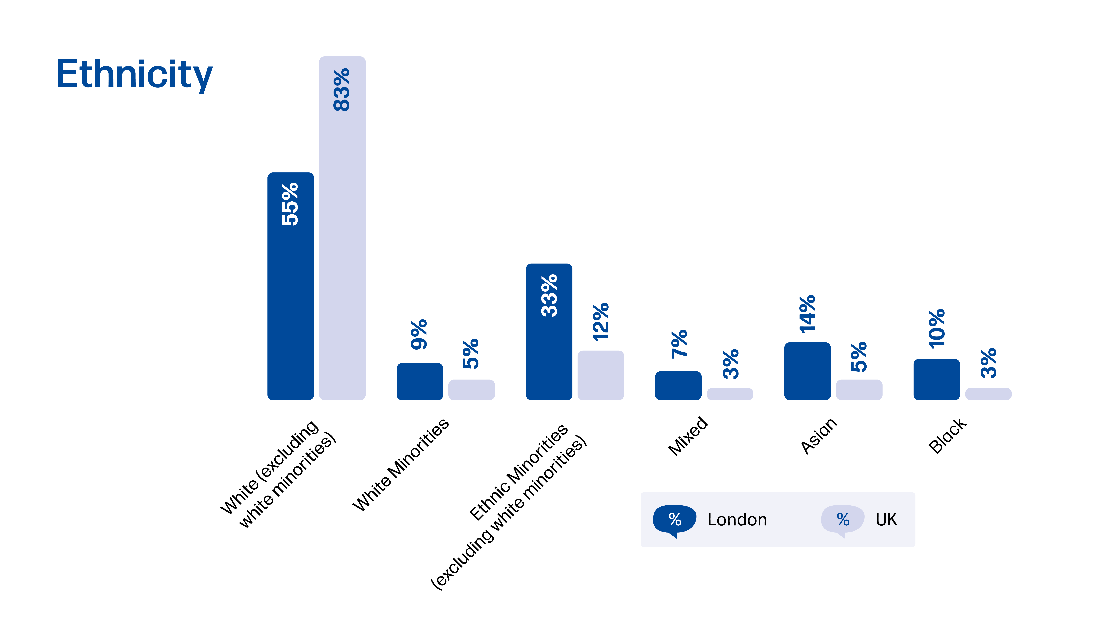

Slide 8
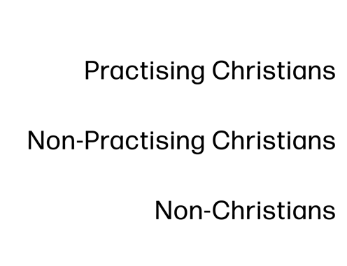

Slide 12
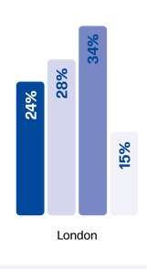
Don’t know

Slide 13
What challenges you?
What is different to what you would have expected?

Slide 20
46%
64%
38%
29%
8%
4%
8%
London in grey

Slide 22
(2%)
(40%)
(58%)
London in brackets

Slide 31
The core opportunity exists amongst parents with children under 5s, that we call Fringe parents (62%). However, there is a sizeable group of Unreached parents who say they would be open to receiving an invitation to activities. If more is done to attract these ‘warm’ Unreached parents, the size of opportunity could increase further.
Base: All parents (1182; weighted data)
Parent Outreach Survey for Talking Jesus

Slide 32
Make Reality great again
Dr Johannas Hartl
HTB Leadership conference 2024
https://www.youtube.com/watch?v=P4vASfEV_aQ&t=2s

Slide 37
What challenges you?
What is different to what you would have expected?
How could this impact your evangelism strategy?
What one thing will YOU do differently?
Who else needs to know this?

