Slide 1
Luke 20: 27-40
Jesus and the Sadducees

Slide 2
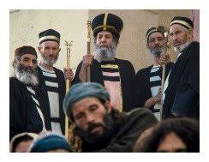
The Sadducees
Only the 5 Books of Moses
Theological Minimalists
Death is the end

Slide 3
Levirate Marriage (Deuteronomy 25:5)
⁵ If brothers are living together and one of them dies without a son, his widow must not marry outside the family. Her husband’s brother shall take her and marry her and fulfil the duty of a brother-in-law to her. ⁶ The first son she bears shall carry on the name of the dead brother so that his name will not be blotted out from Israel.

Slide 4
What will resurrection look like?

Slide 5
The Sadducees know (i) Neither the power of God…
A New Reality

Slide 6
…(ii) Nor The Scriptures
Exodus 3: “I am the God of your Father, the God of Abraham, the God of Isaac and the God of Jacob
Jesus quotes:

Slide 7
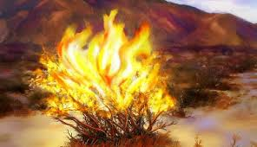
A confidence boost for moses and the Israelites?
God’s name – “I AM”
Faithfulness to the Patriarchs

Slide 8
Jesus highlights the implications
God’s credibility depends on…
…the Patriarchs being alive right now with God
…saints who have gone before being alive right now with God
…the resurrection of the dead

Slide 9
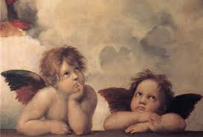
Faith in The God of Power and Faithfulness
Power to make A new Reality
Faithfulness to see us through

