Slide 1
Ephesians 4:1-16
Therefore I, a prisoner for serving the Lord, beg you to lead a life worthy of your calling, for you have been called by God. ² Always be humble and gentle. Be patient with each other, making allowance for each other’s faults because of your love. ³ Make every effort to keep yourselves united in the Spirit, binding yourselves together with peace. ⁴ For there is one body and one Spirit, just as you have been called to one glorious hope for the future.

Slide 2
Ephesians 4:1-16
⁵ There is one Lord, one faith, one baptism, ⁶ one God and Father of all, who is over all, in all, and living through all.
⁷ However, he has given each one of us a special gift through the generosity of Christ. ⁸ That is why the Scriptures say,
“When he ascended to the heights, he led a crowd of captives and gave gifts to his people.”

Slide 3
Ephesians 4:1-16
⁹ Notice that it says “he ascended.” This clearly means that Christ also descended to our lowly world. ¹⁰ And the same one who descended is the one who ascended higher than all the heavens, so that he might fill the entire universe with himself.
¹¹ Now these are the gifts Christ gave to the church: the apostles, the prophets, the evangelists, and the pastors and teachers. ¹² Their responsibility is to equip God’s people to do his work and build up the church, the body of Christ.

Slide 4
Ephesians 4:1-16
¹³ This will continue until we all come to such unity in our faith and knowledge of God’s Son that we will be mature in the Lord, measuring up to the full and complete standard of Christ.
¹⁴ Then we will no longer be immature like children. We won’t be tossed and blown about by every wind of new teaching. We will not be influenced when people try to trick us with lies so clever they sound like the truth.

Slide 5
Ephesians 4:1-16
¹⁵ Instead, we will speak the truth in love, growing in every way more and more like Christ, who is the head of his body, the church. ¹⁶ He makes the whole body fit together perfectly. As each part does its own special work, it helps the other parts grow, so that the whole body is healthy and growing and full of love.

Slide 6
Ephesians 4:1-16
A clear understanding of God’s heart and vision for his Church
A shared sense of God’s heart and vision for us at NMBC
Collective anticipation as to what God might have in store for us moving forwards…

Slide 7
God’s heart and vision for his Church throughout history
Identity
Calling
Gifting
Mission

Slide 8
Identity
The body of Christ (v12), with Christ as the head (v15), perfectly fitted together (v16) and united in Spirit (v3)
Humble, gentle and patient (v2), full of love (v16) and forgiveness (v2)
Desiring to grow more like Christ (v15) and to be united in peace (v3)

Slide 9
Calling
Comes from God himself, to a life worth living (v1)
To a glorious hope for the future (v4)
To one faith, one Lord, one God (vv5-6)
Baptised (v5) in the name of Father, Son and Holy Spirit

Slide 10
Gifting
Special gifts, through the generosity of Christ (v7)
Embodied in many different types of people (v11)
To be used responsibly to build up the church (v11)
Gifts of faith and knowledge (v13), promoting unity (vv4-6, 13), within diversity (v11)

Slide 11
Mission
To be mature in the Lord (v13), not tossed and blown about (v14)
To speak the truth in love and to grow to be more like Christ (v15)
To proclaim the gospel (vv11, 15)
To love and serve one another (v16) so that the whole church might be healthy and growing (v16)

Slide 12
God’s heart and vision for NMBC, past and present
Understanding the past is:
the key to making sense of the present
important in seeking to act wisely in the future

Slide 13
Identity
“To be a Christ-centred community, which practises a ministry of encouragement”
(NMBC vision statement 2001-2009)

Slide 14
Identity
“To become a Christ-centred minister, who practises a ministry of encouragement”
(My “philosophy of ministry”, emerging from training at Spurgeon’s 2021-)

Slide 15
Identity
is rooted in past experiences
is dynamic, changing and developing over time
should be Christ-focussed and Spirit informed

Slide 16
Identity
“A group of ordinary people on a journey, exploring, experiencing and expressing the heart of God”
(NMBC vision statement 2009 - present)

Slide 17
Identity
Collective
Progressive
Adventurous
Evangelistic

Slide 18
Calling
Discipleship
Disciple-making
“To love God and live generously”

Slide 19
Gifting
Apostles, prophets, evangelists, pastors and teachers
Musicians and artists
CYP leaders and CYP themselves
Elders and deacons
Serving behind the scenes
Prayer

Slide 20
Mission
Building relationship with the living God
Building relationships with one another
Building relationships with those who don’t yet know God
Amongst us, on our doorstep and across the world

Slide 21
Words of wisdom…
“Always keep the big picture in mind – you are greatly loved by Jesus and your job is to love Him and others in return. The rest is detail.”
(Bear Grylls, To My Sons)

Slide 22
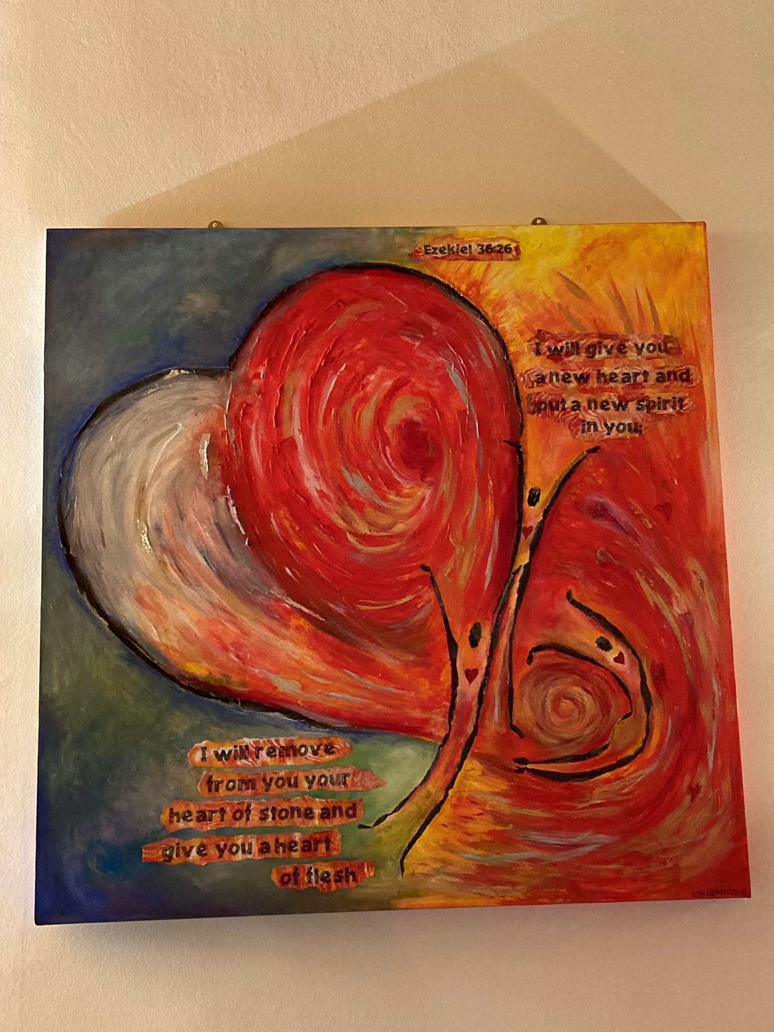
God’s heart and vision for NMBC, into the future…

Slide 23
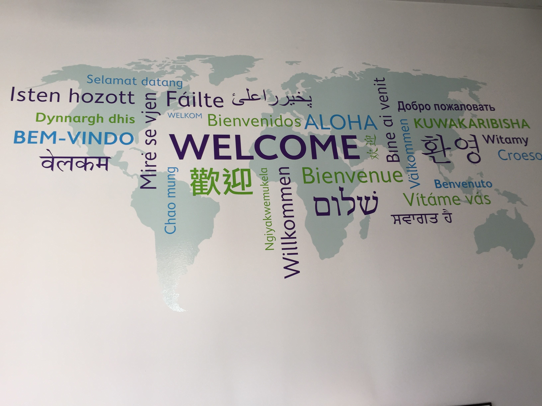
God’s heart and vision for NMBC, into the future…

Slide 24
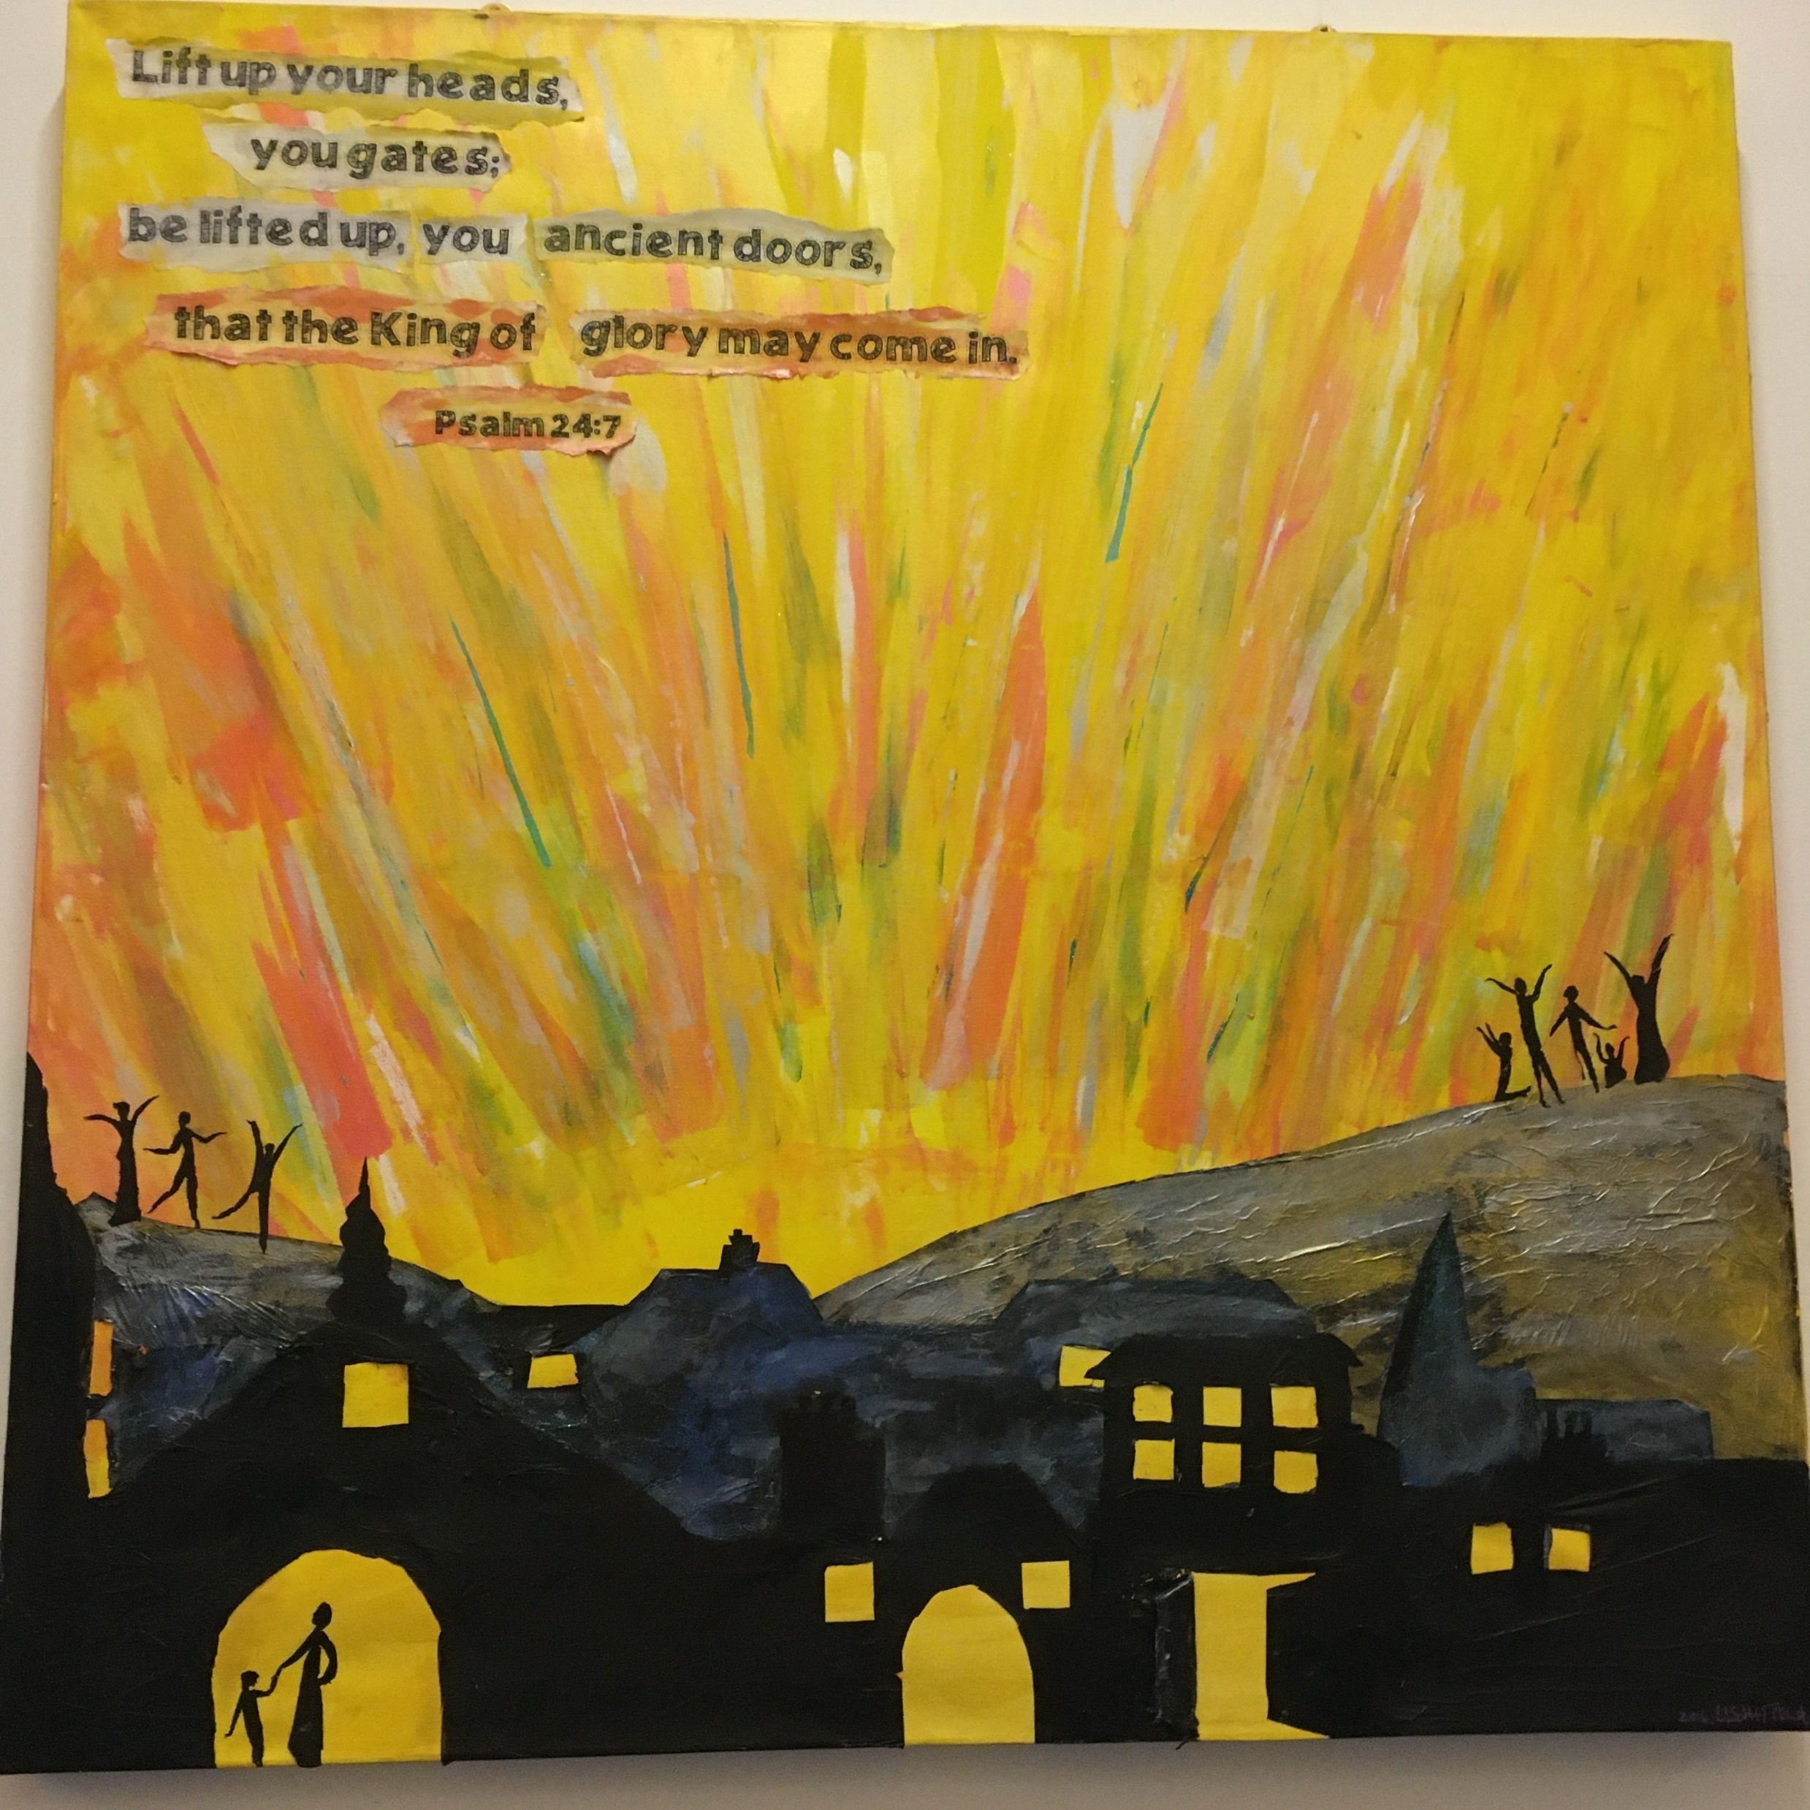
God’s heart and vision for NMBC, into the future…

Slide 25
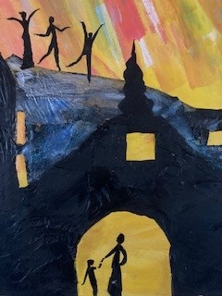
God’s heart and vision for NMBC, into the future…

Slide 26
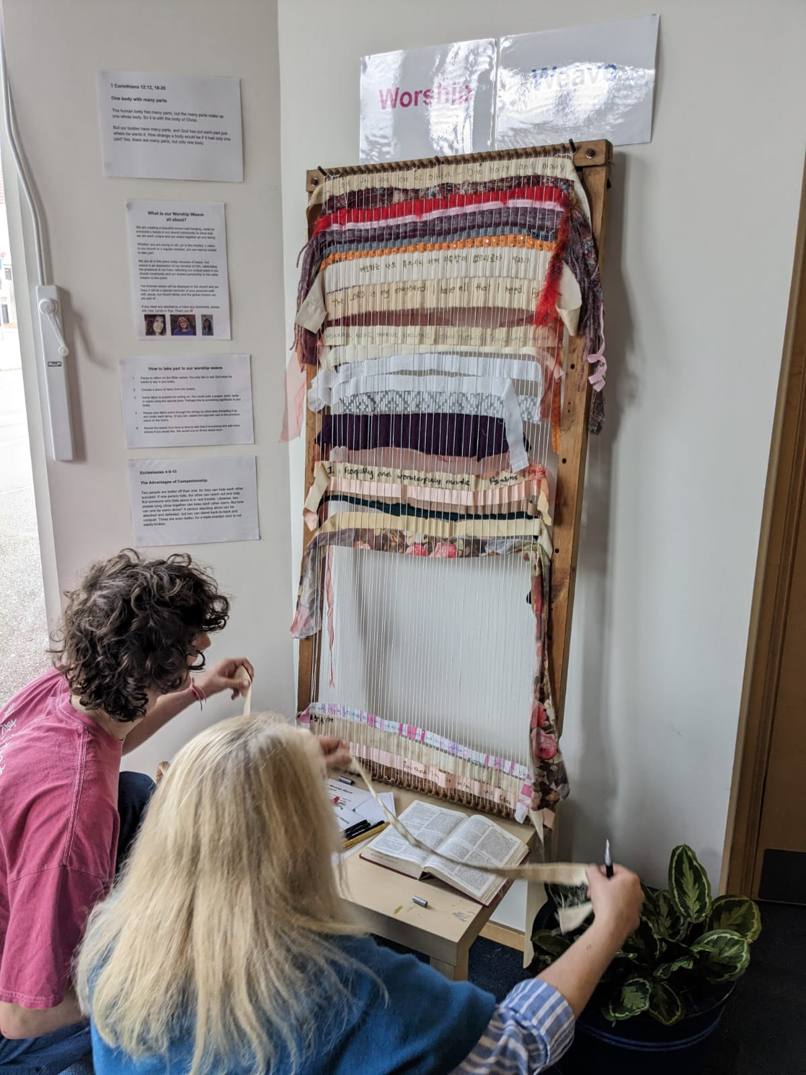
God’s heart and vision for NMBC, into the future…

Slide 27
God’s heart and vision for NMBC, past, present and future…
…Every Member Ministry…

Slide 28
God’s heart and vision for NMBC, past, present and future…
“Ministry takes place when divine resources, meet human need, through loving channels for the glory of God.”
(Warren Wiersbe, On Being a Servant of God)

Slide 29
