Slide 1
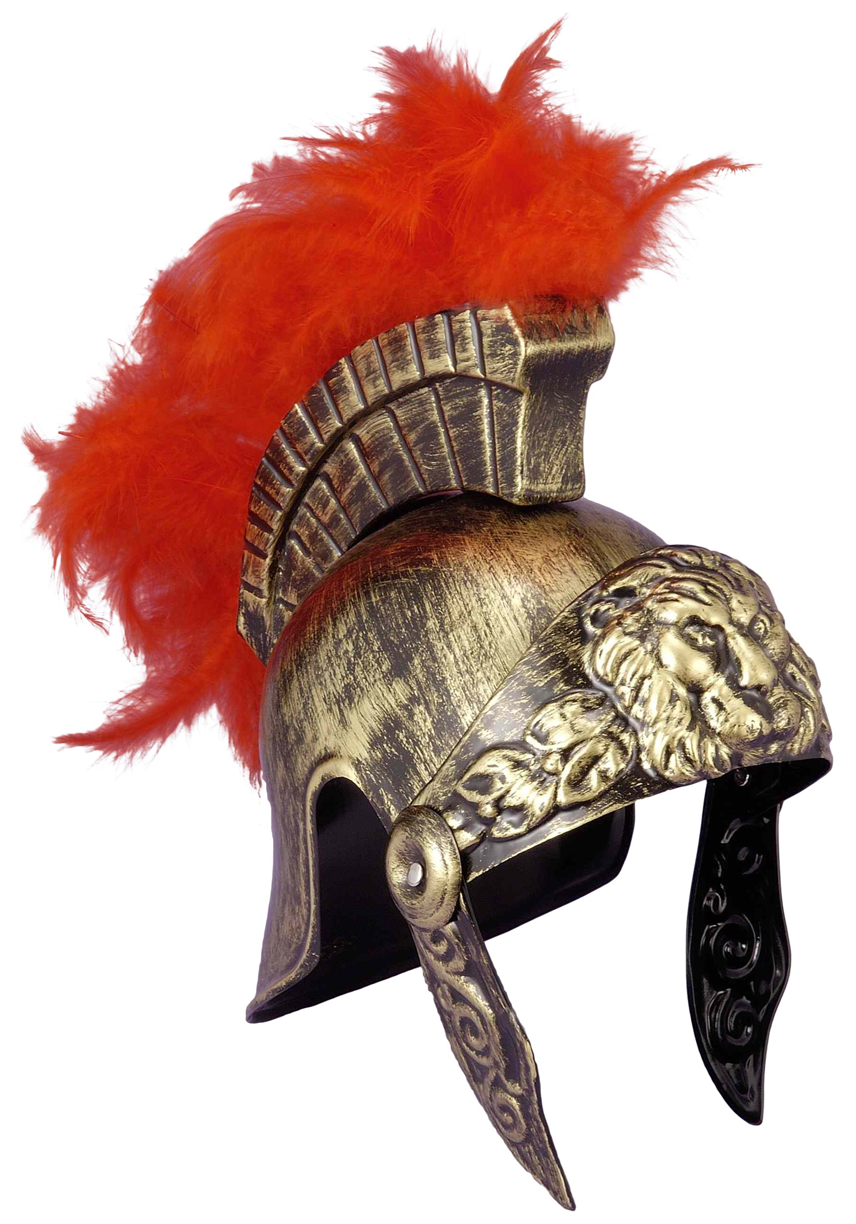
The HELmet of Salvation
Ephesians 6 v 17

Slide 2
Ephesians 6 v 10-18 Finally, be strong in the Lord and in his mighty power. ¹¹ Put on the full armour of God, so that you can take your stand against the devil’s schemes. ¹² For our struggle is not against flesh and blood, but against the rulers, against the authorities, against the powers of this dark world and against the spiritual forces of evil in the heavenly realms. ¹³ Therefore put on the full armour of God, so that when the day of evil comes, you may be able to stand your ground, and after you have done everything, to stand. ¹⁴ Stand firm then, with the belt of truth buckled around your waist, with the breastplate of righteousness in place, ¹⁵ and with your feet fitted with the readiness that comes from the gospel of peace. ¹⁶ In addition to all this, take up the shield of faith, with which you can extinguish all the flaming arrows of the evil one. ¹⁷ Take the helmet of salvation and the sword of the Spirit, which is the word of God. ¹⁸ And pray in the Spirit on all occasions with all kinds of prayers and requests. With this in mind, be alert and always keep on praying for all the Lord’s people.

Slide 3
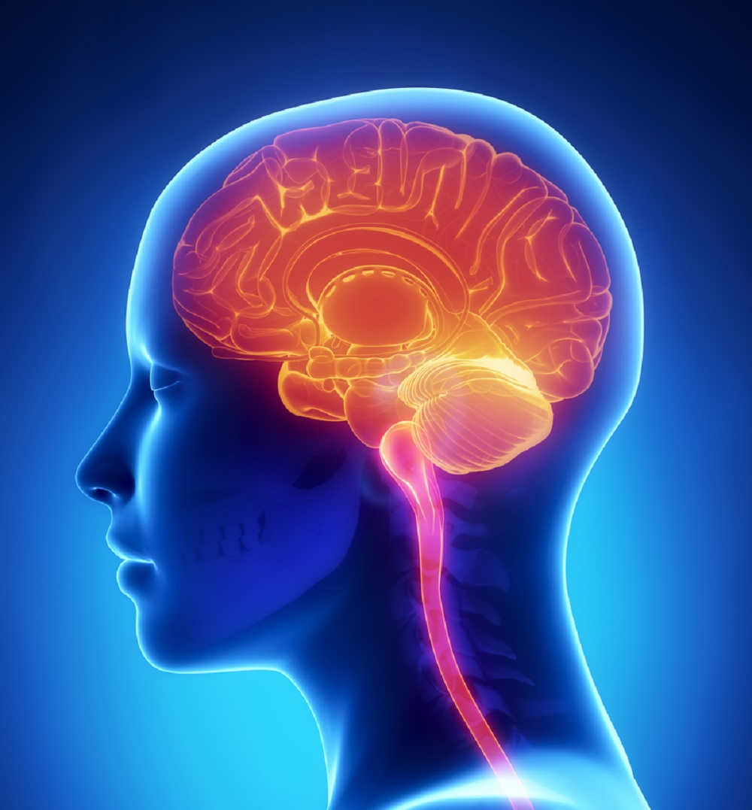
“ A three pound universe processing 70,000 thoughts each day”
2 Cor 10 v 4 -5 The weapons we fight with are not the weapons of the world. On the contrary they have divine power to demolish strongholds. We demolish arguments and every pretension that sets itself up against the knowledge of God, and we take captive every thought to make it obedient to Christ.
What’s our mindset this morning – how does the helmet of salvation help to protect us?

Slide 4
A Salvation Mindset
Who am I ?
What am I doing?
Where am I going?

Slide 5
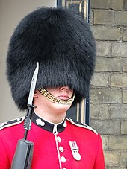
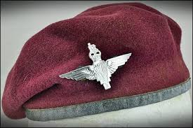
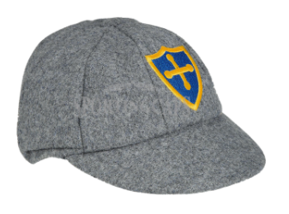
What do these pictures have in common?

Slide 6
What do these pictures have in common?
They show who the wearers belong to…

Slide 7
A Salvation Mindset --Who am I ?
The answer is whose am I ?
Isaiah 43 v 1 Fear not I have redeemed you, I have summoned you by name – you are mine.
Isa 54 v 5 Your maker is your husband – the Lord almighty is his name- the Holy one of Israel is your Redeemer.
Gal 4 v 4-7 But when the set time had fully come, God sent his Son, born of a woman, born under the law, ⁵ to redeem those under the law, that we might receive adoption to sonship.^{[a]} ⁶ Because you are his sons, God sent the Spirit of his Son into our hearts, the Spirit who calls out, “Abba,^{[b]} Father.” ⁷ So you are no longer a slave, but God’s child; and since you are his child, God has made you also an heir.

Slide 8
A Salvation Mindset
Who am I ? Know that I am God’s child
What am I doing? Pursuing goodness
Where am I going?

Slide 9
A Salvation Mindset
What am I doing? Pursuing goodness –
It reflects God’s passion…
It brings glory to God
We are glorified in him too

Slide 10
What am I doing? – Never tire of doing what is right 2 Thess 3 v 13
Is 59 v 17 The Lord looked and was displeased that there was no justice - he saw there was no one to intervene, so his own arm worked salvation for him and his own righteousness sustained him – he put on righteousness as his breastplate and the helmet of salvation on his head.
Is 51 v 5 My righteousness draws near speedily, my salvation is on the way and my arm will bring justice to the nations
Is 51 v 6 My salvation will last for ever, my righteousness will never fail
Is 51 v8 My righteousness will last for ever, my salvation through all generations

Slide 11
What am I doing? “ Never tire of doing what is right
2 Thess 1 v 11 and 12
With this in mind, we constantly pray for you, that our God may make you worthy of his calling, and that by his power he may bring to fruition your every desire for goodness and your every deed prompted by faith. ¹² We pray this so that the name of our Lord Jesus may be glorified in you, and you in him, according to the grace of our God and the Lord Jesus Christ.

Slide 12
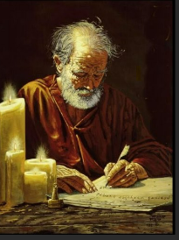
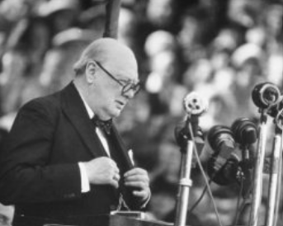
What am I doing? “ Never tire of doing what is right
Keep on….
Keeping on
going
As for you brothers ,
never tire of doing
what is right
2Thess 3 v 13
“K B O”
then your righteousness will go before you and the glory of the Lord will be your rear guard
Isaiah 58 v 6

Slide 13
A Salvation Mindset
Who am I ? – I am God’s child
What am I doing? I am pursuing goodness
Where am I going?

Slide 14
A Salvation Mindset - Where am I going?
Jesus said “ I am going to prepare a place for you, that you may be where I am” John 14 v 3
“Today, you will be with me in Paradise” Luke 23 v 43
Paul writes
“ I pray that you may know the hope to which he has called you, the riches of his glorious inheritance in the saints
Ephesians 1 v 18
13% of non Christians in the UK are asking
What happens when I die?

Slide 15
A Gift not a mindset- it’s the Lord’s helmet
The Lord’s own arm worked salvation for him, and his own righteousness sustained him.
He put on righteousness as his breastplate , and the helmet of salvation on his head
Isaiah 59 v16,17

Slide 16
But we ought always to thank God for you, brothers and sisters loved by the Lord, because God chose you as firstfruits^{[a]} to be saved through the sanctifying work of the Spirit and through belief in the truth. ¹⁴ He called you to this through our gospel, that you might share in the glory of our Lord Jesus Christ.
¹⁵ So then, brothers and sisters, stand firm and hold fast to the teachings^{[b]} we passed on to you, whether by word of mouth or by letter.
¹⁶ May our Lord Jesus Christ himself and God our Father, who loved us and by his grace gave us eternal encouragement and good hope, ¹⁷ encourage your hearts and strengthen you in every good deed and word.
2 Thessalonians 2 v 13-17

