Slide 1
NMBC
AUTUMN 2024

Slide 2
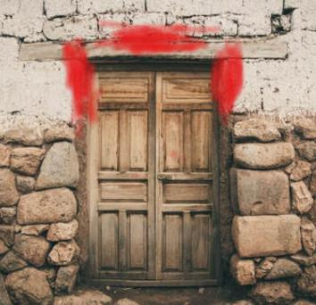
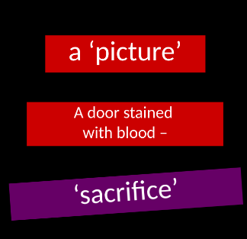

Slide 3
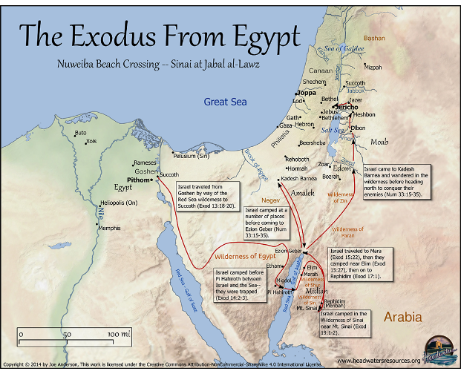

Slide 4
Exodus 19
Trusting the provision of God

Slide 6
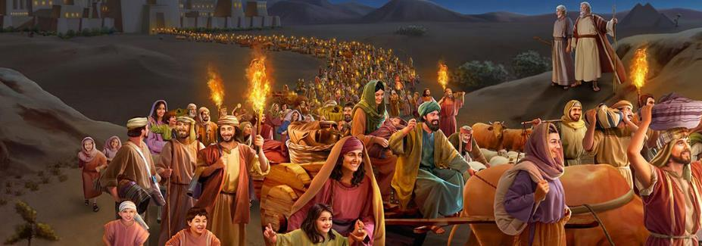

Slide 7
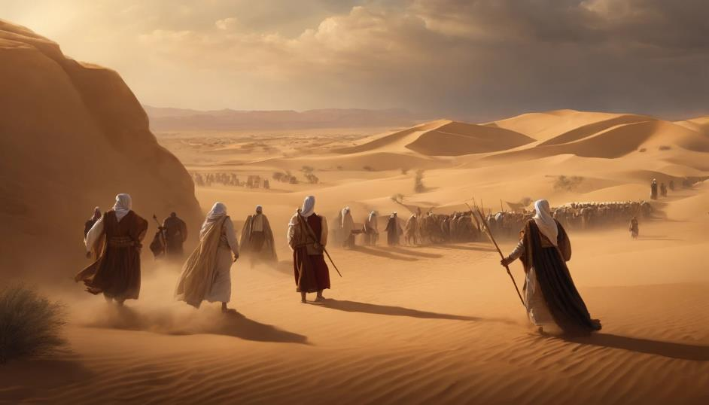
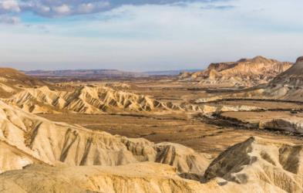
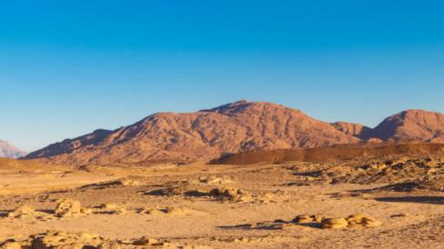
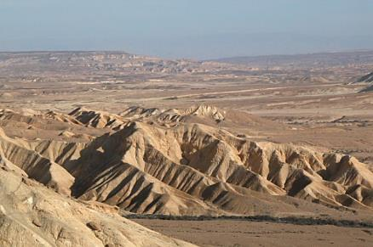

Slide 8
?

Slide 9
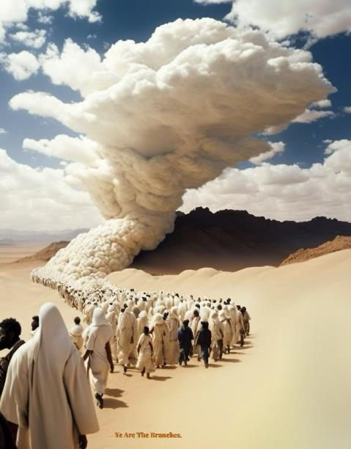
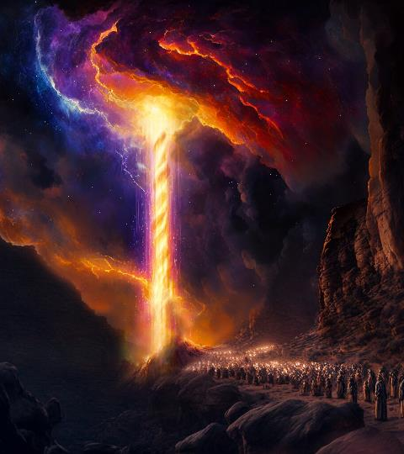
Exodus 13:21
‘By day the Lord went ahead of them in a pillar of cloud to guide them on their way and by night in a pillar of fire to give them light.
‘By day the Lord went ahead of them in a pillar of cloud to guide them on their way and by night in a pillar of fire to give them light.
Exodus 13:21

Slide 11
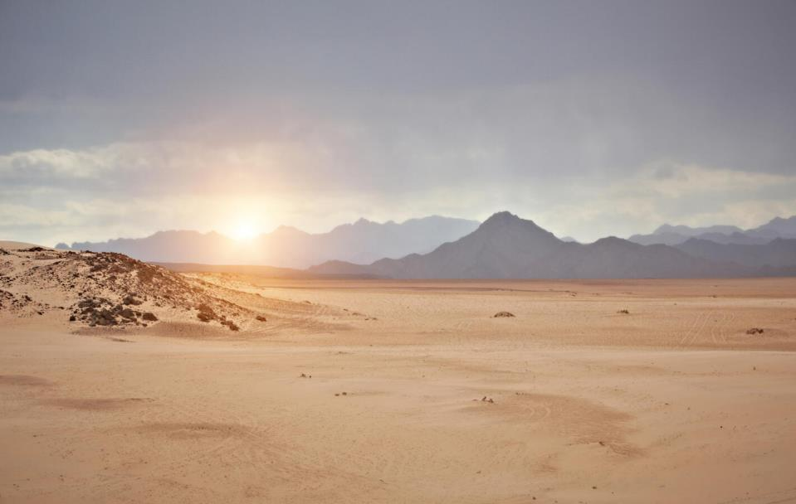

Slide 12
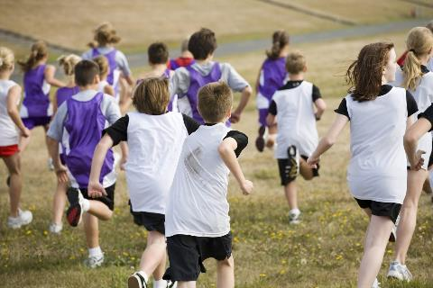

Slide 13
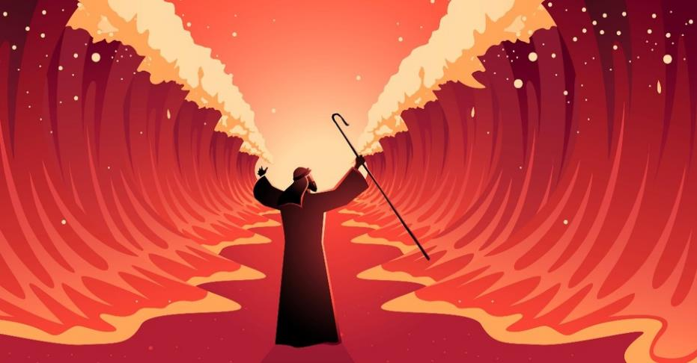
SALVATION / RESCUE / FREEDOM

Slide 14
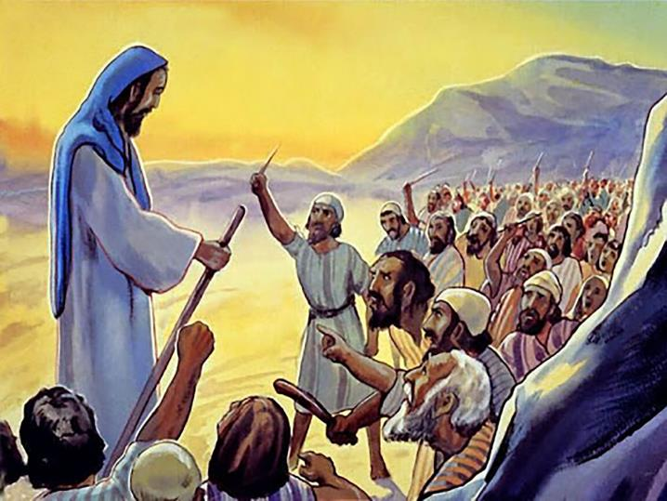
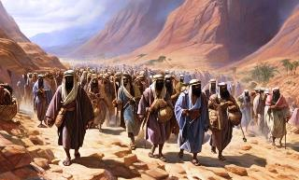
The whole assembly grumbled against Moses

Slide 15
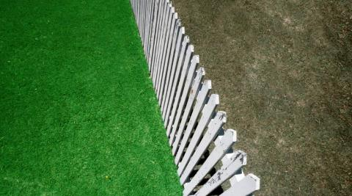
If only…
Grass is greenerIf onlys job/ place/ attention/ faulty focus

Slide 16
v3 ‘If only we had died by the Lord’s hand in Egypt. There we had lots of meat and bread to the full but you have brought us out into the desert to starve this entire assembly to death.’

Slide 17
‘You can get the people out of slavery in an instant but you can’t get the slavery out of the people, except through a long process. The purpose of God in the wilderness was not rapid transportation it was education, counselling and training.’
Tim Keller

Slide 18
Exodus 16:4
That I may test them and see whether they will walk in my law or not’

Slide 20
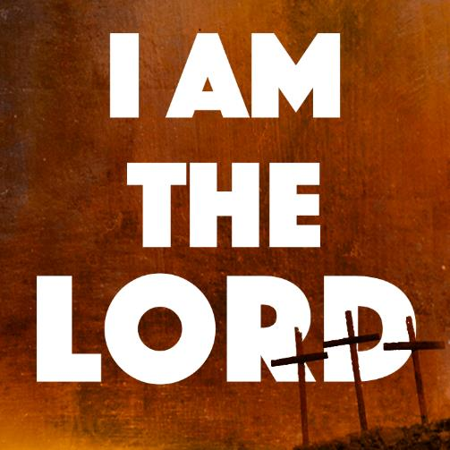
‘at twilight you will eat meat and in the morning you will be filled with bread. Then you will KNOW that I AM THE LORD’
Exodus 16:12

Slide 21
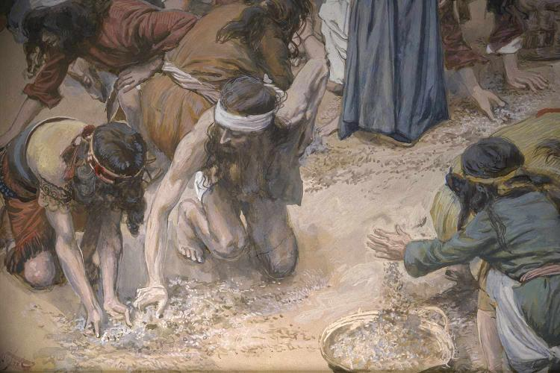

Slide 22
THE SUPERNATURAL PROVISION OF GOD

Slide 23
‘I will rain down for you bread from heaven’
Exodus 16:4

Slide 24
‘it was like coriander seed and tasted like wafers made with honey’
Exodus 16:16

Slide 26
GOD’S PROVISION COMES WITH CONDITIONS

Slide 27
When the dew was gone, thin flakes like frost appeared on the desert floor.’
Exodus 16:14

Slide 28
‘Each one is to gather as much as he needs. Take an omar for each person that you have in your tent’.
Exodus 16:18

Slide 29
‘No-one is to keep any of it until morning. However some of them paid no attention to Moses; they kept some of it until morning but it was full of maggots and began to smell’.
Exodus 16:19-20

Slide 30
GOD’S PROVISION WAS A SUSTAINING PROVISION. IT WAS ENOUGH!

Slide 31
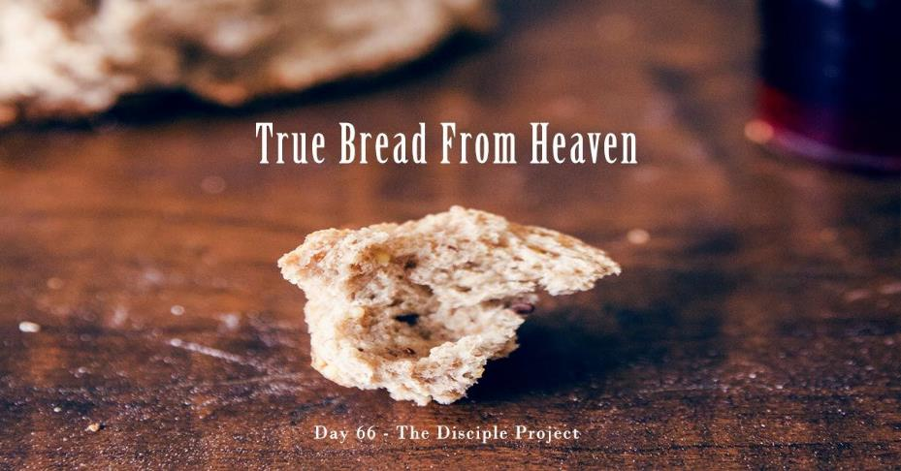

Slide 32
Remember how the Lord your God led you all the way in the desert these 40 years to humble you to test you in order to know what was in your heart, whether or not you would keep his commands. Causing you to hunger and then feeding you with manna, which neither you nor your father had known- to teach you that man does not live on bread alone but on every word that comes from the mouth of the Lord.’
Deuteronomy 8:2

Slide 33
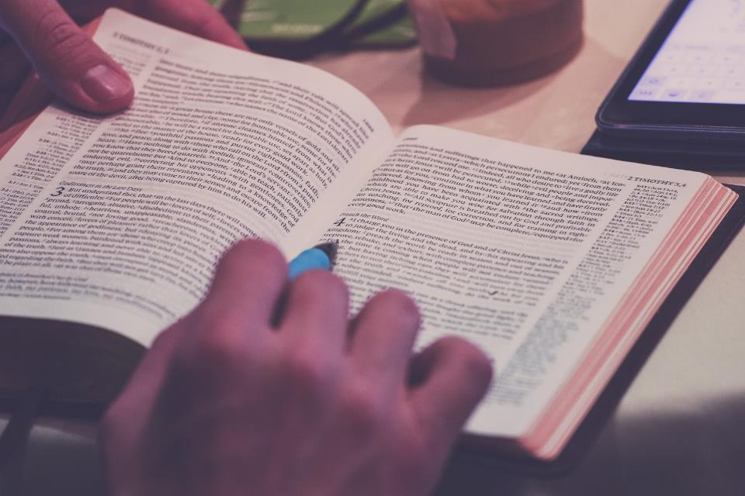

Slide 34
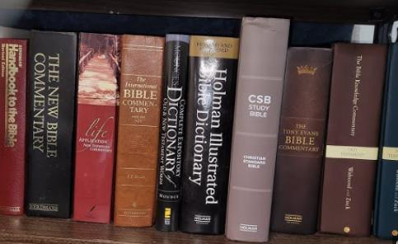
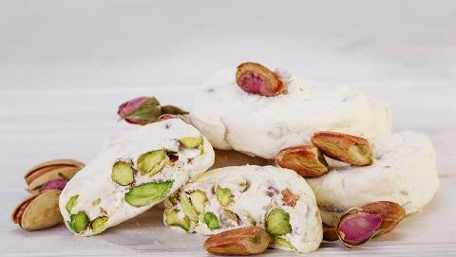
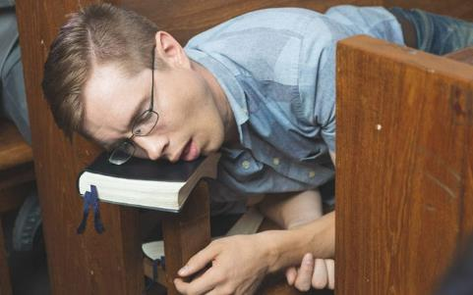
Grass is greenerIf onlys job/ place/ attention/ faulty focus

Slide 35
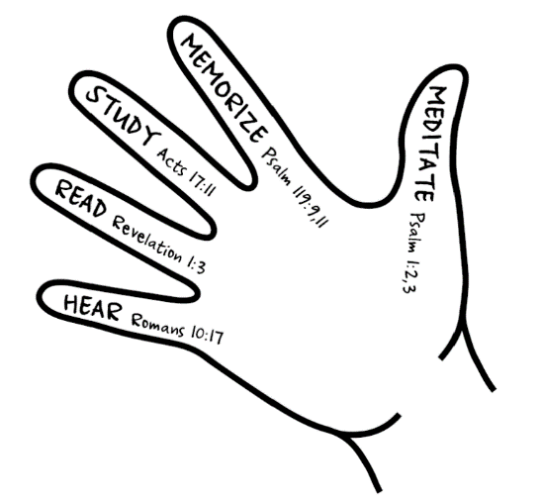

Slide 36
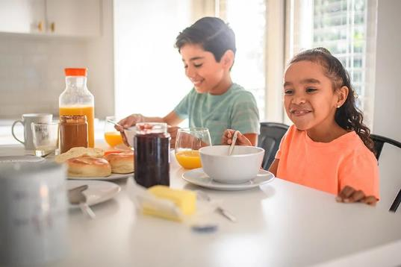
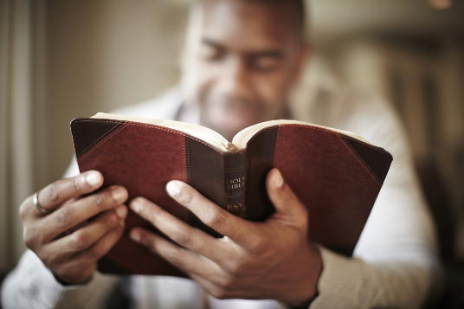

Slide 38
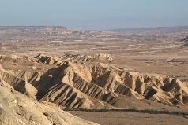

Slide 39
Sorry God for the times I’ve ignored you or grumbled at you. Please forgive me. I trust you and want to follow you, even when I don’t know what to do or when I think my way is better than yours. Thank you for your word, the bible, which feeds me. Please give me a hunger to read it more. Thank you, Jesus, for your love for me shown at the cross. As I believe in you and receive you who is the bread of life, please satisfy the deepest places of my heart. Amen.

