Slide 1
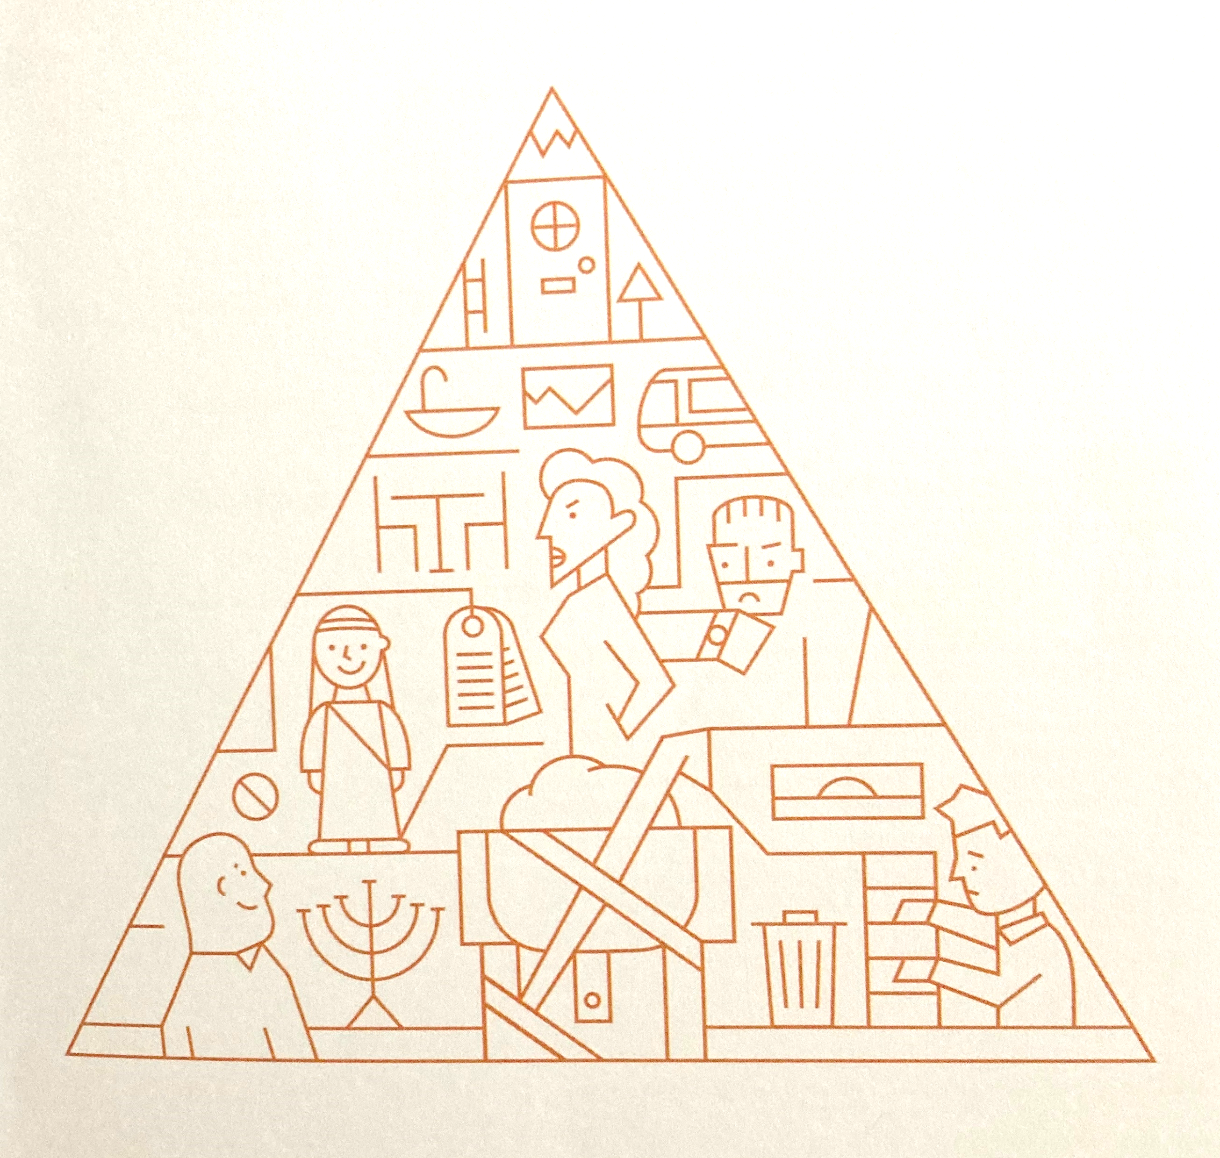
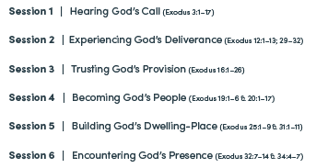
EXODUS
Freedom to serve God

Slide 2
Encountering God’s Presence
Exodus 33:7-34:9
In seeking Him
Ex 33:7-11
In prayer
Ex 33:12-18
In His Word
Ex 33:19-34:9

Slide 3
Encountering God through seeking Him Ex 33:7-11
The tent of meeting
Anyone seeking the Lord …
The Lord would speak to Moses … “as a person speaks to their friend”
Joshua … did not leave the tent

Slide 4
Encountering God through prayer
Ex 33:12-18
Moses prayer to God: verses 13,15,18
“Teach me your ways so that I may know you and continue to find favour with you”
“If your presence does not go with us do not send us up from here”
“Show me your glory”

Slide 5
Encountering God in His Word
Ex 33:19-34:9
Only Moses goes up the mountain
We don’t really know what Moses saw or felt
But we do know what God said
Since then all of us have been able to know God through his Word

Slide 6
Encountering God through His Word Ex 33:19-34:9
God’s word to Moses: verse 19
“I will make all my goodness pass before you and will proclaim before you my name ‘The Lord.’ And I will be gracious to whom I will be gracious and will show mercy on whom I will show mercy.”

Slide 7
Encountering God in His Word
Ex 33:19-34:9
God’s Word to Moses: verse 34:6
The Lord passed before him and proclaimed, “The Lord, the Lord, a God merciful and gracious, slow to anger, and abounding in steadfast love and faithfulness,”

Slide 8
Encountering God in His Word
Ex 33:19-34:9
God’s word to Moses cont. verse 34:7
“… forgiving iniquity and transgression and sin, but who will by no means clear the guilty …”

Slide 9
forgiving iniquity and transgression and sin
but who will by no means clear the guilty
However, to the one who … trusts God who justifies the ungodly, their faith is credited as righteousness. Romans 4:5
“Therefore, my friends, I want you to know that through Jesus the forgiveness of sins is proclaimed to you. Through him everyone who believes is set free from every sin, a justification you were not able to obtain under the law of Moses.” Acts 13:38,39

