Slide 1
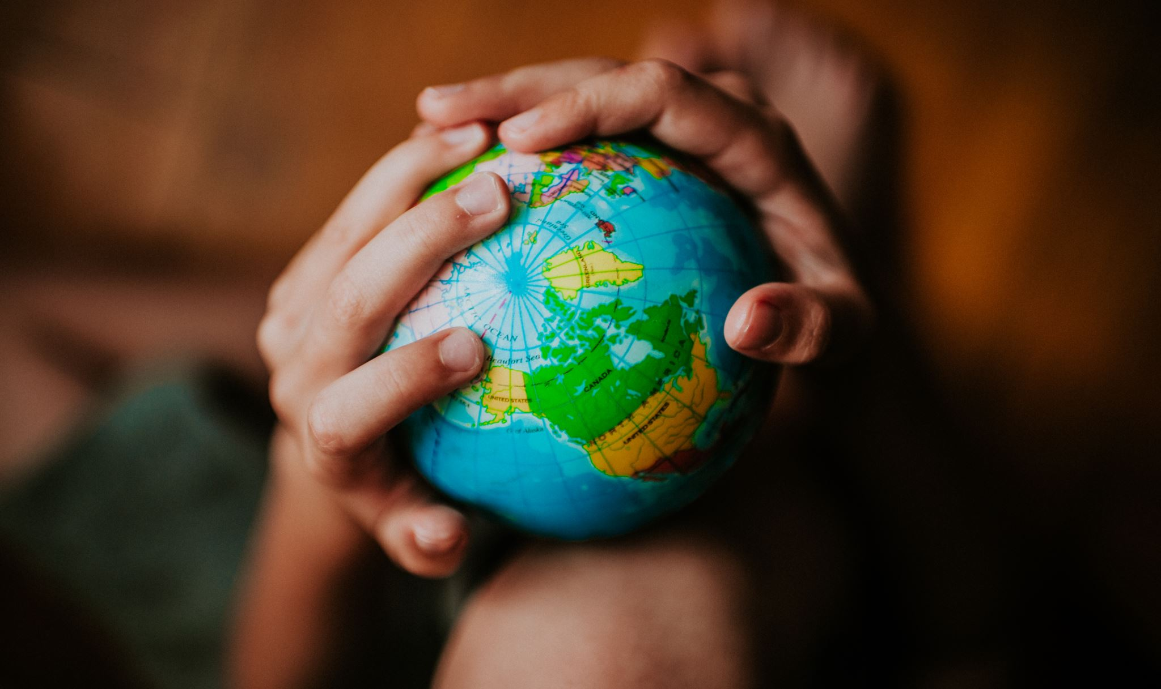
1 Peter:
Confidence in a Complex World

Slide 2
1 Peter: Confidence in a Complex World

Slide 3
1 Peter: Confidence in a Complex World
NAME
HOBBIES
LANGUAGE
FAMILY BACKGROUND
EDUCATION
ECONOMIC STATUS
SEXUALITY
NATIONALITY
GENDER
POLITICS

Slide 4
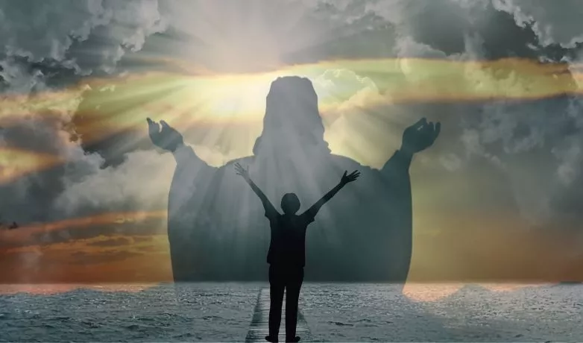
1 Peter 2: 4-10, Confidence in Identity
As you come to him, the living Stone—rejected by humans but chosen by God and precious to him — you also, like living stones, are being built into a spiritual house to be a holy priesthood, offering spiritual sacrifices acceptable to God through Jesus Christ.

Slide 5
1 Peter 2: 4-10, Confidence in Identity
For in Scripture it says:
“See, I lay a stone in Zion, a chosen and precious cornerstone, and the one who trusts in him will never be put to shame.”

Slide 6
1 Peter 2: 4-10, Confidence in Identity
Now to you who believe, this stone is precious. But to those who do not believe,
“The stone the builders rejected has become the cornerstone,” and,
“A stone that causes people to stumble and a rock that makes them fall.”

Slide 7
1 Peter 2: 4-10, Confidence in Identity
They stumble because they disobey the message—which is also what they were destined for.
But you are a chosen people, a royal priesthood, a holy nation, God’s special possession, that you may declare the praises of him who called you out of darkness into his wonderful light.

Slide 8
1 Peter 2: 4-10, Confidence in Identity
Once you were not a people, but now you are the people of God; once you had not received mercy, but now you have received mercy.

Slide 9
1 Peter 2: 4-10, Confidence in Identity
How would you summarize the central message of this passage in just one sentence?

Slide 10
1 Peter 2: 4-10, Confidence in Identity
If we trust and believe in Jesus…
then it is our relationship with Him…
which gives us our identity…
and determines the purposes God has for our life…

Slide 11
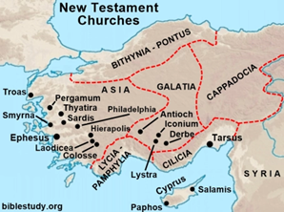

Slide 12
1 Peter 1: 3-4, Confidence in the Gospel
In his great mercy he has given us new birth into a living hope through the resurrection of Jesus Christ from the dead and into an inheritance that can never perish, spoil or fade…

Slide 13
1 Peter 2: 4-10, Confidence in Identity
Israel–Law–Priest-Temple-Old Covenant
Christians–Jesus–All Believers-Living Church-New Covenant

Slide 14
1 Peter 2: 4-10, Confidence in Identity
“Identity in Christ comes from what we receive,
not what we achieve!”

Slide 15
1 Peter 2: 4-10, Confidence in Identity
“Identity in Christ comes from what we receive,
not what we achieve!”
Come – v4
Trust – v6
Believe – v7

Slide 16
1 Peter 2: 4-10, Confidence in Identity
Come – v4…
As you come to him, the living Stone—rejected by humans but chosen by God and precious to him — you also, like living stones, are being built into a spiritual house to be a holy priesthood, offering spiritual sacrifices acceptable to God through Jesus Christ.

Slide 17
1 Peter 2: 4-10, Confidence in Identity
Trust – v6…
For in Scripture it says:
“See, I lay a stone in Zion, a chosen and precious cornerstone, and the one who trusts in him will never be put to shame.”

Slide 18
1 Peter 2: 4-10, Confidence in Identity
Believe – v7…
Now to you who believe, this stone is precious. But to those who do not believe,
“The stone the builders rejected has become the cornerstone,” and,
“A stone that causes people to stumble and a rock that makes them fall.”

Slide 19
1 Peter 2: 4-10, Confidence in Identity
Jesus, the foundation for a new identity,…
Come – v4
Trust – v6
Believe – v7
Receive God’s mercy – v10

Slide 20
1 Peter 2: 4-10, Confidence in Identity
Come – v4…
As you come to him, the living Stone—rejected by humans but chosen by God and precious to him — you also, like living stones, are being built into a spiritual house to be a holy priesthood, offering spiritual sacrifices acceptable to God through Jesus Christ.

Slide 21
1 Peter 2: 4-10, Confidence in Identity
But you are a chosen people, a royal priesthood, a holy nation, God’s special possession, that you may declare the praises of him who called you out of darkness into his wonderful light. Once you were not a people, but now you are the people of God; once you had not received mercy, but now you have received mercy.

Slide 22
1 Peter 2: 4-10, Confidence in Identity
In order to know who you are, the most important thing is to know whose you are.

Slide 23
1 Peter 2: 4-10, Confidence in Identity
You belong to God, chosen by him and special to him
You belong to us, we want you and we need you

Slide 24
1 Peter 2: 4-10, Confidence in Identity
If we trust and believe in Jesus…
then it is our relationship with Him…
which gives us our identity…
and determines the purposes God has for our life…

Slide 25
1 Peter 2: 4-10, Confidence in Identity
Security in our God-given identity leads to… Clarity in our God-given purpose

Slide 26
1 Peter 2: 4-10, Confidence in Identity
God-given purposes – v9
Worship…
Witness…
through sacrificial living – v5

Slide 27
1 Peter 2: 4-10, Confidence in Identity
If you were on trial for being a Christian, would there be enough evidence to convict you?

Slide 28
1 Peter 2: 4-10, Confidence in Identity
But you are a chosen people, a royal priesthood, a holy nation, God’s special possession, that you may declare the praises of him who called you out of darkness into his wonderful light.

