Slide 1
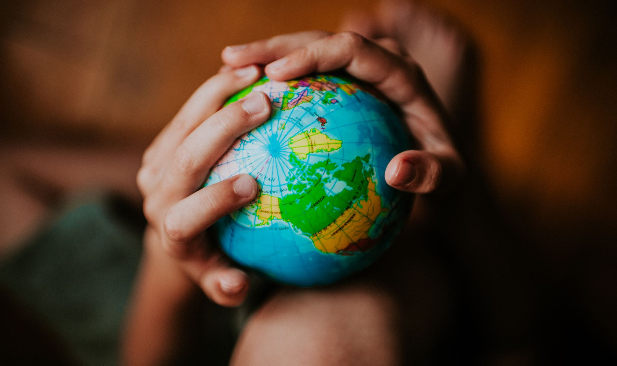
1 Peter:
Confidence in a Complex World

Slide 2
Straw poll…
1. It’s great to be here today to support Anson in his baptism?

Slide 3
Straw poll…
2. Last Sunday was a really encouraging occasion for the NMBC church family?

Slide 4
Straw poll…
3. The Bible is an easy book to read and understand?

Slide 5
Straw poll…
4. Life as a Christian is easy?

Slide 6
Straw poll…
5. Once you’re a Christian, relationships become easy?

Slide 7
It’s not the things which I do not understand in the Bible that bother me, but the things I do understand!
Mark Twain

Slide 8
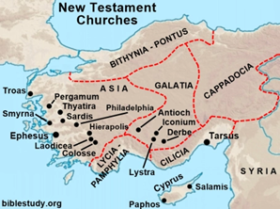

Slide 9
1 Peter 2
… slaves – 1 Peter 2:18
… foreigners and exiles – 1 Peter 2:11
… you also, like living stones, are being built into a spiritual house to be a holy priesthood -1 Peter 2:5
But you are a chosen people, a royal priesthood, a holy nation, God’s special possession… - 1 Peter 2:9

Slide 10
1 Peter
Living for Jesus…
Special!...
But not easy…

Slide 11
1 Peter 3: 1-9, Confidence in Relationships

Slide 12
1 Peter 3: 1-9, Confidence in Relationships
Wives, in the same way submit yourselves to your own husbands so that, if any of them do not believe the word, they may be won over without words by the behaviour of their wives, when they see the purity and reverence of your lives.

Slide 13
1 Peter 3: 1-9, Confidence in Relationships
Your beauty should not come from outward adornment, such as elaborate hairstyles and the wearing of gold jewellery or fine clothes. Rather, it should be that of your inner self, the unfading beauty of a gentle and quiet spirit, which is of great worth in God’s sight.

Slide 14
1 Peter 3: 1-9, Confidence in Relationships
For this is the way the holy women of the past who put their hope in God used to adorn themselves. They submitted themselves to their own husbands, like Sarah, who obeyed Abraham and called him her lord. You are her daughters if you do what is right and do not give way to fear.

Slide 15
1 Peter 3: 1-9, Confidence in Relationships
Husbands, in the same way be considerate as you live with your wives, and treat them with respect as the weaker partner and as heirs with you of the gracious gift of life, so that nothing will hinder your prayers.

Slide 16
1 Peter 3: 1-9, Confidence in Relationships
Finally, all of you, be like-minded, be sympathetic, love one another, be compassionate and humble. Do not repay evil with evil or insult with insult. On the contrary, repay evil with blessing, because to this you were called so that you may inherit a blessing.

Slide 17
1 Peter 3: 1-9, Confidence in Relationships
1. What is Peter NOT saying?
2. What IS Peter saying?
3. So what?

Slide 18
1 Peter 3: 1-9, Confidence in Relationships
Wives, in the same way submit yourselves to your own husbands so that, if any of them do not believe the word, they may be won over without words by the behaviour of their wives, when they see the purity and reverence of your lives.

Slide 19
1 Peter 3: 1-9, Confidence in Relationships
Wives…submit…
1. What is Peter NOT saying?
Wives, you are inferior to your husbands. They have the right to lord it over you. You must obey their every instruction, meet their every need, fulfil their every desire. They are the boss, so just get on with it!

Slide 20
1 Peter 3: 1-9, Confidence in Relationships
Wives…submit…
2. What IS Peter saying?
Wives, in the same way, submit to your husbands, respect their authority, respect order in the home, don’t rebel, don’t nag, set a great, Christlike example!

Slide 21
1 Peter 3: 1-9, Confidence in Relationships
Wives, in the same way submit yourselves to your own husbands so that, if any of them do not believe the word, they may be won over without words by the behaviour of their wives, when they see the purity and reverence of your lives.

Slide 22
For God called you to do good, even if it means suffering, just as Christ suffered for you. He is your example, and you must follow in his steps. He never sinned, nor ever deceived anyone. He did not retaliate when he was insulted, nor threaten revenge when he suffered. He left his case in the hands of God, who always judges fairly.
1 Peter 2:21-23

Slide 23
Submission is an act of spiritual strength

Slide 24
He personally carried our sins in his body on the cross so that we can be dead to sin and live for what is right. By his wounds you are healed.
1 Peter 2:24

Slide 25
1 Peter 3: 1-9, Confidence in Relationships
Wives…submit…
3. So what?
As a witness to Jesus!

Slide 26
Submission isn’t easy, but it brings glory to God!

Slide 27
1 Peter 3: 1-9, Confidence in Relationships
Your beauty should not come from outward adornment, such as elaborate hairstyles and the wearing of gold jewellery or fine clothes. Rather, it should be that of your inner self, the unfading beauty of a gentle and quiet spirit, which is of great worth in God’s sight.

Slide 28
1 Peter 3: 1-9, Confidence in Relationships
Wives…beauty…
1. What is Peter NOT saying?
Don’t bother taking care of your appearance, don’t have your hair done nicely, don’t wear nice clothes or any jewellery. Nobody cares how you look and your husband doesn’t either!

Slide 29
1 Peter 3: 1-9, Confidence in Relationships
Wives…beauty…
2. What IS Peter saying?
True beauty comes from godly character, not physical looks.

Slide 30
1 Peter 3: 1-9, Confidence in Relationships
Wives…beauty…
3. So what?
We are made in God’s image and called to reflect the character of Christ

Slide 31
1 Peter 3: 1-9, Confidence in Relationships
Husbands, in the same way be considerate as you live with your wives, and treat them with respect as the weaker partner and as heirs with you of the gracious gift of life, so that nothing will hinder your prayers.

Slide 32
1 Peter 3: 1-9, Confidence in Relationships
Husbands…living and loving…
1. What is Peter NOT saying?
Men are more intelligent and just generally better at things than women, who are weak and need taking care of!

Slide 33
1 Peter 3: 1-9, Confidence in Relationships
Husbands…living and loving…
2. What IS Peter saying?
Husbands, your wife is your equal in God’s gift of life, so treat her with love, respect and understanding.

Slide 34
1 Peter 3: 1-9, Confidence in Relationships
Husbands…living and loving…
3. So what?
The way we treat those we love, will reflect and affect our relationship with God.

Slide 35
1 Peter 3: 1-9, Confidence in Relationships
Husbands, in the same way be considerate as you live with your wives, and treat them with respect as the weaker partner and as heirs with you of the gracious gift of life, so that nothing will hinder your prayers.

Slide 36
1 Peter 3: 1-9, Confidence in Relationships
Finally, all of you, be like-minded, be sympathetic, love one another, be compassionate and humble. Do not repay evil with evil or insult with insult. On the contrary, repay evil with blessing, because to this you were called so that you may inherit a blessing.

Slide 37
1 Peter 3: 1-9, Confidence in Relationships
Everyone…living to bless…
1. What is Peter NOT saying?
As a Christian, if people are rude to you or behave badly towards you, you should ignore it and just get on with it.

Slide 38
1 Peter 3: 1-9, Confidence in Relationships
Everyone…living to bless…
2. What IS Peter saying?
Live in unity, with humility, compassion and love. Turn the other cheek… forgive and bless others, even those who are seemingly against you.

Slide 39
1 Peter 3: 1-9, Confidence in Relationships
Everyone…living to bless…
3. So what?
As you live to bless those around you, God himself blesses you!

Slide 40
Who could you bless this week?

Slide 41
1 Peter 3: 1-9, Confidence in Relationships
Relationships are not easy…
But as we seek to live with and relate to others in a Christlike way…
We help him to build his Kingdom…
And that is something special!

