Slide 1
Confident in Witnessing
1 Peter chapter 3 v 13 – 4 v 6

Slide 2
1 Peter 3 v 13 – 4 v 6:
Who is going to harm you if you are eager to do good? ¹⁴ But even if you should suffer for what is right, you are blessed. “Do not fear their threats; do not be frightened.”¹⁵ But in your hearts revere Christ as Lord. Always be prepared to give an answer to everyone who asks you to give the reason for the hope that you have. But do this with gentleness and respect, ¹⁶ keeping a clear conscience, so that those who speak maliciously against your good behaviour in Christ may be ashamed of their slander. ¹⁷ For it is better, if it is God’s will, to suffer for doing good than for doing evil. ¹⁸ For Christ also suffered once for sins, the righteous for the unrighteous, to bring you to God. He was put to death in the body but made alive in the Spirit.

Slide 3
1 Peter 3 v 13 – 4 v 6:
19 After being made alive, he went and made proclamation to the imprisoned spirits— ²⁰ to those who were disobedient long ago when God waited patiently in the days of Noah while the ark was being built. In it only a few people, eight in all, were saved through water, ²¹ and this water symbolizes baptism that now saves you also—not the removal of dirt from the body but the pledge of a clear conscience toward God. It saves you by the resurrection of Jesus Christ, ²² who has gone into heaven and is at God’s right hand—with angels, authorities and powers in submission to him.

Slide 4
1 Peter 3 v 13 – 4 v 6:
Therefore, since Christ suffered in his body, arm yourselves also with the same attitude, because whoever suffers in the body is done with sin. ² As a result, they do not live the rest of their earthly lives for evil human desires, but rather for the will of God. ³ For you have spent enough time in the past doing what pagans choose to do—living in debauchery, lust, drunkenness, orgies, carousing and detestable idolatry. ⁴ They are surprised that you do not join them in their reckless, wild living, and they heap abuse on you. ⁵ But they will have to give account to him who is ready to judge the living and the dead. ⁶ For this is the reason the gospel was preached even to those who are now dead, so that they might be judged according to human standards in regard to the body, but live according to God in regard to the spirit.

Slide 6
Vindicated: definition: cleared of blame or suspicion, proved to be right

Slide 7
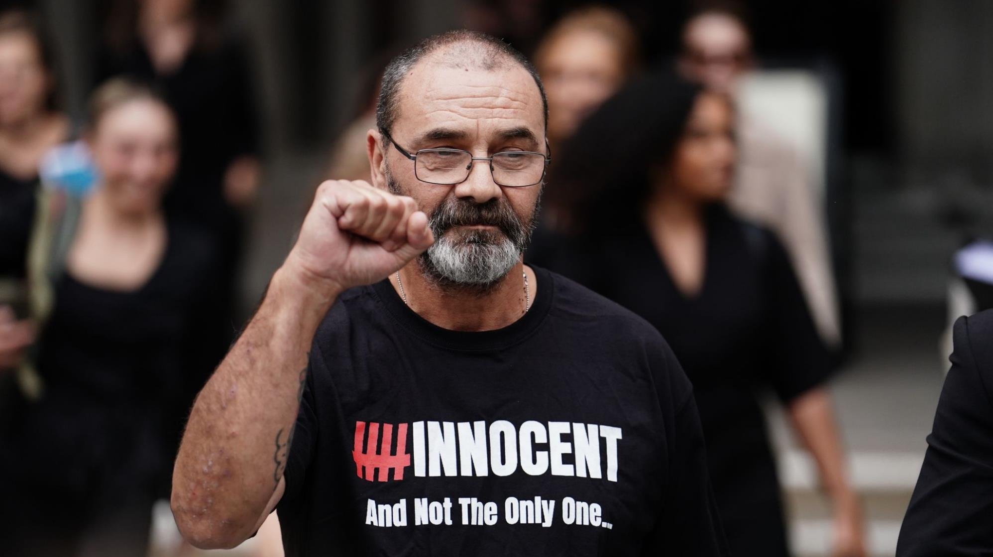

Slide 8
Vindicated: definition: cleared of blame or suspicion, proved to be right

Slide 9
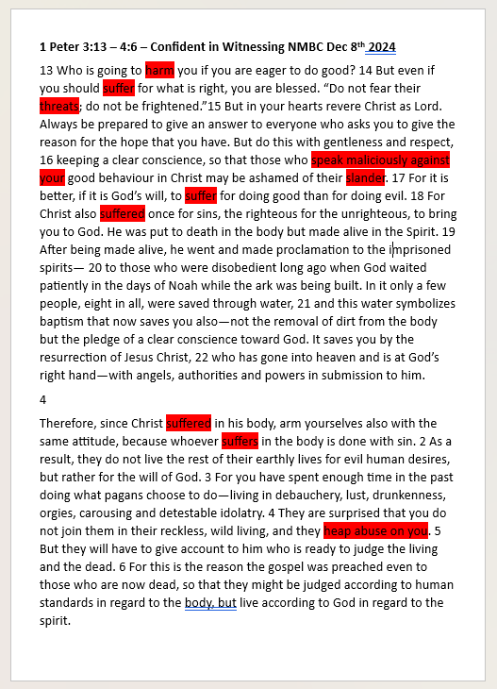

Slide 10
The command: 1 Peter 3 v 15 – 16:
Always be prepared to give and answer to everyone who asks you to give a reason for the hope that you have.

Slide 11
The command: 1 Peter 3 v 15 – 16:
Always be prepared to give and answer to everyone who asks you to give a reason for the hope that you have.
The motivation: 1 Peter 3 v 21-22:
It saves you by the resurrection of Jesus Christ, 22 who has gone into heaven and is at God’s right hand—with angels, authorities and powers in submission to him.

Slide 12
It is possible to live a life that raises questions
Chapter 3:
¹³ Who is going to harm you if you are eager to do good? ¹⁴ But even if you should suffer for what is right, you are blessed. “Do not fear their threats; do not be frightened.”¹⁵ But in your hearts revere Christ as Lord.
Chapter 4:
Therefore, since Christ suffered in his body, arm yourselves also with the same attitude, because whoever suffers in the body is done with sin. ² As a result, they do not live the rest of their earthly lives for evil human desires, but rather for the will of God.

Slide 13
Alexei Navalny
"The fact is that I am a Christian... I was once quite a militant atheist myself...But now I am a believer, and that helps me a lot in my work for justice, because everything becomes much, much easier. I think about things less. There are fewer dilemmas in my life, because there is a book [Bible] in which, in general, it is more or less clearly written what action to take in every situation. It’s not always easy to follow this book, of course, but I am actually trying. As Jesus said: “Blessed are those who hunger and thirst for righteousness, for they will be satisfied”; I’ve always thought that this is more or less an instruction to action."

Slide 14
The command: 1 Peter 3 v 15 – 16:
Always be prepared to give and answer to everyone who asks you to give a reason for the hope that you have.
The motivation: 1 Peter 3 v 21-22:
It saves you by the resurrection of Jesus Christ, 22 who has gone into heaven and is at God’s right hand—with angels, authorities and powers in submission to him.

Slide 16
It is possible to live a life that raises questions
It is possible to live a life that raises questions even with our persecutors
Chapter 4: ³ For you have spent enough time in the past doing what pagans choose to do—living in debauchery, lust, drunkenness, orgies, carousing and detestable idolatry. ⁴ They are surprised that you do not join them in their reckless, wild living, and they heap abuse on you. ⁵ But they will have to give account to him who is ready to judge the living and the dead.

Slide 17
It is possible to live a life that raises questions
It is possible to live a life that raises questions even with our persecutors
Here is how we should do it:
Chapter 3: ¹⁵ Always be prepared to give an answer to everyone who asks you to give the reason for the hope that you have. But do this with gentleness and respect, ¹⁶ keeping a clear conscience, so that those who speak maliciously against your good behaviour in Christ may be ashamed of their slander.

