Slide 1
2025!

Slide 2
A picture is worth a thousand…

Slide 3
A picture is worth a thousand words

Slide 4
Appearances can be…

Slide 5
Appearances can be deceiving

Slide 6
Laughter is the best…

Slide 7
Laughter is the best medicine

Slide 8
Every cloud has a…

Slide 9
Every cloud has a silver lining

Slide 10
Actions speak louder than…

Slide 11
Actions speak louder than words

Slide 12
Honesty is the best…

Slide 13
Honesty is the best policy

Slide 14
Practice makes…

Slide 15
Practice makes perfect

Slide 16
Practice makes permanent!
(Tim Henman)

Slide 18
What is a Proverb?

Slide 19
What is a Proverb?
A short, memorable saying embodying a commonplace fact or experience.
Collins English Dictionary

Slide 20
What is a Proverb?
A proverb is a poetic art form that instils wisdom in you as you wrestle with it.
Tim and Kathy Keller

Slide 21
What is a Proverb?
A proverb is a poetic art form that instils wisdom in you as you wrestle with it.
Tim and Kathy Keller

Slide 22
What is a Proverb?
A proverb is a poetic art form that instils wisdom in you as you wrestle with it.
Tim and Kathy Keller

Slide 23
What is a Proverb?
A proverb is a poetic art form that instils wisdom in you as you wrestle with it.
Tim and Kathy Keller

Slide 24
?
Do not answer a fool according to his folly, or you yourself will be just like him.
Proverbs 26:4
Answer a fool according to his folly, or he will be wise in his own eyes.
Proverbs 26:5

Slide 25
What is a Proverb?
Not a prophecy
Not a promise

Slide 26
What is a Proverb?
Not a prophecy
Not a promise

Slide 27
What is a Proverb?
Not a prophecy
Not a promise
More like a “probability”

Slide 28
The book of Proverbs
A guide for living wisely and well in God’s world
A collection of Go(o)d advice for everyone, in every season of life
A mixture of holy common sense and warning

Slide 29
Proverbs – Wisdom for the whole of life
1. The origin and source of wisdom - fear of the Lord
2. Wisdom for direction in life
3. Wisdom in decision making
4. Wisdom in everyday living
5. Wisdom in the way we speak and relate to others
6. Wisdom in the example we set

Slide 30
Proverbs 1:1-7
The proverbs of Solomon son of David, king of Israel:
for gaining wisdom and instruction;
for understanding words of insight;
for receiving instruction in prudent behaviour,
doing what is right and just and fair;

Slide 31
Proverbs 1:1-7
for giving prudence to those who are simple,
knowledge and discretion to the young –
let the wise listen and add to their learning,
and let the discerning get guidance –
for understanding proverbs and parables,
the sayings and riddles of the wise.

Slide 32
Proverbs 1:1-7
The fear of the Lord is the beginning of knowledge,
but fools despise wisdom and instruction.

Slide 33
Proverbs 1:1
The proverbs of Solomon son of David, king of Israel:

Slide 34
1 Kings 3 – Solomon’s dream
The Lord: Ask for whatever you want me to give you…
Solomon: Give your servant a discerning heart to govern your people and to distinguish between right and wrong.
The Lord: I will give you a wise and discerning heart, so that there will never have been anyone like you…

Slide 35
Proverbs 1:1-2 - Wisdom
The proverbs of Solomon son of David, king of Israel:
for gaining wisdom and instruction;
for understanding words of insight

Slide 36
Proverbs - Wisdom is woven into God’s creation
By wisdom the Lord laid the earth’s foundations
Proverbs 3:19
Wisdom was formed long ages ago, at the very beginning when the world came to be.
Proverbs 8:23

Slide 37
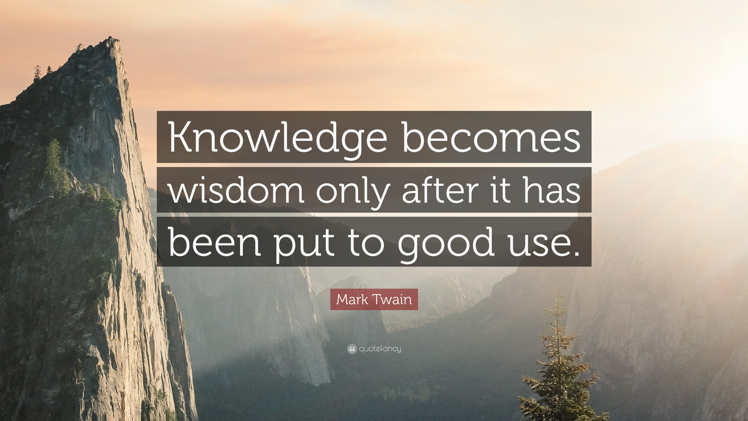
Proverbs - Wisdom = ḥāḵmâ

Slide 38
Proverbs - The fear of the Lord
Wisdom is built on the fear of the Lord…

Slide 39
Proverbs - The fear of the Lord
The fear of the Lord is the beginning of knowledge, but fools despise wisdom and instruction.
Proverbs 1:7

Slide 40
Proverbs - The fear of the Lord
Involves a reverent, eager recognition that the Lord is the source of all true wisdom, knowledge and guidance.
Involves trusting in and being committed to the Lord and his will, as disclosed in his creation and revealed by his Word

Slide 41
Proverbs - The fear of the Lord
A woman who fears the Lord is to be praised.
Proverbs 31:30
The fear of the Lord is the beginning of wisdom and knowledge of the holy one is understanding.
Proverbs 9:10

Slide 42
Proverbs - Relationship
Wisdom is built on the fear of the Lord, in the context of relationship with him…

Slide 43
Proverbs - Relationship
Wisdom is expressed in the context of our human relationships…
…at home
…within marriage
…in the workplace

Slide 44
Proverbs – The whole of life
Wisdom is built on the fear of the Lord, in the context of relationship with him, to guide and instruct us for the whole of life…

Slide 45
Proverbs – The whole of life
Living well in the world =
prudent behavior, doing what is right and fair and just
Proverbs 1:13

Slide 46
Proverbs – Character
Wisdom is built on the fear of the Lord, in the context of relationship with him, to guide and instruct us for the whole of life so that our character is shaped…

Slide 47
Proverbs – Character
Wisdom shapes our attitudes, which lead to habits, which when practised form character…

Slide 48
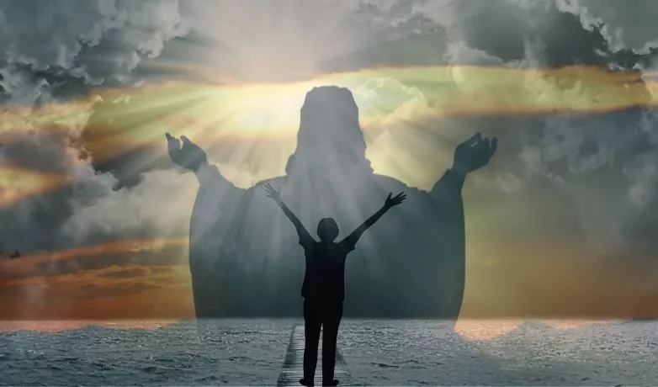
Proverbs – Jesus
Wisdom is built on the fear of the Lord, in the context of relationship with him, to guide and instruct us for the whole of life so that our character is shaped to become more like Jesus.

Slide 49
Proverbs – Jesus
Jesus = greater than Solomon
Matthew 12:42
Christ Jesus has become for us wisdom from God
1 Cor 1:30
Christ, in whom are hidden all the treasures of wisdom and knowledge Col 2:3

Slide 50
Proverbs – Jesus
The blessings of God’s wisdom are now focused on the person and work of Jesus…
The fear of the Lord and the way of life flowing through it find their fullest expression in relationship with Jesus…

Slide 51
Proverbs 1:1-7 – key message
Wisdom is built on the fear of the Lord, in the context of relationship with him, to guide and instruct us for the whole of life so that our character is shaped to become more like Jesus.

Slide 52
Proverbs 3:5-6
Trust in the Lord with all your heart
and lean not on your own understanding;
in all your ways submit to him,
and he will direct your path.
.

