Slide 1
Proverbs 9:1-18

Slide 2
Wisdom
Folly

Slide 4
Wisdom has built her house;
She has hewn her seven pillars.
She has slaughtered her beasts;
She has mixed her wine;
She has set her table.
She has sent out her young women to call
From the highest places in the town,

Slide 5
“Whoever is simple, let him turn in here!”
To him who lacks sense, she says,
“Come, eat of my bread and drink of the wine I have mixed.
Leave your simple ways,
And live,
And walk in the way of insight.”
(Proverbs 9:1-6, ESV)

Slide 6
The woman Folly is loud;
She is seductive and knows nothing.
She sits at the door of her house,
She takes a seat on the highest places on the town,
Calling to those who pass by,
Who are going straight on their way,

Slide 7
“Whoever is simple, let him turn in here!”
And to him who lacks sense she says,
“Stolen water is sweet,
And bread eaten in secret is pleasant.”
But he does not know that the dead are there,
That her guests are in the depths of Sheol.”
(Proverbs 9:13-18, ESV)

Slide 8
“…if we consider the unblushing promises of reward and the staggering nature of the rewards promised in the Gospels, it would seem that Our Lord finds our desires not too strong, but too weak. We are half-hearted creatures, fooling about with drink and sex and ambition when infinite joy is offered us, like an ignorant child who wants to go on making mud pies in a slum because he cannot imagine what is meant by the offer of a holiday at the sea. We are far too easily pleased.”
(CS Lewis, The Weight of Glory)

Slide 9
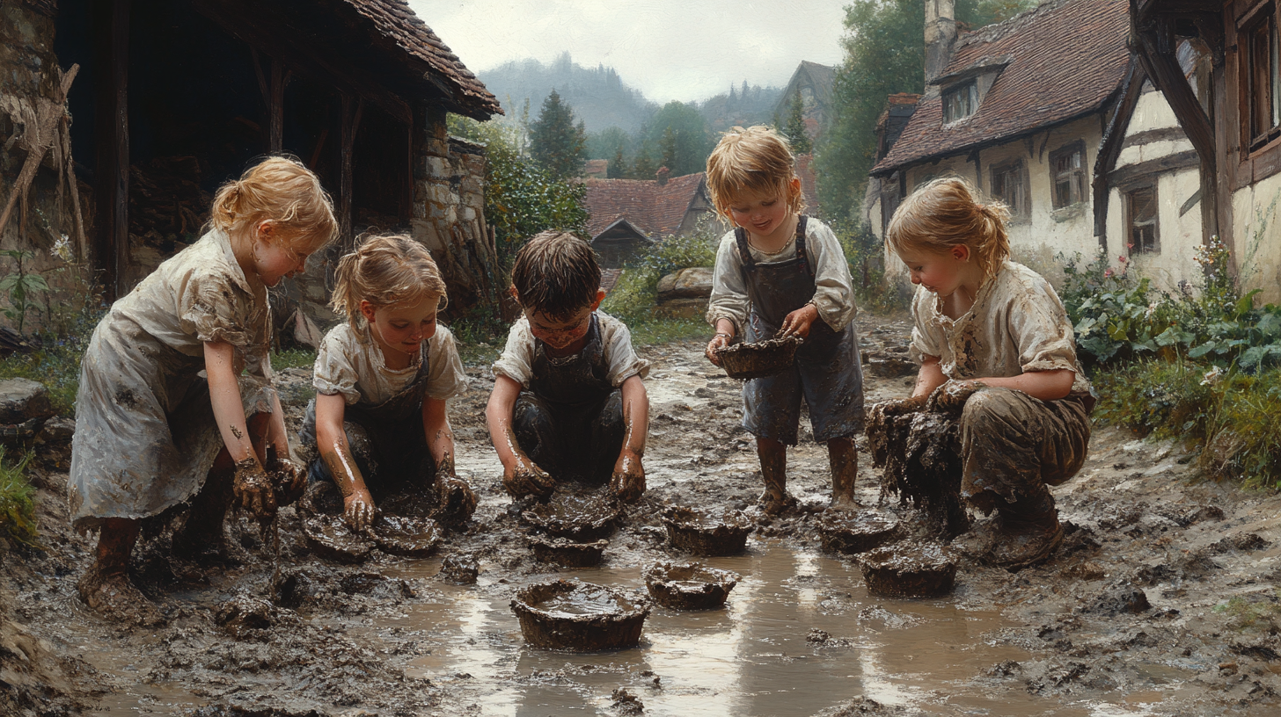

Slide 10
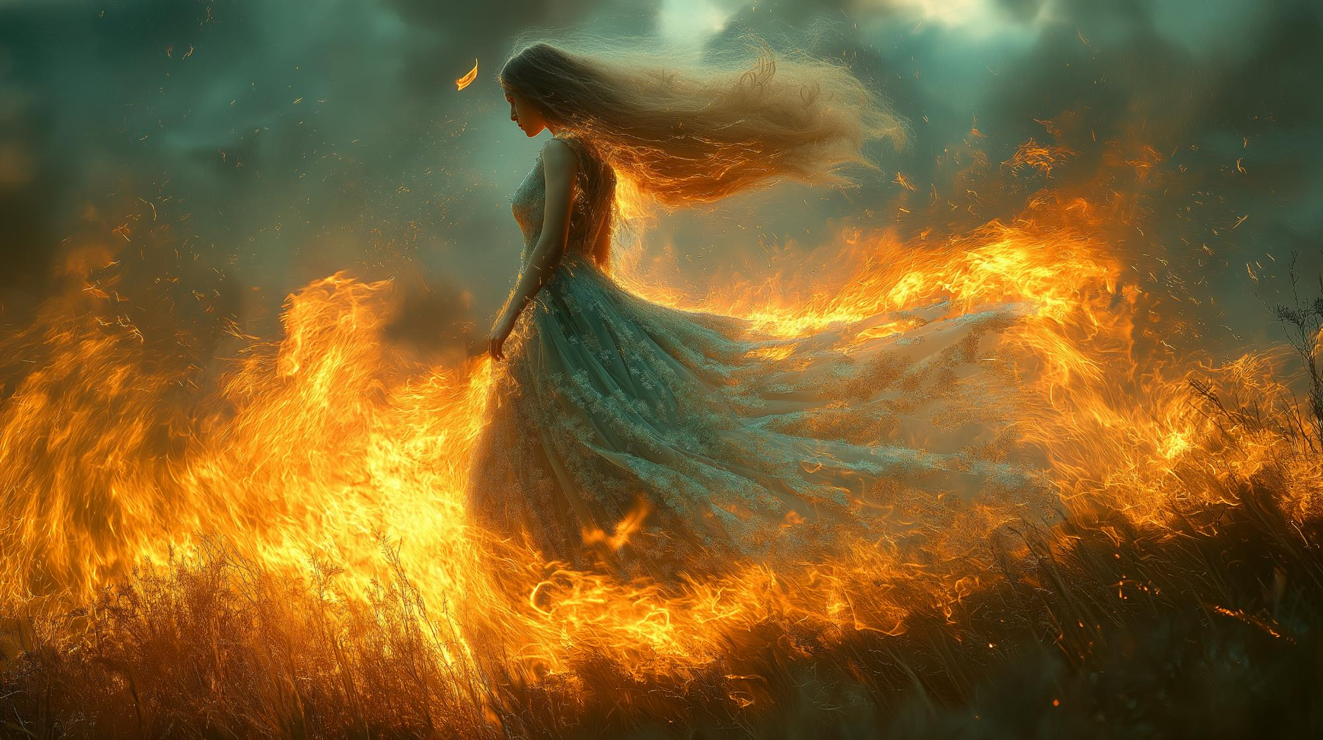

Slide 11
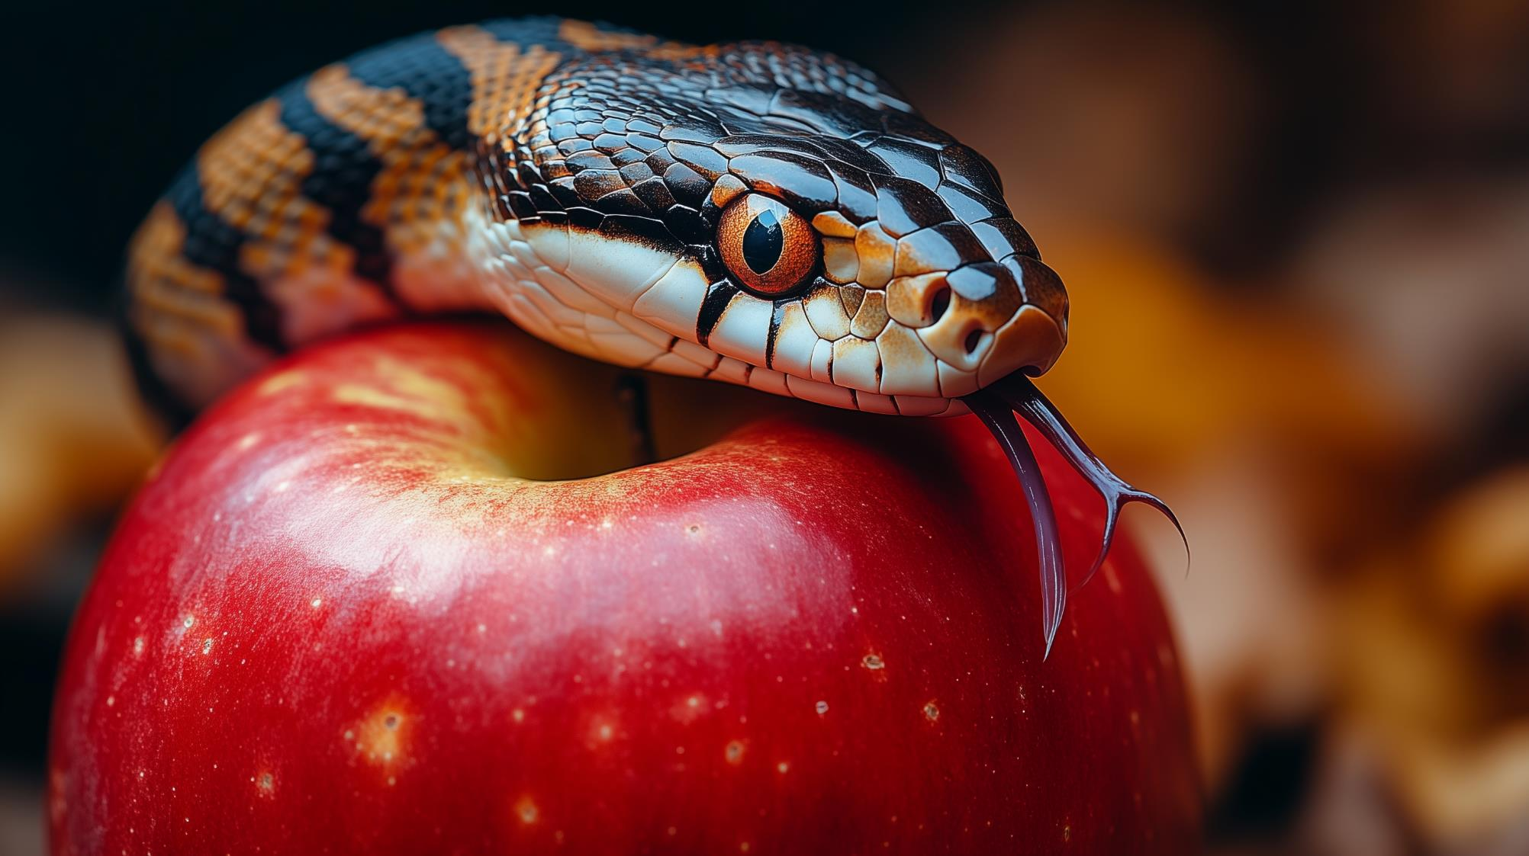

Slide 12
“…lead us not into temptation, but deliver us from evil.”
(Matthew 6:13, ESV)

Slide 13
“When anyone hears the word of the kingdom and does not understand it, the evil one comes and snatches away what has been sown in his heart.”
(Matthew 13:18, ESV)

Slide 14
“For, speaking loud boasts of folly, they entice by sensual passions of the flesh those who are barely escaping from those who live in error. They promise them freedom, but they themselves are slaves of corruption. For whatever overcomes a person, to that he is enslaved. For if, after they have escaped the defilements of the world through the knowledge of our Lord and Saviour Jesus Christ, they are again entangled in them and overcome, the last state has become worse for them than the first.”
(2 Peter 2:18-20, ESV)

Slide 17
…Reprove a wise man, and he will love you.
Give instruction to a wise man, and he will be still wiser;
Teach a righteous man, and he will increase in learning.
(Proverbs 9:8-9, ESV)

Slide 18
“If any of you lacks wisdom, let him ask God, who gives generously to all without reproach, and it will be given him.”
(James 1:5, ESV)

Slide 19
“For where jealousy and selfish ambition exist, there will be disorder and every vile practice. But the wisdom from above is first…

Slide 20
Pure,

Slide 21
Then
peaceable,

Slide 22
Gentle,

Slide 23
Open to reason,

Slide 24
Full of mercy and good fruits,

Slide 25
Impartial and sincere.

Slide 26
And a harvest of righteousness is sown in peace by those who make peace.”
(James 3:16-18, ESV)

Slide 27
“Come, eat of my bread and drink of the wine I have mixed.
Leave your simple ways,
And live,
And walk in the way of insight.”
(Proverbs 9:4-6, ESV)

Slide 28
The fear of the Lord is the beginning of wisdom, And the knowledge of the Holy One is insight. For by me your days will be multiplied, And years will be added to your life.
(Proverbs 9:10-11, ESV)

Slide 30
There shall come forth a shoot from the stump of Jesse, And a branch from his roots shall bear fruit. And the Spirit of the Lord shall rest upon him, The Spirit of wisdom and understanding, The Spirit of counsel and might, The Spirit of knowledge and the fear of the Lord.
(Isaiah 11:1-2, ESV)

Slide 31
“…their hearts may be encouraged, being knit together in love, to reach all the riches of full assurance of understanding and the knowledge of God's mystery, which is Christ, in whom are hidden all the treasures of wisdom and knowledge.”
(Colossians 2:2-3, ESV)

Slide 32
“…Christ the power of God and the wisdom of God.”
(1 Corinthians 1:24, ESV)

Slide 33
“Now as they were eating, Jesus took bread, and after blessing it broke it and gave it to the disciples, and said, ‘Take, eat; this is my body.’ And he took a cup, and when he had given thanks he gave it to them, saying, ‘Drink of it, all of you, for this is my blood of the covenant, which is poured out for many for the forgiveness of sins.”
(Matthew 26:26-28, ESV)

Slide 34
