Slide 1
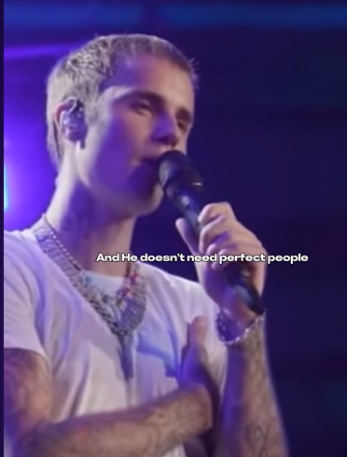
https://www.tiktok.com/@undercovermotivation_/video/7425336221255175456 Who is this young man?

Slide 2
Evangelism = two words…
JESUS LOVE

Slide 3
Do you know Jesus loves you?

Slide 4
Romans 10:13-15, NLT
For “Everyone who calls on the name of the Lord
will be saved.”
But how can they call on him to save them
unless they believe in him?
And how can they believe in him if they have never heard about him? And how can they hear about him unless someone tells them?
And how will anyone go and tell them without being sent? That is why the Scriptures say, “How beautiful are the feet of messengers who bring good news!”

Slide 5
Romans 10:13 NLT
For “Everyone who calls on the name of the Lord
will be saved.”
The foundation of Salvation

Slide 6
Romans 10:14 NLT
But how can they call on him to save them
unless they believe in him?
The Precondition of Calling

Slide 7
Romans 10:14 NLT
And how can they believe in him if they have never heard about him? And how can they hear about him unless someone tells them?
The Responsibility to Share

Slide 8
Romans 10:15 NLT
And how will anyone go and tell them without being sent? That is why the Scriptures say, “How beautiful are the feet of messengers who bring good news!”
The Result of being sent

Slide 9
People are sent to preach or proclaim the good news.
People hear the good news proclaimed.
People believe that good news when they hear it
People call on the name of the Lord, and they are saved!

Slide 10
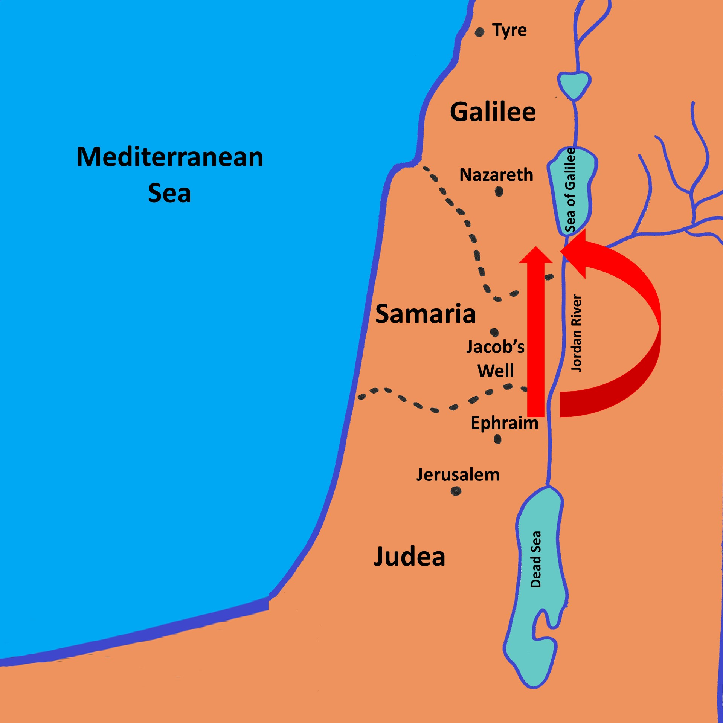

Slide 11
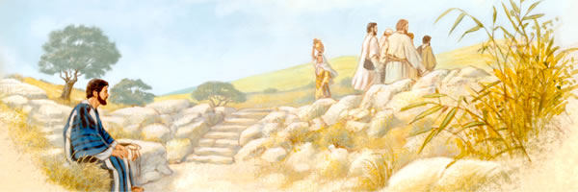

Slide 15
Relational Evangelism
Activity Evangelism
Cold contact Evangelism

Slide 16
Relational Evangelism

Slide 17
Activity Evangelism
Tuesday - Warm Welcome Café
Thursday - Food Bank – Morning
Café 63 – Bible study – Thursday @6:30pm
Friday - Tadpoles
Saturday – Worship Live @Cafe 63 – 4th week
MMCC – Men’s walking club, Community Meal

Slide 18
Cold Contact Evangelism
MMCC (Malden Manor Community Church) - Street Evangelism
- Door to Door

Slide 19
Jo Beadle
MMCC

Slide 20
Matthew 28:19-20
Therefore, go and make disciples of all nations, baptizing them in the name of the Father and the Son and of the Holy Spirit, and teaching them to obey everything I have commanded you.
And surely I am with you always, to the very end of the age.

Slide 21
There’s no I in Team… it is team work…
Warm welcome café – Tuesday
Door to door and street evangelism – Wednesday afternoon in Malden Manor
Food Bank / Café 63 - Thursday
Tadpoles – Friday
Café 63 – Worship Live – 4TH week of Saturday

Slide 22
Next Sunday afternoon
Evangelism with Rev. Chris Duffet
At the café 63, 2:30pm-4pm
We will do some Bible Art with Gigi
We will do worship with Simon
We will do street evangelism with me and Chris.
We need people to pray for us
We need people to give out Bible verses

