Slide 1
Sharing Jesus
in your everyday

Slide 2
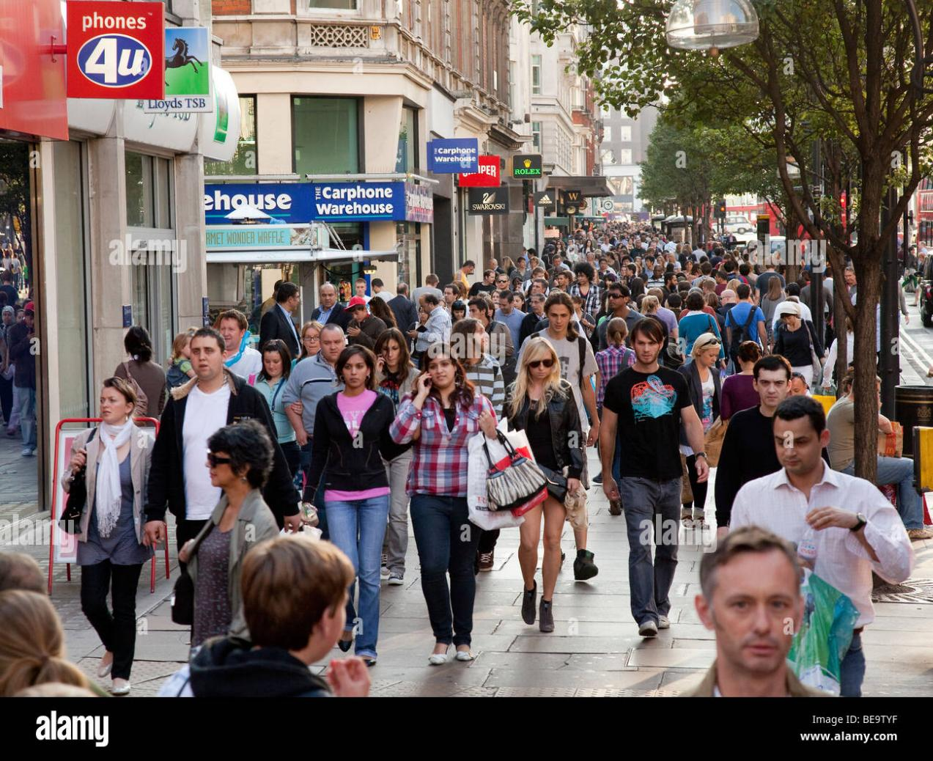
Sharing Jesus
in your everyday

Slide 3
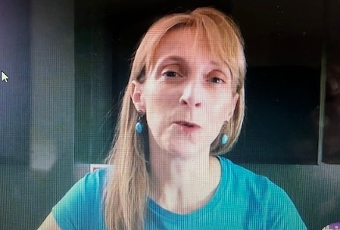
Carolyn Skinner
Love All, Serve All

Slide 4
Sharing Jesus
in your everyday
‘Going deeper’

Slide 5
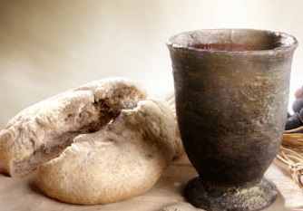
‘Take & eat,
this is my body’
‘This is my blood -
drink from it,
all of you’

Slide 6
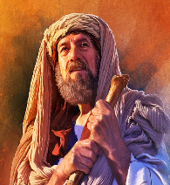
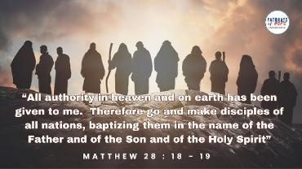
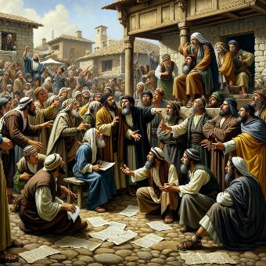
‘I will bless you;
& all peoples on earth
will be blessed through you’
Abraham
‘Go and
make disciples
of all nations’
JESUS
First
Christians
‘These men have
turned the world
upside down’

Slide 7
What was their motivation ?
What shaped their lifestyle ?
What were their PRIORITIES ?

Slide 8
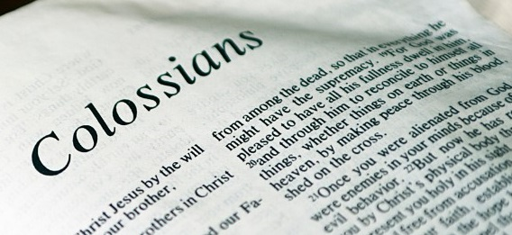

Slide 9
OUR SALVATION
Romans 3:23-24
Everyone has sinned
and is far away from
God's saving presence.
But by the free gift
of God's grace
all are put right with him
through Christ Jesus,
who sets them free.

Slide 10
OUR SALVATION
Colossians 1:13-14
God rescued us from
the power of darkness
and brought us safe into the kingdom of his dear Son, by whom
we are set free,
our sins are forgiven.

Slide 11
OUR SALVATION
1 Peter 1:3-4
Praise be to the God
& Father of our
Lord Jesus Christ!
In his great mercy he has given us new birth
into a living hope
through the
resurrection of
Jesus Christ

Slide 12
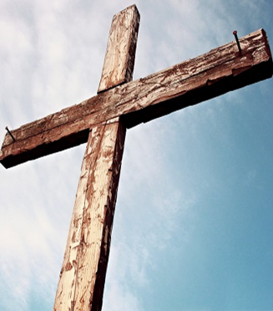
OUR SALVATION
by the CROSS
Romans 3:23-24
Everyone has sinned
and is far away from
God's saving presence.
But by the free gift
of God's grace
all are put right with him
through Christ Jesus,
who sets them free.
Romans 5:6-8
At just the right time, when we were still powerless,
Christ died for the ungodly.
God demonstrates his own love for us in this:
While we were still sinners, Christ died for us.

Slide 14
OUR SALVATION
by the CROSS
Colossians 1:13-14
God rescued us from the power of darkness
and brought us safe into the kingdom of his dear Son, by whom
we are set free,
that is,
our sins are forgiven.
Colossians 1:20
Through the Son,
God decided
to bring the whole universe back to himself. God made peace through
his Son's blood
on the cross

Slide 15
OUR SALVATION
by the CROSS
1 Peter 1:3-4
Praise be to the God
& Father of our Lord Jesus Christ!
In his great mercy he has given us new birth into a living hope through the resurrection of
Jesus Christ
1 Peter 1:18-19
It was not with perishable things
such as silver or gold that you were redeemed from an empty way of life… but with
the precious blood
of Christ

Slide 16
OUR MISSION
Romans 12:18-19
Do everything possible on your part to live in peace with everybody.
If your enemy is hungry, feed him; if he is thirsty, give him something
to drink.

Slide 17
OUR MISSION
Colossians 3:16-17
Christ's message
in all its richness must live
in your hearts…
Everything you do or say, then, should be done in the name of the Lord Jesus…

Slide 18
OUR MISSION
1 Peter 2:9
You are a chosen people, a royal priesthood,
a holy nation, God’s special possession,
that you may declare
the praises of him
who called you out of darkness into his wonderful light.

Slide 19
OUR MISSION
by the CROSS
Romans 12:18-19
Do everything possible on your part to live in peace with everybody.
If your enemy is hungry, feed him; if he is thirsty, give him something
to drink.
Romans 12:1
I urge you, in view of God’s mercy, to
offer your bodies as
a living sacrifice
holy and pleasing
to God—
this is your true
& proper worship.

Slide 20
OUR MISSION
by the CROSS
Colossians 3:16-17
Christ's message
in all its richness must live
in your hearts…
Everything you do or say, then, should be done in the name of the Lord Jesus…
Colossians 3:1 & 5
You have been raised to life with Christ…
You must put to death, then, the earthly desires at work in you,
such as sexual immorality, indecency, lust, evil passions, & greed.

Slide 21
OUR MISSION
by the CROSS
1 Peter 2:9
You are a chosen people, a royal priesthood,
a holy nation, God’s special possession,
that you may declare
the praises of him
who called you out of darkness into his wonderful light.
1 Peter 2:20 & 22
If you suffer for doing good & you endure it,
this is commendable before God.
To this you were called,
because
Christ suffered for you, leaving
you an example…

Slide 22
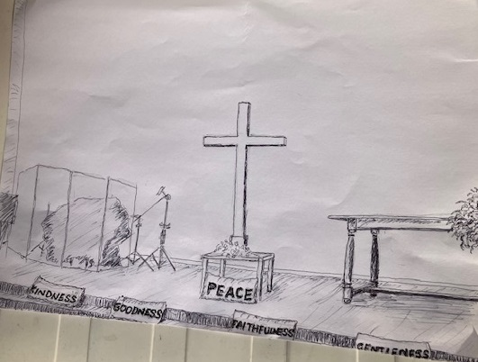

Slide 23
patience
joy
kindness
goodness
self-control
gentleness
peace
faithfulness
love

Slide 24
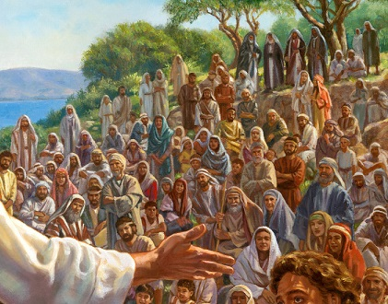
Jesus
called
the crowd
and
his followers
to him.

Slide 25
“Any of you who
want to be my follower
must stop thinking
about yourself
and what you want.”
“You must be willing
to carry the cross
that is given to you for following me.”

Slide 26
“Any of you who try to save
the life you have will lose it.
But you who give up your life
for me & for the Good News
will save it.”
“You must be willing
to carry the cross
that is given to you for following me.”

Slide 27
“As you live among them,
don’t be ashamed of me
& my teaching.”
“If that happens, I will be ashamed of you
when I come with the glory of my Father
and the holy angels.”

Slide 28
1 Peter 3:15
Always be prepared
to give an answer
to everyone who asks you
to give the reason for
the hope that you have.
But do this with gentleness and respect…

Slide 29
1 Peter 3:15
Always be prepared
to give an answer
to everyone who asks you

Slide 30
Always be prepared
with
a way of explaining
how Jesus changes
our hearts & lives
Bridge to
Life

Slide 31
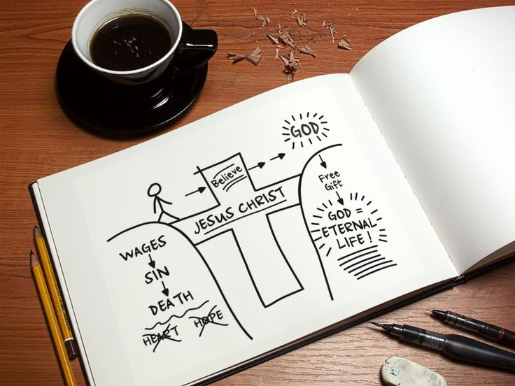

Slide 32
Sharing Jesus
in your everyday

Slide 34
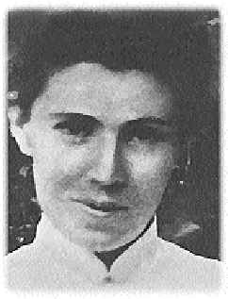
From subtle love of softening things,
from easy choices, weakenings,
not thus are spirits fortified,
not this way went the Crucified,
from all that dims thy Calvary,
O Lamb of God, deliver me.
Amy Carmichael

Slide 35
‘Take & eat,
this is my body’
‘This is my blood -
drink from it,
all of you’

