Slide 1
Evangelism: Sharing Jesus in Your Everyday

Slide 2
Sharing Jesus in Your Everyday How was your week?

Slide 3
Sharing Jesus in Your Everyday What did you see?

Slide 4
Sharing Jesus in Your Everyday What did you hear?

Slide 5
Sharing Jesus in Your Everyday What did you do?

Slide 6
Sharing Jesus in Your Everyday What did you not do?

Slide 7
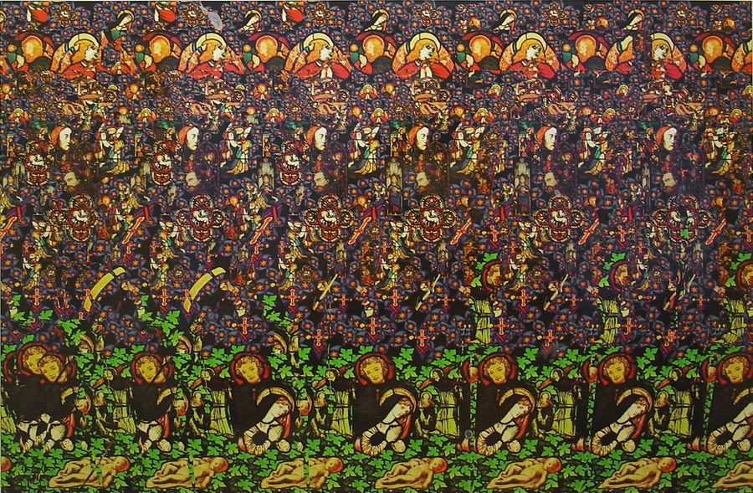
3 questions for today… and for each and Everyday… What do you see?

Slide 8
3 questions for today… and for each and Everyday… What do you hear? https://www.youtube.com/watch?v=eO2YlQiFHeg&t=21s

Slide 9
3 questions for today… and for each and Everyday… What do you do/not do?

Slide 10
Acts 4:1-22… What do you see? What do you hear? What do you do/not do?

Slide 11
Acts 4:1-22
The priests and the captain of the temple guard and the Sadducees came up to Peter and John while they were speaking to the people. ² They were greatly disturbed because the apostles were teaching the people, proclaiming in Jesus the resurrection of the dead.
Pendant qu’ils parlaient ainsi à la foule, survinrent quelques prêtres accompagnés du chef de la police du Temple et des membres du parti des sadducéens : ² ils étaient irrités de voir les apôtres enseigner le peuple et leur annoncer que, puisque Jésus était ressuscité, les morts ressusciteraient eux aussi.

Slide 12
Acts 4:1-22
³ They seized Peter and John and, because it was evening, they put them in jail until the next day. ⁴ But many who heard the message believed; so the number of men who believed grew to about five thousand.
⁵ The next day the rulers, the elders and the teachers of the law met in Jerusalem.
³ Ils les arrêtèrent donc et, comme il se faisait déjà tard, ils les jetèrent en prison jusqu’au lendemain. ⁴Cependant, parmi ceux qui avaient entendu leurs paroles, beaucoup crurent, ce qui porta le nombre des croyants à près de cinq mille hommes.
⁵ Le lendemain, les chefs des Juifs, les responsables du peuple et les spécialistes de la Loi se réunirent à Jérusalem.

Slide 13
Acts 4:1-22
⁶ Annas the high priest was there, and so were Caiaphas, John, Alexander and others of the high priest’s family. ⁷ They had Peter and John brought before them and began to question them: ‘By what power or what name did you do this?’
⁸ Then Peter, filled with the Holy Spirit, said to them:
⁶ Il y avait là, en particulier, Hanne le grand-prêtre, Caïphe, Jean, Alexandre et tous les membres de la famille du grand-prêtre. ⁷ Ils firent comparaître Pierre et Jean, les placèrent au milieu de leur assemblée et les interrogèrent : Par quel pouvoir ou au nom de qui avez-vous fait cela ?
⁸ Alors Pierre, rempli de l’Esprit Saint, leur répondit :

Slide 14
Acts 4:1-22
‘Rulers and elders of the people! ⁹ If we are being called to account today for an act of kindness shown to a man who was lame and are being asked how he was healed, ¹⁰ then know this, you and all the people of Israel: it is by the name of Jesus Christ of Nazareth, whom you crucified but whom God raised from the dead, that this man stands before you healed.
Dirigeants et responsables de notre peuple ! ⁹ Nous sommes aujourd’hui interrogés sur le bien que nous avons fait à un infirme et sur la manière dont il a été guéri. ¹⁰ Eh bien, sachez-le tous, et que tout le peuple d’Israël le sache : c’est au nom de Jésus-Christ de Nazareth que nous avons agi, de ce Jésus que vous avez crucifié et que Dieu a ressuscité ; c’est grâce à lui que cet homme se tient là, debout, devant vous, en bonne santé.

Slide 15
Acts 4:1-22
¹¹ Jesus is
‘“the stone you builders rejected, which has become the cornerstone.”
¹² Salvation is found in no one else, for there is no other name under heaven given to mankind by which we must be saved.’
¹¹ Il est la pierre rejetée par les constructeurs – par vous – et qui est devenue la pierre principale, la pierre d’angle.
¹² C’est en lui seul que se trouve le salut. Dans le monde entier, Dieu n’a jamais donné le nom d’aucun autre homme par lequel nous devions être sauvés.

Slide 16
Acts 4:1-22
¹³ When they saw the courage of Peter and John and realised that they were unschooled, ordinary men, they were astonished and they took note that these men had been with Jesus. ¹⁴ But since they could see the man who had been healed standing there with them, there was nothing they could say.
¹³ Les membres du Grand-Conseil étaient étonnés de voir l’assurance de Pierre et de Jean, car ils se rendaient compte que c’étaient des gens simples et sans instruction ; ils les reconnaissaient pour avoir été avec Jésus. ¹⁴ Mais, comme ils voyaient, debout à côté d’eux, l’homme qui avait été guéri, ils ne trouvaient rien à répondre.

Slide 17
Acts 4:1-22
¹⁵ So they ordered them to withdraw from the Sanhedrin and then conferred together. ¹⁶ ‘What are we going to do with these men?’ they asked. ‘Everyone living in Jerusalem knows they have performed a notable sign, and we cannot deny it.
¹⁵ Alors ils leur ordonnèrent de sortir de la salle et délibérèrent entre eux : ¹⁶ Qu’allons-nous faire de ces gens-là ? disaient-ils. Car ils ont accompli un signe miraculeux évident et tous les habitants de Jérusalem sont au courant. Nous ne pouvons pas le nier.

Slide 18
Acts 4:1-22
¹⁷ But to stop this thing from spreading any further among the people, we must warn them to speak no longer to anyone in this name.’
¹⁸ Then they called them in again and commanded them not to speak or teach at all in the name of Jesus. ¹⁹ But Peter and John replied, ‘Which is right in God’s eyes: to listen to you, or to him? You be the judges!
¹⁷ Mais il ne faut pas que cela s’ébruite davantage parmi le peuple. Défendons-leur donc, sous peine de sanctions, de parler désormais à qui que ce soit au nom de Jésus.
¹⁸ Là-dessus, ils les firent rappeler et leur interdirent formellement de parler ou d’enseigner au nom de Jésus. ¹⁹ Mais Pierre et Jean leur répondirent : Jugez-en vous-mêmes : est-il juste devant Dieu de vous obéir, plutôt qu’à Dieu ?

Slide 19
Acts 4:1-22
²⁰ As for us, we cannot help speaking about what we have seen and heard.’
²¹ After further threats they let them go. They could not decide how to punish them, because all the people were praising God for what had happened. ²² For the man who was miraculously healed was over forty years old.
²⁰ Quant à nous, nous ne pouvons pas garder le silence sur ce que nous avons vu et entendu.
²¹ Après leur avoir fait de nouvelles menaces, ils les relâchèrent. En effet, ils n’avaient pas trouvé de moyen de les punir, parce que tout le peuple louait Dieu pour ce qui venait d’arriver. ²² L’homme qui avait été miraculeusement guéri était âgé de plus de quarante ans.

Slide 20
Acts 4:1-22… What do I see?

Slide 21
Acts 4:1-22… What do I see?
Proclamation (v1) - Peter and John…were speaking to the people…
Disruption (v2) – They (the religious leaders) were greatly disturbed because the apostles were teaching the people…
Sacrifice (v3) – They seized Peter and John and …put them in jail…
Growth (v4) - …the number of men who believed grew…
The Holy Spirit (v8) – Then Peter, filled with the Holy Spirit…
Kindness (v9) - …called to account today for an act of kindness…
Testimony (v10) - …then know this…it is by the name of Jesus Christ…that this man stands before you healed.
Scripture (v11) - …the stone you builders rejected…(Psalm 118:22)

Slide 22
Acts 4:1-22… What do I see?
Salvation (v12) – Salvation is found in no one else…
Courage (v13) – When they saw the courage of Peter and John…
“Ordinaryness” (v13) – …(Peter and John) they were unschooled, ordinary men…
Astonishment (v13) - …they were astonished…
Presence of Jesus (v13) – …these men had been with Jesus.
Changed lives (v14) - …the man who had been healed standing there with them…
Questions provoked (v16) - …What are we going to do with these men?
Denial impossible (v16) – We cannot deny it…

Slide 23
Acts 4:1-22… What do I see?
Opposition (v18) – …they…commanded them not to speak or teach at all in the name of Jesus.
Obedience to God, not man (v20) – …we cannot help speaking about what we have seen and heard.
Threats (v21) - After further threats…
Freedom (v21) – …they let them go.
Praise (v21) - …all the people were praising God for what had happened
Miracles (v22) - …the man who was miraculously healed…
Age no barrier (v22) – …was over forty years old.

Slide 24
Acts 4:1-22… A “masterclass” in evangelism

Slide 25
Evangelism: Sharing Jesus in Your Everyday Taught?

Slide 26
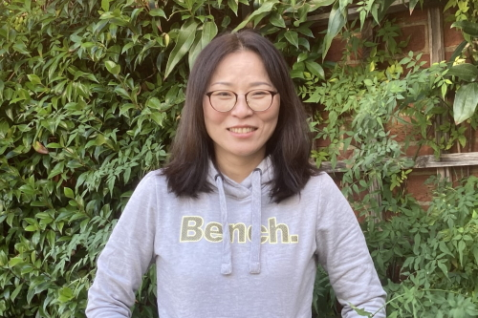
Sharing Jesus in Your Everyday Taught by NMBC’s evangelist to… NMBC’s “reluctant evangelist”…

Slide 27
Sharing Jesus in Your Everyday… I went into New Malden Costa and ordered something. The barista then asked, “Anything else?" And I said, “Just to say God loves you" She just smiled but it was a victory for me, for I am a very reluctant evangelist.

Slide 28
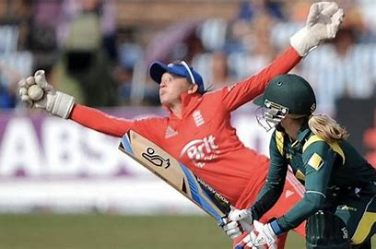
Evangelism: Sharing Jesus in Your Everyday Caught?

Slide 29
Sharing Jesus in Your Everyday Caught by NMBC’s Pastoral Team Leader from … NMBC’s “reluctant evangelist”…

Slide 30
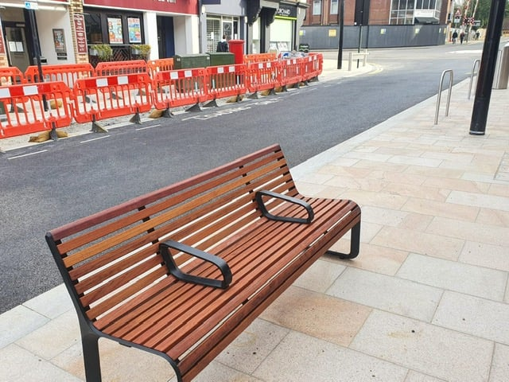
Sharing Jesus in Your Everyday…

Slide 31
Evangelism: Sharing Jesus in Your Everyday Taught? Caught? Best of both?

Slide 32
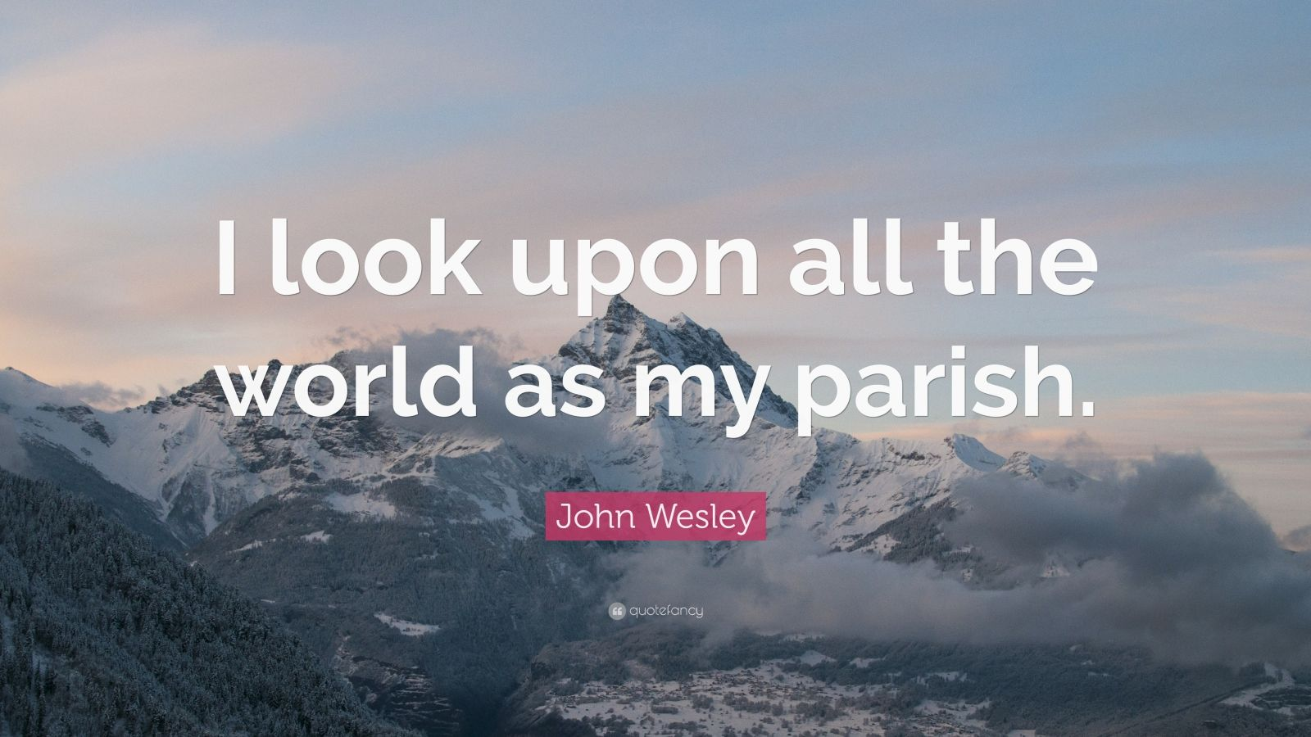
Sharing Jesus in Your Everyday Taught by NMBC’s “reluctant evangelist”… to NMBC’s Pastoral Team Leader …

Slide 33
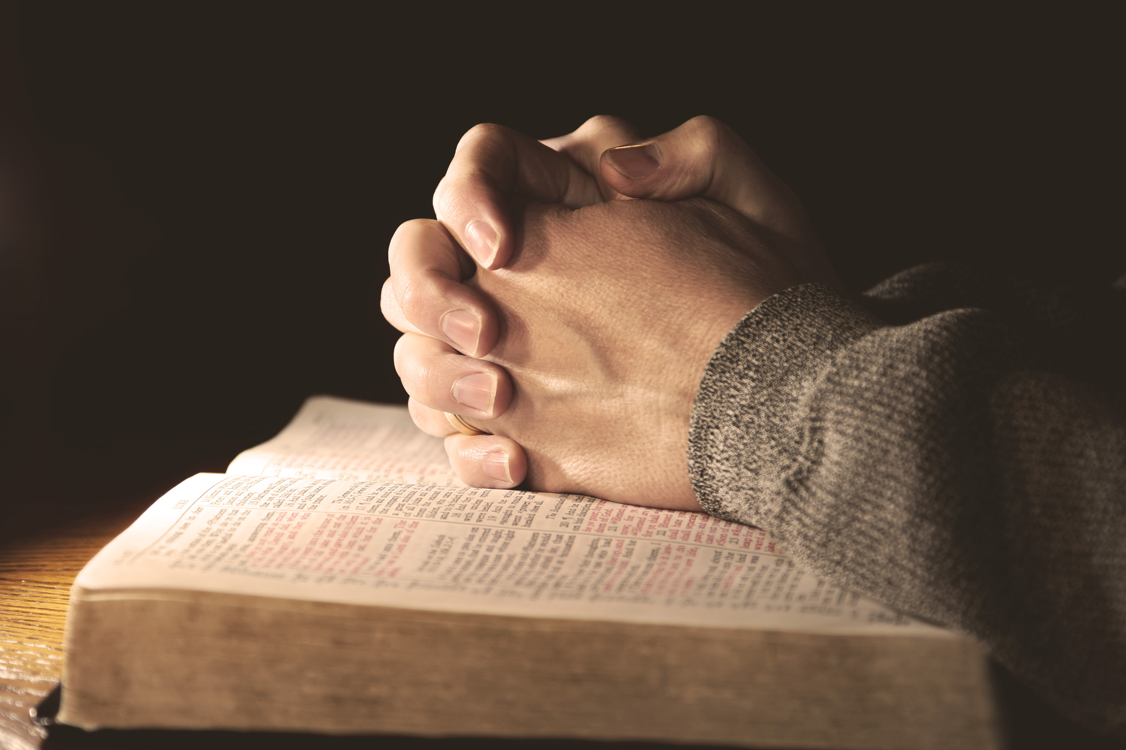
Sharing Jesus in Your Everyday NMBC’s “reluctant evangelist”… “All of New Malden is my parish!”

Slide 34
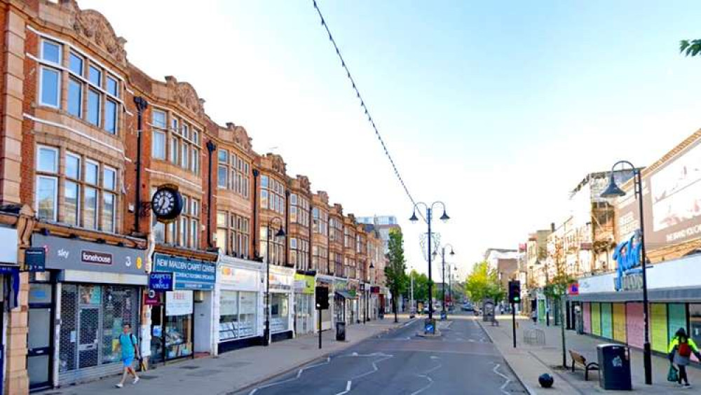
Sharing Jesus in Your Everyday Caught by NMBC’s Pastoral Team Leader … from NMBC’s “reluctant evangelist”…

Slide 35
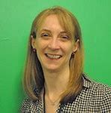
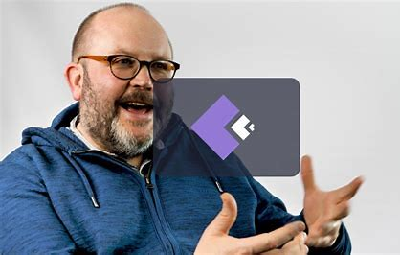
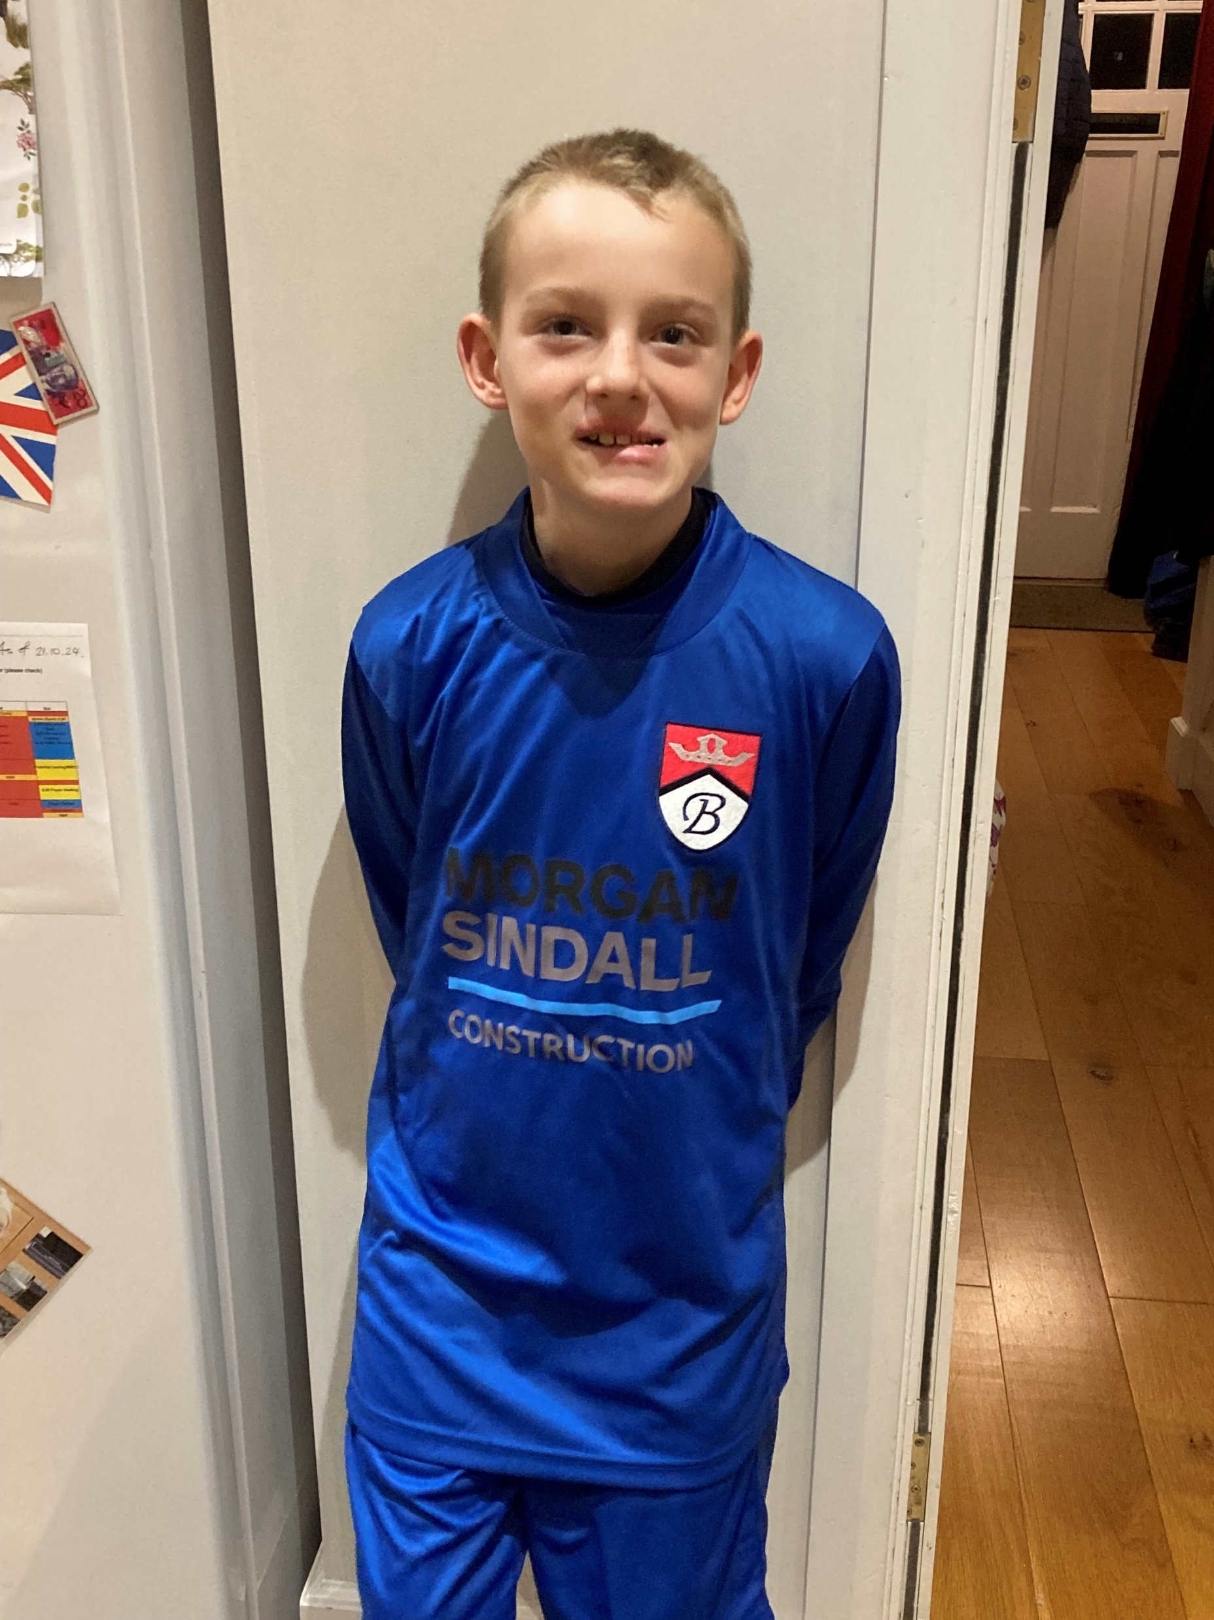
Sharing Jesus in Your Everyday Taught and caught…

Slide 36
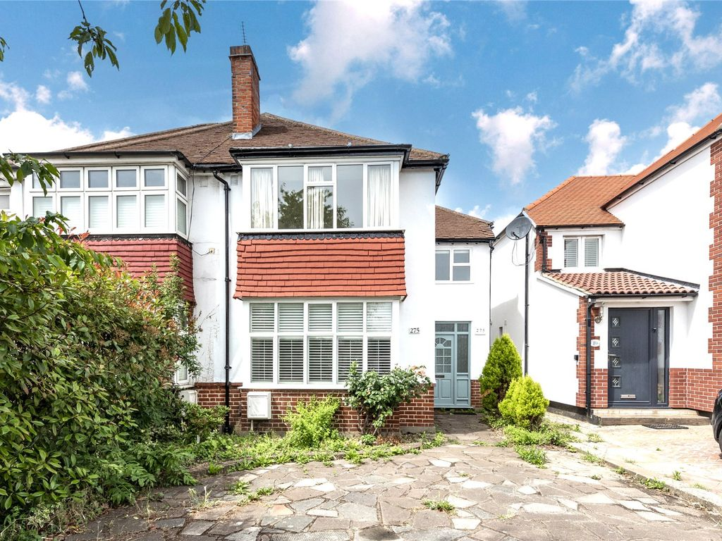
Sharing Jesus in Your Everyday Taught and caught…
YOU?

Slide 37
3 questions for today and for Everyday this week… What will you see? What will you hear? What will you do/not do?

Slide 38
Evangelism: Sharing Jesus in Your Everyday
“The one who calls you is faithful,
and HE will do it.”
‭‭1 Thessalonians‬ ‭5‬:‭24‬‬

