Slide 1
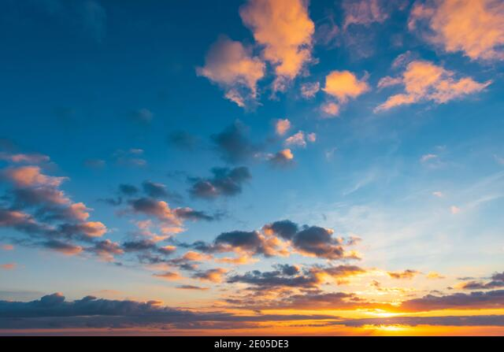

Slide 2


Slide 3
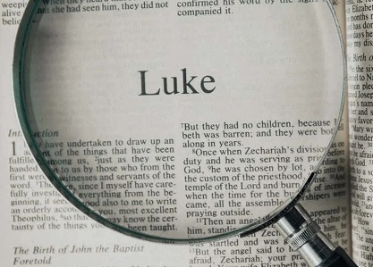

Slide 4
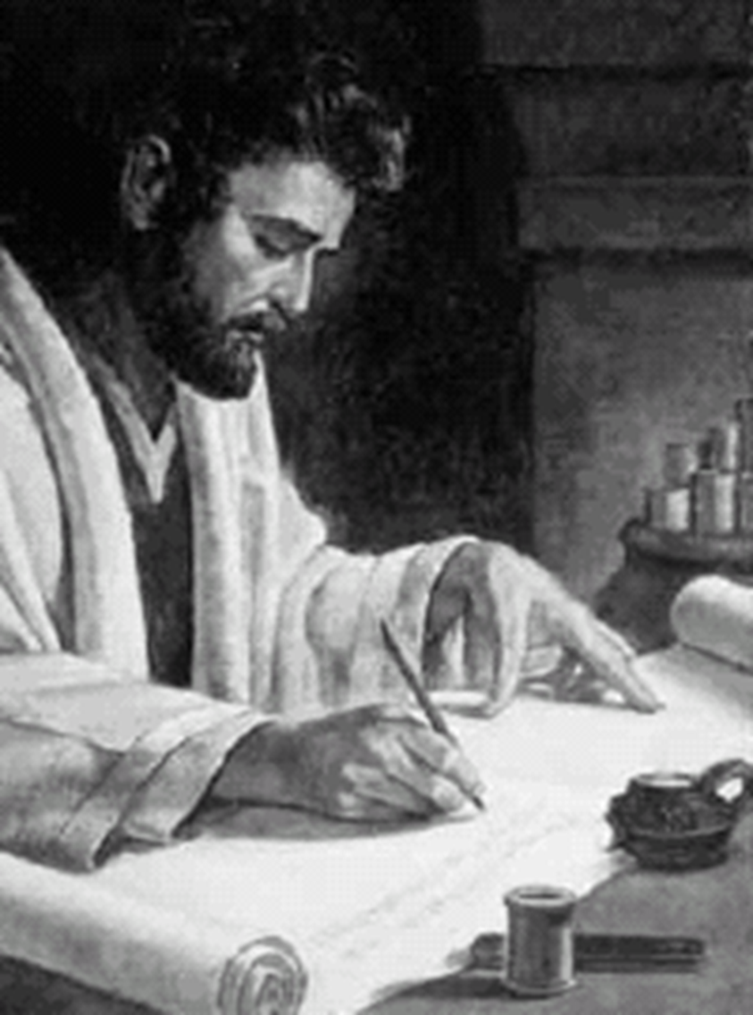
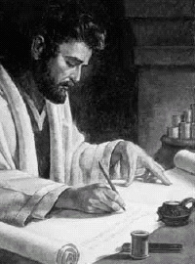
Analysis of OT books – not animated
New Testament
HISTORY
LETTERS
PAUL
Matthew
Mark
Luke
John
OTHER
WRITERS
to churches:
Romans
Corinthians 2
Galatians
Ephesians
Philippians
Colossians
Thessalonians 2
to:
Hebrews
LUKE
2 longest books in the New Testment
from:
James
Peter 2
John 1/2/3
Jude
to individuals:
Timothy 2 Titus
Philemon
ACTS
Acts
of the Apostles
PROPHECY
Revelation

Slide 5
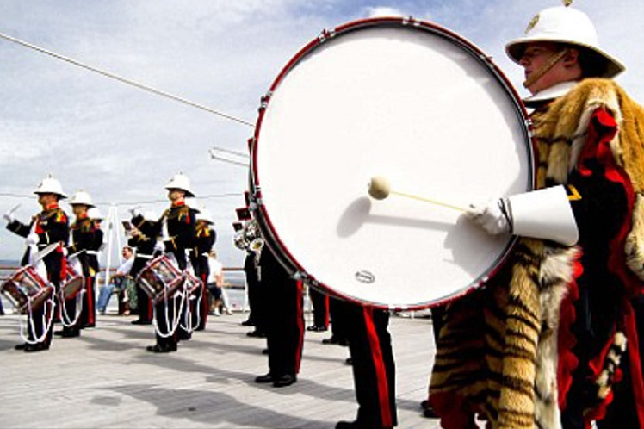
‘bang the drum’
for
LUKE’s Gospel

Slide 6

LUKE
was not a disciple of Jesus
was a medical doctor
was a Gentile
had never met Jesus
was a companion of Paul
… & had met MARK

Slide 7
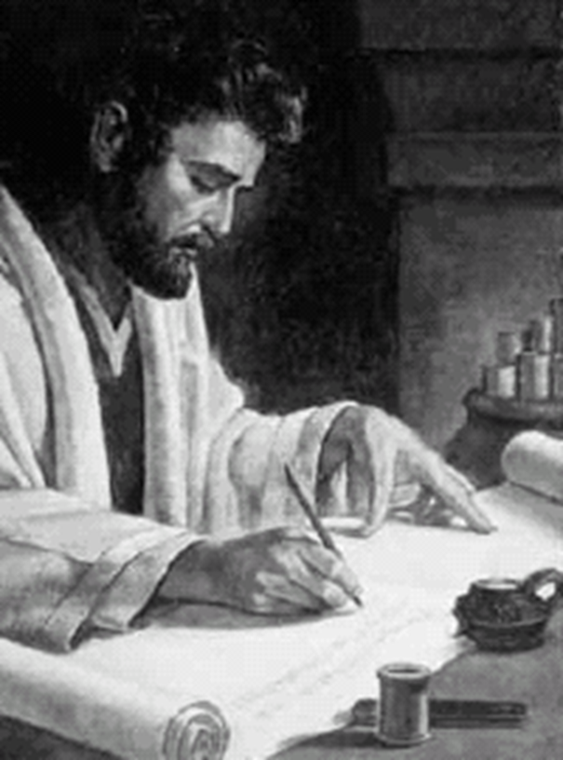
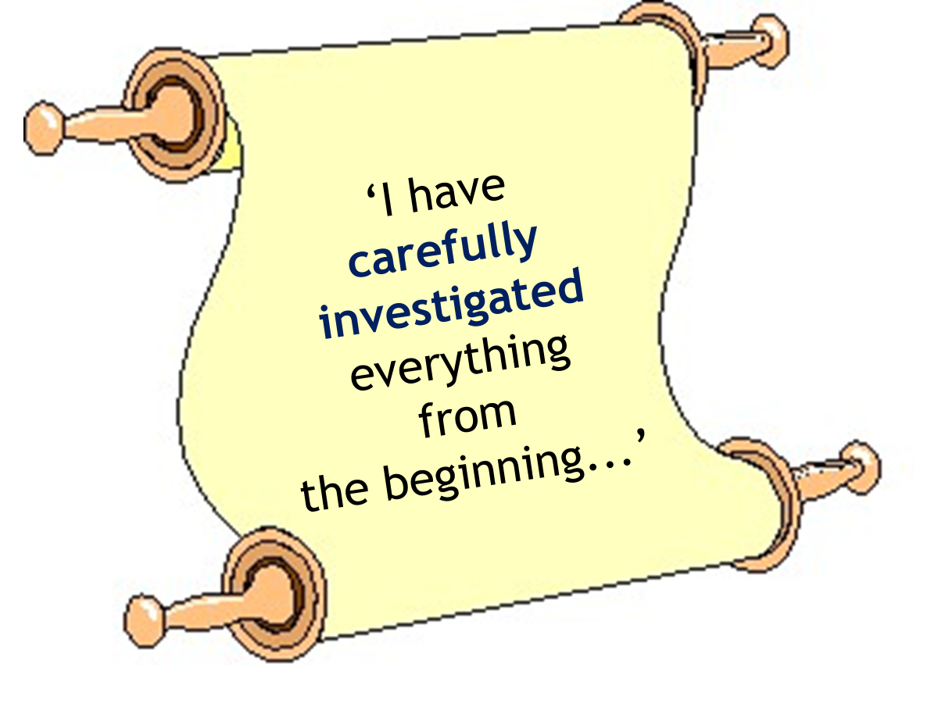

Slide 8


Slide 9
The Gospel of LUKE
is the longest of 4 gospels
It starts earlier than the others…
with the birth of John the Baptist
It finishes later than the others…
with the return of Jesus to Heaven
Blank

Slide 10
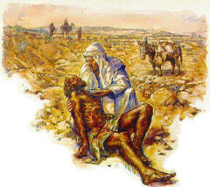
Our series specially
includes
the Parables of Jesus
Blank

Slide 11
PARABLES
only recorded in Luke’s Gospel
Two debtors 7 Good Samaritan 10
Friend at night 11 Rich fool 12
Barren fig-tree 13 Wedding feast 14
Building a tower 14 Going to war 14
Lost coin 15 Lost son 15
Unrighteous manager 16 Rich man & Lazarus 16
Unworthy servants 17 Unjust judge 18
Pharisee & tax collector 18
…& the highest number of Parables
compared to the other gospels

Slide 12
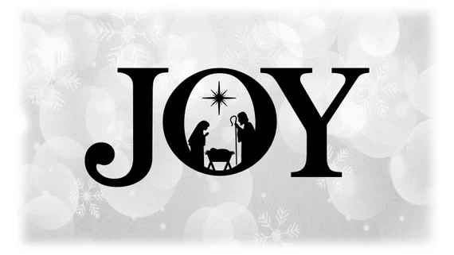
Matthew 3
Mark 1
LUKE 12
John 8

Slide 13

Joy
in Luke’s Gospel
1:14 He will be a joy and delight to you…
1:44 the baby in my womb leapt for joy.
1:58 Her neighbours and relatives …shared her joy.
2:10 good news that will cause great joy for all people.
6:23 “Rejoice in that day and leap for joy…
10:17 The seventy-two returned with joy…
15:5 when he finds it, he joyfully puts it on his shoulders
19:37 the whole crowd began joyfully to praise God
24:41 still did not believe because of joy & amazement…
24:52 They returned to Jerusalem with great joy.

Slide 14
And in
Luke’s Gospel…
there’s a lot about compassion…
& about the role of women…
& it’s written for ‘Theophilus’
which means
‘loved by God’ or ‘lover of God’

Slide 15


Slide 16
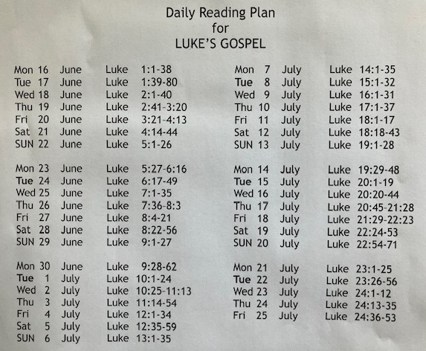

Slide 17
Luke 13:18-19
Therefore Jesus asked,
“What is the kingdom of God like?
What shall I compare it to?
It is like a mustard seed,
which a man took & planted in his garden.
It grew & became a tree,
& the birds perched in its branches.”
Blank

Slide 18
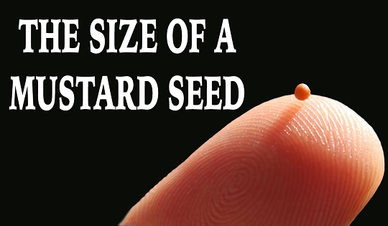

Slide 19
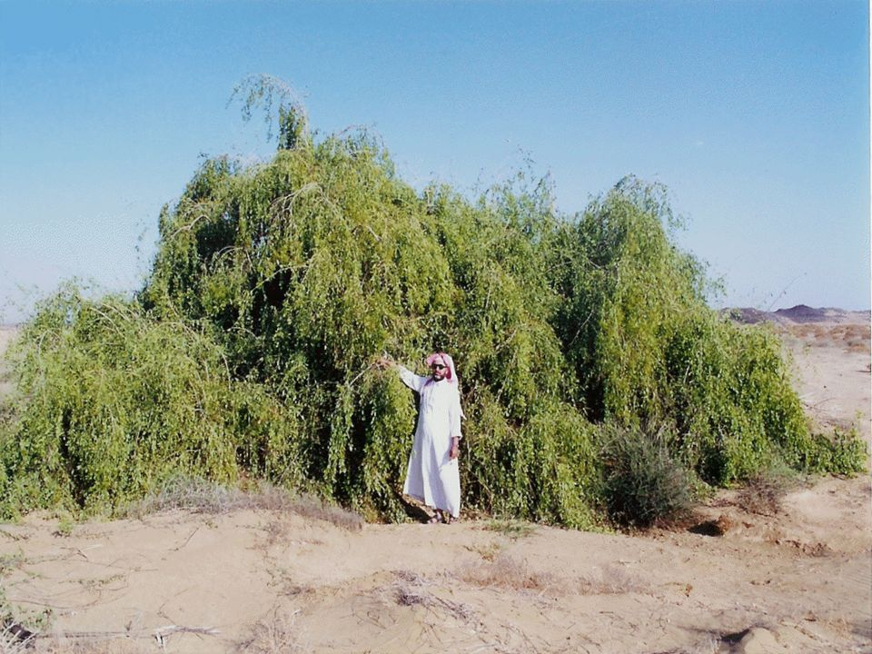

Slide 20
A question about ‘size’

Slide 21
Luke 13:20-21
Again Jesus asked,
“What shall I compare
the kingdom of God to?
It is like yeast
that a woman took and mixed into
about sixty pounds of flour
until it worked all through the dough.”
Blank

Slide 22
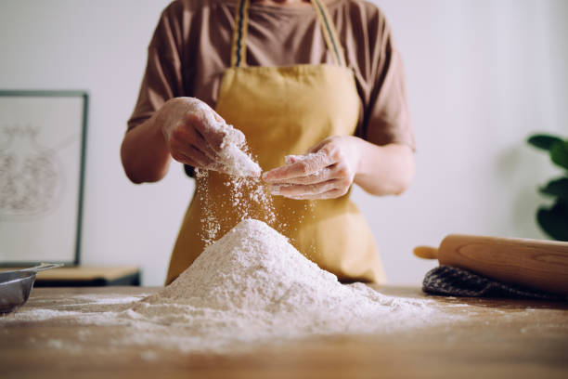

Slide 23
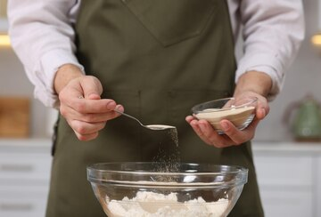

Slide 24
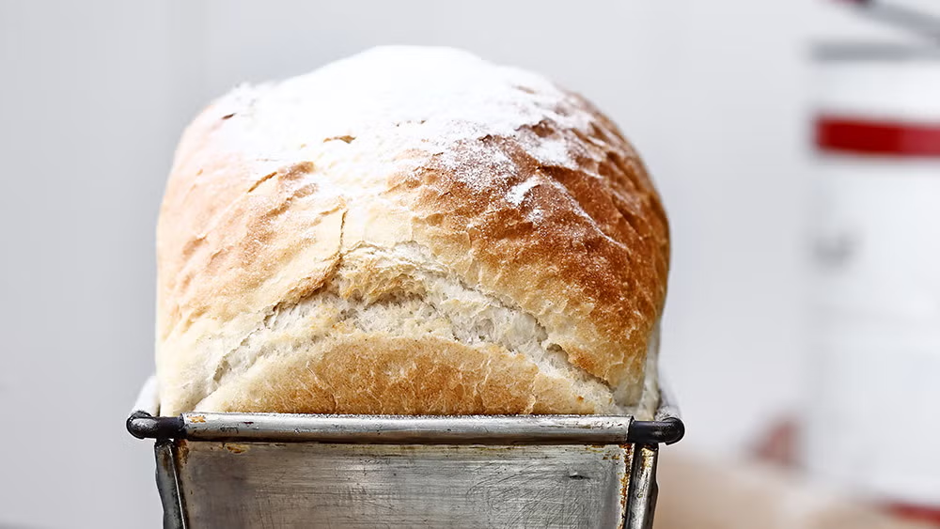
A question about ‘growth’

Slide 25

SCOTLAND
N IRELAND
ENGLAND
WALES

Slide 26
SCOTLAND
N IRELAND
ENGLAND
WALES
CORNWALL

Slide 27
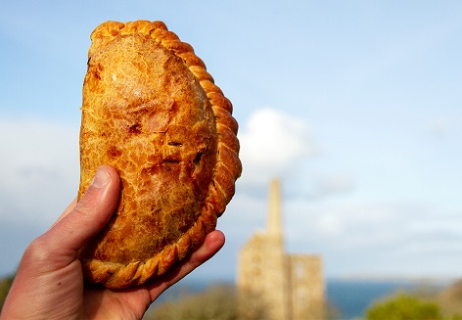
Cornish Pasty

Slide 28
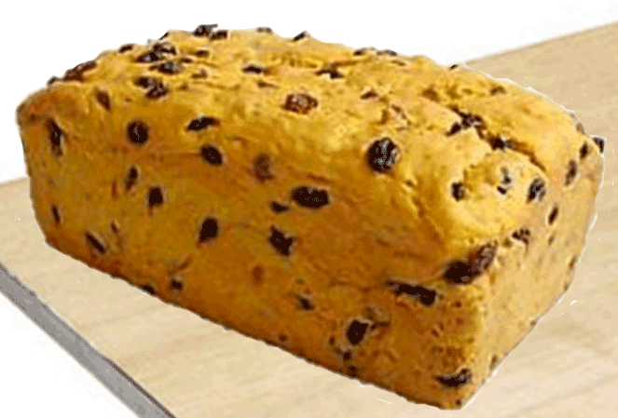
Saffron Cake

Slide 29
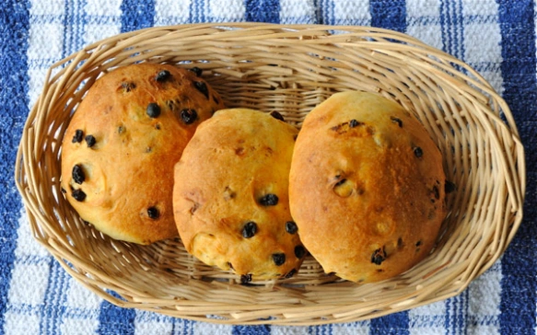
Saffron Buns

Slide 30
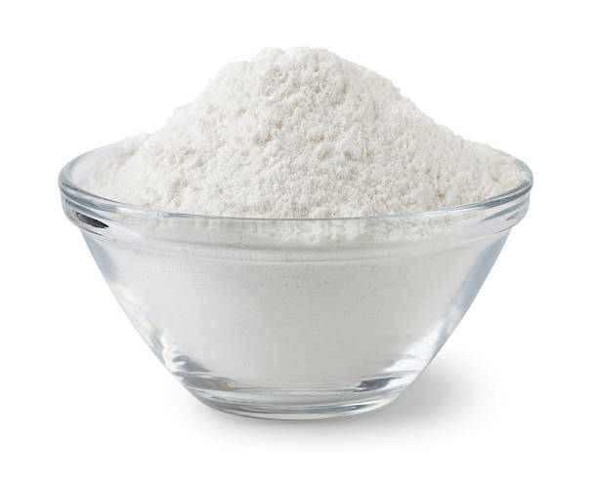
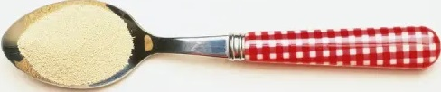
RECIPE FOR SAFFRON CAKE
500 grams Strong Plain White Flour
125g Butter, cold and cubed
125g Lard, cold and cubed
Pinch of salt
250g Currants
50g Caster Sugar + 2 tsp
1 teaspoon Dried Yeast
100ml Lukewarm Water
½ teaspoon Saffron Strands
150ml Boiling Whole Milk

Slide 31
Saffron Cake

Slide 32
Acts 2:41
Those who accepted what
Peter said were baptized.
On that day about 3000 people
were added to the
group of believers.

Slide 33
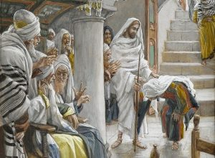

Slide 34
Luke 13:10-17
On a Sabbath Jesus was teaching in one of the synagogues,
& a woman was there
who had been crippled by a spirit
She was bent over and
could not straighten up at all.
for eighteen years

Slide 35
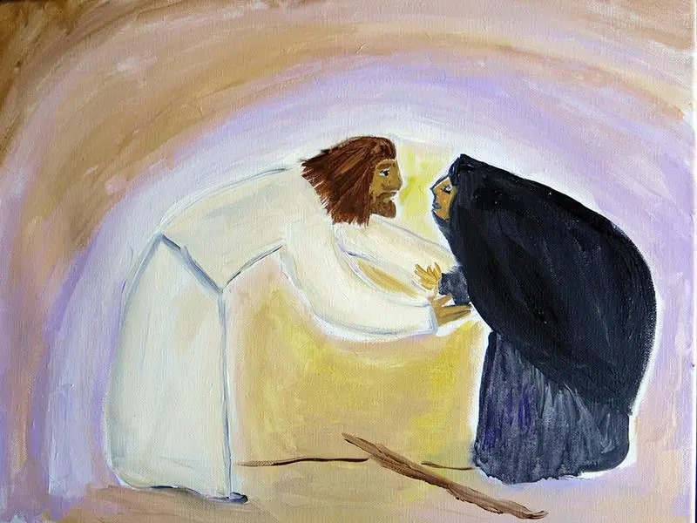

Slide 36

…a touch of compassion

Slide 37

…a word of encouragement

Slide 38
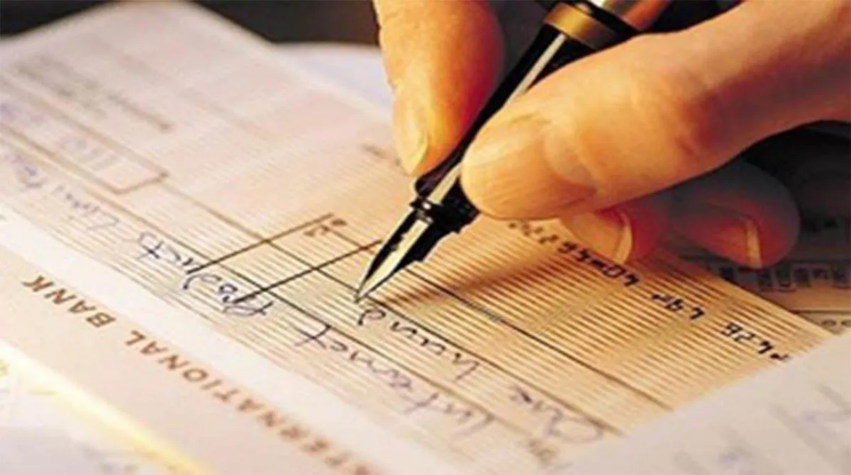
…an act of generosity

Slide 39


Slide 40


Slide 41
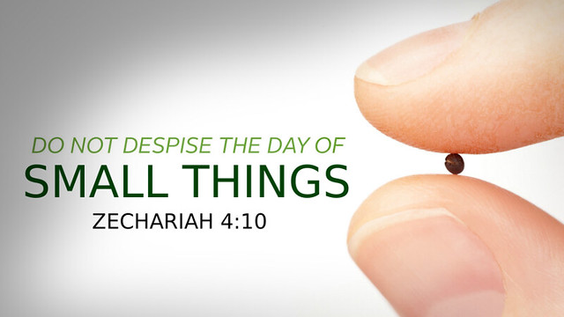

Slide 42
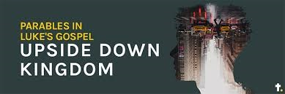

Slide 43
Acts 17:6
They dragged Jason & some other believers before the city officials, shouting:
‘These men who have
turned the world upside down
have now come here.
Blank

Slide 44
Acts 17:7
They are disobeying
Caesar’s laws
They say there is
another king
one called Jesus
Blank

Slide 45


Slide 46


Slide 47
www.bmsworldmission.org/pray
Saturday 14th North Africa
Pray that God will strengthen
BMS-supported disciple-maker Kamil,
who counts the cost,
yet chooses the cross,
& continues to train disciple-makers
in North Africa.

Slide 48
Psalm 41:1
Blessed are those
who have regard for the weak…

