Slide 1
Jesus’s Teaching
Luke 12:13-21
The Parable of The Rich Fool

Slide 2
Luke 12:13-14 A Request and Response
¹³ Someone in the crowd said to him, “Teacher, tell my brother to divide the inheritance with me.”
¹⁴ Jesus replied, “Man, who appointed me a judge or an arbiter between you?”

Slide 3
Luke 12:15 A Warning
¹⁵ Then he said to them, “Watch out! Be on your guard against all kinds of greed; life does not consist in an abundance of possessions.”

Slide 4
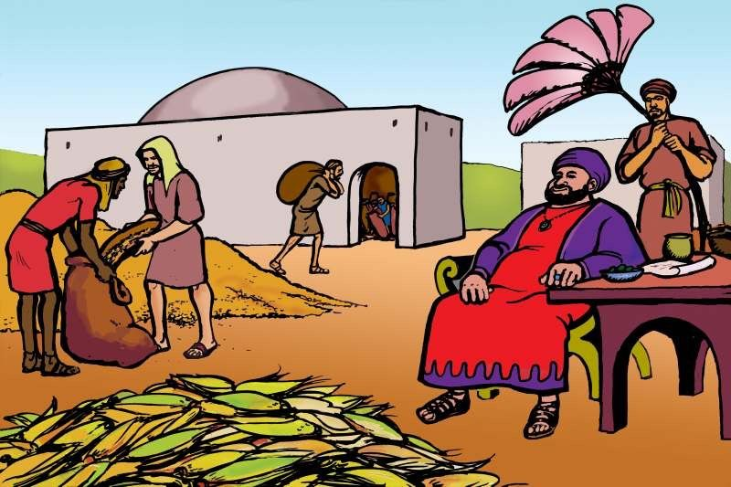
Luke 12:16-20 Jesus told them this parable
¹⁶ The ground of a certain rich man yielded an abundant harvest. ¹⁷ He thought to himself, ‘What shall I do? I have no place to store my crops.’ ¹⁸ Then he said, ‘This is what I’ll do. I will tear down my barns and build bigger ones, and there I will store my surplus grain.

Slide 5
Luke 12:16-20 Jesus told them this parable
¹⁹ And I’ll say to myself, “You have plenty of grain laid up for many years. Take life easy; eat, drink and be merry.”’ ²⁰ “But God said to him, ‘You fool! This very night your life will be demanded from you. Then who will get what you have prepared for yourself?’

Slide 6
Luke 12:21
²¹ “This is how it will be with whoever stores up things for themselves but is not rich toward God.”

Slide 7
Is Jesus saying it’s wrong to save?
Proverbs 6:6-8 Go to the ant, you sluggard; consider its ways and be wise! It has no commander, no overseer or ruler, yet it stores its provisions in summer and gathers its food at harvest.
Proverbs 21:20 The wise man saves for the future, but the foolish man spends whatever he gets

Slide 8
Jesus is saying we will all give account for our lives to God
Heb 9:27 It is appointed to men to die once and after that comes judgement.
Romans 14:12 Each of us will give account of ourselves to God
2 Cor 5:10 For we must all appear before the judgment seat of Christ, so that each of us may receive what is due us for the things done while in the body, whether good or bad.

Slide 9
Jesus is warning us about selfishness, greed and materialism
1 Timothy 6:6-10 For godliness with contentment is great gain. For we brought nothing into the world, and we can take nothing out of it ….
… Those who want to get rich fall into temptation and a trap and into many foolish and harmful desires that plunge people into ruin and destruction. For the love of money is a root of all kinds of evil.

Slide 10
Jesus is saying it’s foolish to build our hope for the future on material possessions.
1 Timothy 6:17-19 Command those who are rich in this present world not to be arrogant nor to put their hope in wealth, which is so uncertain, but to put their hope in God, who richly provides us with everything for our enjoyment.

Slide 11
Jesus is encouraging us to make sure we are ‘rich toward God’.
1 Timothy 6:17-19 Command those who are rich in this present world not to be arrogant nor to put their hope in wealth, which is so uncertain, but to put their hope in God, who richly provides us with everything for our enjoyment.
¹⁸ Command them to do good, to be rich in good deeds, and to be generous and willing to share. ¹⁹ In this way they will lay up treasure for themselves as a firm foundation for the coming age, so that they may take hold of the life that is truly life.

