Slide 1
Luke 12:22-31
²² Then Jesus said to his disciples: ‘Therefore I tell you, do not worry about your life, what you will eat; or about your body, what you will wear. ²³ For life is more than food, and the body more than clothes. ²⁴ Consider the ravens: they do not sow or reap, they have no storeroom or barn; yet God feeds them. And how much more valuable you are than birds!

Slide 2
Luke 12:22-31
²⁵ Who of you by worrying can add a single hour to your life? ²⁶ Since you cannot do this very little thing, why do you worry about the rest?
²⁷ ‘Consider how the wild flowers grow. They do not labour or spin. Yet I tell you, not even Solomon in all his splendour was dressed like one of these. ²⁸ If that is how God clothes the grass of the field, which is here today, and tomorrow is thrown into the fire, how much more will he clothe you – you of little faith!

Slide 3
Luke 12:22-31
²⁹ And do not set your heart on what you will eat or drink; do not worry about it. ³⁰ For the pagan world runs after all such things, and your Father knows that you need them. ³¹ But seek his kingdom, and these things will be given to you as well.

Slide 4
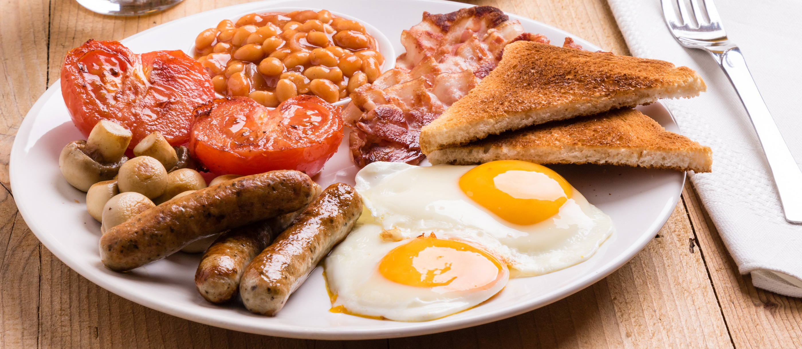

Slide 6
Teachings of Jesus, in the Gospel of Luke…

Slide 7
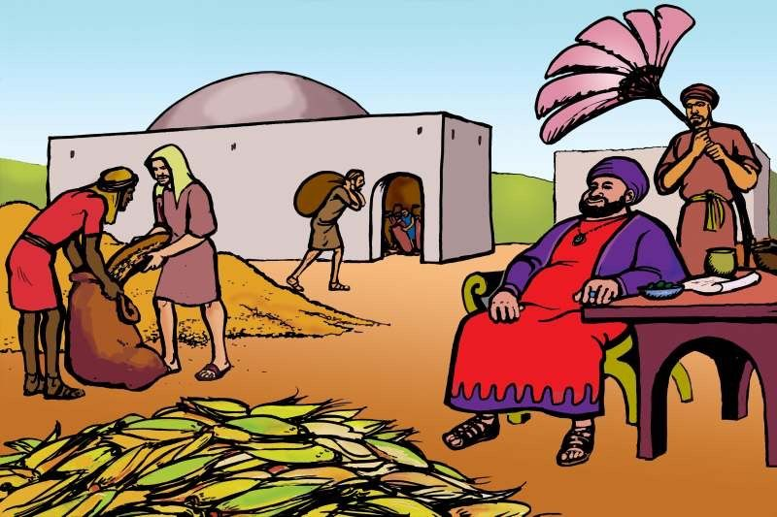
Teachings of Jesus, in the Gospel of Luke…
Parable of the Sower, Luke 8:4-15
Parable of the Rich Fool, Luke 12:13-21

Slide 8
What do these things all have in common?
Being late
The weather
This sermon
My wife
How I look
You!
Not being on top of things
My children
My weight
My colleagues
What to say in a difficult conversation
Letting other people down
Finances
Losing my keys
My mental health

Slide 9
Luke 12:22-31
^{What is Jesus NOT saying?...}
Food and clothes are unimportant…
^{Don’t take life seriously…}

Slide 10
Luke 12:22-31
If you get anxious (like me)...
^{Thank you for being you!}

Slide 11
Luke 12:22-31
^{What IS Jesus saying?...}
²² Then Jesus said to his disciples: ‘Therefore I tell you, do not worry about your life, what you will eat; or about your body, what you will wear.

Slide 12
Luke 12:22-31
^{What IS Jesus saying?...}
²² Then Jesus said to his disciples: ‘Therefore I tell you, do not worry about your life, what you will eat; or about your body, what you will wear.

Slide 13
Luke 12:22-31
^{What IS Jesus saying?...}
^{God is in control…}
^{God made us}
^{God loves us}
^{God knows what we need}
If we put God first, he will provide all we need (not all we want)
We can trust God completely in this

Slide 14
Luke 12:29-32 (The Message)
“What I’m trying to do here is get you to relax, not be so preoccupied with getting so you can respond to God’s giving. People who don’t know God and the way he works fuss over these things, but you know both God and how he works. Steep yourself in God-reality, God-initiative, God-provisions. You’ll find all your everyday human concerns will be met. Don’t be afraid of missing out. You’re my dearest friends! The Father wants to give you the very kingdom itself.”

Slide 15
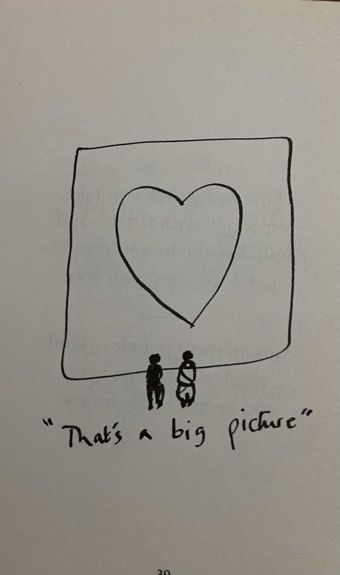
Bear Grylls…
“Always keep the big picture in mind – you are greatly loved by Jesus and your job is to love Him and others in return. The rest is detail.”

Slide 16
Philippians 4:6
Do not be anxious about anything, but in every situation, by prayer and petition, with thanksgiving, present your requests to God.

Slide 17
Philippians 4:6
Do not be anxious about anything, but in every situation, by prayer and petition, with thanksgiving, present your requests to God.
Repentance
Thanksgiving
Requests

Slide 18
Song to play (audio only)
https://www.youtube.com/watch?v=HqpNGYbcy3U&list=RDHqpNGYbcy3U&start_radio=1
Lauren Daigle – You say

