Slide 2
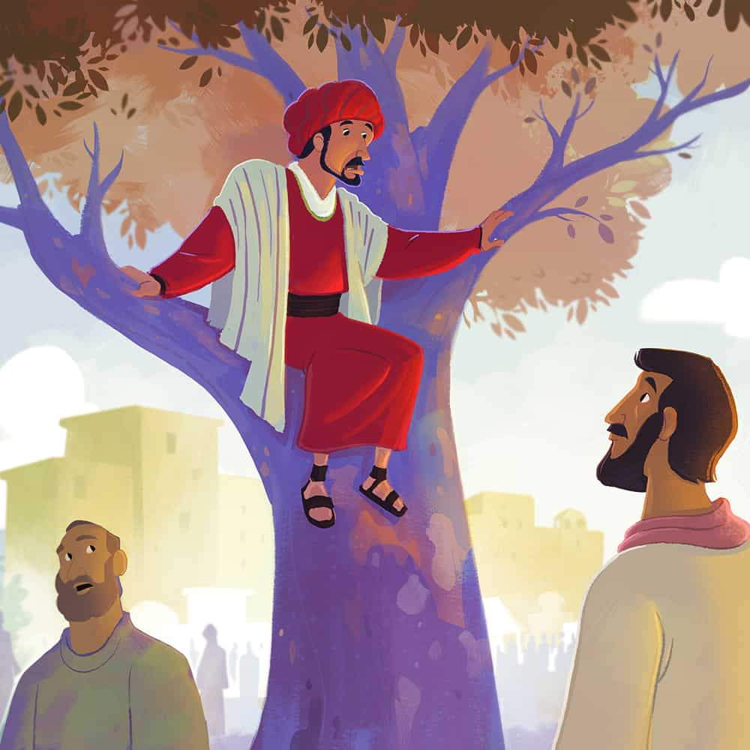
Today Salvation has come to this house

Slide 3
The crowd was listening to everything Jesus said. And because he was nearing Jerusalem, he told them a story to correct the impression that the Kingdom of God would begin right away.
Luke 19:11

Slide 4
For to us a child is born,
to us a son is given ….
He will reign on David’s throne
and over his kingdom,
establishing and upholding it
with justice and righteousness
from that time on and forever.
Isaiah 9:6-7

Slide 6
We don’t want this man to be our king.’
Luke 19:14
NO!
And as for those enemies of mine who didn’t want me to be their king —bring them here and execute them right here in front of me.’”
Luke 19:27

Slide 7
Possible responses to the king
Outright rejection

Slide 8
“But because you are stubborn and refuse to turn from your sin, you are storing up terrible punishment for yourself. For a day of anger is coming, when God’s righteous judgment will be revealed. He will judge everyone according to what they have done.”
Romans 2:5-6

Slide 9
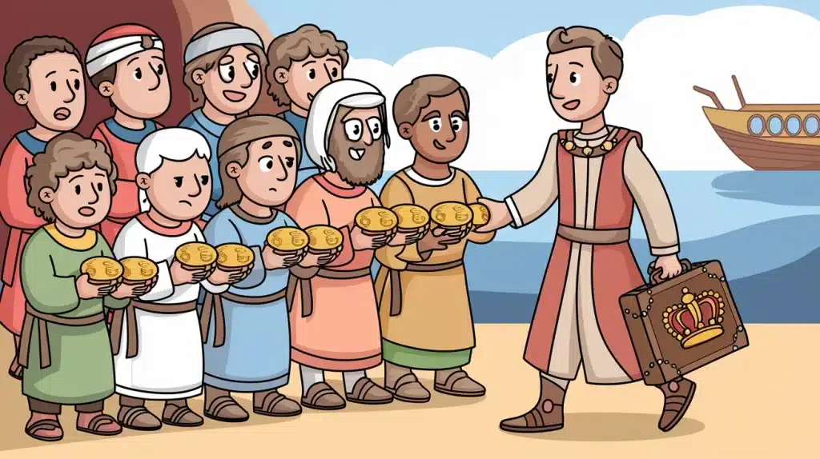

Slide 10
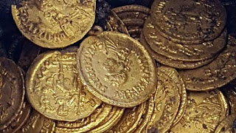

Slide 11
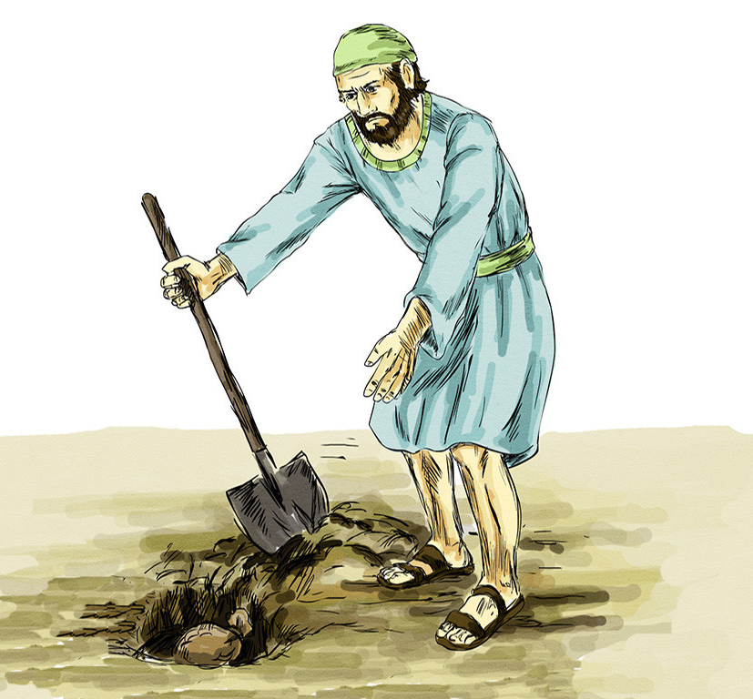
But the third servant brought back only the original amount of money and said, ‘Master, I hid your money and kept it safe. I was afraid because you are a hard man to deal with, taking what isn’t yours and harvesting crops you didn’t plant.’

Slide 12
‘You wicked servant!’ the king roared. ‘Your own words condemn you. If you knew that I’m a hard man who takes what isn’t mine and harvests crops I didn’t plant, why didn’t you deposit my money in the bank? At least I could have gotten some interest on it.’
“Then, turning to the others standing nearby, the king ordered, ‘Take the money from this servant, and give it to the one who has ten pounds.’

Slide 13
I tell you that to everyone who has, more will be given, but as for the one who has nothing, even what they have will be taken away.
Luke 19:26
Therefore consider carefully how you listen. Whoever has will be given more; whoever does not have, even what they think they have will be taken from them.’
Luke 8:18

Slide 14
Possible responses to the king
Outright rejection
Distorted perspective

Slide 15
Possible responses to the king
Outright rejection
Distorted perspective
Embrace the treasure

Slide 16
Freedom
Forgiveness
Grace
Strength
Acceptance
Never alone
Joy
Faith
Power
Courage

Slide 17
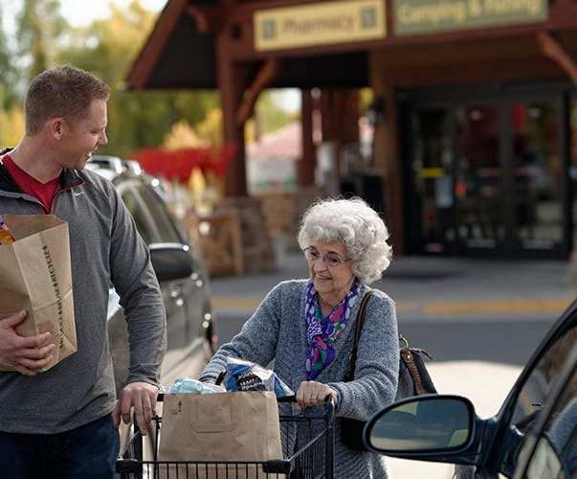

Slide 18
How are you responding to king Jesus?
Outright rejection
Distorted perspective
Embrace the treasure

