Slide 1
Philippians 3: 1-12
Further, my brothers and sisters, rejoice in the Lord! It is no trouble for me to write the same things to you again, and it is a safeguard for you. ² Watch out for those dogs, those evildoers, those mutilators of the flesh. ³ For it is we who are the circumcision, we who serve God by his Spirit, who boast in Christ Jesus, and who put no confidence in the flesh – ⁴ though I myself have reasons for such confidence.
If someone else thinks they have reasons to put confidence in the flesh, I have more:⁵ circumcised on the eighth day, of the people of Israel, of the tribe of Benjamin, a Hebrew of Hebrews; in regard to the law, a Pharisee; ⁶ as for zeal, persecuting the church; as for righteousness based on the law, faultless.
⁷ But whatever were gains to me I now consider loss for the sake of Christ. ⁸ What is more, I consider everything a loss because of the surpassing worth of knowing Christ Jesus my Lord, for whose sake I have lost all things. I consider them garbage, that I may gain Christ⁹ and be found in him, not having a righteousness of my own that comes from the law, but that which is through faith in Christ – the righteousness that comes from God on the basis of faith. ¹⁰ I want to know Christ – yes, to know the power of his resurrection and participation in his sufferings, becoming like him in his death, ¹¹ and so, somehow, attaining to the resurrection from the dead.
¹² Not that I have already obtained all this, or have already arrived at my goal, but I press on to take hold of that for which Christ Jesus took hold of me.

Slide 2
Last week:
“I run towards the goal” (14)

Slide 3
Last week:
“I run towards the goal” (14)
This week:
“Rejoice in the Lord!” (1)

Slide 4
How to run well …
“Rejoice in the Lord”
“Watch out for those dogs”
“Follow my example”

Slide 5
Past
Present
Future
Minus
Plus

Slide 6
Past
Present
Future
Minus
Plus
Here’s how Paul used to think about himself.
His spiritual credentials were more impressive than his spiritual failures. He had achieved a righteousness of his own.

Slide 7
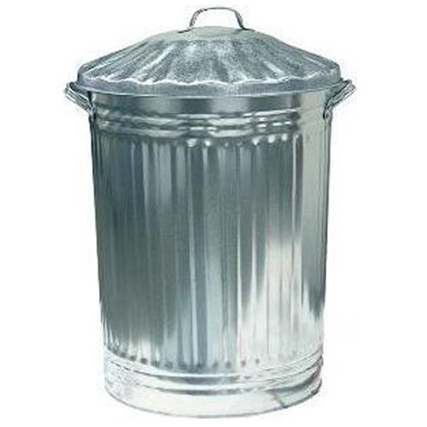
Past
Present
Future
Minus
Plus
Here’s how Paul now thinks about himself.
His spiritual credentials were rubbish.
He has received a righteousness from God.

Slide 8
Past
Present
Future
Minus
Plus
Here’s how Paul now thinks about himself.
His spiritual credentials were rubbish.
He has received a righteousness from God.
Rejoice in the Lord!

Slide 9
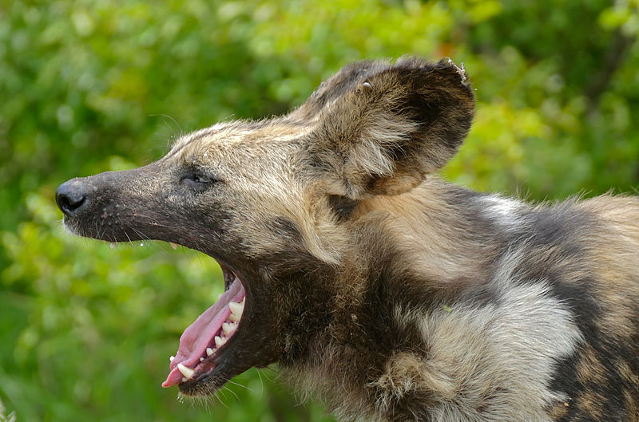
Past
Present
Future
Minus
Plus
Watch out for those dogs!

Slide 10
Past
Present
Future
Minus
Plus
Follow my example - receive a righteousness from God. Do not rely on a righteousness of your own. Rejoice in the Lord!

Slide 11
How to run well …
“Rejoice in the Lord”
“Watch out for those dogs”
“Follow my example”

