Slide 1
1 Peter 4:1-11
The Church Under Pressure – Living in the end times
Be prepared for suffering
  Realise that saying ‘no’ sin means saying ‘yes’ suffering (v1-4)
  Realise the world's judgement is not the final judgement (v5-6)

Slide 2
1 Peter 4:1-11
The Church Under Pressure – Living in the end times
Be prepared for suffering
Be prepared for the final day

Slide 3
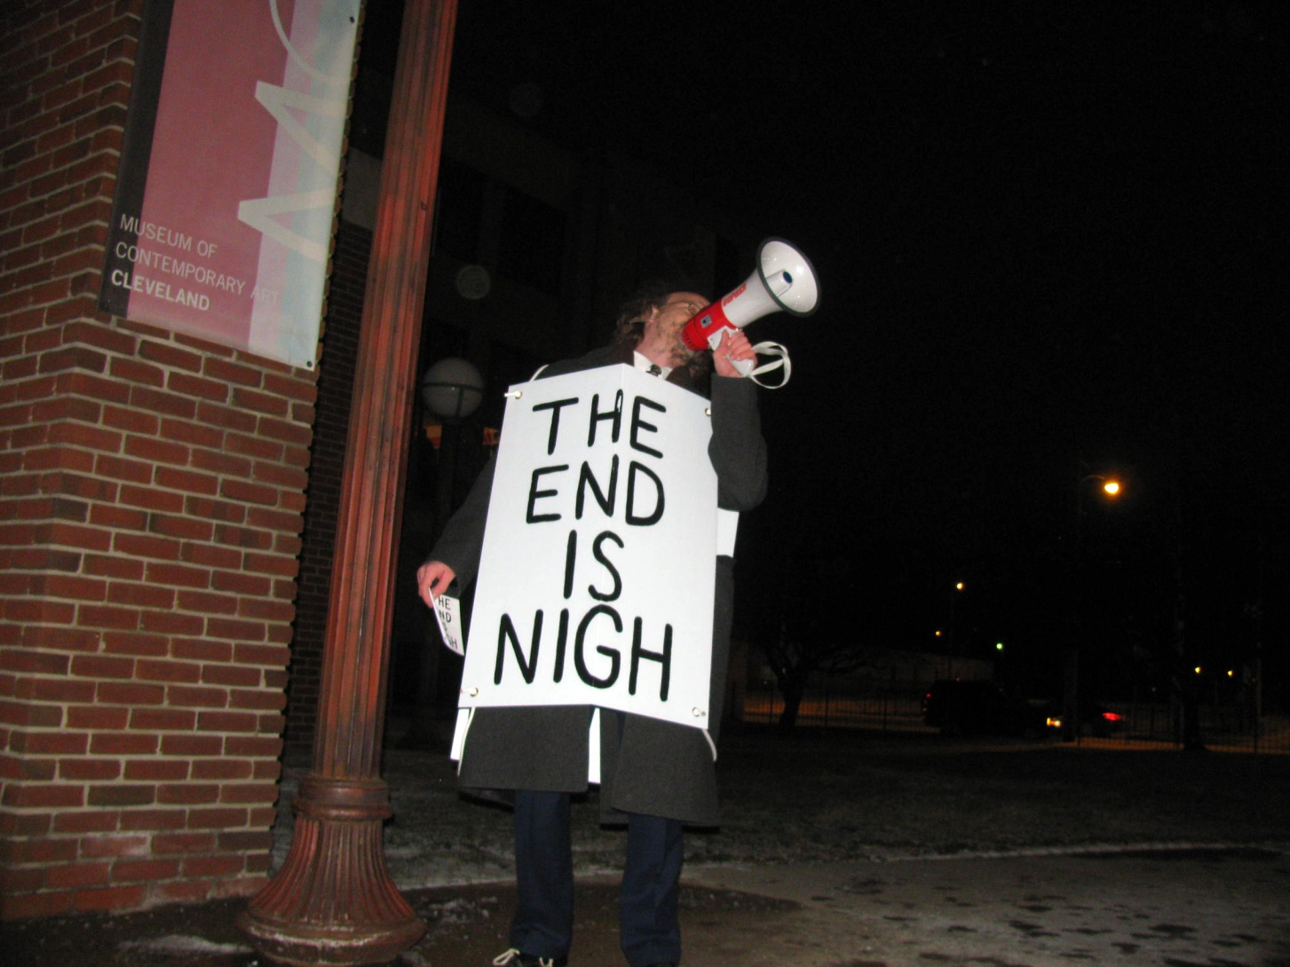

Slide 4
1 Peter 4:1-11
The Church Under Pressure – Living in the end times
Be prepared for suffering
Be prepared for the final day
  … By praying
  … By loving
  A love that forgives
  A love that is hospitable
  What happens when hospitality becomes self-centred?
    It becomes a burden
    It becomes a clique
    It becomes a show

Slide 5
1 Peter 4:1-11
The Church Under Pressure – Living in the end times
Be prepared for suffering
Be prepared for the final day
  … By praying
  … By loving
  A love that forgives
  A love that is hospitable
  A love that serves
  What happens when service becomes self-centred?
    We become self-conscious
    We become possessive
    We become consumers

