Slide 1
The Apostles’ Creed
“He will come again to judge” from 2 Thessalonians 1.3-12
Rev Jonathan Juckes
17th May 2015

Slide 2

Bible Reading
2 Thessalonians 1 verses 3-12
³We ought always to thank God for you, brothers, and rightly so, because your faith is growing more and more, and the love every one of you has for each other is increasing. ⁴Therefore, among God’s churches we boast about your perseverance and faith in all the persecutions and trials you are enduring.
⁵All this is evidence that God’s judgement is right, and as a result you will be counted worthy of the kingdom of God, for which you are suffering. ⁶God is just: He will pay back trouble to those who trouble you ⁷and give relief to you who are troubled, and to us as well. This will happen when the Lord Jesus is revealed from heaven in blazing fire with his powerful angels. ⁸He will punish those who do not know God and do not obey the gospel of our Lord Jesus. ⁹They will be punished with everlasting destruction and shut out from the presence of the Lord and from the majesty of his power ¹⁰on the day he comes to be glorified in his holy people and to be marvelled at among all those who have believed. This includes you, because you believed our testimony to you.
¹¹With this in mind, we constantly pray for you, that our God may count you worthy of his calling, and that by his power he may fulfil every good purpose of yours and every act prompted by your faith. ¹²We pray this so that the name of our Lord Jesus may be glorified in you, and you in him, according to the grace of our God and the Lord Jesus Christ.
read by Brian Elwick

Slide 3
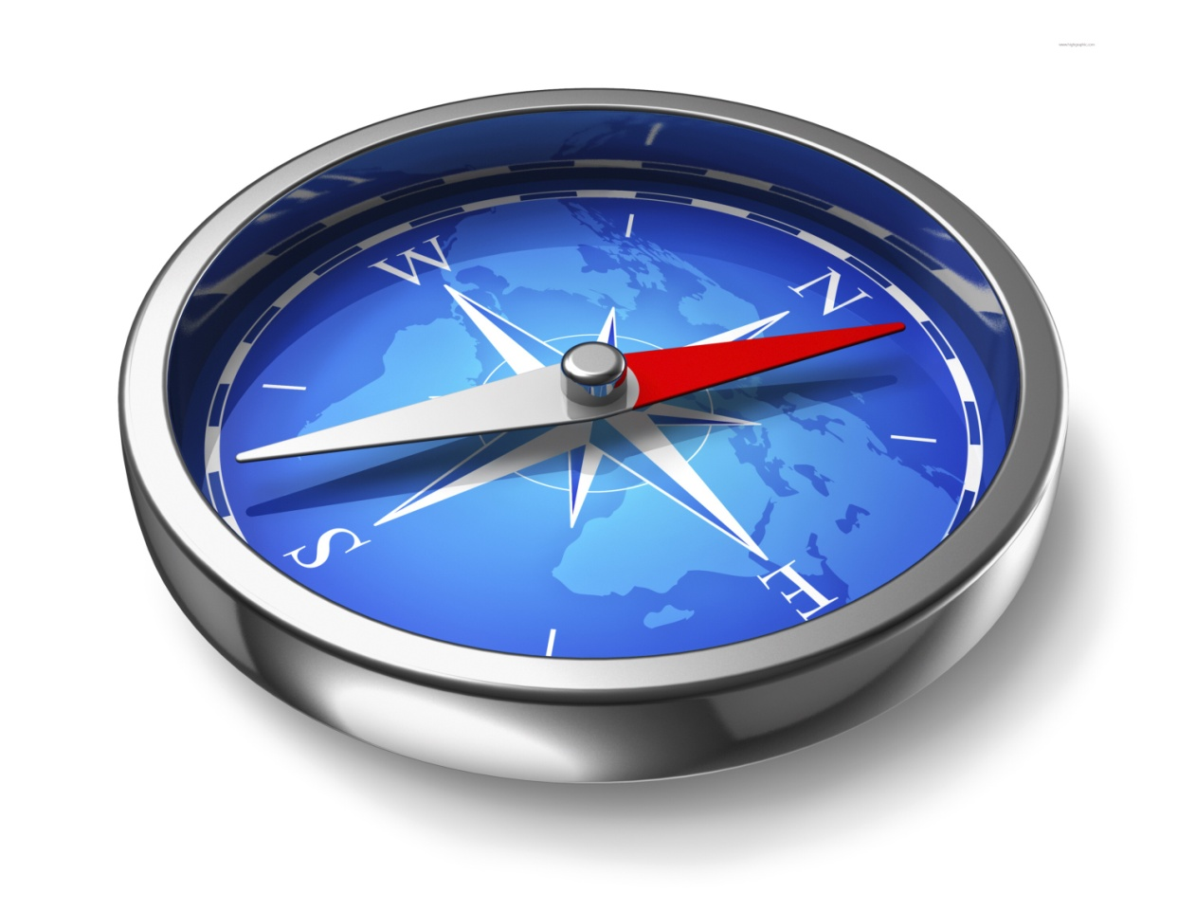
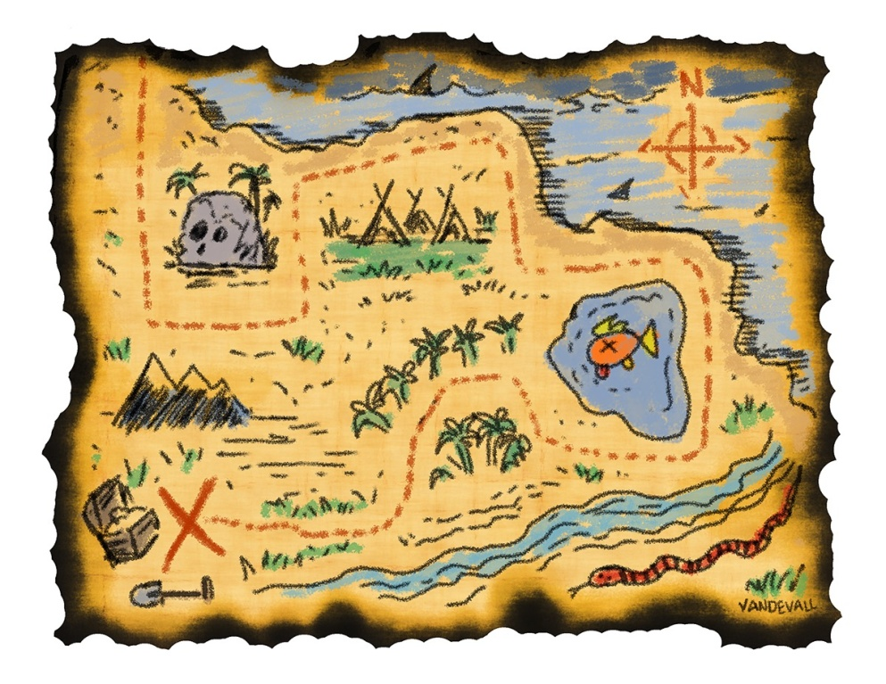
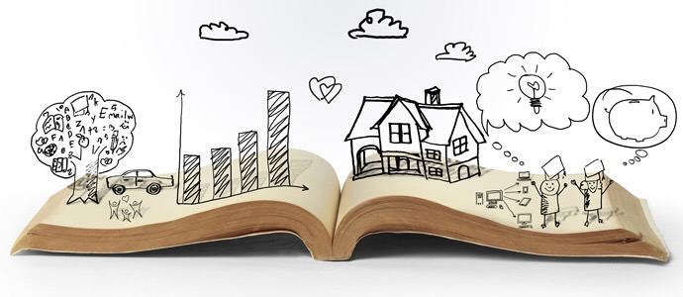
The Apostles' Creed

Slide 4

The Apostles' Creed
He will come again to judge ..
"the day he comes" (verse 10)
Getting our bearings
Paul gives thanks for God's grace (3-4)
Paul looks forward to God's ultimate goal (6-10)
Paul remembers God's goal as he prays (11)
Paul prays for glory (12)
Paul relies on God's grace (12)

Slide 5
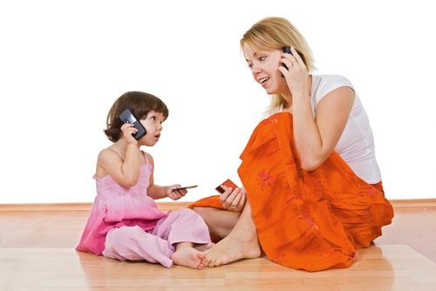

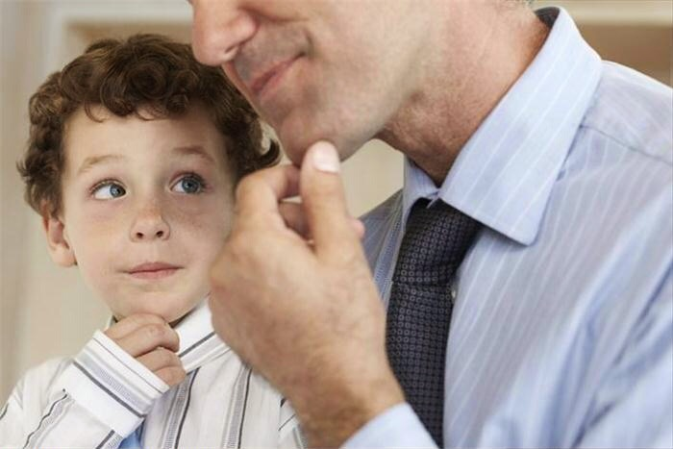
Learning how to pray ..remembering the BIG truths in the Creed

Slide 6
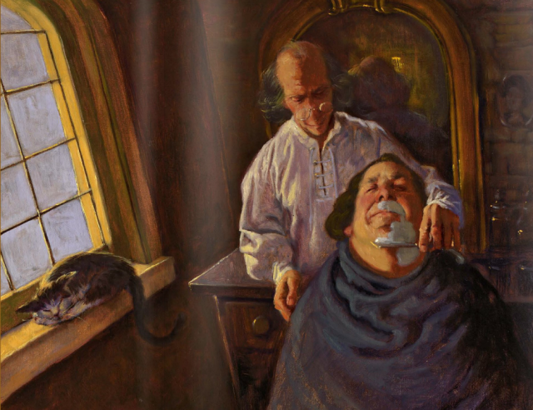

Slide 7

Give thanks for God's grace (3-4)
  Growing faith (3)
  Increasing love (3)
  Persevering under pressure (4)
Look forward to God's ultimate goal (6-10)
  Relief for believers (6,10)
  Trouble for others (6-10)
Remember God's goal as you pray (11)
Pray for glory (12)
  Glory for the Lord Jesus (12)
  Glory for believers (12)
Rely on God's grace (12)

